Slide 1
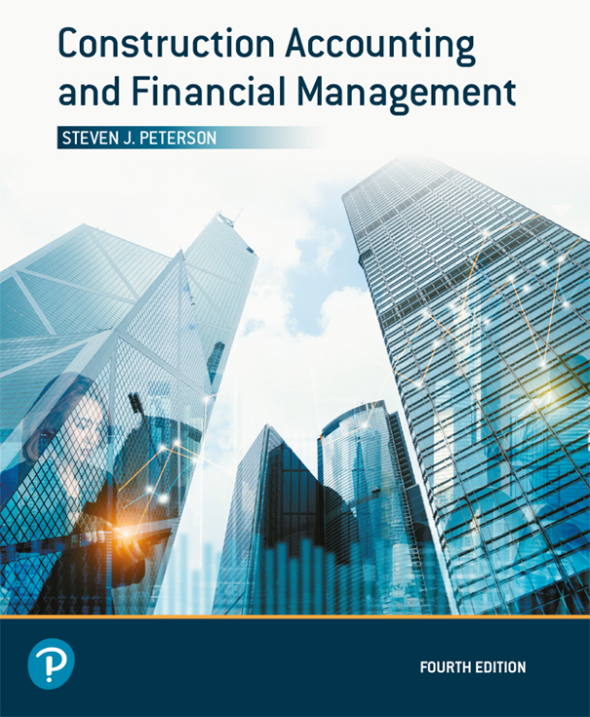
Construction Accounting and Financial Management
Fourth Edition
Chapter 05
Depreciation
Copyright © 2020, 2013, 2009 Pearson Education, Inc. All Rights Reserved

Slide 2
Use of Depreciation
Financial statements
Cost allocation of equipment
Taxes

Slide 3
Variables (1 of 2)
P = Purchase price
F = Salvage Value
  Zero for tax purposes
N = Recovery period (years)
  Set by code for tax purposes

Slide 4
Variables (2 of 2)
R_{m} = Percentage of depreciation taken in year m
D_{m} = Depreciation for year m
BV_{m} = Book value at the end of year m
  Book value equals the purchase price less the depreciation recorded to date

Slide 5
Straight-Line (1 of 3)
Depreciates uniformly over the life of the asset
Annual depreciation

Slide 6
Straight-Line (2 of 3)
Book Value

Slide 7
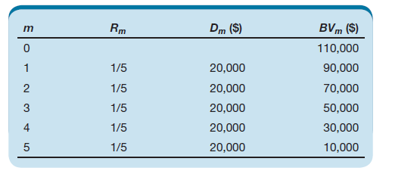
Straight-Line (3 of 3)
Table 5.1 Depreciation Schedule for Example 5-1

Slide 8
Sum-of-the-Years (1 of 3)
Accelerates depreciation
Annual depreciation

Slide 9
Sum-of-the-Years (2 of 3)
Book Value

Slide 10
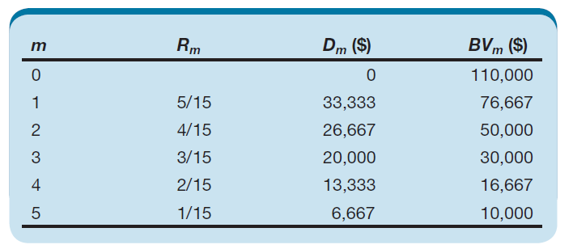
Sum-of-the-Years (3 of 3)
Table 5.2 Depreciation Schedule for Example 5-2

Slide 11
Declining-Balance Method (1 of 2)
Accelerates depreciation
Annual depreciation
    R_{m} = 2.00/N for 200% declining-balance
    R_{m} = 1.50/N for 150% declining-balance
Book Value

Slide 12
Declining-Balance Method (2 of 2)
Does not automatically reach salvage value
Must stop depreciation at salvage value when book value goes below salvage value
- or -
Must switch to straight-line depreciation when the straight-line depreciation for the remaining years is greater than declining-balance depreciation

Slide 13
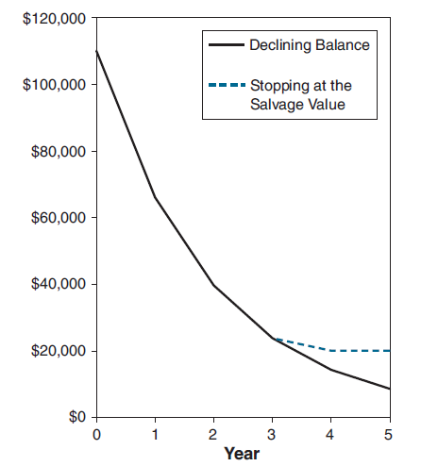
Stopping at Salvage Value ($20,000)
Figure 5.2 Stopping the Declining-Balance Depreciation at the Salvage Value

Slide 14
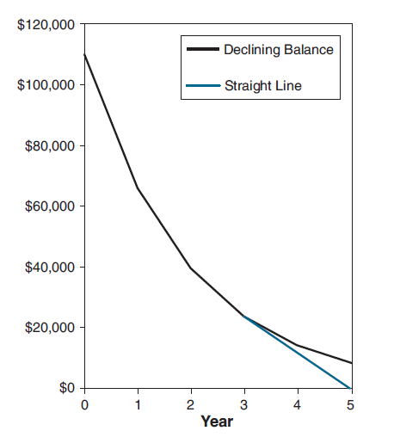
Switching to Straight Line (F = 0)
Figure 5.1 Switching to Straight-Line Depreciation When Straight-Line Depreciation Exceeds Declining-Balance Depreciation

Slide 15
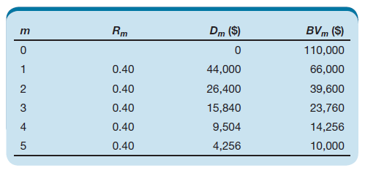
200% Declining-Balance Method
Table 5.3 Depreciation Schedule for Example 5-3

Slide 16
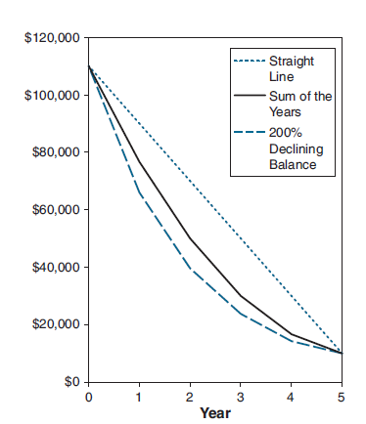
Comparison of Methods
Figure 5.3 Comparison of Depreciation Methods

Slide 17
MACRS
Modified accelerated cost recovery system
The IRS’s rules for depreciation
Depreciation methods used:
  200% declining balance
  150% declining balance
  Straight line
Includes rules for placing and removing assets from service

Slide 18
Placing in Service
Half-year
  General rule
Mid-quarter
  Must use when placing 40% or more of assets in service during the last quarter
Mid-month
  For real estate

Slide 19
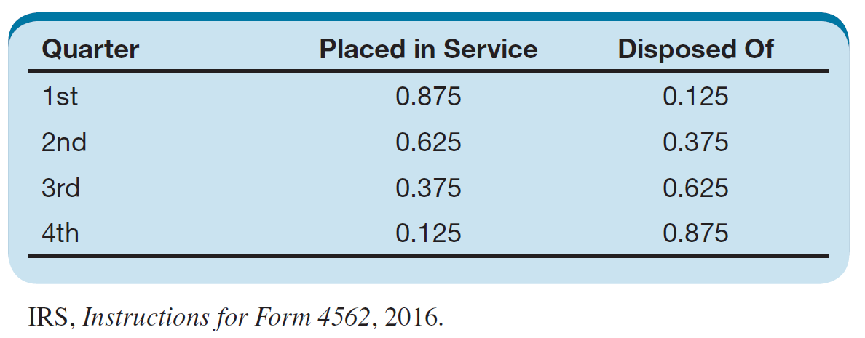
Midquarter Convention
Table 5-4 Depreciation Percentages for the Midquarter Convention

Slide 20
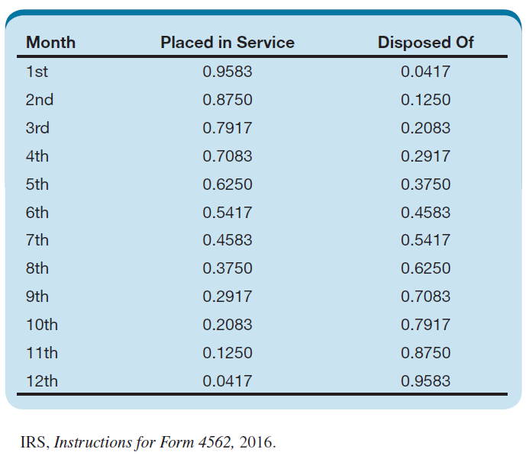
Midmonth Convention
Table 5.5 Depreciation Percentages for the Midmonth Convention

Slide 21
IRS Recovery Periods (1 of 2)
Three-year: Rent-to-own property and tractors
Five-year: Automobiles, light general propose trucks, calculators, copiers, computer equipment, concrete trucks, heavy general purpose trucks, trailers, and other construction assets
Seven-year: Office furniture, office equipment, and railroad tracks
Ten-year: Vessels, barges, tugs, and other water transportation equipment
Fifteen-year: Retail motor fuel outlets

Slide 22
IRS Recovery Periods (2 of 2)
Twenty-year: Farm buildings
Twenty-five-year: Municipal sewers, water treatment plants, and water distribution lines
Twenty-seven-and-a-half-year: Residential real estate where more than 80% of the rent is derived from the dwelling units
Thirty-nine-year: Non-residential real estate
Fifty-year: Railroad roadbeds, right-of-ways, and tunnels

Slide 23
Use of Depreciation Tables (1 of 2)
Find correct table
Find correct recovery period for asset across top of table
Percentages are percentage of asset value depreciated during the year
  not the percent of the previous year’s book value

Slide 24
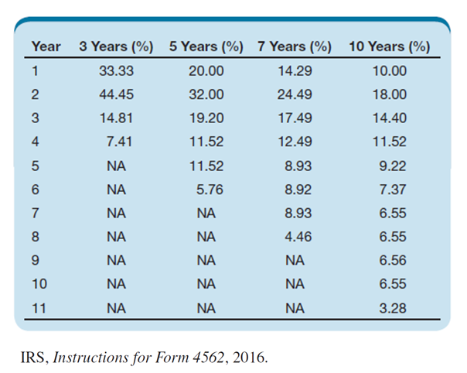
Use of Depreciation Tables (2 of 2)
Table 5.6 Depreciation Rates for 200% Declining Balance Using the Half-Year Convention

Slide 25
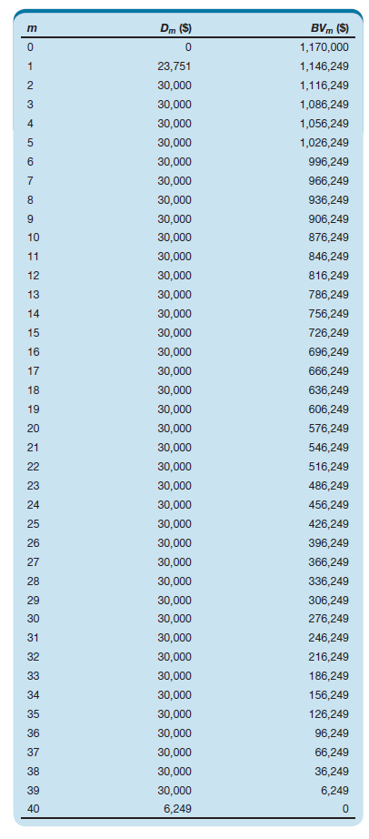
Commercial Building Depreciation
Table 5-14 Depreciation Schedule for Example 5-6

Slide 26
Cost Segregation (1 of 4)
IRS allows building costs to be segregated by recovery period
Accelerates depreciation
Requires cost segregation study

Slide 27
Cost Segregation (2 of 4)
Group into four classes
  Personal property (5 or 7 year)
  Land improvements (15-year recovery period and 150% declining balance)
  Building (39 or 27.5 years)
  Land (cannot depreciate)

Slide 28
Cost Segregation (3 of 4)
Personal property
  Equipment specific for the operation of the business, but not the operation of the building
  Furnishings (e.g., restaurant booths, counters)
  Interior theme décor
  Decorative light fixtures
  Strippable wallpaper and floorcovering
  MEP that services equipment classified as personal property

Slide 29
Cost Segregation (4 of 4)
Land improvements
  Roads, parking lots, curbs and gutters, sidewalks, fencing, monument signs, light poles, freestanding waste receptacles
Building
  Everything not classified elsewhere
Land
  Purchase of the land
  Clearing, grubbing, and landscaping not associated with land improvements or building

Slide 30
Bonus Depreciation (1 of 2)
Allows companies to write off qualified property
  100% September 28, 2017 to 2022
  80% in 2023
  60% in 2024
  40% in 2025
  20% in 2026
  0% in 2027 and beyond

Slide 31
Bonus Depreciation (2 of 2)
Qualified property
  MACRS property with a recovery period of 20 years or less (computer systems, vehicles, machinery, equipment, office furniture, etc.)
  Software
  Qualified improvement property (improvements to the interior portions of a nonresidential building except improvement that enlarge the building, addition of an elevator or escalator, and modification to the structural framework)

Slide 32
Section 179
Can expense up to $1,000,000 of equipment without depreciation
Deduction is reduced if you place more than $2,500,000 of Section 179 property in service during the year
Amounts adjusted for inflation annually

Slide 33
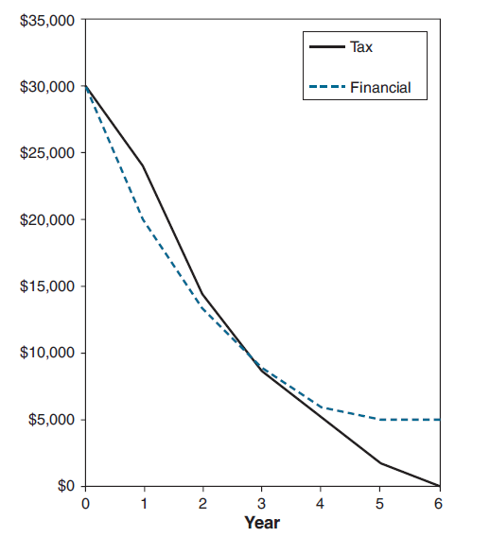
Tax vs Financial Depreciation
Figure 5.4 Book Values Comparison for Examples 5-4 and 5-8

Slide 34
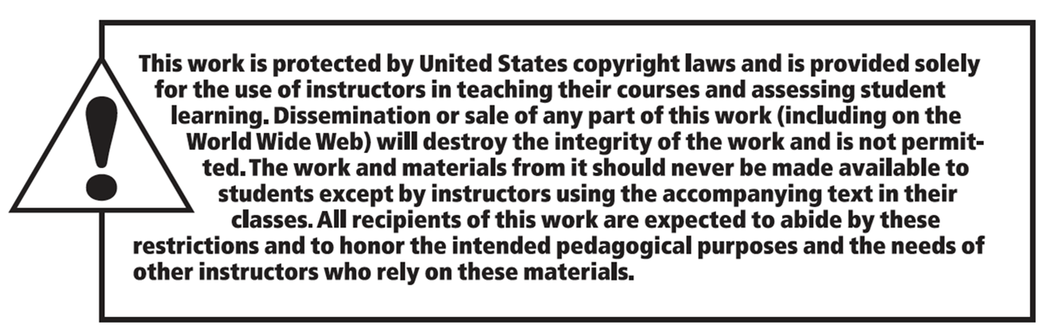
Copyright

