Slide 1
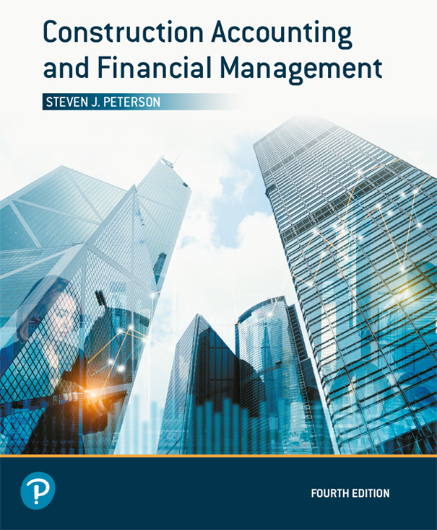
Construction Accounting and Financial Management
Fourth Edition
Chapter 04
More Construction Accounting
Copyright © 2020, 2013, 2009 Pearson Education, Inc. All Rights Reserved

Slide 2
Committed Costs
Costs that the company has committed to pay
Costs are known, even if a bill has not been received for these costs
Example:
  Subcontracts
  Purchase orders with costs

Slide 3
Estimated Cost At Completion
Best estimate of final cost
  ECAC = Committed Costs
  + Noncommitted costs invoiced + Cost to complete
Cost to complete is the non-committed costs that we expect to incur to complete the project

Slide 4
Earned Profit

Slide 5
Costs and Profits in Excess of Billings (1 of 2)
Based upon the assumption that the profit is uniformly spread over the project:
  The project is under billed
  We have billed for less profit that we have earned
  We may pay taxes on profit even though it has not been paid
Is an asset to the company

Slide 6
Costs and Profits in Excess of Billings (2 of 2)

Slide 7
Billings in Excess of Costs and Profits (1 of 2)
Based upon the assumption that the profit is uniformly spread over the project:
  The project is overbilled
  We have billed for more profit that we have earned
  Taxes may be deferred on profit even though it has been paid
Is a liability to the company

Slide 8
Billings in Excess of Costs and Profits (2 of 2)

Slide 9
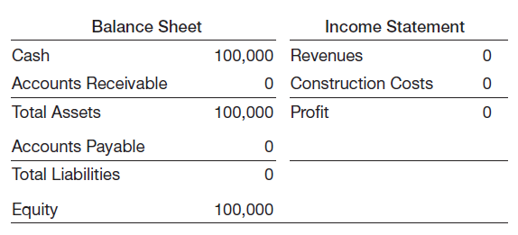
Profit with Accrual Method July 1
Figure 4.5 July 1st Balance Sheet and Income Statement

Slide 10
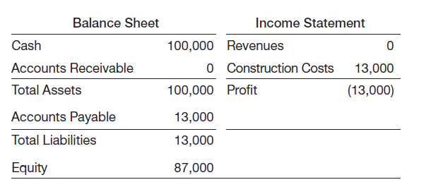
Profit with Accrual Method August 1
Figure 4.6 August 1st Accrual Balance Sheet and Income Statement

Slide 11
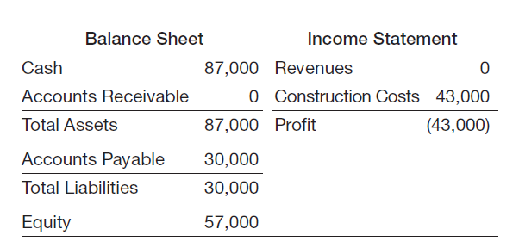
Profit with Accrual Method September 1
Figure 4.7 September 1st Accrual Balance Sheet and Income Statement

Slide 12
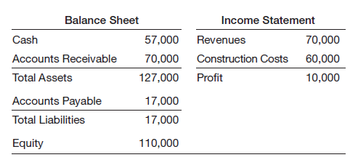
Profit with Accrual Method
October 1
Figure 4.8 October 1st Accrual Balance Sheet and Income Statement

Slide 13
Profit with Percent Complete Method
July 1
Figure 4.5 July 1st Balance Sheet and Income Statement

Slide 14
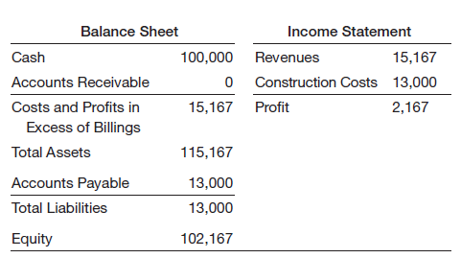
Profit with Percent Complete Method
August 1
Figure 4.9 August 1st Percentage-of-Completion Balance Sheet and Income Statement

Slide 15
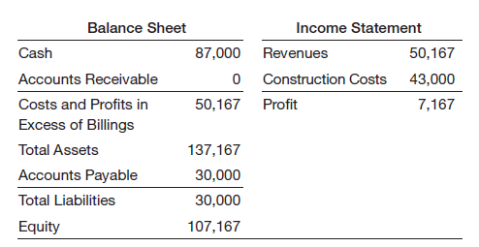
Profit with Percent Complete Method
September 1
Figure 4.10 September 1st Percentage-of-Completion Balance Sheet and Income Statement

Slide 16
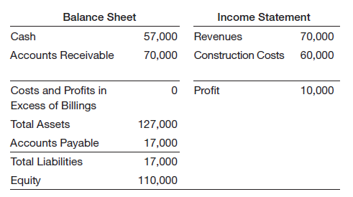
Profit with Percent Complete Method
October 1
Figure 4.11 October 1st Percentage-of-Completion Balance Sheet and Income Statement

Slide 17
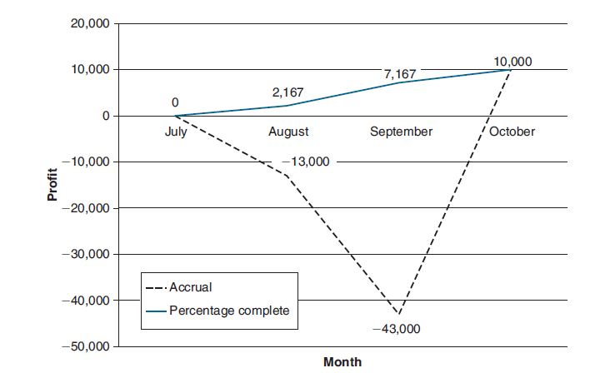
Profit: Accrual vs. Percent Complete
Figure 4.12 Profit by Month

Slide 18
Internal Controls
Separation of duties
Proper paper trail
Review by owner or manager
Track all assets
Keep accounting current
Limit access

Slide 19
Selecting a Construction
Accounting Systems
Reliability
Cost
Training and support
Ease of use
System protection
Integration
Leverage technology
Backup and recover procedures
Customization

Slide 20
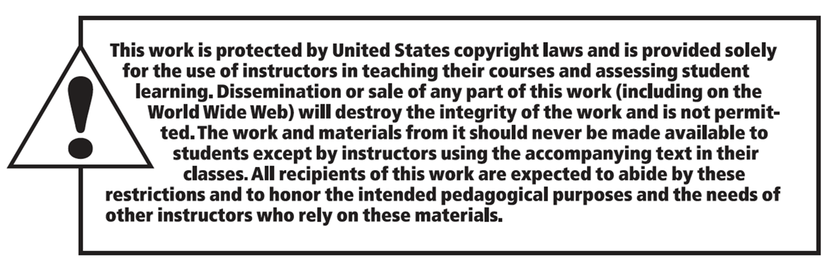
Copyright

