Slide 1

Construction Accounting and Financial Management
Fourth Edition
Chapter 03
Accounting Transactions
Copyright © 2020, 2013, 2009 Pearson Education, Inc. All Rights Reserved

Slide 2
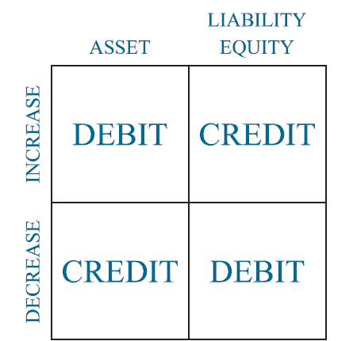
Debits and Credits
Figure 3.1 Debits and Credits

Slide 3
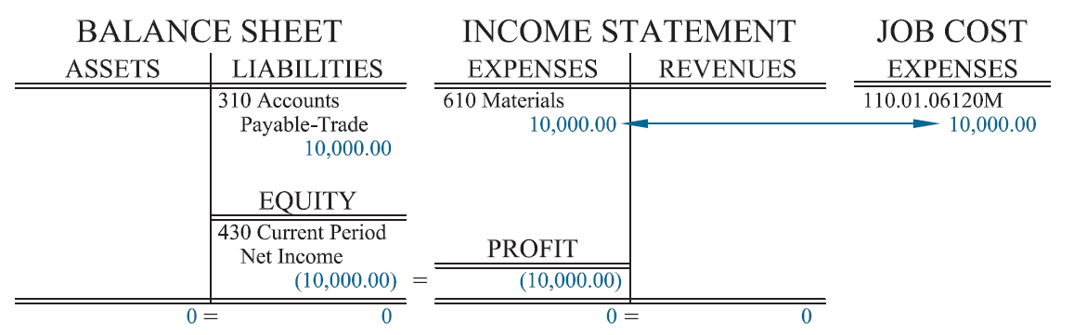
Invoice (Materials) Charged to a Job without Retention
Figure 3.2 Invoice Charged to a Job without Retention

Slide 4
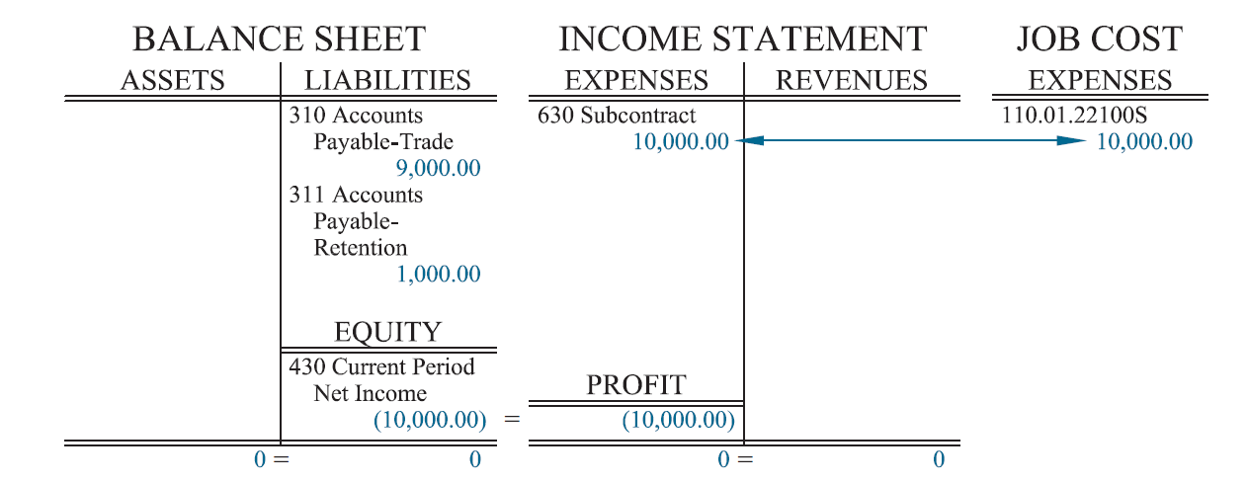
Invoice (Subcontractor) Charged to a Job with Retention:
Figure 3.3 Invoice Charged to a Job with Retention

Slide 5
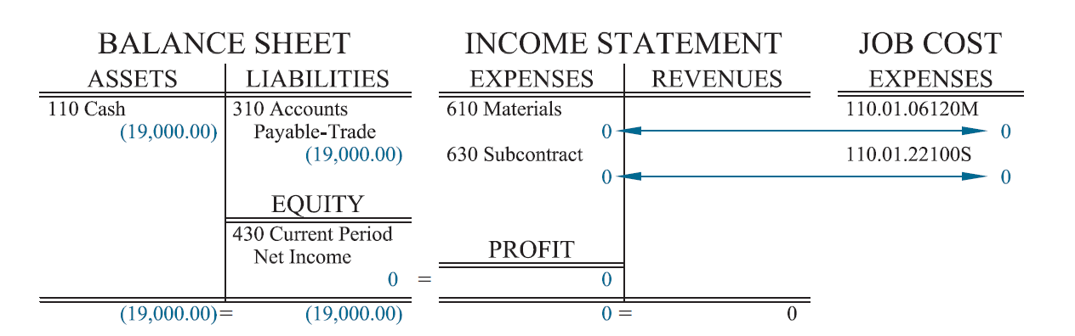
Paying Invoices
Figure 3.4 Paying Invoices

Slide 6
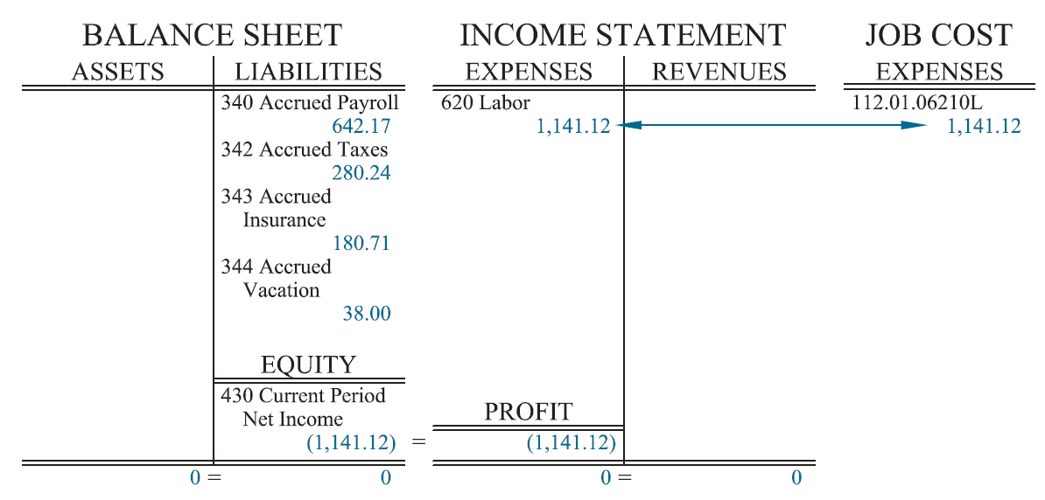
Labor Charged to a Job
Figure 3.5 Labor Charged to a Job

Slide 7
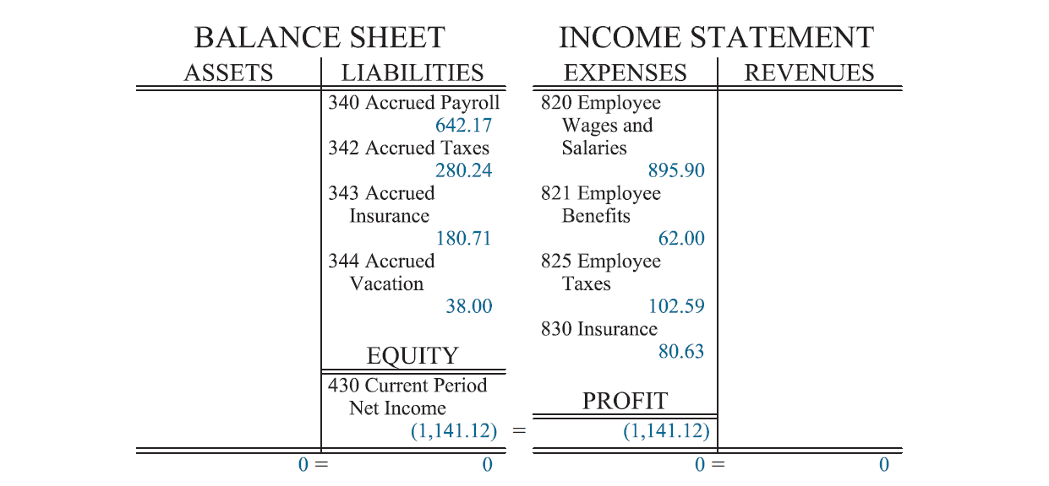
Labor Charged to General Overhead
Figure 3.6 Labor Charged to General Overhead

Slide 8
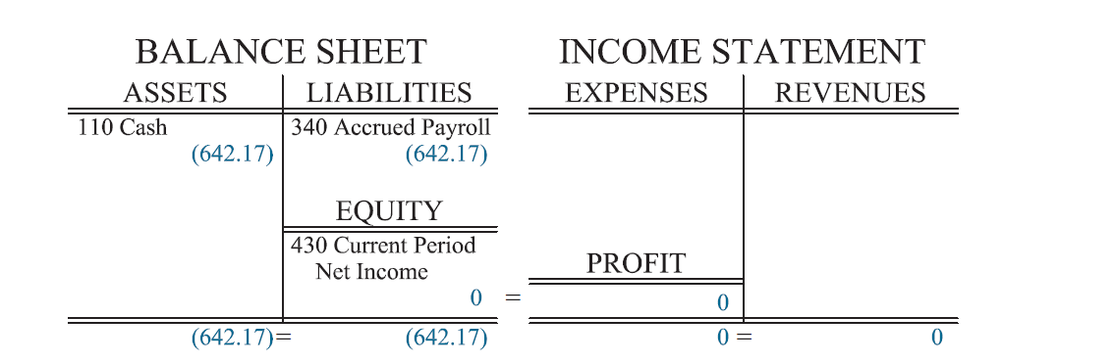
Paying Employee’s Wages
Figure 3.7 Paying an Employee’s Wages

Slide 9
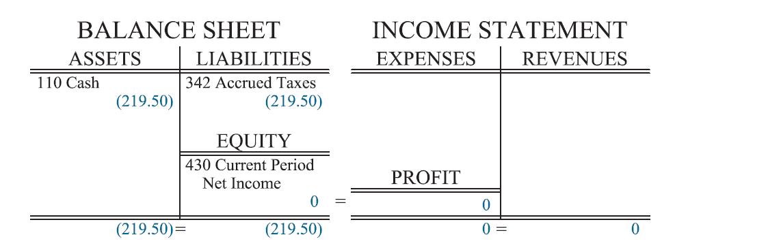
Paying Payroll Taxes
Figure 3.8 Paying Payroll Taxes

Slide 10
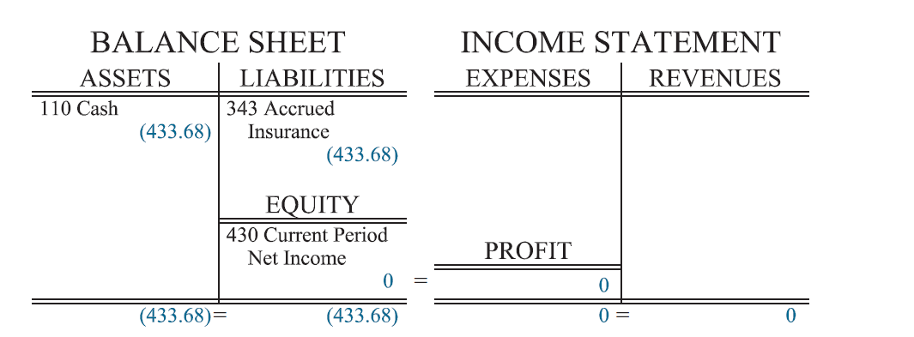
Paying for Benefits
Figure 3.9 Paying for Benefits

Slide 11
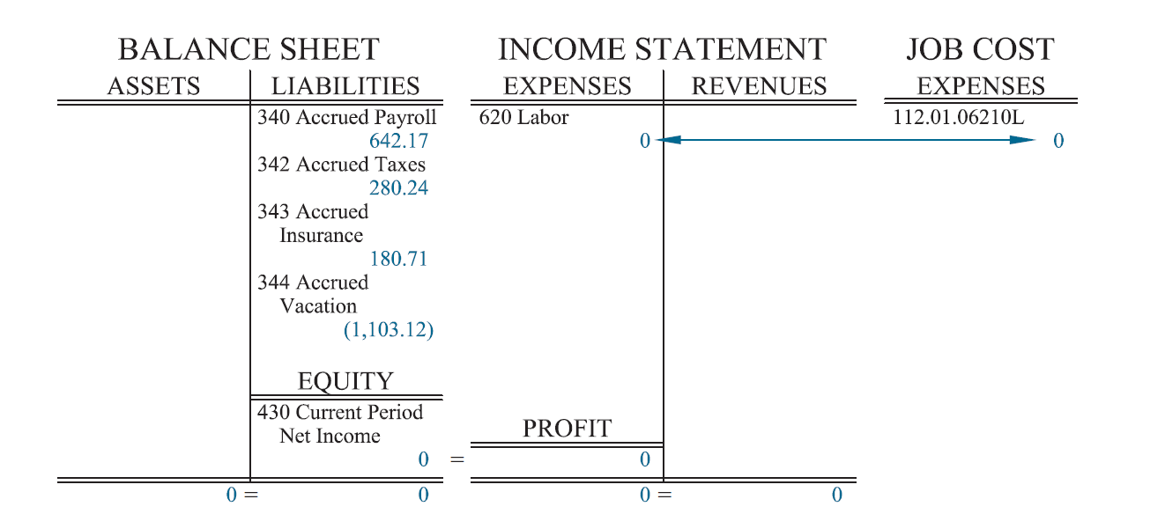
Vacation Time for Jobsite Employees
Figure 3.10 Vacation Time for Jobsite Employees

Slide 12
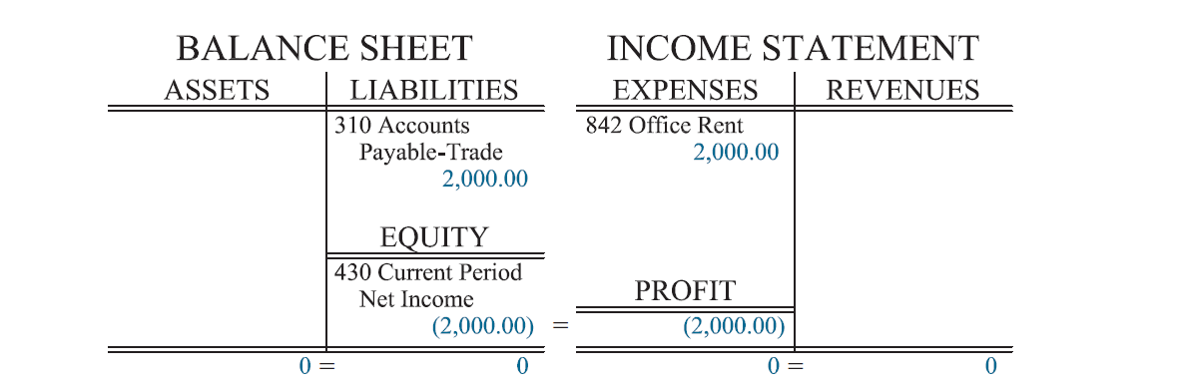
Recording Office Rent
Figure 3.11 Recording Office Rent

Slide 13
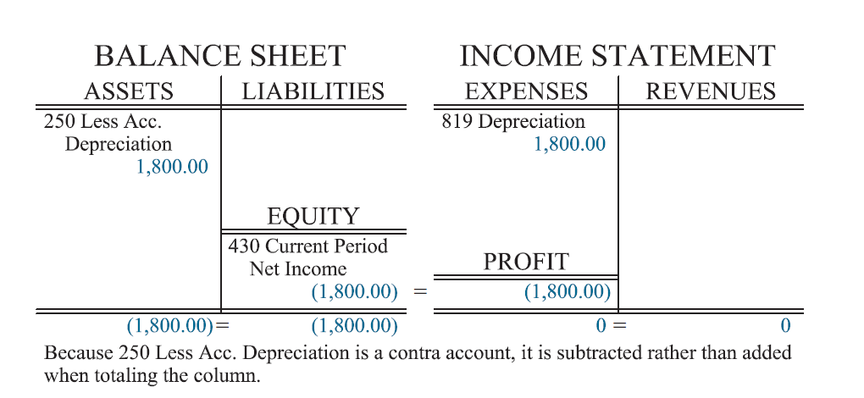
Recording Office Depreciation
Figure 3.12 Recording Office Depreciation

Slide 14
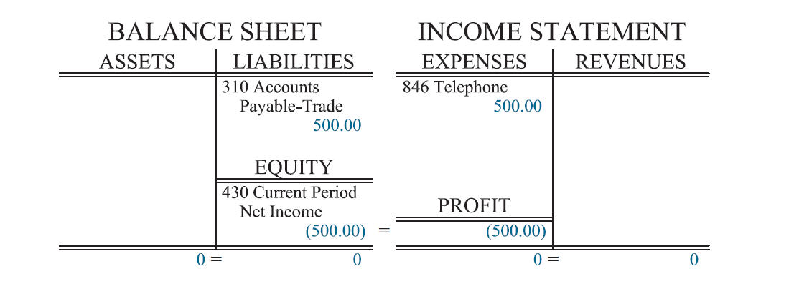
Recording General Overhead Invoices
Figure 3.13 Recording General Overhead Invoices

Slide 15
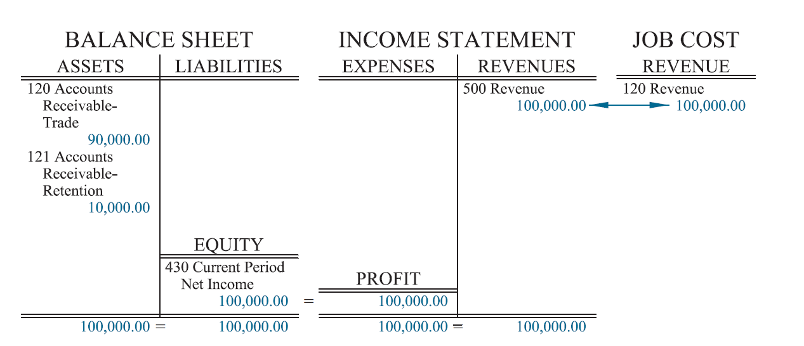
Billing a Client
Figure 3.14 Billing a Client

Slide 16
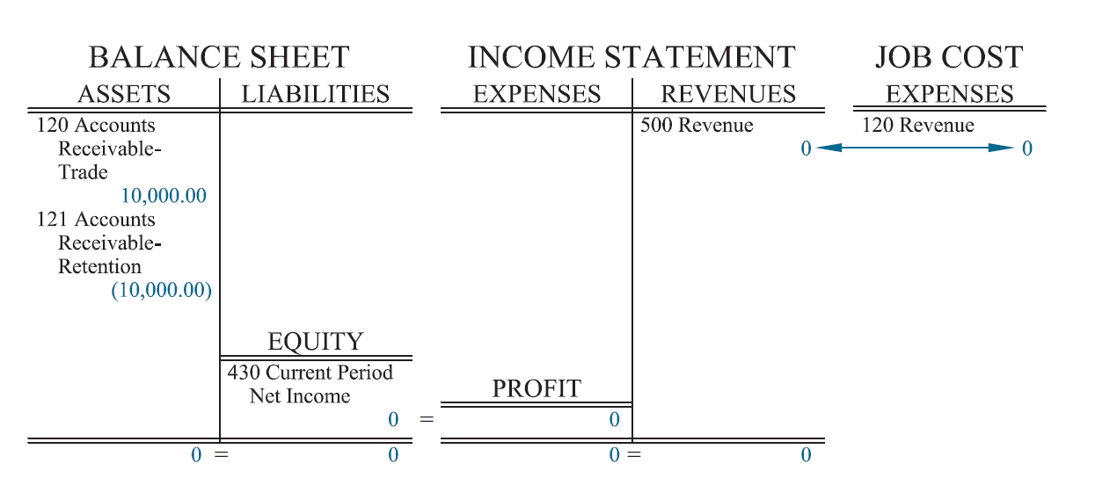
Billing for Retention
Figure 3.15 Billing for Retention

Slide 17
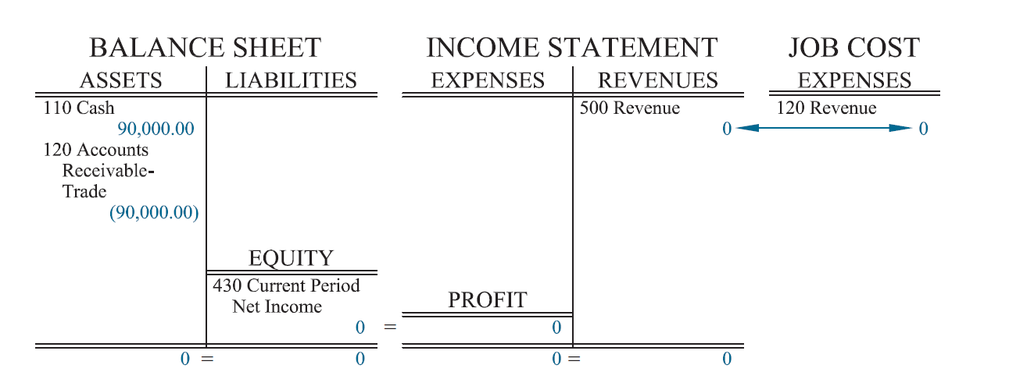
Receiving Payment from a Client
Figure 3.16 Receiving Payment from a Client

Slide 18
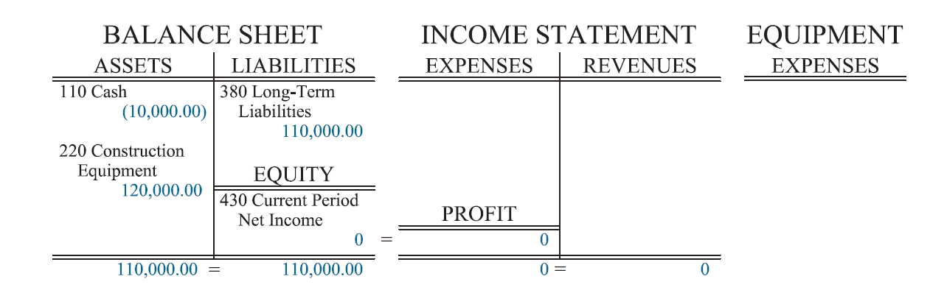
Purchase of Equipment with a Loan
Figure 3.17 Purchase of Equipment with a Loan

Slide 19
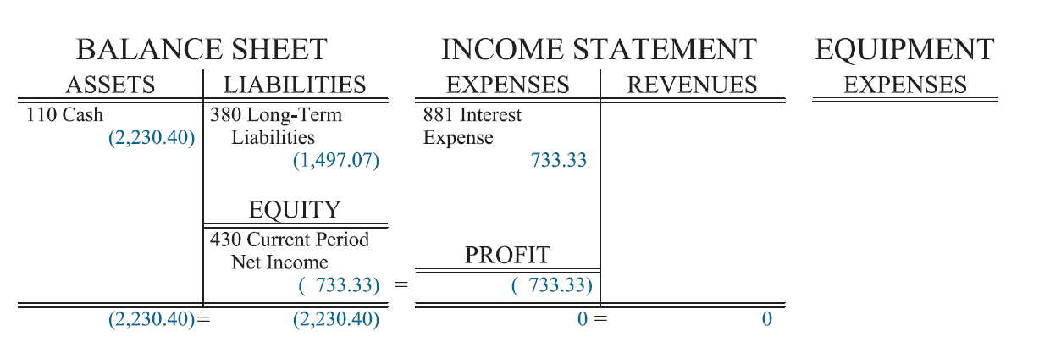
Loan Payment
Figure 3.18 Loan Payment

Slide 20
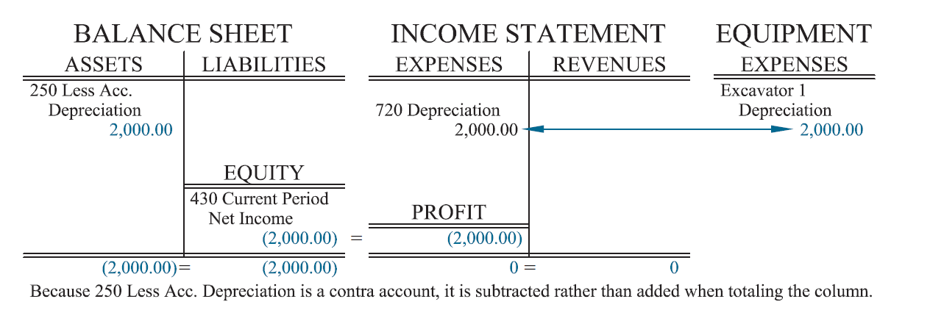
Equipment Depreciation
Figure 3.19 Equipment Depreciation

Slide 21
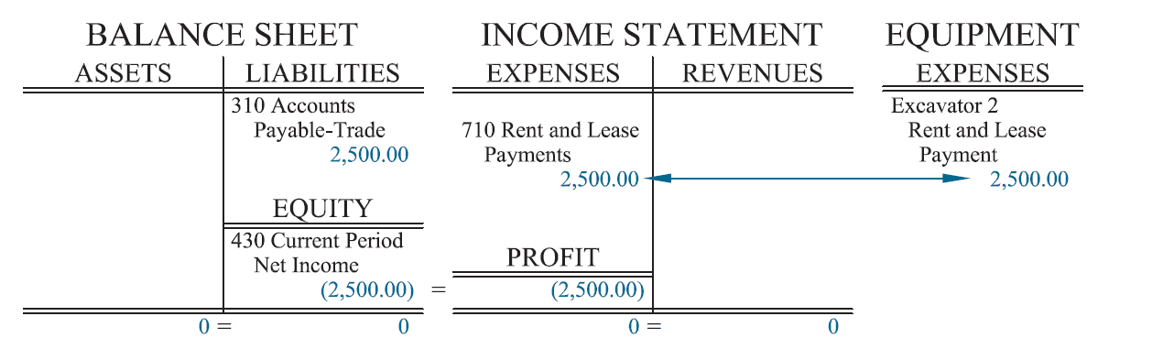
Leased Equipment with an Operating Lease
Figure 3.20 Leased Equipment with an Operating Lease

Slide 22
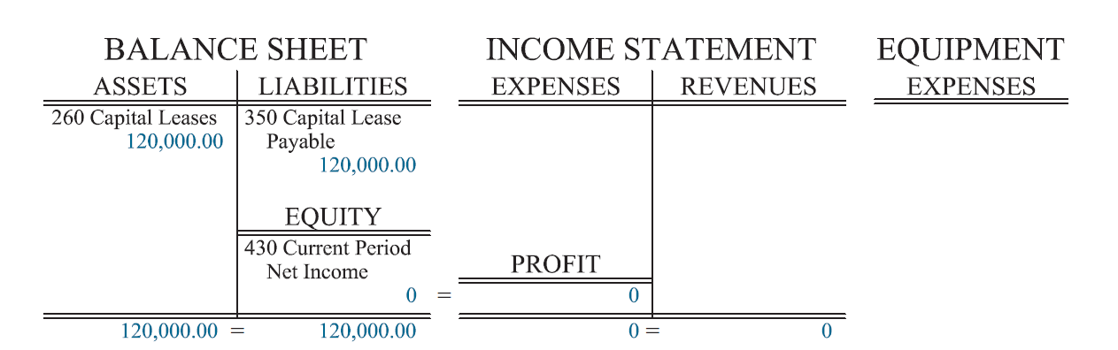
Figure 3.21 Leased Equipment with a Capital Lease
Figure 3.21 Leased Equipment with a Capital Lease

Slide 23
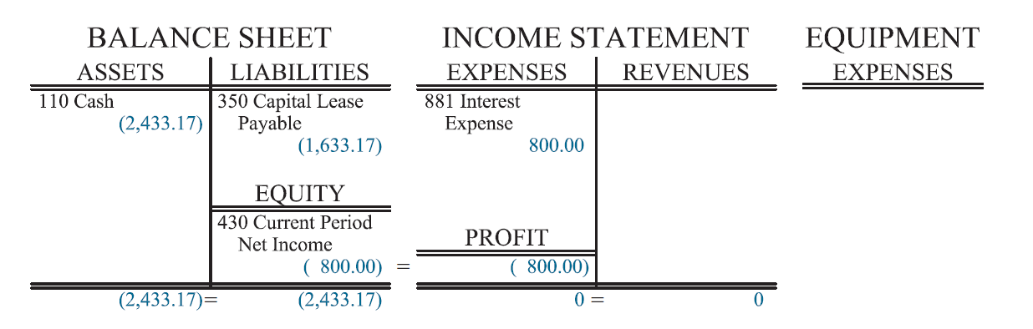
Lease Payment on a Capital Lease
Figure 3.22 Lease Payments on a Capital Lease

Slide 24
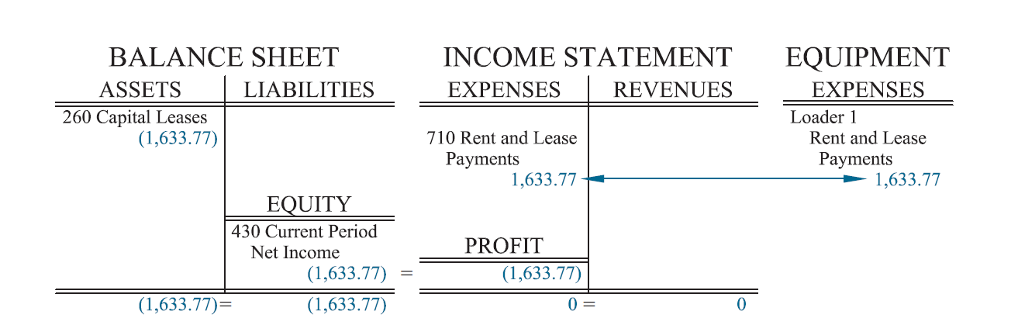
Amortization of a Capital Lease
Figure 3.23 Amortization of a Capital Lease

Slide 25
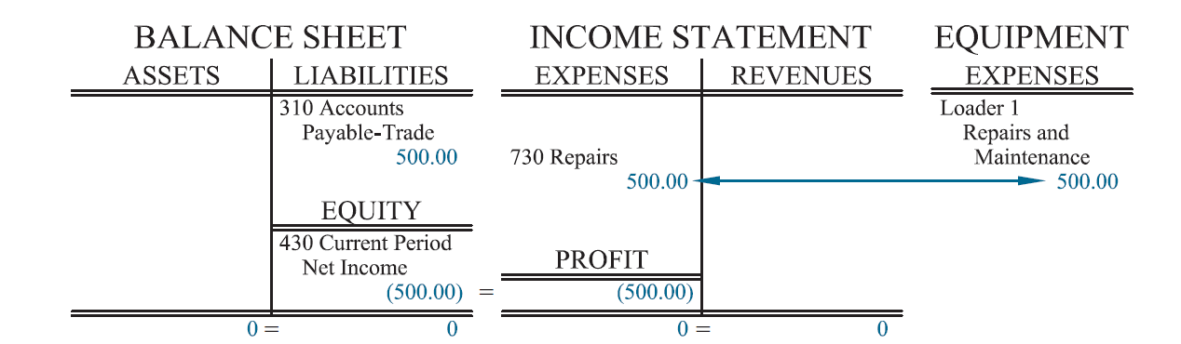
Invoice for Equipment Repairs
Figure 3.24 Invoice for Equipment Repairs

Slide 26
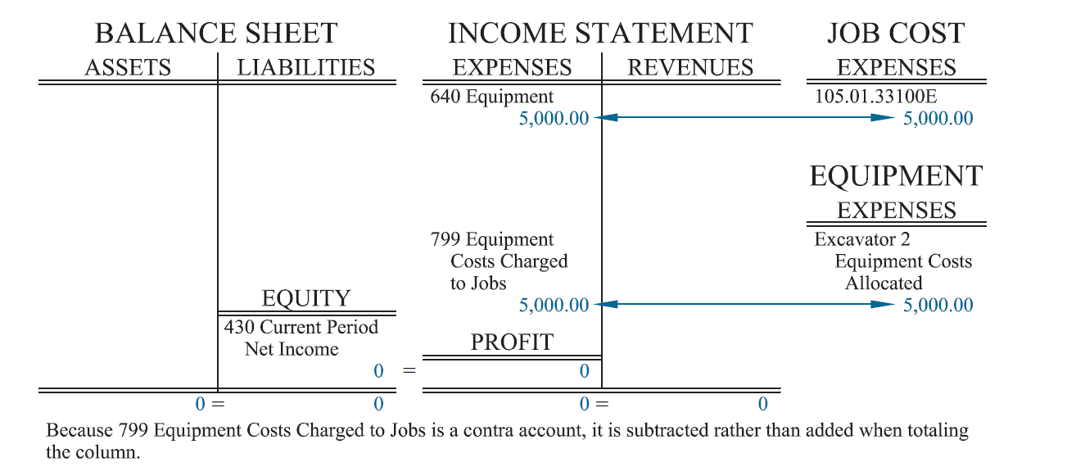
Equipment Charge to Job
Figure 3.25 Equipment Charged to a Job

Slide 27
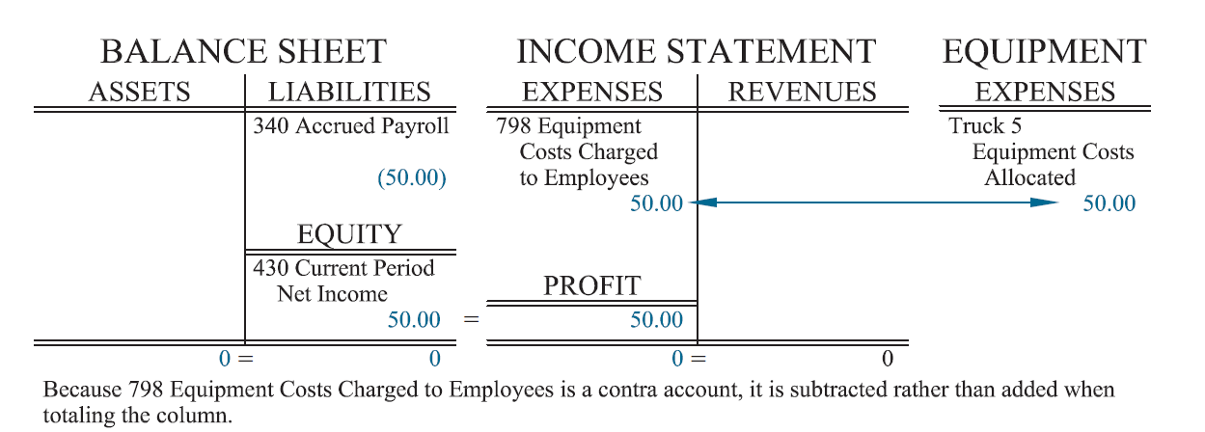
Equipment Charged to an Employee
Figure 3.26 Equipment Charged to an Employee

Slide 28
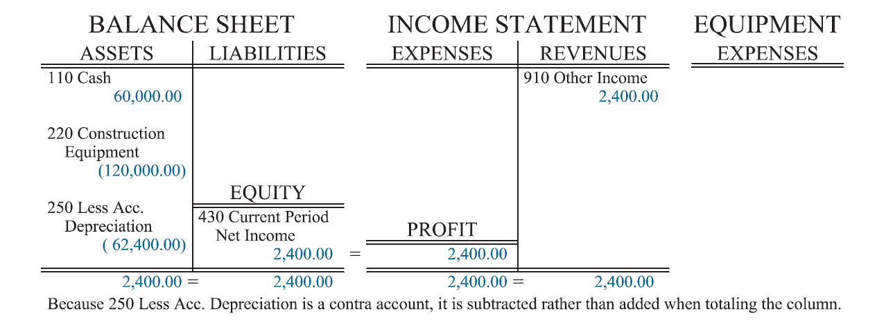
Sale of Equipment
Figure 3.27 Sale of Equipment

Slide 29
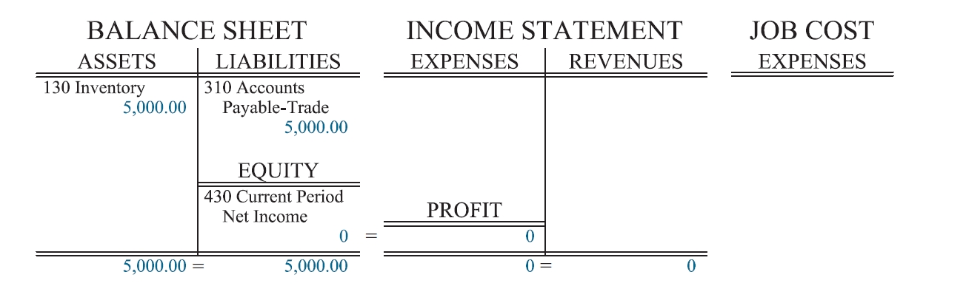
Purchase of Inventory
Figure 3.28 Purchase of Inventory

Slide 30
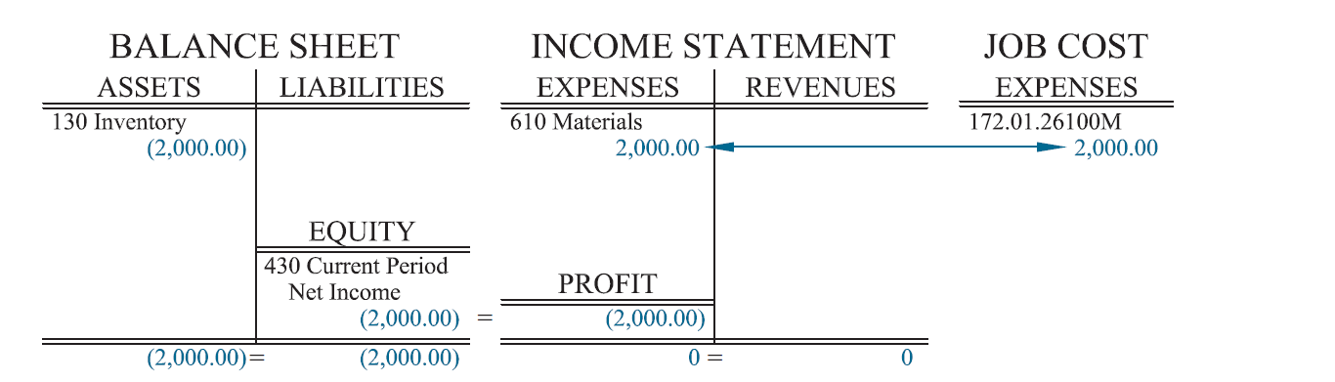
Charging Inventory to a Job
Figure 3.29 Charging Inventory to a Job

Slide 31
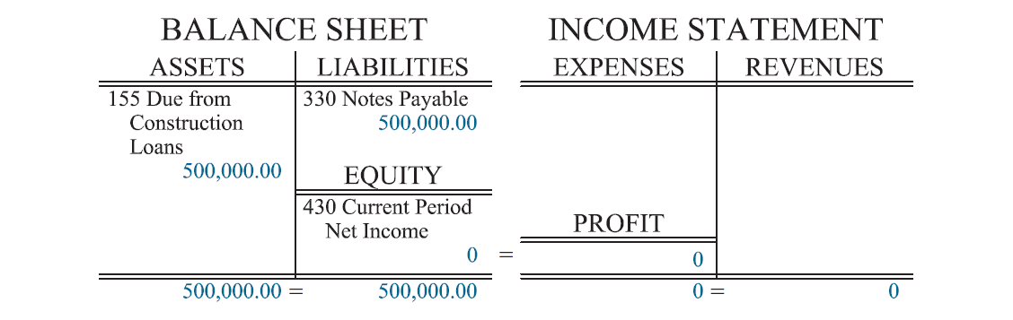
Signing a Construction Loan
Figure 3.30 Signing a Construction Loan

Slide 32
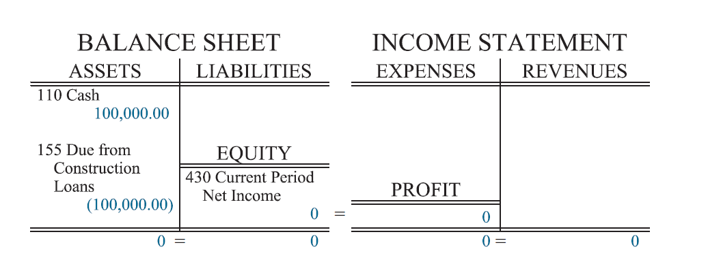
Drawings Funds from a Construction Loan
Figure 3.31 Drawing Funds from a Construction Loan

Slide 33
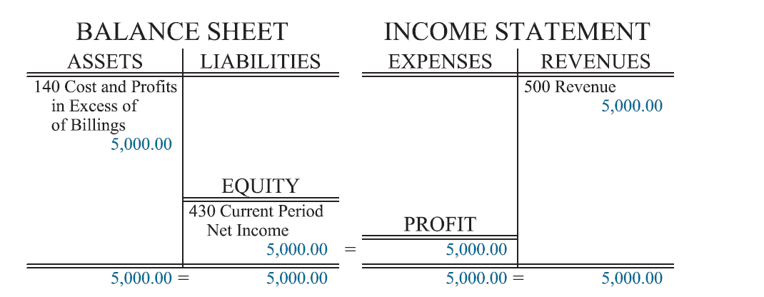
Recording Changes in Costs and Profits in Excess of Billings
Figure 3.32 Recording Changes in Cost and Profits in Excess of Billings

Slide 34
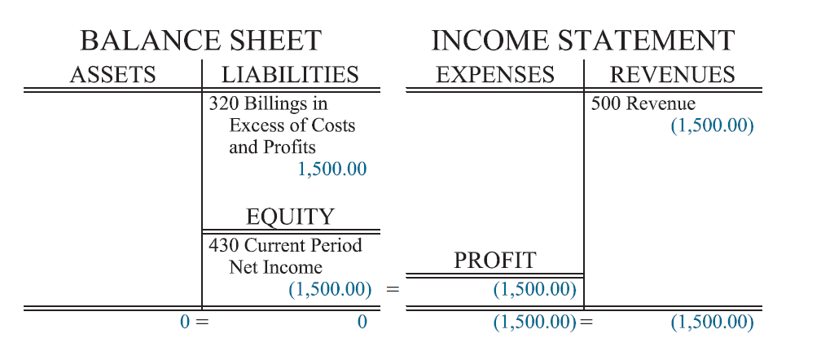
Recording Changes in Billings in Excess of Costs and Profits
Figure 3.33 Recording Changes in Billings in Excess of Cost and Profits

Slide 35
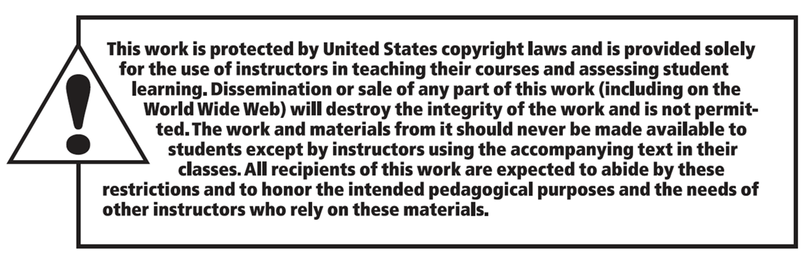
Copyright

