Slide 1
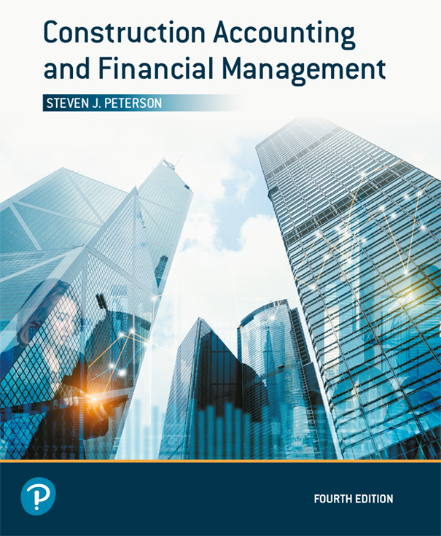
Construction Accounting and Financial Management
Fourth Edition
Chapter 02
Construction Accounting Systems
Copyright © 2020, 2013, 2009 Pearson Education, Inc. All Rights Reserved

Slide 2
Purposes of the Accounting System
Process cash receipts and disbursements
Prepare financial statements
Pay Income and employment tax
Provide data for financial management

Slide 3
Cost Reporting Versus Cost Control
Cost Reporting:
  Provides data after the opportunity has passed for management to respond to and correct the problems
  Shows where the company has been
Cost Control:
  Provides data in time for management to analyze the data and make corrections in a timely manner
  Proactive

Slide 4
Components of a Cost Control System
Strong job cost and equipment tracking
  Costs must be up to date
Uses management by exception
Follows established procedures
Data must readily be available

Slide 5
Components of an Accounting System
General Ledger:
  Chart of accounts
  Balance sheet and income statement
Job Cost Ledger:
  Costs by project
Equipment Ledger:
  Costs by piece of equipment or vehicle

Slide 6
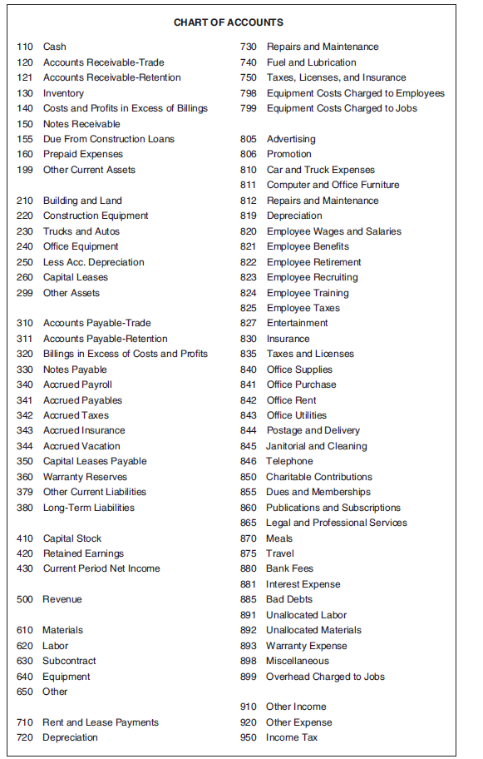
Chart of Accounts
Figure 2.1 Chart of Accounts

Slide 7
Method of Accounting
Cash
Accrual
Percentage of completion
Completed contract

Slide 8
Cash
Revenue is recognized when payment is received
Expenses are recognized when bills are paid
Easiest to use
Little use for financial management because data is not up to date

Slide 9
Accrual
Revenue is recognized when the company has the right to received payment
  Retention is not an revenue until the job is complete
Expenses are recognized when the company is obligated to pay bills
May pay income taxes on imaginary profits

Slide 10
Percentage of Completion
Revenue is recognized throughout the project
  Retention is recognized throughout the project
Expenses are recognized throughout the project
Estimated profits are equally distributed throughout the project
  Based upon expected revenues and expenses

Slide 11
Completed Contract
Revenue is recognized at completion of the project
Expenses are recognized at completion of the project
Revenues and expenses are known
Useless for financial management
May create large swings in income

Slide 12
Balance Sheet (1 of 2)
Assets = Liabilities + Equity
Snapshot of a company’s assets, liabilities, and owners’ equity

Slide 13
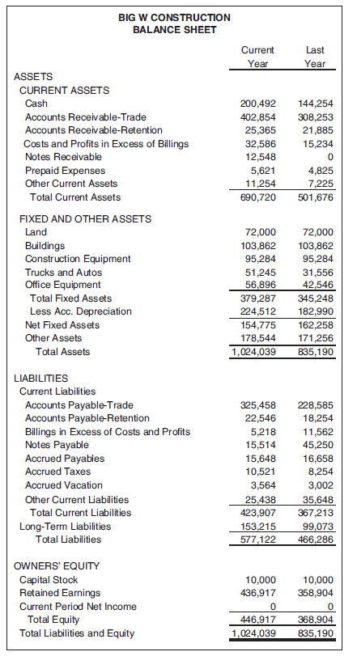
Balance Sheet (2 of 2)
Figure 2.2 Balance Sheet for Big W Construction

Slide 14
Current Assets
Cash
Accounts Receivable-Trade
Accounts Receivable-Retention
Inventory
Costs and Profits in Excess of Billings
Notes Receivable
Due from Construction Loans
Prepaid Expenses
Other Current Assets
  Total Current Assets (sum of above)

Slide 15
Fixed and Other Assets (1 of 2)
Land
Buildings
Construction Equipment
Trucks and Autos
Office Equipment
  Total Fixed Assets (sum of above)

Slide 16
Fixed and Other Assets (2 of 2)
Less Accumulated Depreciation (Contra Account)
  Net Fixed Assets (Total Fixed assets − Less Accumulated Depreciation)
Capital Leases
Other Assets
  Total Assets (Total Current Assets + Net Fixed Assets + Capital Leases + Other Assets)

Slide 17
Liabilities (1 of 3)
Current Liabilities
Accounts Payable-Trade
Accounts Payable-Retention
Billings in Excess of Costs and Profits (overbillings)
Notes Payable
Accrued Payables (including taxes and vacation)

Slide 18
Liabilities (2 of 3)
Capital Lease Payable
Warranty Reserves
Other Current Liabilities
  Total Current Liabilities (sum of above)

Slide 19
Liabilities (3 of 3)
Long-term Liabilities
  Total Liabilities (Total Current Liabilities + Long-term Liabilities)

Slide 20
Owners’ Equity (Corporation)
Capital Stock
Retained Earnings
Current Period Net Income
  Total Equity

Slide 21
Income Statement (1 of 4)
Spans a period of time
Represents the transactions that occur between two balance sheets

Slide 22
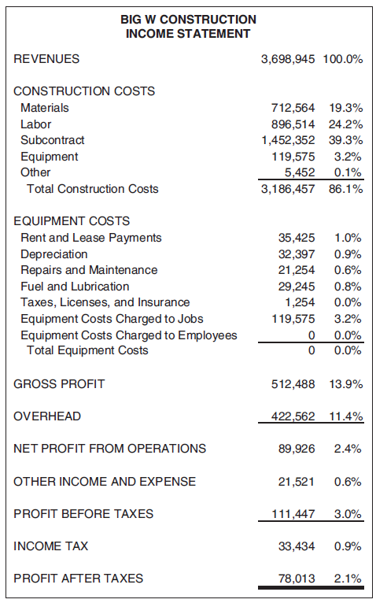
Income Statement (2 of 4)
Figure 2.3 Income Statement for Big W Construction

Slide 23
Income Statement (3 of 4)
Revenue
Construction Costs
Equipment Costs
  Gross Profit (Revenue − Construction Costs − Equipment Costs)
Overhead
  Net Profit From Operations (Gross Profit − Overhead)

Slide 24
Income Statement (4 of 4)
Other Income and Expense
  Profit Before Tax (Net Profit + Other Income − Other Expense)
Income Tax
  Profit After Tax (Profit Before Tax − Income Tax)

Slide 25
Construction Costs
Materials
Labor
  Passes through payroll system and is charge to a job
Subcontract
  Always includes labor component
Equipment
Other

Slide 26
Equipment Costs (1 of 2)
Rent and Lease Payments
Depreciation
Repairs and Maintenance
Fuel and Lubrication
Taxes, Licenses, and Insurance
Equipment Costs Charged to Jobs (Contra)
Equipment Costs Charged to Employees (Contra)
  Total Equipment Costs

Slide 27
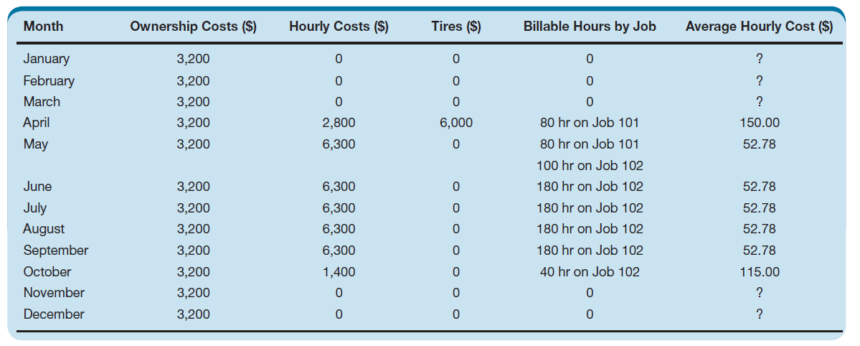
Equipment Costs (2 of 2)
Table 2.1 Loader Costs

Slide 28
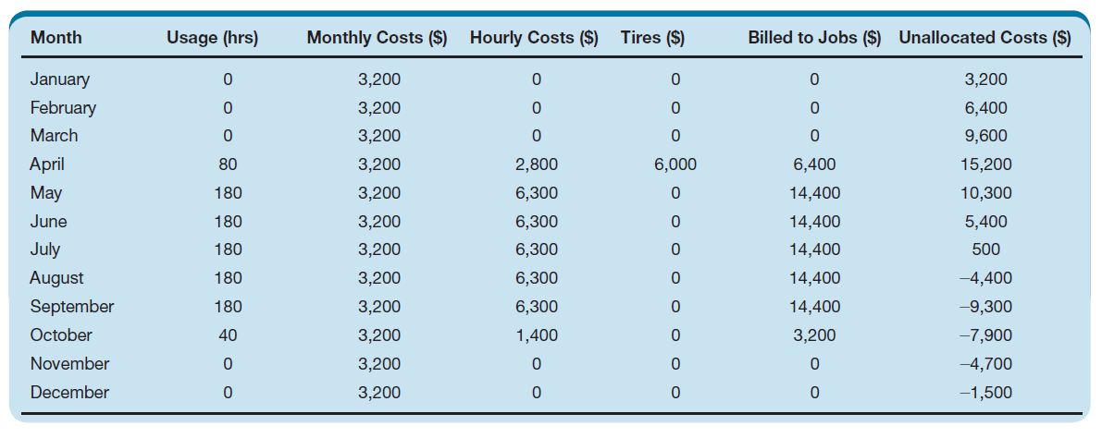
Allocation of Equipment Costs
Table 2.2 Allocation of Loader Costs

Slide 29
Relationships
Balance Sheet
  Assets = Liabilities + Equity
Income Statement
  Revenue = Expenses + Profit
Balance Sheet and Income Statement
  Change in Equity = Profit

Slide 30
Job Cost Ledger (1 of 3)
Provides breakdown of construction costs on income statement
May provide a breakdown of revenues on the income statement
Costs are broken down by:
  Job
  Phase (optional)
  Cost code
  Cost type

Slide 31
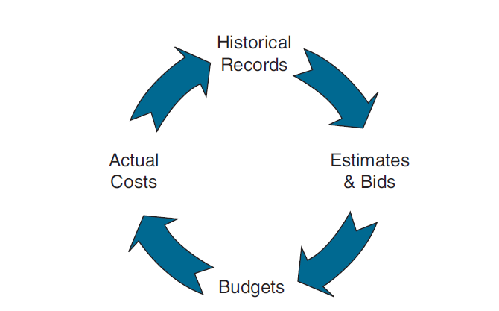
Job Cost Ledger (2 of 3)
Figure 2.4 Cost Information Cycle

Slide 32
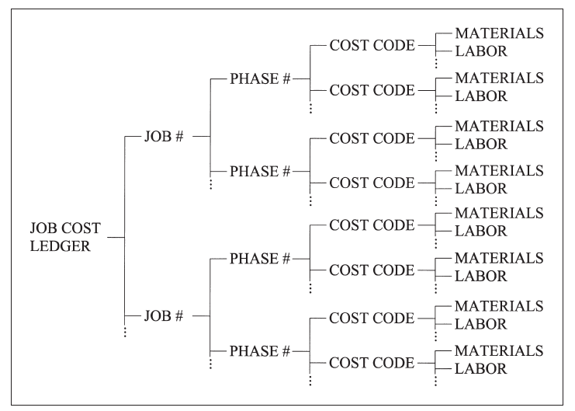
Job Cost Ledger (3 of 3)
Figure 2.5 Breakdown of the Job Cost Ledger

Slide 33
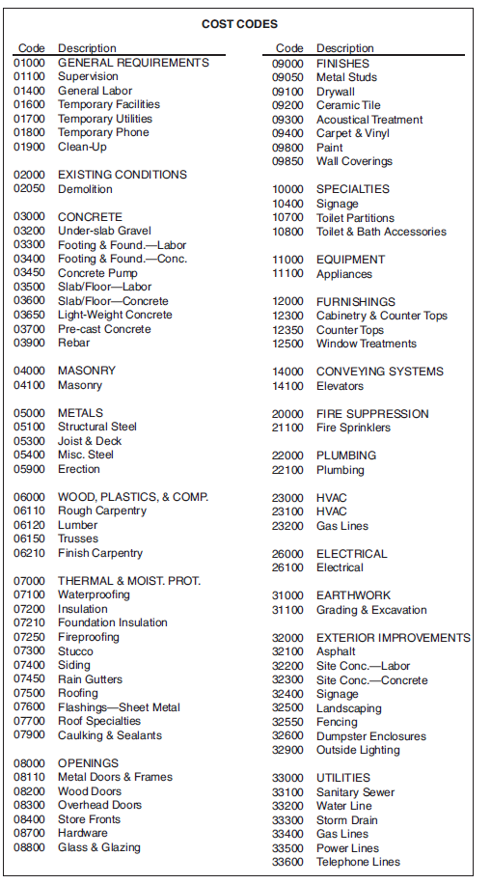
Job Cost Codes-Commercial
Figure 2.6 Sample Cost Codes for a Commercial Contractor

Slide 34
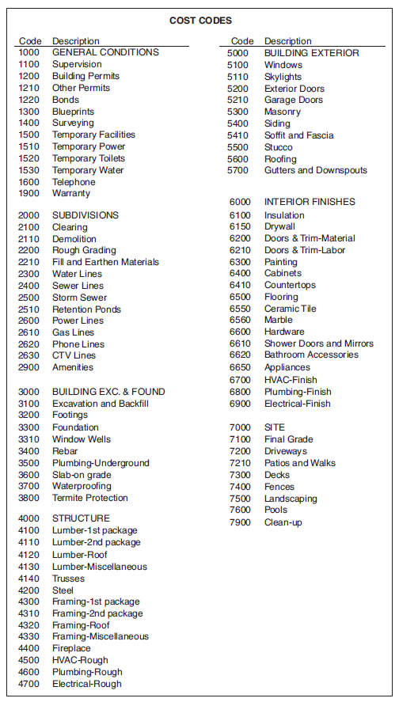
Job Cost Codes-Residential
Figure 2.7 Sample Cost Codes for a Residential Contractor

Slide 35
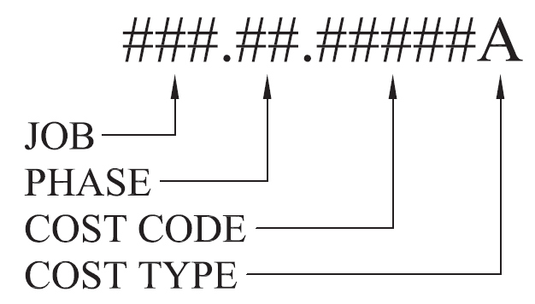
Job Cost Code Structure
Figure 2.8 Sample Job Cost Code

Slide 36
Relationships (1 of 2)
Income Statement and Job Cost Ledger
  Revenue = Revenues
  Construction Costs = Construction Costs
    Excludes Committed Costs not Recognized
    Materials = Materials
    Labor = Labor
    Subcontract = Subcontract
    Equipment = Equipment
    Other = Other

Slide 37
Equipment Ledger (1 of 2)
Provides breakdown of equipment costs on income statement by piece of equipment
May provide additional breakdown

Slide 38
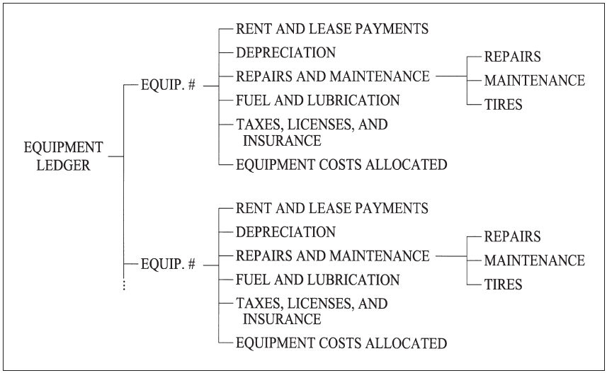
Equipment Ledger (2 of 2)
Figure 2.9 Breakdown of the Equipment Ledger

Slide 39
Relationships (2 of 2)
Income statement and Equipment Ledger
  Charge Costs = Cost Allocated
  Costs = Costs
    Rent and Lease Payments = Rent and Lease Payments
    Depreciation = Depreciation
    Repairs and Maintenance = Repairs and Maintenance
    Fuel and Lubrication = Fuel and Lubrication
    Taxes, Licenses, and Insurance = Taxes, Licenses, and Insurance

Slide 40
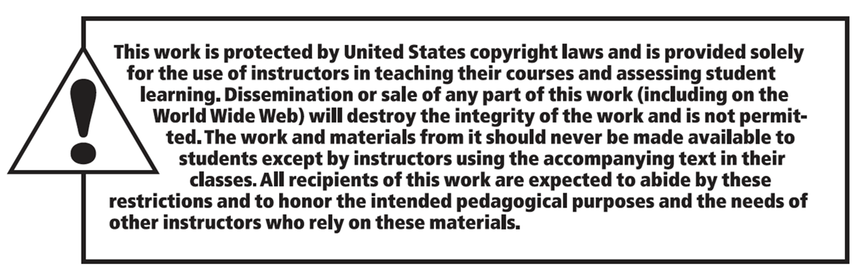
Copyright
Notes:
If this slide was not included in the original PPT, it should be added.

