Slide 1

Construction Accounting and Financial Management
Fourth Edition
Chapter 01
Construction Financial Management
Slide in this Presentation Contain Hyperlinks. JAWS users should be able to get a list of links by using INSERT+F7
Copyright © 2020, 2013, 2009 Pearson Education, Inc. All Rights Reserved

Slide 2
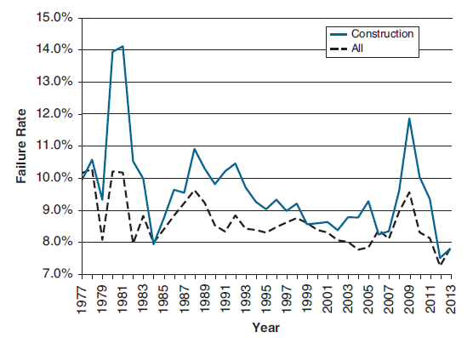
Business Failure Rates by Year
Figure 1.1 Business Failure Rates by Year

Slide 3
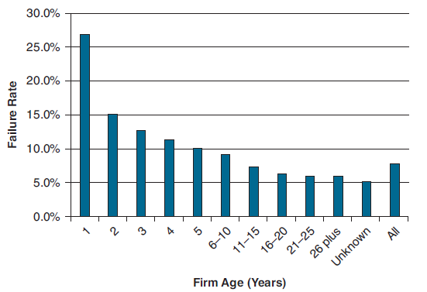
Business Failure Rate by Age of Firm for 2013
Figure 1.2 Business Failure Rate by Age of Firm for 2013

Slide 4
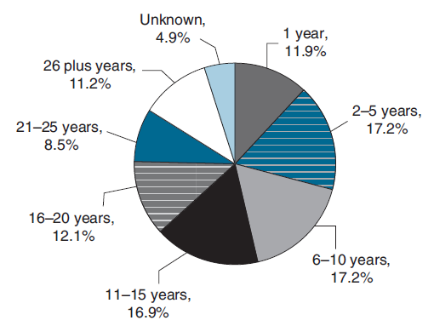
Percent of Business Failures by Age of Firm for 2013
Figure 1.3 Percent of Business Failures by Age of Firm for 2013

Slide 5
Why do Construction Companies Fail?
Ineffective financial management systems
Lines of credit constantly borrowed to the limits
Poor estimating and/or job cost reporting
Poor project management
No comprehensive business plan
Communication problems
Surety Information Office, Why Do Contractors Fail?,
downloaded from http://www.sio.org/html/whyfail.html downloaded on April 3, 2003.

Slide 6
What is Financial Management?
Financial management is the use of a company’s financial resources
Financial resources include:
  Cash
  Assets—such as equipment

Slide 7
Why Is Construction Financial
Management Different? (1 of 2)
Project oriented:
  Greater variety of projects (products)
  Harder to determine the cost of projects
  Cannot stockpile completed work for future use
  Greater need for detailed job cost accounting

Slide 8
Why Is Construction Financial
Management Different? (2 of 2)
Decentralized:
  Must track equipment
Payment terms:
  Progress payments
  Retention
Heavy use of subcontractors

Slide 9
Who Is Responsible for
Construction Management?
Owners
General Managers
CFO (Chief Financial Officer)
Estimators
Project Managers
Superintendents

Slide 10
What Does a Financial Manager Do?
Accounting for financial resources
Managing costs and profits
Managing cash flows
Choosing among financial alternatives

Slide 11
Accounting for Financial Resources (1 of 2)
Making sure costs are accurately tracked through the accounting system
Ensuring that the construction accounting system is functioning properly
Projecting the costs at completion for the individual projects, including unbilled committed costs
Determining whether the individual projects are over- or underbilled

Slide 12
Accounting for Financial Resources (2 of 2)
Making sure that the needed financial statements have been prepared
Reviewing the financial statements:
  Inline with the rest of the industry
  Identify potential financial problems before they become a crisis

Slide 13
Managing Costs and Profits (1 of 2)
Monitoring and controlling project costs
Monitoring project and company profitability
Setting labor burden markups
Developing and tracking general overhead budgets

Slide 14
Managing Costs and Profits (2 of 2)
Setting the minimum profit margin for use in bidding
Analyzing the profitability of different parts of the company and making the necessary changes to improve profitability
Monitoring the profitability of different customers and making the necessary marketing changes to improve profitability

Slide 15
Manage Cash Flows (1 of 2)
Matching the use of in-house labor and subcontractors to the cash available for use on a project
Ensuring that the company has sufficient cash to take on an additional project
Preparing an income tax projection for the company

Slide 16
Manage Cash Flows (2 of 2)
Preparing and updating annual cash flow projections for the company
Arranging for financing to cover the needs of the construction company

Slide 17
Choosing among Financial Alternatives
Selecting which equipment to purchase
Deciding which area of the business to invest the company’s limited resources

Slide 18
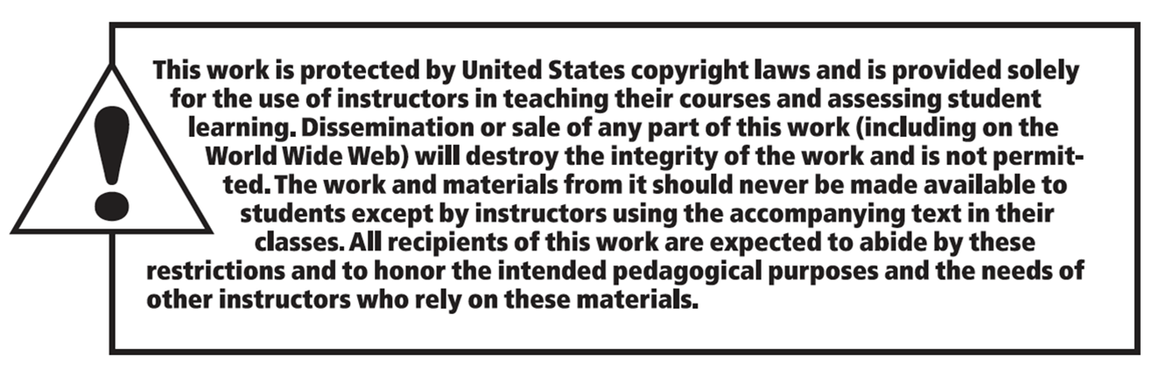
Copyright

