Slide 1
Correlation
Cal State Northridge
Ψ320
Andrew Ainsworth PhD

Slide 2
Major Points
Questions answered by correlation
Scatterplots
An example
The correlation coefficient
Other kinds of correlations
Factors affecting correlations
Testing for significance

Slide 3
The Question
Are two variables related?
  Does one increase as the other increases?
    e. g. skills and income
  Does one decrease as the other increases?
    e. g. health problems and nutrition
How can we get a numerical measure of the degree of relationship?

Slide 4
Scatterplots
AKA scatter diagram or scattergram.
Graphically depicts the relationship between two variables in two dimensional space.

Slide 5
Direct Relationship

Slide 6
Inverse Relationship

Slide 7
An Example
Does smoking cigarettes increase systolic blood pressure?
Plotting number of cigarettes smoked per day against systolic blood pressure
  Fairly moderate relationship
  Relationship is positive

Slide 8
Trend?

Slide 9
Smoking and BP
Note relationship is moderate, but real.
Why do we care about relationship?
  What would conclude if there were no relationship?
  What if the relationship were near perfect?
  What if the relationship were negative?

Slide 10
Heart Disease and Cigarettes
Data on heart disease and cigarette smoking in 21 developed countries (Landwehr and Watkins, 1987)
Data have been rounded for computational convenience.
  The results were not affected.
Notes:
Landwehr, J.M. & Watkins, A.E. (1987) Exploring Data: Teacher’s Edition. Palo Alto, CA: Dale Seymour Publications.

Slide 11
The Data
Surprisingly, the U.S. is the first country on the list--the country
with the highest consumption and highest mortality.

Slide 12
Scatterplot of Heart Disease
CHD Mortality goes on ordinate (Y axis)
  Why?
Cigarette consumption on abscissa (X axis)
  Why?
What does each dot represent?
Best fitting line included for clarity

Slide 13
{X = 6, Y = 11}

Slide 14
What Does the Scatterplot Show?
As smoking increases, so does coronary heart disease mortality.
Relationship looks strong
Not all data points on line.
  This gives us “residuals” or “errors of prediction”
    To be discussed later

Slide 15
Correlation
Co-relation
The relationship between two variables
Measured with a correlation coefficient
Most popularly seen correlation coefficient: Pearson Product-Moment Correlation

Slide 16
Types of Correlation
Positive correlation
  High values of X tend to be associated with high values of Y.
  As X increases, Y increases
Negative correlation
  High values of X tend to be associated with low values of Y.
  As X increases, Y decreases
No correlation
No consistent tendency for values on Y to increase or decrease as X increases

Slide 17
Correlation Coefficient
A measure of degree of relationship.
Between 1 and -1
Sign refers to direction.
Based on covariance
  Measure of degree to which large scores on X go with large scores on Y, and small scores on X go with small scores on Y
  Think of it as variance, but with 2 variables instead of 1 (What does that mean??)

Slide 18
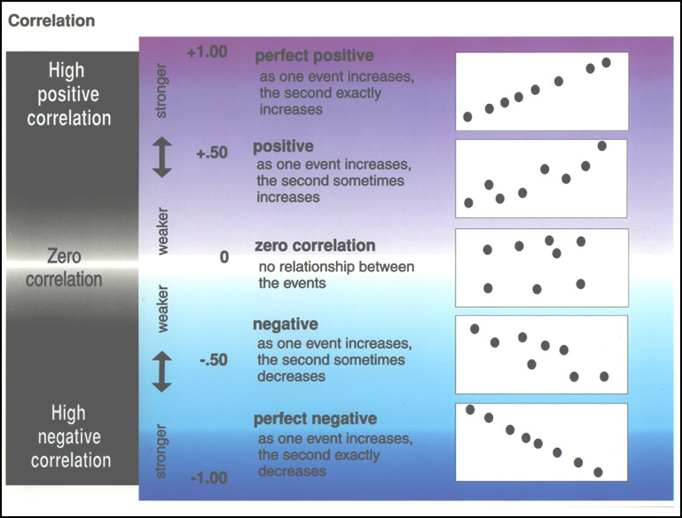

Slide 19
Covariance
Remember that variance is:
The formula for co-variance is:
How this works, and why?
When would cov_{XY} be large and positive? Large and negative?

Slide 20
Example

Slide 21
Example
What the heck is a covariance?
I thought this was the correlation chapter?

Slide 22
Correlation Coefficient
Pearson’s Product Moment Correlation
Symbolized by r
Covariance ÷ (product of the 2 SDs)
Correlation is a standardized covariance

Slide 23
Calculation for Example
Cov_{XY} = 11.12
s_{X} = 2.33
s_{Y} = 6.69

Slide 24
Example
Correlation = .713
Sign is positive
  Why?
If sign were negative
  What would it mean?
  Would not alter the degree of relationship.

Slide 25
Other calculations
Z-score method
Computational (Raw Score) Method

Slide 26
Other Kinds of Correlation
Spearman Rank-Order Correlation Coefficient (r_{sp})
  used with 2 ranked/ordinal variables
  uses the same Pearson formula

Slide 27
Other Kinds of Correlation
Point biserial correlation coefficient (r_{pb})
  used with one continuous scale and one nominal or ordinal or dichotomous scale.
  uses the same Pearson formula

Slide 28
Other Kinds of Correlation
Phi coefficient (Φ)
  used with two dichotomous scales.
  uses the same Pearson formula

Slide 29
Factors Affecting r
Range restrictions
  Looking at only a small portion of the total scatter plot (looking at a smaller portion of the scores’ variability) decreases r.
  Reducing variability reduces r
Nonlinearity
  The Pearson r (and its relatives) measure the degree of linear relationship between two variables
  If a strong non-linear relationship exists, r will provide a low, or at least inaccurate measure of the true relationship.

Slide 30
Factors Affecting r
Heterogeneous subsamples
  Everyday examples (e.g. height and weight using both men and women)
Outliers
  Overestimate Correlation
  Underestimate Correlation

Slide 31
Countries With Low Consumptions
Data With Restricted Range
Truncated at 5 Cigarettes Per Day
20
18
16
14
12
CHD Mortality per 10,000
10
8
6
4
2
2.5
3.0
3.5
4.0
4.5
5.0
5.5
Cigarette Consumption per Adult per Day

Slide 32
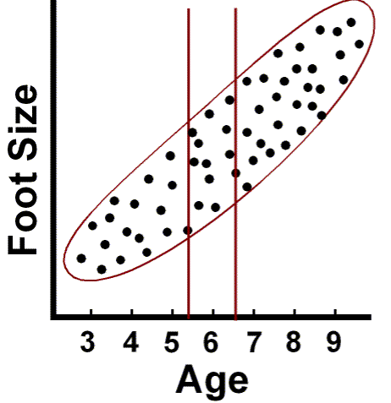
Truncation

Slide 33
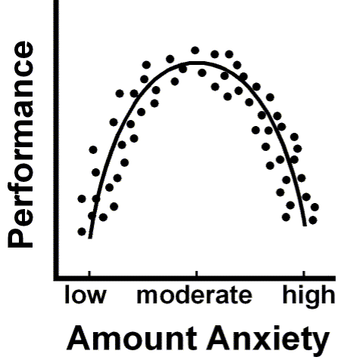
Non-linearity

Slide 34
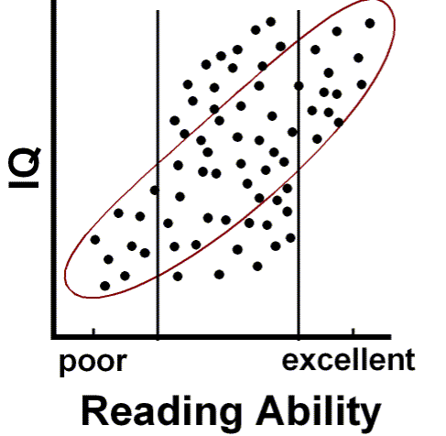
Heterogenous samples

Slide 35
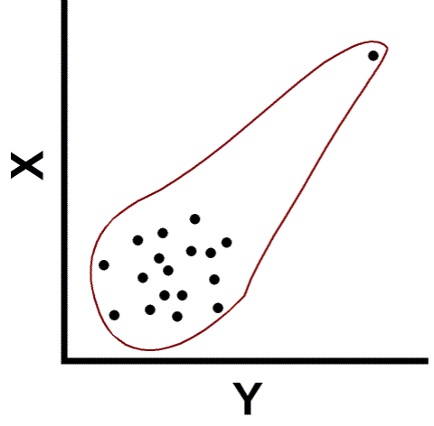
Outliers

Slide 36
Testing Correlations
So you have a correlation. Now what?
In terms of magnitude, how big is big?
  Small correlations in large samples are “big.”
  Large correlations in small samples aren’t always “big.”
Depends upon the magnitude of the correlation coefficient
AND
The size of your sample.

Slide 37
Testing r
Population parameter = ρ
Null hypothesis H₀: ρ = 0
  Test of linear independence
  What would a true null mean here?
  What would a false null mean here?
Alternative hypothesis (H₁) ρ ≠ 0
  Two-tailed

Slide 38
Tables of Significance
Our example r was .71
Table in Appendix E.2
For N - 2 = 19 df, r_{crit} = .433
Our correlation > .433
Reject H₀
  Correlation is significant.
  Greater cigarette consumption associated with higher CHD mortality.

Slide 39
Computer Printout
Printout gives test of significance.

