Slide 1
Power and Effect Size
Cal State Northridge
Ψ320
Andrew Ainsworth PhD

Slide 2
Major Points
Review
What is power?
What controls power?
Effect size
Power for one sample t
Power for related-samples t
Power for two sample t

Slide 3
Important Concepts
Concepts critical to hypothesis testing
  Decision
  Type I error
  Type II error
  Critical values
  One- and two-tailed tests

Slide 4
Decisions
When we test a hypothesis we draw a conclusion; either correct or incorrect.
  Type I error
    Reject the null hypothesis when it is actually correct.
  Type II error
    Retain the null hypothesis when it is actually false.

Slide 5
Type I Errors
Null Hypothesis really is true
We conclude the null is false.
This is a Type I error
  Probability set at alpha (α)
    α usually at .05
  Therefore, probability of Type I error = .05

Slide 6
Type II Errors
The Alternative Hypothesis is true
We conclude that the null is true
This is also an error (Type II)
  Probability denoted beta (β)
    We can’t set beta easily.
    We’ll talk about this issue later.
Power = (1 - β) = probability of correctly rejecting false null hypothesis.

Slide 7
Confusion Matrix

Slide 8
Critical Values
These represent the point at which we decide to reject null hypothesis.
e.g. We might decide to reject null when (p|null) < .05.
  In the null distribution there is some value with p = .05
  We reject when we exceed that value.
  That value is called the critical value.

Slide 9
One- and Two-Tailed Tests
Two-tailed test rejects null when obtained value too extreme in either direction
  Decide on this before collecting data.
One-tailed test rejects null if obtained value is too low (or too high)
  We only set aside one direction for rejection.

Slide 10
One- & Two-Tailed Example
One-tailed test
  Reject null if IQPLUS group shows an increase in IQ
    Probably wouldn’t expect a reduction and therefore no point guarding against it.
Two-tailed test
  Reject null if IQPLUS group has a mean that is substantially higher or lower.

Slide 11
What Is Power?
Probability of rejecting a false H₀
Probability that you’ll find difference that’s really there
1 - β, where β = probability of Type II error

Slide 12
What Controls Power?
The significance level (α)
True difference between null and alternative hypotheses
  μ₁ - μ₂
Sample size
Population variance
The particular test being used

Slide 13
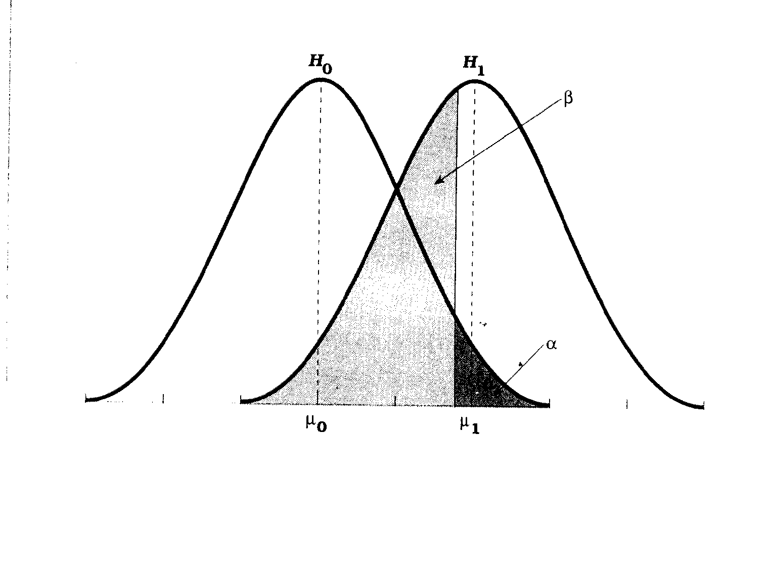
Distributions Under μ₁ and μ₀

Slide 14
Effect Size
The degree to which the null is false
  Depends on distance between μ₁ and μ₂
  Also depends on standard error (of mean or of difference between means)

Slide 15
What happened to n?
It doesn’t relate to how different the two population means are.
It controls power, but not effect size.
We will add it in later.

Slide 16
Estimating Effect Size
Judge your effect size by:
  Past research
  What you consider important
  Cohen’s conventions

Slide 17
Combining Effect Size and n
We put them together and then evaluate power from the result.
General formula for Delta
  where f (n) is some function of n that will depend on the type of design

Slide 18
Power for One-Sample or Related samples t
First calculate delta with:
  where n = size of sample, and δ and γ as above
Look power up in table using δ and significance level (α)

Slide 19
Power for Single Sample
IQPLUS Study
One sample z and t
  Compared IQPLUS group with population mean = 100, sigma = 10
  Used 25 subjects
  We got a sample mean of 106 and s = 7.78
Notes:
Bushman, B.J. (1998) Priming effects of media violence on the accessibility of aggressive constructs in memory. Personality and Social Psychology Bulletin, 24, 537-545.

Slide 20
IQPLUS
Assuming we don’t know sigma
  = 0.77
  n = 25
  We are testing at α = .05
  Use Appendix D.5

Slide 21
Appendix D.5
This table is severely abbreviated.
Power for
δ = 3.85, α = .05

Slide 22
Conclusions
If we can trust our estimates in the IQPLUS study then if this study were run repeatedly, 97% of the time the result would be significant.

Slide 23
How Many Subjects Do I Really Need (Single/Related Sample(s))?
Run calculations backward
  Start with anticipated effect size ( )
  Determine δ required for power = .80.
    Why .80?
  Calculate n
What if we wanted to rerun the IQPLUS study, and wanted power = .80?

Slide 24
Calculating n
We estimated = .77
Complete Appendix D.5 shows we need δ = 2.80
Calculations on next slide

Slide 25
IQPLUS n

Slide 26
Power for Two Independent Groups
What changes from preceding?
  Effect size deals with two sample means
  Take into account both values of n
Effect size

Slide 27
Estimating d
We could calculate d directly if we knew populations.
We could estimate from previous data.
Here we will calculate using Violent Video Games example

Slide 28
Example: Violent Videos Games
Two independent randomly selected/assigned groups
  GTA (violent: 8 subjects) VS. NBA 2K7 (non-violent: 10 subjects)
  We want to compare mean number of aggressive behaviors following game play
  GTA had a mean of 10.25 and s = 1.669
  NBA 2K7 had a mean of 8.4 and s = 1.647
  s²_{pooled} = 2.745, so s_{pooled} = 1.657

Slide 29
Two Independent Groups
Then calculate δ from effect size
Note: The above formula assumes that the 2 groups have equal n

Slide 30
Two Independent Groups
Our data do not have equal n, but let’s pretend they do for a moment (both 10)
For our data

Slide 31
Appendix D.5
This table is severely abbreviated.
Power for δ = 2.5, α = .05
Estimate = .71

Slide 32
Conclusions
If we had equal n and we can trust our estimates in the violent video game study then if this study were run repeatedly, 71% of the time the result would be significant.

Slide 33
Unequal Sample Sizes
With unequal samples use harmonic mean of sample sizes
Where k is the number of groups (i.e. 2), n_{i} is each group size
Standard arithmetic average will work well if n ’s are close.

Slide 34
Two Independent Groups
Our data do not have equal n, so we need to find the harmonic mean
For our data

Slide 35
Two Independent Groups
Our data do not have equal n, so…
For our data

Slide 36
Appendix D.5
This table is severely abbreviated.
Power for δ = 2.4, α = .05
Estimate = .67

Slide 37
Conclusions
If we we can trust our estimates in the violent video game study then if this study were run repeatedly, 67% of the time the result would be significant.

Slide 38
How Many Subjects Do I Really Need (Independent Samples)?
Run calculations backward
  Start with anticipated effect size ( )
  Determine δ required for power = .80.
    Why .80?
  Calculate n
What if we wanted to rerun the violent video game study, and wanted power = .80?

Slide 39
Calculating n
We estimated = 1.116
Complete Appendix E.5 shows we need δ = 2.80
Calculations on next slide

Slide 40
Violent Video Games n

