Slide 1
Hypothesis Tests: One Sample Mean
Cal State Northridge
Ψ320
Andrew Ainsworth PhD

Slide 2
Major Points
Sampling distribution of the mean revisited
Testing hypotheses: sigma known
  An example
Testing hypotheses: sigma unknown
  An example
Factors affecting the test
Measuring the size of the effect
Confidence intervals

Slide 3
Review: Hypothesis Testing Steps
State Null Hypothesis
Alternative Hypothesis
Decide on α (usually .05)
Decide on type of test (distribution; z, t, etc.)
Find critical value & state decision rule
Calculate test
Apply decision rule

Slide 4
Sampling Distributions
In reality, we take only one sample of a specific size (N) from a population and calculate a statistic of interest.
Based upon this single statistic from a single sample, we want to know:
  “How likely is it that I could get a sample statistic of this value from a population if the corresponding population parameter was ___”

Slide 5
Sampling Distributions
BUT, in order to answer that question, we need to know what the entire range of values this statistic could be.
How can we find this out?
Draw all possible samples of size N from the population and calculate a sample statistic on each of these samples (Chapter 8)
Or we can calculate it

Slide 6
Sampling Distributions
A distribution of all possible statistics calculated from all possible samples of size N drawn from a population is called a Sampling Distribution.
Three things we want to know about any distribution?
  – Central Tendency, Dispersion, Shape

Slide 7
An Example – Back to IQPLUS
Returning to our study of IQPLUS and its affect on IQ
A group of 25 participants are given 30mg of IQPLUS everyday for ten days
At the end of 10 days the 25 participants are given the Stanford-Binet intelligence test.

Slide 8
IQPLUS
The mean IQ score of the 25 participants is 106
  μ = 100, σ = 10
Is this increase large enough to conclude that IQPLUS was affective in increasing the participants IQ?

Slide 9
Sampling Distribution of the Mean
Formal solution to example given in Chapter 8.
We need to know what kinds of sample means to expect if IQPLUS has no effect.
  i. e. What kinds of means if μ = 100 and
  σ = 10?
  This is the sampling distribution of the mean (Why?)

Slide 10
What is the relationship between σ and the SD above?

Slide 11
Sampling Distribution of the Mean
The sampling distribution of the mean depends on
  Mean of sampled population
    Why?
  St. dev. of sampled population
    Why?
  Size of sample
    Why?

Slide 12
Sampling Distribution of the mean
Shape of the sampling distribution
  Approaches normal
    Why?
  Rate of approach depends on sample size
    Why?
Basic theorem
  Central limit theorem

Slide 13
Central Limit Theorem
Central Tendency
  The mean of the Sampling Distribution of the mean is denoted as
Dispersion
  The Standard Deviation of the Sampling Distribution of the mean is called the Standard Error of the Mean and is denoted as

Slide 14
Central Limit Theorem
Standard Error of the Mean
  We defined this manually in Chapter 8
  And it can be calculated as:
Shape
  The shape of the sampling distribution of the mean will be normal if the original population is normally distributed OR
  if the sample size is “reasonably large.”

Slide 15
Demonstration
Let a population be very skewed
Draw samples of size 3 and calculate means
Draw samples of size 10 and calculate means
Plot means
Note changes in means, standard deviations, and shapes

Slide 16
Parent Population

Slide 18
Demonstration
Means have stayed at 3.00 throughout
  Except for minor sampling error
Standard deviations have decreased appropriately
Shape has become more normal as we move from n = 3 to n = 10
  See superimposed normal distribution for reference

Slide 19
Testing Hypotheses: μ and σ known
Called a 1-sample Z-test
H₀: μ = 100
H₁: μ ≠ 100 (Two-tailed)
Calculate p (sample mean) = 106 if
μ = 100
Use z from normal distribution
Sampling distribution would be normal

Slide 20
Using z to Test H₀ → 2-tailed_{α = .05}
Calculate z
If z > + 1.96, reject H₀ (Why 1.96?)
____ > 1.96
  The difference is significant.

Slide 21
Using z to Test H₀ → 1-tailed_{α = .05}
Calculate z (from last slide)
If z > + 1.64, reject H₀ (Why 1.64?)
____ > 1.64
  The difference is significant.

Slide 22
Z-test
Compare computed z to histogram of sampling distribution
The results should look consistent.
Logic of test
  Calculate probability of getting this mean if null true.
  Reject if that probability is too small.

Slide 23
Testing Hypotheses: μ known σ not known
Assume same example, but σ not known
We can make a guess at σ with s
But, unless we have a large sample, s is likely to underestimate σ (see next slide)
So, a test based on the normal distribution will lead to biased results (e.g. more Type 1 errors)

Slide 24
Sampling Distribution of the Variance
Let’s say you have a population variance = 138.89
If n = 5 and you take 10,000 samples
58.94% < 138.89
138.89

Slide 25
Testing Hypotheses: μ known σ not known
Since s is the best estimate of σ; is the best estimate of
Since Z does not work in this case we need a different distribution
  One that is based on s
  Adjusts for the underestimation
  And takes sample size (i.e. degrees of freedom) into account

Slide 26
The t Distribution
Symmetric, mean = median = mode = 0.
Asymptotic tails
Infinite family of t distributions, one for every possible df .
  For low df, the t distribution is more leptokurtic (e.g. spiked, thin, w/ fat tails)
  For high df, the t distribution is more normal
  With df = ∞, the t distribution and the z distribution are equivalent.

Slide 27
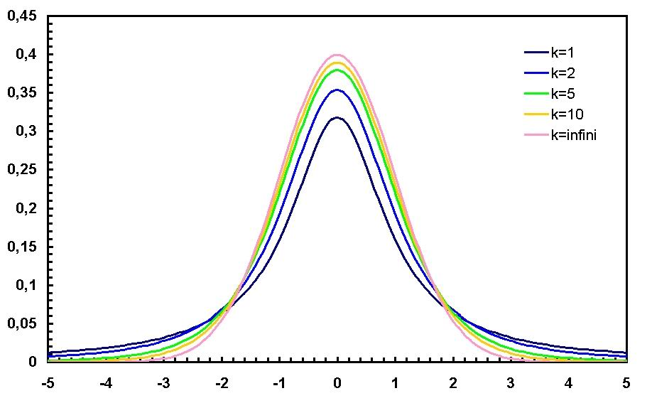
The t Distribution

Slide 28
Degrees of Freedom
Skewness of sampling distribution of variance decreases as n increases
t will differ from z less as sample size increases
Therefore need to adjust t accordingly
Degrees of Freedom: df = n - 1
t based on df

Slide 29
Testing Hypotheses: μ known σ not known
Called a 1-sample t-test
H₀: μ = 100
H₁: μ ≠ 100 (Two-tailed)
Calculate p (sample mean) = 106 if
μ = 100
Use t-table to look up critical value using degrees of freedom
Compare t_{observed} to t_{critical} and make decision

Slide 30
Using t to Test H₀ → 2-tailed_{α = .05}
Same as z except for s in place of σ.
In our sample of 25, s = 7.78
With α = .05, df=24, 2-tailed
t_{critical} = _____ (Table D.6; see next slide)
Since ____ > ____ reject H₀

Slide 31
t Distribution

Slide 32
Using t to Test H₀ → 1-tailed_{α =} _{.05}
H₀: μ ≤ 100
H₁: μ > 100 (One-tailed)
The t_{observed} value is the same → _____
With α = .05, df=24, 1-tailed t_{critical} = ____ (Table D.6; see next slide)
Since _____ > _____ reject H₀

Slide 33
t Distribution

Slide 34
Conclusions
With n = 25, t_{observed}(24) = _____
Because _____ is larger than both _____ (1-tailed) and _____ (2-tailed) we reject H₀ under both 1- and 2-tailed hypotheses
Conclude that taking IQPLUS leads to a higher IQ than normal.

Slide 35
Factors Affecting…
t test
  Difference between sample and population means
  Magnitude of sample variance
  Sample size
Decision
  Significance level α
  One-tailed versus two-tailed test

Slide 36
Size of the Effect
We know that the difference is significant.
  That doesn’t mean that it is important.
Population mean = 100, Sample mean = 106
Difference is 6 words or roughly a 6% increase.
Is this large?

Slide 37
Effect Size
Later we develop this more in terms of standard deviations.
For Example:
  In our sample s = 7.78
  over 3/4 of a standard deviation

Slide 38
Confidence Intervals on Mean
Sample mean is a point estimate
We want interval estimate
Given the sample mean we can calculate an interval that has a probability of containing the population mean
This can be done if σ is known or not

Slide 39
Confidence Intervals on Mean
If σ is known than the 95% CI is
If σ is not known than the 95% CI is

Slide 40
For Our Data
Assuming σ known

Slide 41
For Our Data
Assuming σ not known

Slide 42
Confidence Interval
Neither interval includes 100 - the population mean of IQ
Consistent with result of t test.
Confidence interval and effect size tell us about the magnitude of the effect.
What else can we conclude from confidence interval?

