Slide 1
Sampling Distributions and Hypothesis Testing
Cal State Northridge
Ψ320
Ainsworth

Slide 2
Major Points
Sampling distribution – What are they?
Hypothesis testing
  The null hypothesis
  Test statistics and their distributions
  The normal distribution and testing
Some other Important concepts

Slide 3
Hypothetical Study on Intelligence
Can we create a pill that when taken regularly (like a vitamin) increases intelligence?
A group of 25 participants are given 30mg of IQPLUS everyday for ten days
At the end of 10 days the 25 participants are given the Stanford-Binet intelligence test.

Slide 4
IQPLUS: Results
The mean IQ score of the 25 participants is 106 (the average score for IQ in the population is 100)
Is this increase large enough to conclude that IQPLUS was affective in increasing the participants IQ?

Slide 5
What is the REAL Question?
Is the difference between 106 and 100 large enough to lead us to conclude that it is a real difference?
  Would we expect a similar kind of difference with a repeat of this experiment?
    Or...
  Is the difference due to something called “sampling error”?

Slide 6
Sampling Error
AKA sampling variation
The normal variability that we would expect to find from one sample to another, or one study to another
Random variability among observations or statistics that is just due to chance

Slide 7
How Could we Assess Sampling Error?
Take many groups of 25 participants who did not get IQPLUS.
Record the average IQ score for each group.
Plot the distribution and record its mean and standard deviation.
This distribution is called a “Sampling Distribution.”

Slide 8
Sampling Distribution
The distribution of a statistic over repeated sampling from a specified population.
Possible result for this example.
  See next slide.
  Shows the kinds of means we expect to find when people don’t take IQPLUS.

Slide 9
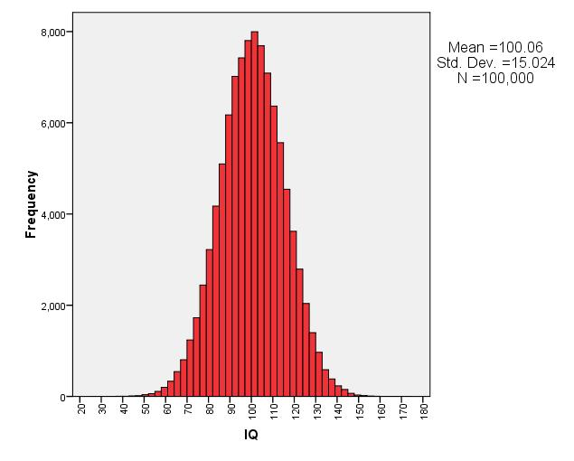
Population Distribution

Slide 10
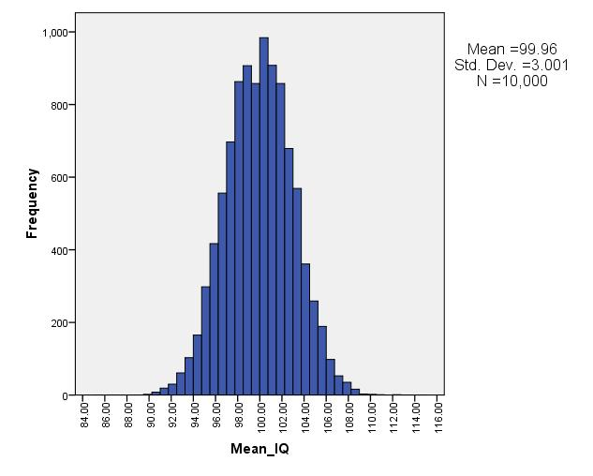
Population Distribution

Slide 11
What Do We Conclude?
When people don’t get IQPLUS the majority of sample means fall between 96 and 104
Our IQPLUS group had an average IQ score of 106
  Our subjects’ responses were not like normal.
Conclude that IQPLUS increased intelligence

Slide 12
Sampling Distribution
Central Tendency
  “typical value”
  Usually estimates the population parameter
  The mean is the mean of the means
Dispersion - Standard Error
  “variability”
  The SD of a sampling distribution is called the Standard Error (SE)
Shape - depends upon the statistic and the assumptions

Slide 13
Hypothesis Testing
A formal way of doing what we just did
Start with hypothesis that subjects are normal.
  The null hypothesis
Find what normal subjects do.
Compare our subjects to that standard.

Slide 14
Steps in Hypothesis Testing
Define the null hypothesis.
Decide what you would expect to find if the null hypothesis were true.
Look at what you actually found.
Reject the null if what you found is not what you expected.

Slide 15
Hypothesis Testing Steps
State Null Hypothesis (H₀)
Alternative Hypothesis (H₁)
Decide on α (usually .05)
Decide on type of test
Find critical value & state decision rule
Calculate test
Apply decision rule

Slide 16
H₀ and H₁
Always stated in terms of population parameters, never sample statistics.
Together, define the entire range of possibilities.
H₀: µ = 0
H₁: µ ≠ 0

Slide 17
The Null Hypothesis
The hypothesis that our subjects came from a population of normal responders.
The hypothesis that taking IQPLUS has no affect on intelligence.
The hypothesis we usually want to reject.

Slide 18
The Null Hypothesis
Specifies a single value (has the equals sign in it somewhere)
Says:
  “Nothing happened.”
  “There’s no difference.”
  “Chance is a good explanation for your results.”
  “Your sample statistic doesn’t differ from your hypothesized population parameter.”

Slide 19
The Research Hypothesis
Also known as the “alternative hypothesis”
Always specifies a range of values (has an inequality in it somewhere)
Says,
  “Something happened.”
  “There is a difference.”
  “Chance is not a good explanation for your results.”
  “Your sample statistic differs ‘significantly’ from your hypothesized population parameter.”

Slide 20
Important Concepts
Concepts critical to hypothesis testing
  It’s all probability
  Decision
  Type I error
  Type II error
  Critical values
  One- and two-tailed tests

Slide 21
Probability Statement
The Unsettling Part to it all
YOU decide on the odds for casting your decision in favor of H₀ or H₁.
Even after you decide, you’re still never certain if you made the right decision.
All your choices are based upon probability distributions (sampling distributions).
Nothing is ever proved!!

Slide 22
Decisions
When we test a hypothesis we draw a conclusion; either correct or incorrect.
  Type I error
    Reject the null hypothesis when it is actually correct.
  Type II error
    Retain the null hypothesis when it is actually false.

Slide 23
Type I Errors
Assume IQPLUS really has no effect on intelligence
Assume we conclude that IQPLUS does work.
This is a Type I error
  Probability set at alpha (α)
    α usually at .05
  Therefore, probability of Type I error = .05

Slide 24
Type II Errors
Assume IQPLUS makes a difference
Assume that we conclude it doesn’t
This is also an error (Type II)
  Probability denoted beta (β)
    We can’t set beta easily.
    We’ll talk about this issue later.
Power = (1 - β) = probability of correctly rejecting false null hypothesis.

Slide 25
Confusion Matrix

Slide 26
Critical Values
These represent the point at which we decide to reject null hypothesis.
e.g. We might decide to reject null when (p|null) < .05.
  Our test statistic has some value with p = .05
  We reject when we exceed that value.
  That value is the critical value.

Slide 27
One- and Two-Tailed Tests
Two-tailed test rejects null when obtained value too extreme in either direction
  Decide on this before collecting data.
One-tailed test rejects null if obtained value is too low (or too high)
  We only set aside one direction for rejection.

Slide 28
One- & Two-Tailed Example
One-tailed test
  Reject null if IQPLUS group shows an increase in IQ
    Probably wouldn’t expect a reduction and therefore no point guarding against it.
Two-tailed test
  Reject null if IQPLUS group has a mean that is substantially higher or lower.

Slide 29
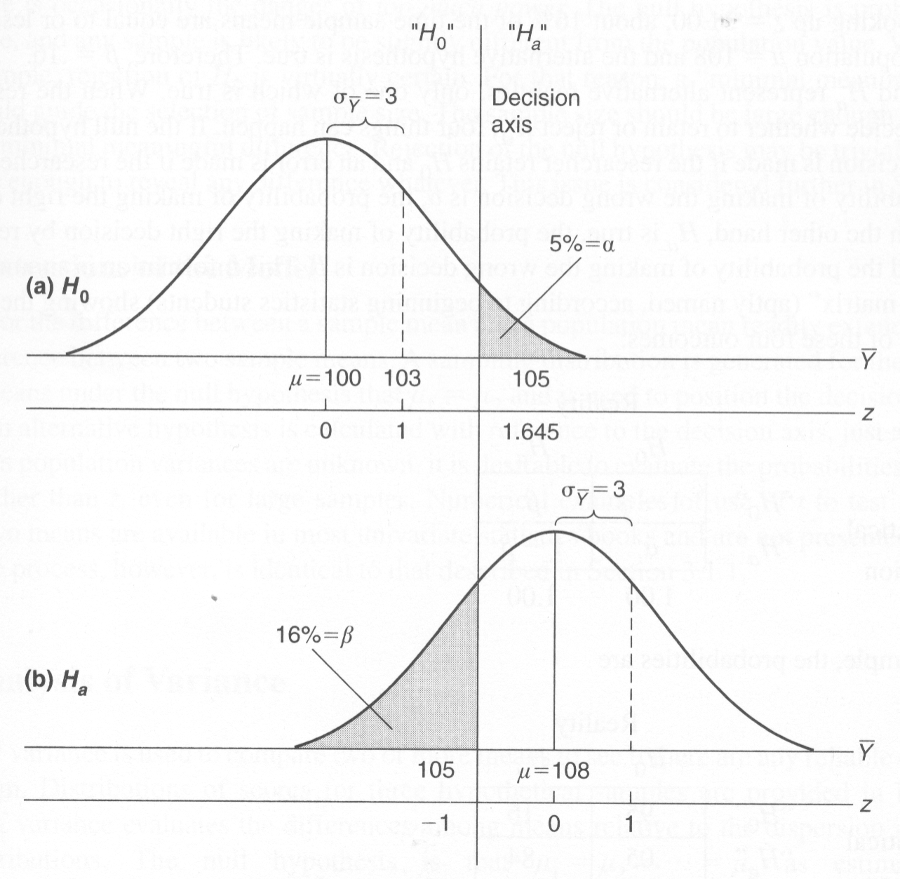
Hypothesis Testing and Z

Slide 30
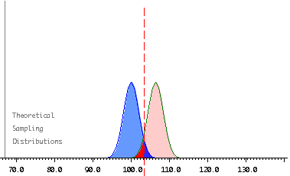
1-tailed example (α = .05)
All 5% in one tail
h₀: μ = 100
h₁: μ = 106
(1.64 * 2) + 100 = 103.28

Slide 31
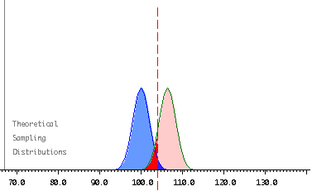
2-tailed example (α = .05)
5% split into 2 tails
(2.5% in each tail)
h₀: μ = 100
h₁: μ = 106
103.92

