Slide 1
The Normal Distribution
Cal State Northridge
Ψ320
Andrew Ainsworth PhD

Slide 2
The standard deviation
Benefits:
  Uses measure of central tendency (i.e. mean)
  Uses all of the data points
  Has a special relationship with the normal curve
  Can be used in further calculations

Slide 3
Example: The Mean = 100 and the Standard Deviation = 20

Slide 4
Normal Distribution (Characteristics)
Horizontal Axis = possible X values
Vertical Axis = density (i.e. f(X) related to probability or proportion)
Defined as
The distribution relies on only the mean and s

Slide 5
Normal Distribution (Characteristics)
Bell shaped, symmetrical, unimodal
Mean, median, mode all equal
No real distribution is perfectly normal
But, many distributions are approximately normal, so normal curve statistics apply
Normal curve statistics underlie procedures in most inferential statistics.

Slide 6
Normal Distribution
μ
μ − 4sd
μ − 3sd
μ − 2sd
μ − 1sd
μ + 1sd
μ + 2sd
μ + 3sd
μ + 4sd

Slide 7
The standard normal distribution
What happens if we subtract the mean from all scores?
What happens if we divide all scores by the standard deviation?
What happens when we do both???

Slide 8
-mean -80 -60 -40 -20 0 20 40 60 80
/sd 1 2 3 4 5 6 7 8 9
both -4 -3 -2 -1 0 1 2 3 4

Slide 9
The standard normal distribution
A normal distribution with the added properties that the mean = 0 and the s = 1
Converting a distribution into a standard normal means converting raw scores into Z-scores

Slide 10
Z-Scores
Indicate how many standard deviations a score is away from the mean.
Two components:
  Sign: positive (above the mean) or negative (below the mean).
  Magnitude: how far from the mean the score falls

Slide 11
Z-Score Formula
Raw score → Z-score
Z-score → Raw score

Slide 12
Properties of Z-Scores
Z-score indicates how many SD’s a score falls above or below the mean.
Positive z-scores are above the mean.
Negative z-scores are below the mean.
Area under curve → probability
Z is continuous so can only compute probability for range of values

Slide 13
Properties of Z-Scores
Most z-scores fall between -3 and +3 because scores beyond 3sd from the mean
Z-scores are standardized scores → allows for easy comparison of distributions

Slide 14
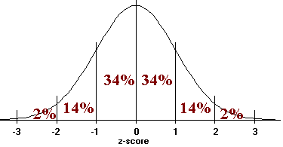
The standard normal distribution
Rough estimates of the SND (i.e. Z-scores):

Slide 15
The standard normal distribution
Rough estimates of the SND (i.e. Z-scores):
50% above Z = 0, 50% below Z = 0
34% between Z = 0 and Z = 1,
or between Z = 0 and Z = -1
68% between Z = -1 and Z = +1
96% between Z = -2 and Z = +2
99% between Z = -3 and Z = +3

Slide 16
Normal Curve - Area
In any distribution, the percentage of the area in a given portion is equal to the percent of scores in that portion
  Since 68% of the area falls between ±1 SD of a normal curve
  68% of the scores in a normal curve fall between ±1 SD of the mean

Slide 17
Rough Estimating
Example: Consider a test (X) with a mean of 50 and a S = 10, S² = 100
At what raw score do 84% of examinees score below?
30 40 50 60 70

Slide 18
Rough Estimating
Example: Consider a test (X) with a mean of 50 and a S = 10, S² = 100
What percentage of examinees score greater than 60?
30 40 50 60 70

Slide 19
Rough Estimating
Example: Consider a test (X) with a mean of 50 and a S = 10, S2 = 100
What percentage of examinees score between 40 and 60?
30 40 50 60 70

Slide 20
Have→Need Chart
When rough estimating isn’t enough

Slide 21
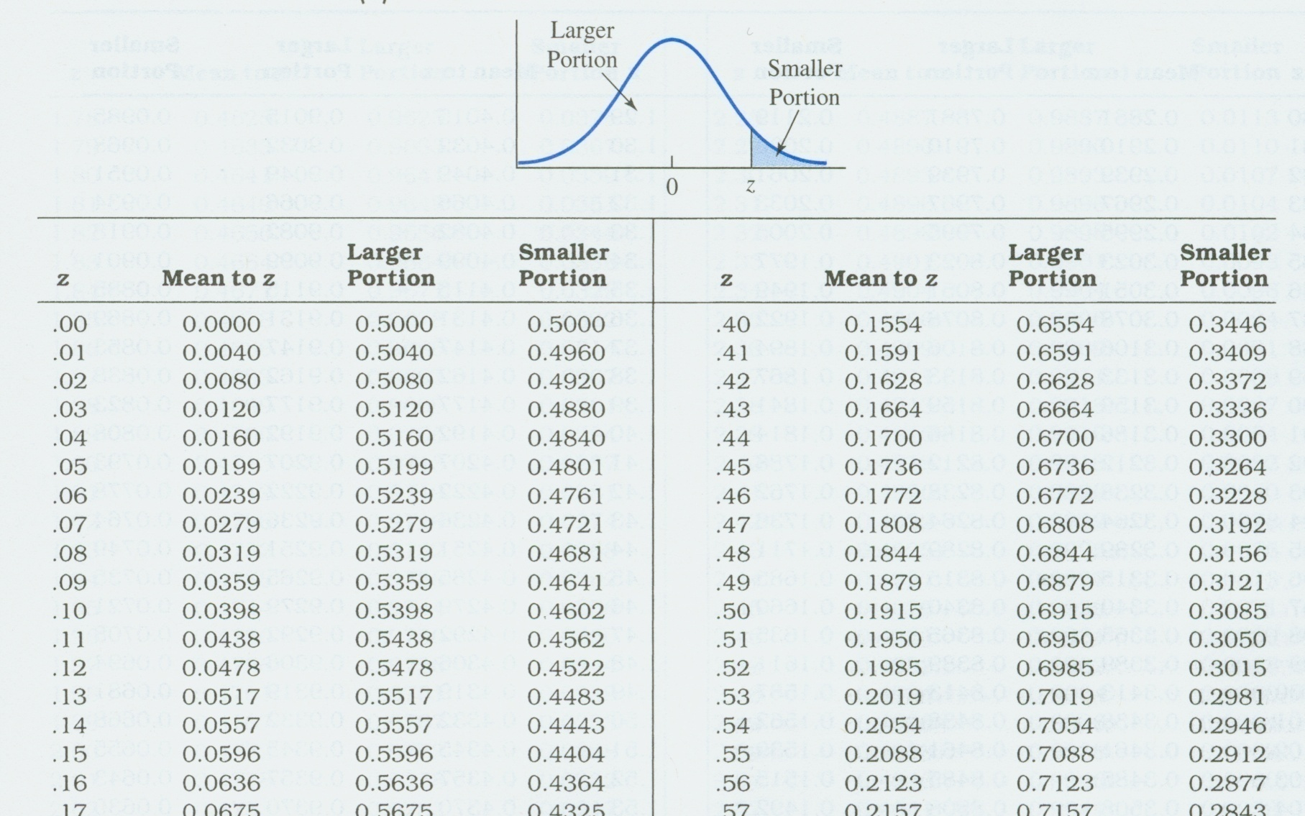
Table D.10

Slide 22
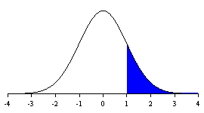
Smaller vs. Larger Portion
Smaller Portion is .1587
Larger Portion is .8413

Slide 23
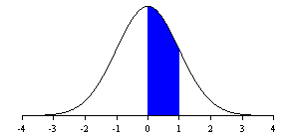
From Mean to Z
Area From Mean to Z is .3413

Slide 24
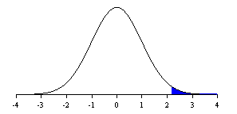
Beyond Z
Area beyond a Z of 2.16 is .0154

Slide 25
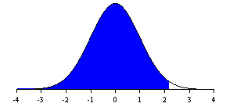
Below Z
Area below a Z of 2.16 is .9846

Slide 26
What about negative Z values?
Since the normal curve is symmetric, areas beyond, between, and below positive z scores are identical to areas beyond, between, and below negative z scores.
There is no such thing as negative area!

Slide 27
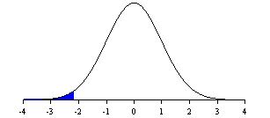
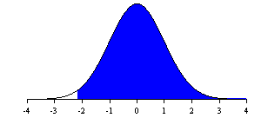
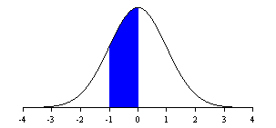
What about negative Z values?
Area below a Z of -2.16 is .0154
Area above a Z of -2.16 is .9846
Area From Mean to Z is also .3413

Slide 28
Keep in mind that…
total area under the curve is 100%.
area above or below the mean is 50%.
your numbers should make sense.
  Does your area make sense? Does it seem too big/small??

Slide 29
Tips to remember!!!
Always draw a picture first
Percent of area above a negative or below a positive z score is the “larger portion”.
Percent of area below a negative or above a positive z score is the “smaller portion”.
Always draw a picture first!

Slide 30
Tips to remember!!!
Always draw a picture first!!
Percent of area between two positive or two negative z-scores is the difference of the two “mean to z” areas.
Always draw a picture first!!!

Slide 31
Converting and finding area
Table D.10 gives areas under a standard normal curve.
If you have normally distributed scores, but not z scores, convert first.
Then draw a picture with z scores and raw scores.
Then find the areas using the z scores.

Slide 32
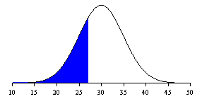
Example #1
In a normal curve with mean = 30, s = 5, what is the proportion of scores below 27?
Smaller portion of a Z of .6 is .2743
Mean to Z equals .2257 and
.5 - .2257 = .2743
Portion ≅ 27%
-4 -3 -2 -1 0 1 2 3 4
27

Slide 33
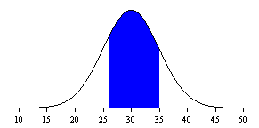
Example #2
In a normal curve with mean = 30, s = 5, what is the proportion of scores fall between 26 and 35?
.2881
.3413
Mean to a Z of .8 is .2881
Mean to a Z of 1 is .3413
.2881 + .3413 = .6294
Portion = 62.94% or ≅ 63%
-4 -3 -2 -1 0 1 2 3 4
26

Slide 34
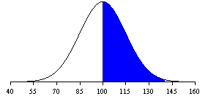
Example #3
The Stanford-Binet has a mean of 100 and a SD of 15, how many people (out of 1000 ) have IQs between 120 and 140?
.4082
Mean to a Z of 2.66 is .4961
Mean to a Z of 1.33 is .4082
.4961 - .4082 = .0879
Portion = 8.79% or ≅ 9%
.0879 * 1000 = 87.9 or ≅ 88 people
←.4961→
-4 -3 -2 -1 0 1 2 3 4
120
140

Slide 35
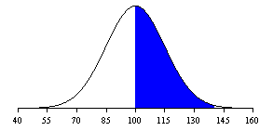
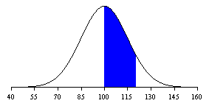
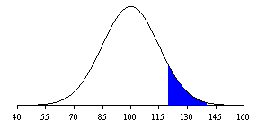
When the numbers are on the same side of the mean: subtract
-
=

Slide 36
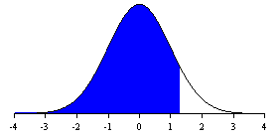
Example #4
The Stanford-Binet has a mean of 100 and a SD of 15, what would you need to score to be higher than 90% of scores?
In table D.10 the closest area to 90% is .8997 which corresponds to a Z of 1.28
IQ = Z(15) + 100
IQ = 1.28(15) + 100 = 119.2
90%
40 55 70 85 100 115 130 145 160

