Slide 1
Measures of Variability
Descriptive Statistics Part 2
Cal State Northridge
Ψ320
Andrew Ainsworth PhD

Slide 2
Reducing Distributions
Regardless of numbers of scores, distributions can be described with three pieces of info:
  Shape (Normal, Skewed, etc.)
  Central Tendency
  Variability

Slide 3
How do scores spread out?
Variability
  Tell us how far scores spread out
  Tells us how the degree to which scores deviate from the central tendency

Slide 4
How are these different?
Mean = 10
Mean = 10

Slide 5
Measure of Variability

Slide 6
The Range
The simplest measure of variability
  Range (R) = X_{highest} – X_{lowest}
  Advantage – Easy to Calculate
  Disadvantages
    Like Median, only dependent on two scores → unstable
  {0, 8, 9, 9, 11, 53} Range = 53
  {0, 8, 9, 9, 11, 11} Range = 11
    Does not reflect all scores

Slide 7
Detour: Percentile
A percentile is the score at which a specified percentage of scores in a distribution fall below
  To say a score 53 is in the 75th percentile is to say that 75% of all scores are less than 53
The percentile rank of a score indicates the percentage of scores in the distribution that fall at or below that score.
  Thus, for example, to say that the percentile rank of 53 is 75, is to say that 75% of the scores on the exam are less than 53.

Slide 8
Detour: Percentile
Scores which divide distributions into specific proportions
  Percentiles = hundredths
P1, P2, P3, … P97, P98, P99
  Quartiles = quarters
  Q1, Q2, Q3
  Deciles = tenths
  D1, D2, D3, D4, D5, D6, D7, D8, D9
Percentiles are the SCORES

Slide 9
Detour: Percentile Ranks
What percent of the scores fall below a particular score?
Percentile Ranks are the Ranks not the scores

Slide 10
Detour: Percentile Rank
Ranking no ties – just number them
Ranking with ties - assign midpoint to ties

Slide 11
Steps to Calculating Percentile Ranks
Example:

Slide 12
Detour: Finding a Percentile in a Distribution
Where X_{P} is the score at the desired percentile, p is the desired percentile (a number between 0 and 1) and n is the number of scores)
If the number is an integer, than the desired percentile is that number
If the number is not an integer than you can either round or interpolate

Slide 13
Detour: Interpolation Method Steps
Apply the formula
  You’ll get a number like 7.5 (think of it as place1.proportion)
  Start with the value indicated by place1 (e.g. 7.5, start with the value in the 7th place)
  Find place2 which is the next highest place number (e.g. the 8th place) and subtract the value in place1 from the value in place2, this distance1
  Multiple the proportion number by the distance1 value, this is distance2
  Add distance2 to the value in place1 and that is the interpolated value

Slide 14
Detour: Finding a Percentile in a Distribution
Interpolation Method Example:
25th percentile:
{1, 4, 9, 16, 25, 36, 49, 64, 81}
X₂₅ = (.25)(9+1) = 2.5
  place1 = 2, proportion = .5
  Value in place1 = 4
  Value in place2 = 9
  distance1 = 9 – 4 = 5
  distance2 = 5 * .5 = 2.5
  Interpolated value = 4 + 2.5 = 6.5
  6.5 is the 25th percentile

Slide 15
Detour: Finding a Percentile in a Distribution
Interpolation Method Example 2:
75th percentile
{1, 4, 9, 16, 25, 36, 49, 64, 81}
X₇₅ = (.75)(9+1) = 7.5
  place1 = 7, proportion = .5
  Value in place1 = 49
  Value in place2 = 64
  distance1 = 64 – 49 = 15
  distance2 = 15 * .5 = 7.5
  Interpolated value = 49 + 7.5 = 56.5
  56.5 is the 75th percentile

Slide 16
Detour: Rounding Method Steps
Apply the formula
  You’ll get a number like 7.5 (think of it as place1.proportion)
  If the proportion value is any value other than exactly .5 round normally
  If the proportion value is exactly .5
    And the p value you’re looking for is above .5 round down (e.g. if p is .75 and X_{p} = 7.5 round down to 7)
    And the p value you’re looking for is below .5 round up (e.g. if p is .25 and X_{p} = 2.5 round up to 3)

Slide 17
Detour: Finding a Percentile in a Distribution
Rounding Method Example:
25th percentile
{1, 4, 9, 16, 25, 36, 49, 64, 81}
X₂₅ = (.25)(9+1) = 2.5 (which becomes 3 after rounding up),
The 3rd score is 9, so 9 is the 25th percentile

Slide 18
Detour: Finding a Percentile in a Distribution
Rounding Method Example 2:
75th percentile
{1, 4, 9, 16, 25, 36, 49, 64, 81}
X₇₅ = (.75)(9+1) = 7.5 which becomes 7 after rounding down
The 7th score is 49 so 49 is the 75th percentile

Slide 19
Detour: Quartiles
To calculate Quartiles you simply find the scores the correspond to the 25, 50 and 75 percentiles.
Q₁ = P₂₅, Q₂ = P₅₀, Q₃ = P₇₅

Slide 20
Back to Variability: IQR
Interquartile Range
  = P₇₅ – P₂₅ or Q₃ – Q₁
  This helps to get a range that is not influenced by the extreme high and low scores
  Where the range is the spread across 100% of the scores, the IQR is the spread across the middle 50%

Slide 21
Variability: SIQR
Semi-interquartile range
  =(P₇₅ – P₂₅)/2 or (Q₃ – Q₁)/2
  IQR/2
  This is the spread of the middle 25% of the data
  The average distance of Q1 and Q3 from the median
  Better for skewed data

Slide 22
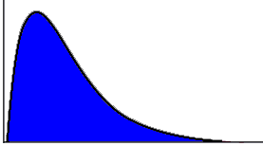
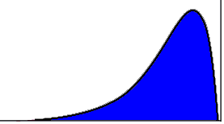
Variability: SIQR
Semi-Interquartile range
Q₁ Q₂ Q₃
Q₁ Q₂ Q₃

Slide 23
Average Absolute Deviation
Average distance of all scores from the mean disregarding direction.

Slide 24
Average Absolute Deviation

Slide 25
Average Absolute Deviation
Advantages
  Uses all scores
  Calculations based on a measure of central tendency - the mean.
Disadvantages
  Uses absolute values, disregards direction
  Discards information
Cannot be used for further calculations

Slide 26
Variance
The average squared distance of each score from the mean
Also known as the mean square
Variance of a sample: s²
Variance of a population: σ²

Slide 27
Variance
When calculated for a sample
When calculated for the entire population

Slide 28
Variance
Variance Example
  Data set = {8, 6, 4, 2}
  Step 1: Find the Mean

Slide 29
Variance
Variance Example
  Data set = {8, 6, 4, 2}
  Step 2: Subtract mean from each value

Slide 30
Variance
Variance Example
  Data set = {8, 6, 4, 2}
  Step 3: Square each deviation

Slide 31
Variance
Variance Example
  Data set = {8, 6, 4, 2}
  Step 4: Add the squared deviations and divide by N - 1

Slide 32
Standard Deviation
Variance is in squared units
What about regular old units
Standard Deviation = Square root of the variance

Slide 33
Standard Deviation
Uses measure of central tendency (i.e. mean)
Uses all data points
Has a special relationship with the normal curve (we’ll see this soon)
Can be used in further calculations
Standard Deviation of Sample = SD or s
Standard Deviation of Population = σ

Slide 34
Why N-1?
When using a sample (which we always do) we want a statistic that is the best estimate of the parameter

Slide 35
Degrees of Freedom
Usually referred to as df
Number of observations minus the number of restrictions
__+__+__+__=10 - 4 free spaces
2 +__+__+__=10 - 3 free spaces
2 + 4 +__+__=10 - 2 free spaces
2 + 4 + 3 +__=10
Last space is not free!! Only 3 dfs.

Slide 36
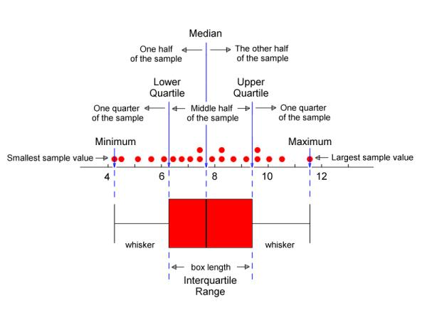
Boxplots

Slide 37
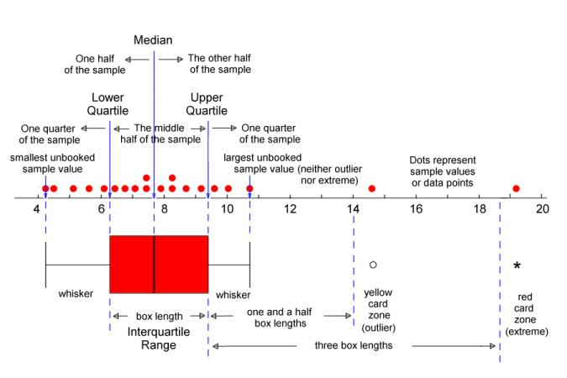
Boxplots with Outliers

Slide 38
Computational Formulas
Algebraic Equivalents that are easier to calculate

