Slide 1
Measures of
Central Tendency
Descriptive Statistics Part 1
Cal State Northridge
Ψ320
Andrew Ainsworth PhD

Slide 2
What is a typical score like?
There are three indices of this central tendency:
  Mode
  Median
  Mean

Slide 3
Measures of Central Tendency

Slide 4
The Mode
Mode: most common (frequent) number
Peak of distribution
Always an observed score
With grouped data is merely the midpoint of the most frequent measurement class.
Thus, if a case were drawn at random from the distribution, that case is more likely to fall in the modal class than any other.
  Important interpretation

Slide 5
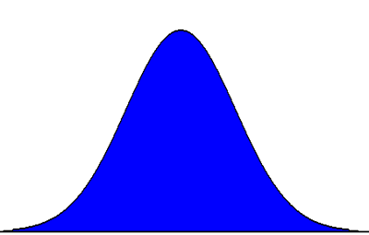
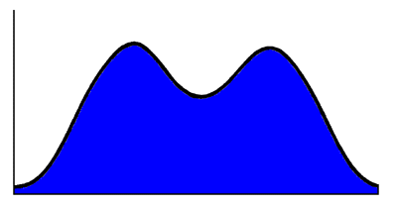
How to find the mode?
One Mode
Two Modes

Slide 6
Problems with the Mode
However, there are three disadvantages with the mode:
  Multiple modes (especially with grouped data)
  The mode is very sensitive to the size and number of class intervals (different intervals = different modes)
  The mode of a sample undependable when estimated population

Slide 7
The Median
Median: middle of distribution (50th percentile)
Not applicable to nominal data; ordinal, interval & ratio data only
Is considerably less sensitive when grouping into class intervals.
More useful for making inferences (although not the best)
Not affected by outliers.

Slide 8
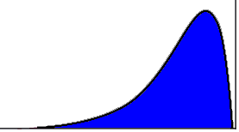
Median
Median
Balancing Point

Slide 9
Median
The median requires 1 or 2 pieces of information
If there are an odd number of scores the median is the center score
If there is an even number the median is midpoint between the two middle numbers

Slide 10
Median
Examples
  Data Set 1: {7, 2, 9, 3, 4, 5, 8}
    Ordered: ________________
    Median = _______
  Data Set 2: {11, 15, 10, 9, 5, 13, 12}
    Ordered: _____________________
    Median = _______

Slide 11
Median
Data set 1: {12, 9, 8, 5, 3, 2}
Data set 2: {77, 50, 8, 5, 5, 5}
Example: In a six-score set of data the only scores that matter when calculating the median are the two middle scores
The rest of the data is ignored
Because of this the median is not sensitive to outlying scores

Slide 12
Median
The average absolute deviation is smallest when taken from the median.

Slide 13
The Mean
Only used for interval & ratio data.
Major advantages:
  The sample value is a very good estimate of the population value.
  Mean of the sample =
  Mean of the population =

Slide 14
The Mean
Example
  Data Set: {3, 4, 6, 10}
  Formula:

Slide 15
The Mean and Deviations
For the mean the following is always true.
  *When compared to the other 2 measures of central tendency

Slide 16
Mean: Demonstration
Since

Slide 17
The Mean
Mental Note: If the mean is guessed as the value of any case drawn at random from a distribution, on average the amount of signed error will be 0.
  This is a most important interpretation of the mean and why it’s so most often!
Disadvantage
  Highly affected by outliers

Slide 18
The Influence of Outliers

Slide 19
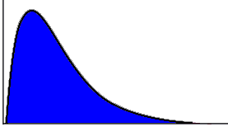
Mode, Mean and Median
Positively Skewed Distribution
Mode Median Mean

Slide 20
Mode, Mean and Median
Negatively Skewed Distribution
Mean Median Mode

Slide 21
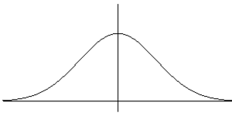
Mode = median = mean?
When the distribution is symmetric
Mean
Median
Mode

Slide 22
The mean vs. the median
The degree of discrepancy between them indicates the skewness of the data
The closer the two values are the more symmetric the data

