Slide 1

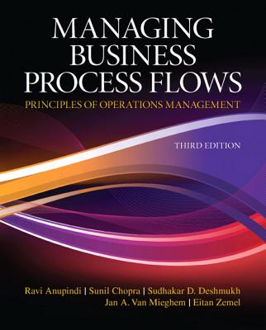
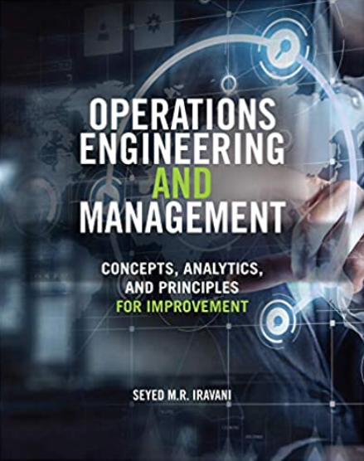
Waiting Line Analysis
These slides have been developed on the foundations provided by the following books.
Ardavan Asef-Vaziri

Slide 2
Make to Stock (MTS) vs. Make to Order (MTO)
Made-to-stock (MTS) operations. Product is manufactured and stocked in advance. Safety inventory protects against stockouts due to variability of arrival time and processing time. Inventory also permits economies of scale.
  Make-to-order (MTO) operations. Each order is specific, cannot be stored in advance. Ex. banks, restaurants, retail checkout counters, airline reservation, hospitals , repair shops, call centres. Production systems also try to follow Dell Computer model. We needs to maintain sufficient capacity to deal with uncertainty in both arrival and processing time. Safety Capacity vs. Safety Inventory.
  The Psychology of Waiting Lines
  Pre-process waits feels longer than in-process waits.
  Uncertain waits are longer than known, finite waits.
  Unexplained waits are longer than explained waits.
  Long waits feel shorter for more valuable services.
  Unfair waits are longer than equitable waits.
  Solo waiting feels longer than group waiting.

Slide 3
Queues Exist in all Business Processes
Waiting lines are everywhere in business processes
– Jobs waiting in workstation to be processed
– Broken machines in factories wait for repair crew
– Parcels are waiting in warehouses to be shipped
– Customers wait in emergency departments to see a doctor
– Airplanes wait in line for takeoff
– Files in computer systems wait for processing
– … waiting lines are every where in business processes
Both customers and managers do not like long waiting line and long waiting times (i.e., flow times)
Question: Why do waiting lines exist?

Slide 4
A Single Station Waiting Line- A Call Centre
A Call Centre Process
R
R
Sales Reps
Processing
Calls
(Service Process)
Incoming Calls
(Customer Arrivals)
Answered Calls
(Customer Departures)
Calls
on Hold
(Service Inventory)
Flow time T = Ti + Tp
Inventory I = Ii + Ip
Ti: waiting time in the inflow buffer.
Ii: number of customers in the inflow buffer.

Slide 5
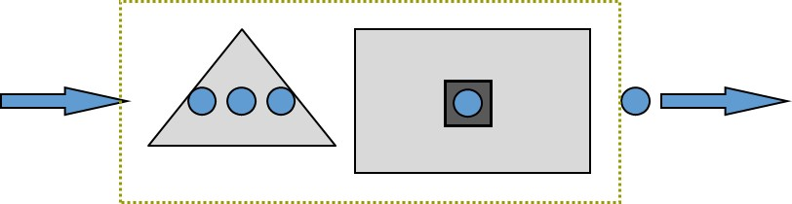
Single Station Process
Tp : Activity processing time or Resource unit load. It is stated in terms of units of time. Ex. on average it takes 5 minutes to serve a customer, Tp=5.
Rp : Capacity or processing rate. This many flow units are handled per unit of time.
Processing time is Tp=5 mins. What is capacity Rp?
For one processor Rp =1/Tp
Rp=1/Tp= 1/5 per minute.
Why per minute? Because Tp was in minute.
Rp=60(1/5) = 12 per hour

Slide 6
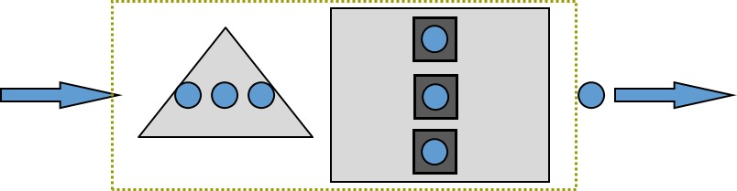
AVERAGE Processing Time Tp & AVERAGE Processing Rate Rp
For one resource unit, Rp =1/Tp
For c resource units c(1/Tp)= c/Tp
If Tp is 5 minutes, and there are three resource units, compute Rp for the resource pool.
Tp = 5 minutes. Capacity of each processor is 1/5 per minutes.
Since we have c = 3 servers, capacity is 3(1/5)=3/5 per minute or 36 per hour. .
Rp = c/Tp
Ta : customer inter-arrival time.
Example. On average each 10 minutes one customer arrives.
Ra: customer arrival (inflow) rate. That is customer demand.
What is the relationship between Ta and Ra?
How many customers in a minute? Ra= 1/Ta= 1/10 customer per minute.

Slide 7
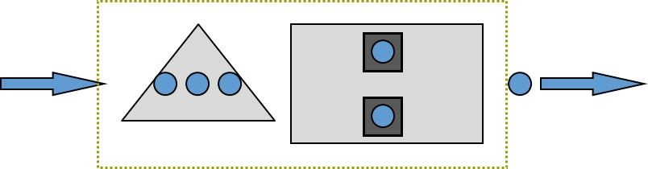
Inter-arrival Time (Ta) and Arrival Rate (Ra)
Ra = 1/10 customers per min; 6 customers per hour ➔ Ta= 1/Ra=1/6 hour.
Ra <= Rp.
We will show later that even Ra = Rp is not possible.
Incoming rate must be less than processing rate.
Throughput = Flow Rate R = Min (Ra, Rp) .
Stable Process = Ra< Rp ➔ R = Ra
Utilization = inflow-rate/processing-rate = throughout/capacity
Utilization = U = R/ Rp < 1
Safety Capacity = Rs = Rp – Ra
Given a single server, R = 6 per hour, processing time for a single server is 5 min ➔ Rp= 12 per hour,
U = R/ Rp = 6/12 = 0.5
Rs = Rp – R = 12-6 = 6

Slide 8
The Relationship Between U and Ip
How many flow units are in the server ?
U = 0.5 means 50% of time there is 1 flow unit in the server, 50% of time there is 0 flow unit in the server
0.5 × 1 + 0.5 × 0 = 0.5
For one server, average Inventory in the server is equal to utilization
Ip= U = 1U
Given 2 servers, and a utilization of U = 0.3, How many flow units are in the servers ?
U = 0.3 means 30% of time there is 1 flow unit in each server, and 70% of time there is 0 flow unit in each server.
0.3 × 1 + 0.7 × 0 = 0.3 flow unit in each server
Average Inventory in the server is equal to utilization times the number of servers
Ip = cU =2(0.3) = 0.6 flow units with the servers.

Slide 9
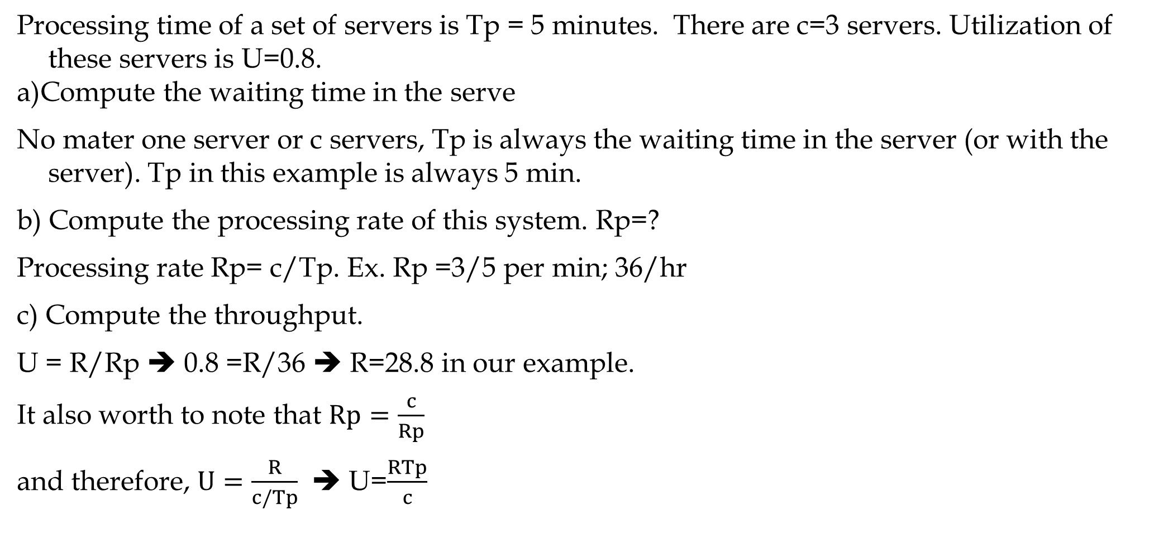
What We Have Learned Without Looking for any Formula
Processing time of a set of servers is Tp = 5 minutes. There are c=3 servers. Utilization of these servers is U=0.8.
a)Compute the waiting time in the serve
No mater one server or c servers, Tp is always the waiting time in the server (or with the server). Tp in this example is always 5 min.
b) Compute the processing rate of this system. Rp=?
Processing rate Rp= c/Tp. Ex. Rp =3/5 per min; 36/hr
c) Compute the throughput.
U = R/Rp ➔ 0.8 =R/36 ➔ R=28.8 in our example.
It also worth to note that $Rp=\frac{c}{Rp}$
and therefore, $U=\frac{R}{c/Tp}$ ➔ U=$\frac{RTp}{c}$

Slide 10
What We Have Learned Without Looking for any Formula
d) On average how many flow units are in these servers?
By using utilization we have Ip= cU.
Ip=3(0.8) = 2.4
By using the Little’s Law, Ip= R×Tp
Ip= 18.8(5/60) = 2.4.
e) What is the average interarrival time?
Ta = 60/28.8 =2.08 minute
f) Compute the number of the flow units in the waiting line (Ii)
g) Compute the time spent in the waiting line (Ii)
h) Compute the number of the flow units in the System I=Ii+Ip
h) Compute the time spent in the system T=Ti+Tp

Slide 11
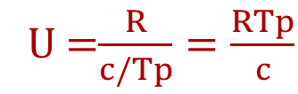
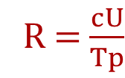
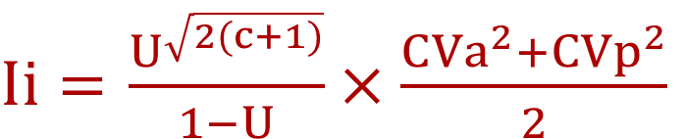
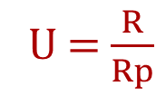
Utilization – Variability - Delay Curve
Ii =
Utilization effect
U-part
Variability effect
V-part
$Ii=$ $\frac{U^{\sqrt{2(c+1)}}}{1−U}×\frac{{CVa}^{2}+{CVp}^{2}}{2}$
U = $\frac{R}{Rp}$
U =$\frac{R}{c/Tp}=\frac{RTp}{c}$
R = $\frac{cU}{Tp}$
Variability in the interarrival time and processing time is measured using standard deviation. Higher standard deviation means greater variability.
Standard deviation is not enough to understand the extend of variability. Does a standard deviation of 20 represents more variability or a standard deviation of 150
for an average of 80
for an average of 1000?
CVa: Coefficients of Variation of Interarrival Time. CV=Standatd Deviation/Mean CVp: Coefficients of Variation of processing Time.
It is assumed that inter-arrival time and processing times are independent.

Slide 12
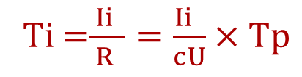


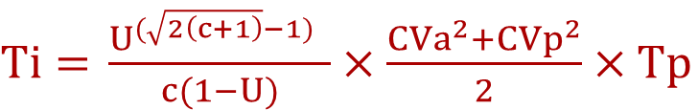
Utilization – Variability - Delay Curve
Ti =$\frac{ Ii }{R }=\frac{Ii }{cU}×Tp$
I
$Ti=$ $\frac{U^{(\sqrt{2\left(c+1\right)}−1)} }{c(1−U)}×\frac{{CVa}^{2}+{CVp}^{2}}{2}×Tp$
Variability
Increases
Ti= U-part×V-part×T-part
Average # of units in the system
In M/M/1
$Ii=$ $\frac{U^{2}}{1−U}$
$Ti=$ $\frac{U }{1−U}×Tp$
Ip= SUM(cU)
Ip= R/ThFT
Utilization
100%
U

Slide 13
Coefficient of Variations for Alternative Distributions
While the capacity is not fully utilized, since U must be less than 1, if there is variability in arrival or in processing times, queues will build up and customers will have to wait.
Tp: average processing time ➔ Rp =c/Tp
Ta: average interarrival time ➔ Ra = 1/Ta
Sp: Standard deviation of the processing time
Sa: Standard deviation of the interarrival time

Slide 14
Queueing Theory—Kendall’s Notation A1/A1/A3/A4/A5/A6
: Correspond to the distribution of inter-arrival times
  Use M if the inter-arrival times are Markovian (i.e., exponential distribution)
  Use D if the inter-arrival times are Deterministic (i.e., no variability)
  Use G if the inter-arrival times has completely General Distribution.
  : Corresponds to the distribution of service times
  Use M if the processing times are Markovian (i.e., exponential distribution)
  Use D if the processing times are Deterministic (i.e., no variability)
  Use G if the processing times has completely General Distribution.
: Corresponds to the number of servers (can be any number between 1 to infinity)
: Corresponds to the system size (can be any number between 1 to infinity. Omit it if no limit.
: Corresponds to the size of customer population (can be any number between 1 to infinity)
: Corresponds to service discipline (can be any of the following: FCFS, LCFS, SIRO, PRIO)

Slide 15
Terminology and Classification of Waiting Lines
M/M/1; Poisson arrival rate, Exponential service times, one server, no capacity limit.
M/G/12/23; Poisson arrival rate, General service times, 12 servers, queue capacity is 23.
Approximation formula gives exact answers for M/M/1 system.
Approximation formula provide good approximations for M/M/2 system.
From Now on, for all computations Regarding M/M/c (including M/M/1), M/G/1 (including M/D/1) and M/M/c/b we use predesigned Excelsheets with Macros.
For other situations, we use the approximation formula.

Slide 16
Problem-1. Utilization and Safety Capacity
Interarrival time is 8 minutes. Processing time is 7.5 minutes. There is only one server.
Both interarrival time and processing time follow Exponential distribution. Compute the performance Measures Tp, Rp, R, U, Rs, Ip, Ii, Ti, I, T.
Also check for c=2. This is M/M/c. Go to the Excel Sheet.
Average utilization rate of server - U | 93.8%
Average number of customers waiting in line Ii | 14.063
Average number of customers in system I | 15.000
Average time waiting in line Ti | 1.875
Average time in system - T | 2.000
Probability of no customers in system (P0) | 0.063
Probability that all servers are busy | 93.8%
Probability that at least one server is idle | 6.3%
46.9%
0.264
1.202
0.035
0.160
0.362
29.9%
70.1%
hour
hour

Slide 17
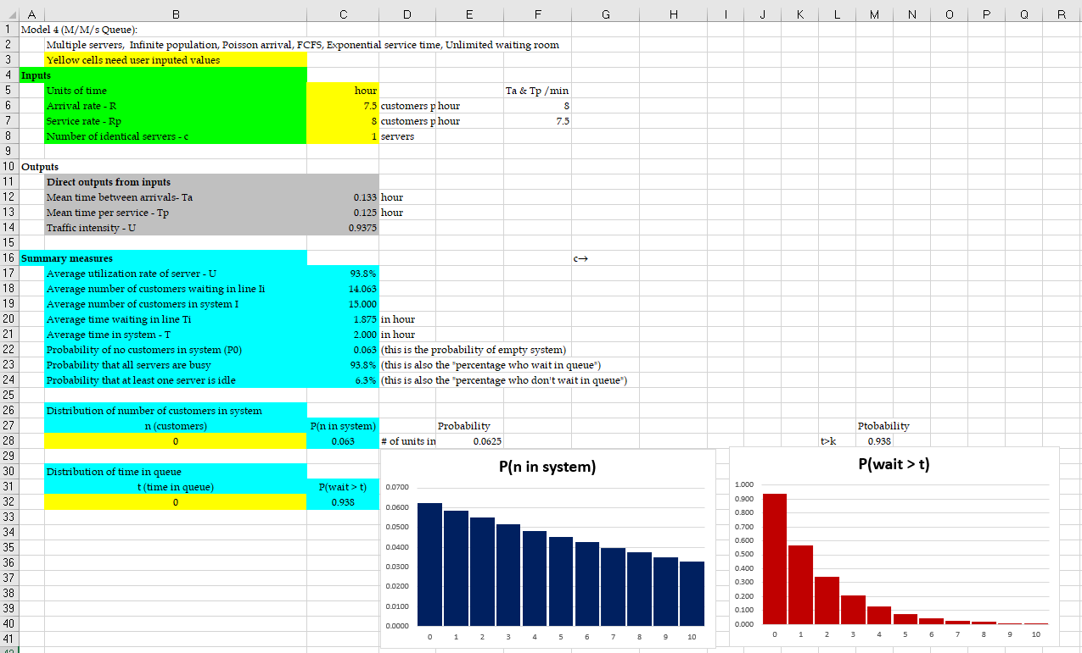
Utilization and Safety Capacity

Slide 18
Problem-2. G/G/c
Consider a call center with 8 agents. Past data collected on the customer inter-arrival times has shown that the mean time between customer arrivals is 1 minute and has a standard deviation of 1/2 minute. The amount of time in minutes the past 10 callers have spent talking to an agent is as follows: 4.1, 6.2, 5.5, 3.5, 3.2, 7.3, 8.4, 6.3, 2.6, 4.9.
  a) What is the coefficient of variation for the inter-arrival times? 0.5.
  b) What is the mean time a caller spends talking to an agent? 5.2 minutes.
  c) What is the standard deviation of the time a caller spends talking to an agent? 1.88 minutes
d) What is the coefficient of variation for the times a caller spends talking to an agent?
  Sp/Tp=0.192.
  e) What is the expected number of callers on hold, waiting to talk to an agent? Ii=0.09.
f) What is the expected number of callers either on hold or talking to an agent?
I = Ii +Ip= 0.09 + 0.65(8) =5.29
g) Compute Ti for R=1, 1.1, 1.2, 1.3, 1.4,1.5 per min. That is 66, 72, 78, 84, 90 per hour.
h) Compute Ti for Sa of 0.5 to 1.5.

Slide 19
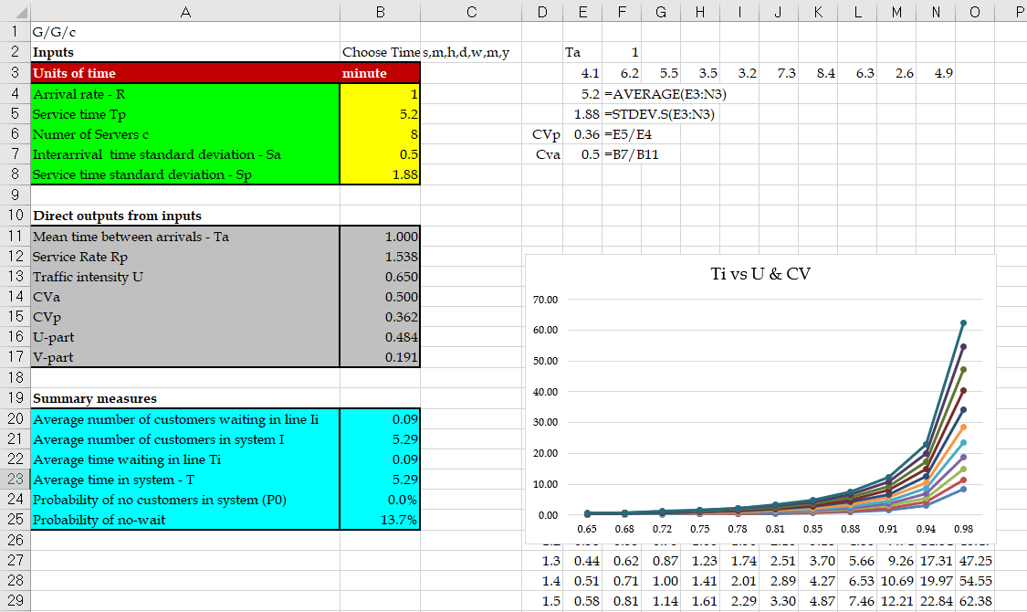
G/G/c & Sensitivity

Slide 20
Impact of Utilization & Variability on Flow Time

Slide 21
Problem-3. M/M/1 Performance Evaluation
Case 1. An airport runway for arrivals only. Arriving aircraft join a single line for the runway. Exponentially distributed service time with a rate 25 arrivals /hour. Poisson arrivals with a rate 18 / hour. Compute Tp, Ip, Ii, Ti, I, and T. Case 2. Now suppose we are in holidays and the arrival rate increases to 21 arrivals/hour. Case 3. Now suppose we have a bad weather, and the service rate decreases 22 landing /hour. Case 4. Now suppose we open a second runway. R=21, Rp=2*25/hr ➔ U= 21/50 = 0.42

Slide 22
Problem-4. Trade-off Analysis, Capacity Cost vs Waiting Cost
Bank of San Pedro has only 1 teller. On average, 1 customer comes every 6 minutes, and it takes the teller an average of 3 minutes to serve a customer. To improve customer satisfaction, the bank is going to implement a unique policy called, “We Pay While You Wait.” Once implemented, the bank will pay each customer $3 per minute while a customer waits in line. (So the clock starts when a customer joins the line and stops when the customer begins to talk to the teller.) Bank of San Pedro hired you as a consultant and you are responsible for estimating how much the “We Pay While You Wait” program will cost. Assume linear cost. If a customer waits for ten seconds in line, Bank of San Pedro will pay $0.5. Assume that arrival follows Poisson and service time follows exponential distribution.
Compute the capacity of the Teller Station.
It takes the teller an average of 3 mins to serve a customer, 60/3 = 20 customers per hr.
b) Compute the proportion of the time the teller is busy.
R=10, Rp= 20 ➔ U= R/Rp= 10/20 = 0.5 ➔ Busy 50%, Idle 50%.
c) Compute key waiting line Metrics.

Slide 23
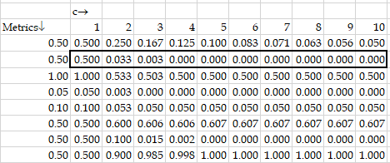
M/M/c - Trade-off Analysis, Capacity Cost vs Waiting Cost
Average utilization rate of server - U
Average number of customers waiting in line Ii
Average number of customers in system I
Average time waiting in line Ti
Average time in system - T
Ii= 0.5
There is 0.5 customers around the clock in the waiting line.
We pay $3 per minute for one customer in the line. That is $3(60) =$180 per hour for one customer in the line.
We have 0.5 customers, that is 0.5($180) = $90 per hour.
It seems you do not believe me.
Let's compute it in an alternative way.

Slide 24
M/M/c - Trade-off Analysis, Capacity Cost vs Waiting Cost
Each customer spends 0.05 hours. Why hour?
Because R and Rp were in hours. 0.5(60)= 3 minutes in the line.
He or she receives, on average, 3(3) =$9. There are 10 customers arriving per hour.
The overall hourly cost of this program is 9*10=$90.
e) Suppose each additional clerk costs X dollars per hour (including all other clerk related costs such as benefits, space and equipment hourly costs). Compute the maximum value of X if it is at our benefit to hire one additional clerk?
If we have two clerks, Rp increases from 20 to 40, and utilization drops from 0.5 to 10/40 = 0.25.
Ii= 0.0333 for two clerks.
Ii reduced from 0.5 customers to 0.033 customers = 0.467 reduction in the number of customers in the line. That is 0.467(3(60))= $84 cost reduction.

Slide 25
M/M/c – Diminishing Marginal Return
We are ready to pay up to $84 for the second clerk.
f) Suppose each additional clerk costs $30 per hour. How many new clerk should we hire, one or two?
Obviously, it is at our benefit to hire one clerk. But lets also think about two.
If we hire two clerks (to have 3 clerks), Rp increases to 60, and utilization drops 10/60 = 0.167. With three clerks, Ii os reduced to 0.003.
That is from 0.033 with two clerks to 0.003. That is 0.03 reduction.
By adding the third clerk, there are 0.03 less customers waiting in line (each hour and always). 180(0.03) = about $5-$6.
It is not at our benefit to hire the second additional clerk, pay $30 per hour capacity cost to reduce waiting cost by $5-$6 per hour.
We did not need to do this much computations for the third clerk. With two clerks the total number of customers waiting in line was 0.033.

Slide 26
M/M/c – Diminishing Marginal Return
Even if we reduce the number of customers in the waiting line to 0, we have reduced the line by 0.033(180) =$6. It is not worth the cost $30 to benefit $6. We will pay not even one dollar (0.003(180)) for the fourth clerk.

Slide 27
Problem-5. Pooling- M/M/2 vs. 2M/M/1
R
Tp
Server 1
Queue1
2M/M/1
Server 2
Queue2
R
Tp
Server 1
M/M/2
20/hr
Queue
Server 2

Slide 28
Problem 8. Effect of Pooling- M/M/2 vs. 2M/M/1
10/hr
5 min
Server 1
Queue1
2M/M/1
Server 2
Queue2
10/hr
5 min
Server 1
M/M/2
20/hr
Queue
Server 2

Slide 29
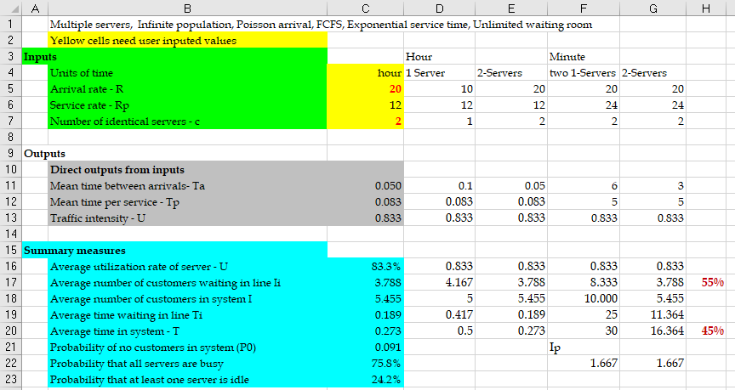
Problem 5. Effect of Pooling- M/M/2 vs. 2M/M/1

Slide 30
Problem 5. Effect of Pooling- M/M/2 vs. 2M/M/1
U = R/Rp =10/12 = 5/6 ➔
Ip = cU = U = 0.833 or
RTp =Ip ➔ 10(5/60) = 0.833
10/hr
Ti = 25 min.
Tp= 5 min
Tp= 5 min
Server 1
Queue1
Ii = 4.167
Ip= 0.833
Ip=
0.833
+0.833
---------
1.667
Ii = 2*4.167 = 8. 334
Ti = 25 min.
Tp= 5 min
Ti = 25 min.
Server 2
Queue2
10/hr
Ii = 4.167
Ip= 0.833
T= Tp+Ti = 5+ 25 = 30 mins

Slide 31
Effect of Pooling- M/M/2 vs. 2M/M/1
U = R/Rp =20/24 = 5/6 ➔
Ip = cU = 2(0.833) = 1.667 or
RTp =Ip ➔ 20(5/60) = 1.667
Tp= 5 min
Server 1
20/hr
Queue
Ii = 3.79
Server 2
Ti = 11.36 min.
T= Tp+Ti = 5+11.365 = 16.36 mins
Why is Design B better than A?
  Design A the waiting time of customer is dependent on the processing time of those ahead in the queue
  Design B, the waiting time of customer is only partially dependent on each preceding customer’s processing time
  Combining queues reduces variability and leads to reduce waiting times

Slide 32
Problem-6 Vending Machine, MMc or MM1
A Vending company supplies vending food to a large university. Because students often kick the machines out of anger and frustration, management has a constant repair problem. The machines break down on an average of 3/hr, and the breakdowns are distributed in a Poisson manner. Downtime costs the company $25/hr/machine, and each maintenance worker gets $4 per hr.
One worker can service machines at an average rate of 5/hr, distributed exponentially;
2 workers working together can service 7/hr, distributed exponentially;
and a team of 3 workers can do 8/hr, distributed exponentially. What is the optimal maintenance crew size for servicing the machines?

Slide 33
Problem-6
c=????
c = 1
U=??
Down time cost = 25Ii
Capacity Cost= 4(# of team members)
Total Cost
Have I made any mistakes?
Downtime costs the company $25 /hr/machine.
When the machine is down?
Until it is up.
In the waiting line it is down. In the processor until the end of the process it is down.
There fore, besides Ii, I also need Ip
Ip is simply U+Ii

Slide 34
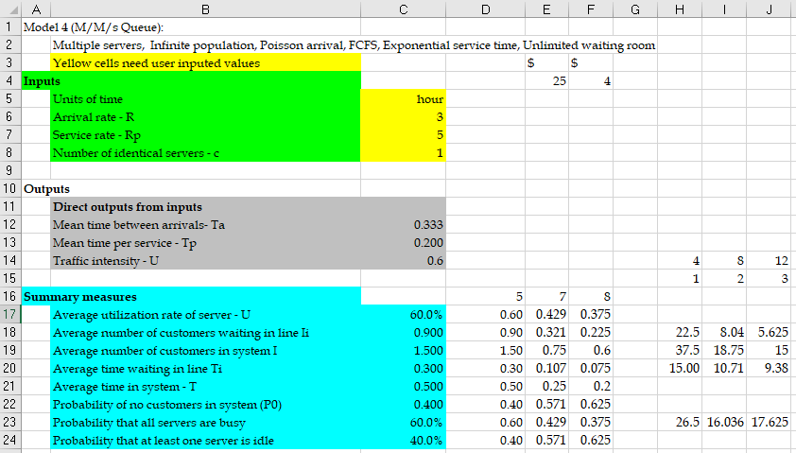
Problem-6

Slide 35
MMcb- A Single Station Waiting Line- A Call Centre
A Call Centre Process
Sales Reps
Processing
Calls
(Service Process)
Incoming Calls
(Customer Arrivals)
Answered Calls
(Customer Departures)
Calls
on Hold
(Service Inventory)
Blocked Calls
(Due to busy signal)
Abandoned Calls
(Due to long waits)
Calls In Process
(Due to long waits)
Flow time T = Ti + Tp
Inventory I = Ii + Ip
Ti: waiting time in the inflow buffer.
Ii: number of customers in the inflow buffer.

Slide 36
Problem-7. Single-Stage Processes with Limited Buffer Size
Easysurrance call center has two agents who answer the calls.
The time that takes an agent to answer a caller’s inquiry follows an exponential distribution with mean of 15 minutes.
The call center has 7 different phone lines, called Trunk Lines. If a customer calls and all 7 lines are busy, the customer will hear a busy signal and will hang up.
Calls that do not get busy signals (i.e., not blocked) and are connected to the call center, and wait on hold (if no agent is available). These calls are answered in the order they are received.
Data shows that call arrivals according to a Poisson process with a mean of 11 calls per hour
Performance Measure: Call center performance is measured based on three metrics:
Average Speed of Answer (ASA): the average time a caller waits on hold before speaking to an agent.
Fraction of Blocked Callers (FBC): the percent of callers who get busy signal and thus are blocked from getting connected to the call center.
Occupancy (OCC): the percentage of time call center agents are busy answering calls.

Slide 37
Single-Stage Processes with Limited Buffer Size
M/M/2/7
New service Goals: The new service goals are to keep ASA below 4 minutes and FBC below 15% and occupancy above 75%.
Question: To achieve these goals, they are authorized to hire one additional agent if needed. Managers are wondering if hiring an additional agent can help them achieve the new service goals.
After hiring an agent, Easysurrance call center is an M/M/3/7 queueing systems.

Slide 38
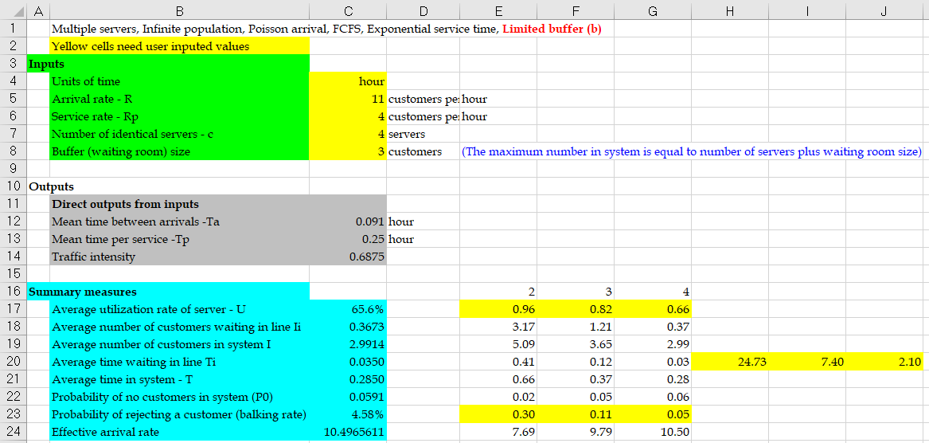
Single-Stage Processes with Limited Buffer Size

Slide 39
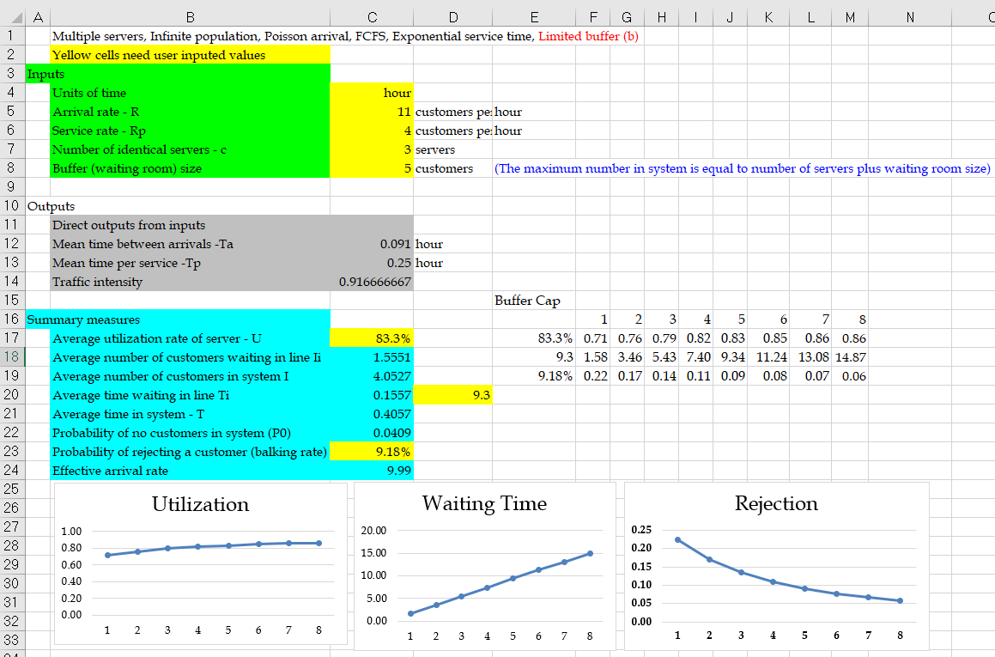
Single-Stage Processes—Impact of Limited Buffer Size
Managers are not sure if they can get permission to hire more than one agent. Thus, they are trying to find other ways to achieve their new service goals. One suggestion is to improve their performance by increasing the number of trunk lines.
How does increasing the number of trunk lines affect average speed of answer (ASA) and fraction of blocked callers (FBC) as well as occupancy (OCC) in their call center?

Slide 40
Single-Stage Processes—Impact of Limited Buffer Size

Slide 41
Single-Stage Processes with Limited Buffer—Impact of Variability
Easysurrance decided to hire one agent and reduce the number of trunk lines to 6.
The arrival rate is still 11 calls per hour.
Managers are now considering a training program for all their agents that can reduce the variability in (coefficient of variation of) call handling times from 1 to 0.5.
Question: How will this change impact the call center measures in the coming year?
With change in CV_{eff} = 1 to CV_{eff} = 0.5, the queueing model of call center would be M/G/3/6, for which there is no simple queueing model, so we must use computer simulation.
We do not have an exact analytical model for M/G/c/b. Using computer simulation we get the following:
FBC is reduced from 13.5% to 7.8%
OCC is increased from 79.3% to 84.1%
ASA is decreased from 5.4 minutes to 4.9 minutes

Slide 42
Single-Stage Processes with Limited Buffer—Impact of Variability

Slide 43
Flow Time Analysis—Service Levels
Expresso is a manufacturer of espresso machines one-by-one in a produce-to-order fashion. Time to finish an order in one of 3 assembly cells follows an exponential distribution with mean of 2 days. The firm receives orders according to a Poisson process with a rate of 1.4 orders per day.
Current data shows the following:
It takes an average of around ?? days from the time a customer places an order until the order is shipped. 10
About ?? percent of the customers receive their orders within the 10 days. 63$
However, one of every five customers receives their orders in 17 days or more. 18.23%
Improving Performance:
Managers of Expresso want to increase the capacity of each cell by 10 percent. They believe this increase in capacity such that
(i) at least 90 percent of the customers receive their orders within a week of placing their orders, and
(ii) the percent of customers who receive their orders later than 10 days would be less than 3 percent.
Question: Can this capacity investment help Expresso to achieve its new service goals?
0.826
0.918

Slide 44
Flow Time Analysis—Service Levels

Slide 45
Flow Time Analysis—Service Levels
Fraction of Delayed Customers (FDC):
Utilization:
Throughput:
Where :
Average Flow Time:
Flow Time Service Level:
In-buffer Flow Time Service Level:
Average Inventory:

Slide 46
Flow Time Analysis—Service Levels
Expresso’s process after increasing capacity would be an M/M/3 queueing system with capacity of μ = 1.10 (0.5) = 0.55 orders per day and λ = 1.4 orders per day.

Slide 47
Flow Time Analysis—Service Levels
Computing flow time service level for t = 7 days:
Repeating the above calculation for t = 10 days we get
Conclusion:
After investing in increasing the capacity by 10 percent,
Only 77.5 percent of customers will receive their orders within 1 week.
About 1 – 0.892 = 0.108 = 10.8% of customers will receive their orders later than 10 days after they place their orders.

Slide 48


Problem-8. Michigan Yacht Club – Seyed Iravani
Michigan Club : M/M/2/6
No place to park, I am going to another club!
Michigan Yacht Club
(2 launch ramps)
Limited space for 4 trailers
Demand = 12/hour
Leaves if no space available
Customers: Cars with boat trailers
Servers: Two launch ramps

Slide 49
Modeling Arrivals—General Arrival Models
General Arrival Models only require mean, standard deviation and coefficient of variation of interarrival times.

Slide 50
Modeling Arrivals—Markovian Models
Markovian Arrival Models: If the interarrival times follow exponential distribution, then the arrivals are called Markovian arrivals.
Markovian Arrival Models:
Probability of next arrival arrives in the next x time units:
Probability of having D = x arrivals in the next time unit (e.g., next hour)
Arrivals at the yacht club is Markovian

Slide 51
Queueing Theory—Modeling Process Times
Markovian Model:
If process times follow exponential distribution, then processing times are called Markovian.
The process times at the Yacht club is Markovian (Check the histogram)

Slide 52
Single-Stage Processes with Limited Buffer Size
Utilization:
Offered Load:
Throughput:
Probability of all agents being idle: :
Average Flow Time:
Probability of a customers is blocked (FBC):
Utilization (OCC) and throughput:
Average Inventory:

