Slide 1
Problem 12
Bank of San Pedro has only 1 teller. On average, 1 customer comes every 6 minutes, and it takes the teller an average of 3 minutes to serve a customer. To improve customer satisfaction, the bank is going to implement a unique policy called, “We Pay While You Wait.” Once implemented, the bank will pay each customer $3 per minute while a customer waits in line. (So the clock starts when a customer joins the line, and stops when the customer begins to talk to the teller.) Bank of San Pedro hired you as a consultant and you are responsible for estimating how much the “We Pay While You Wait” program will cost. Your preliminary study indicates there are, on average, 0.5 customers waiting in line. Assume linear cost. If a customer waits for ten seconds in line, Bank of San Pedro will pay $0.5. Assume that arrival follows Poisson and service time follows exponential distribution.

Slide 2
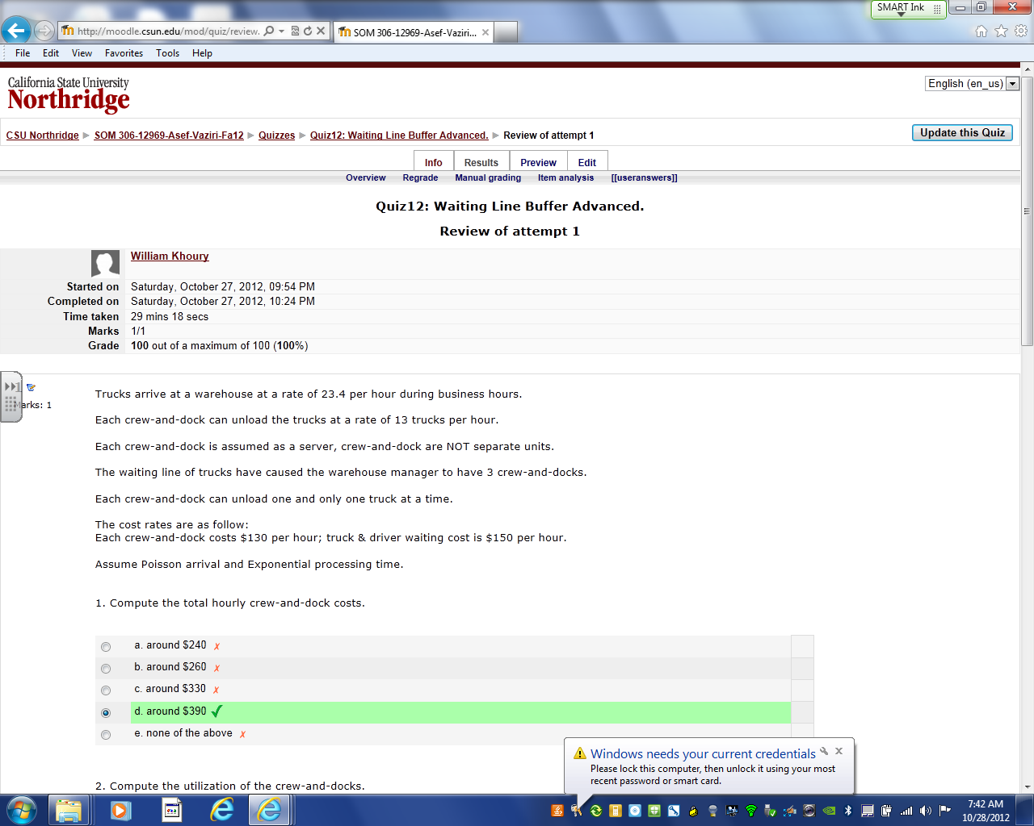

Slide 3
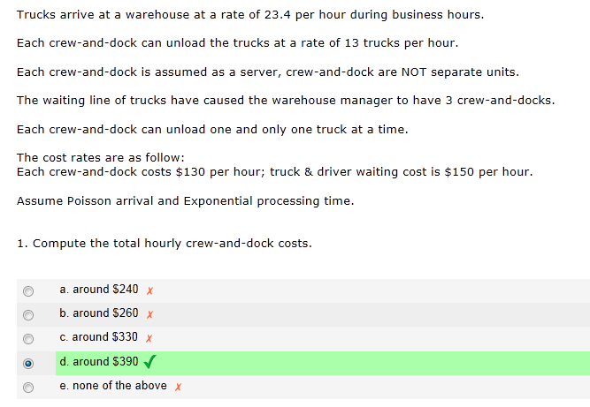
$130 (3) = 390

Slide 4
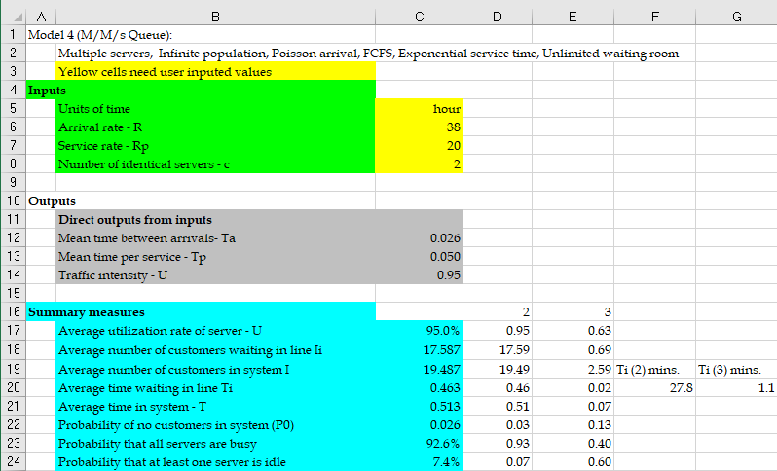
Queueing Models of Single-Stage Processes—An Example
A bank has two tellers who serve customers waiting in a single line. Customers arrive according to a Poisson process with a rate of 38 customers per hour. The time it takes for a teller to serve a customer follows Exponential distribution with an average of 3. Bank managers are considering to hire another teller to reduce customer waiting time.

Slide 5
Single-Stage Processes—Impact of Utilization on Flow Times
In Diorucci Furniture, the time to complete a customer’s has an average of 3 days and standard deviation of 6 days.
The demand, which follows Poisson process, is expected to increase from 8 orders per month to 9 orders per month.
The company’s policy has been to keep the average time the customers wait until they get their order—the average order lead time—less than 50 days. Managers are worried that the expected increase
Marketing department’s claim:
Two years ago when demand increased by one unit from 7 to 8 days, the average order lead time increased by 13 days. Thus, increasing the demand by one unit from 8 to 9 would increase the average order lead time from its current 31 days to 31 + 13 = 44 days, which is still lower than the company’s goal of 50 days. Thus, they concludes that no action is needed to handle the new demand.
Question: Do you agree with?
http://www.csun.edu/~aa2035/CourseBase/WaitingLine/Slides/M-G-1-Rags-Seyed-Furniture.xlsx

Slide 6
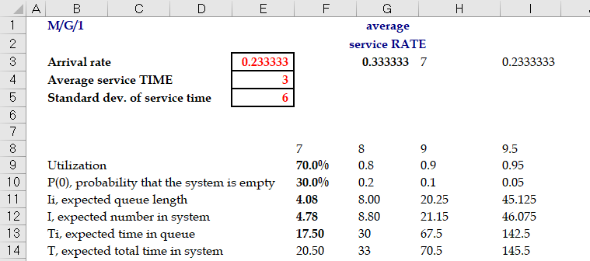
Single-Stage Processes—Impact of Utilization on Flow Times
Conclusion:
Increase in demand by one unit increases the average lead time to about 70 days.

Slide 7
Single-Stage Processes—Impact of Utilization on Flow Times

Slide 8
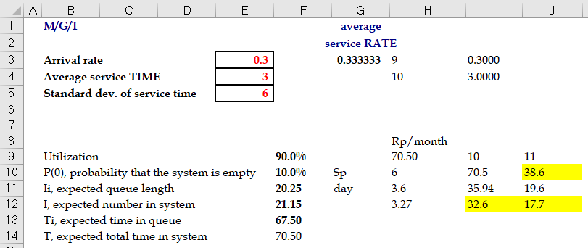
Single-Stage Processes—Impact of Variability on Flow Times
To decrease lead time, Diorucci Furniture is considering the following two actions
Increasing Capacity: Increasing capacity of the factory by 10 percent from 10 orders to 11 orders per month. Increasing capacity is not expected to affect the variability.
Reducing Variability: Implementing lean manufacturing principles to reduce the variability in the order processing time by 40 percent from 2 to 1.2 or less.
Question: Do you think if any of these actions can keep the target lead time below 50 days when the demand increases to 9 orders per month?

Slide 9
Single-Stage Processes—Impact of Variability on Flow Times

Slide 10
Single-Stage Processes—Impact of Variability on Flow Times

Slide 11
Single-Stage Processes with Limited Buffer Size
Easysurrance call center has two agents who answer the calls.
The time that takes an agent to answer a caller’s inquiry follows an exponential distribution with mean of 15 minutes.
The call center has 7 different phone lines, called Trunk Lines. If a customer calls and all 7 lines are busy, the customer will hear a busy signal and will hang up.
Calls that do not get busy signals (i.e., not blocked) and are connected to the call center, and wait on hold (if no agent is available). These calls are answered in the order they are received.
Data shows that call arrivals according to a Poisson process with a mean of 11 calls per hour
Performance Measure: Call center performance is measured based on three metrics:
Average Speed of Answer (ASA): the average time a caller waits on hold before speaking to an agent.
Fraction of Blocked Callers (FBC the percent of callers who get busy signal and thus are blocked from getting connected to the call center.
Occupancy (OCC), is the percentage of time call center agents are busy answering calls.

Slide 12
Single-Stage Processes with Limited Buffer Size
M/M/3/7
New service Goals: The new service goals are to keep ASA below 4 minutes and FBC below 15 percent and occupancy above 75 percent.
Question: To achieve these goals, they are authorized to hire one additional agent if needed. Managers are wondering if hiring an additional agent can help them achieve the new service goals.
After hiring an agent, Easysurrance call center is an M/M/3/7 queueing systems.

Slide 13
Single-Stage Processes with Limited Buffer Size
Utilization:
Offered Load:
Throughput:
Probability of all agents being idle: :
Average Flow Time:
Probability of a customers is blocked (FBC):
Utilization (OCC) and throughput:
Average Inventory:

Slide 14
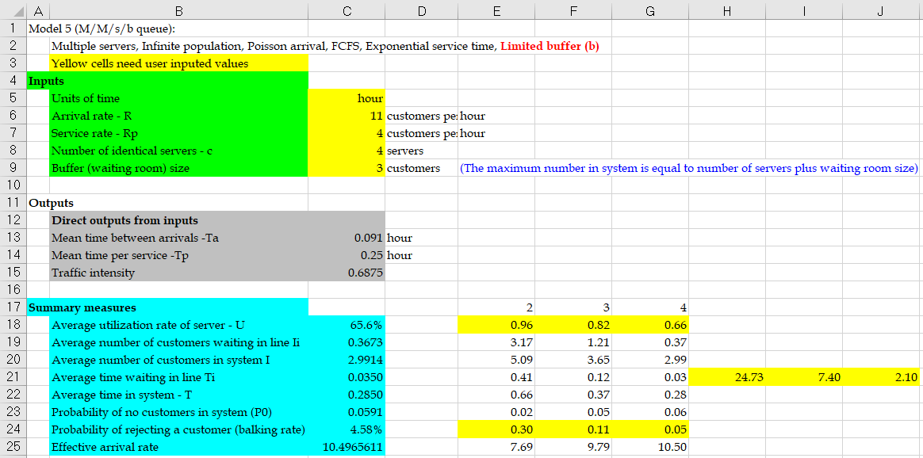
Single-Stage Processes with Limited Buffer Size

Slide 15
Single-Stage Processes with Limited Buffer Size
Question: After hiring one agent, the target level FBC < 15% will be satisfied. But what about ASA being less than 4 minutes?
ASA violates the target level of ASA < 4 minutes.
However, with one additional agent, the center will have the occupancy of 81.6%, satisfying target level OCC > 75%.
With Two Additional Agents: The system becomes M/M/4/7, and:
FBC = 4.6% < 15% , ASA = 2.1 < 4 minutes , OCC = 65.6% (violating the target level)

Slide 16
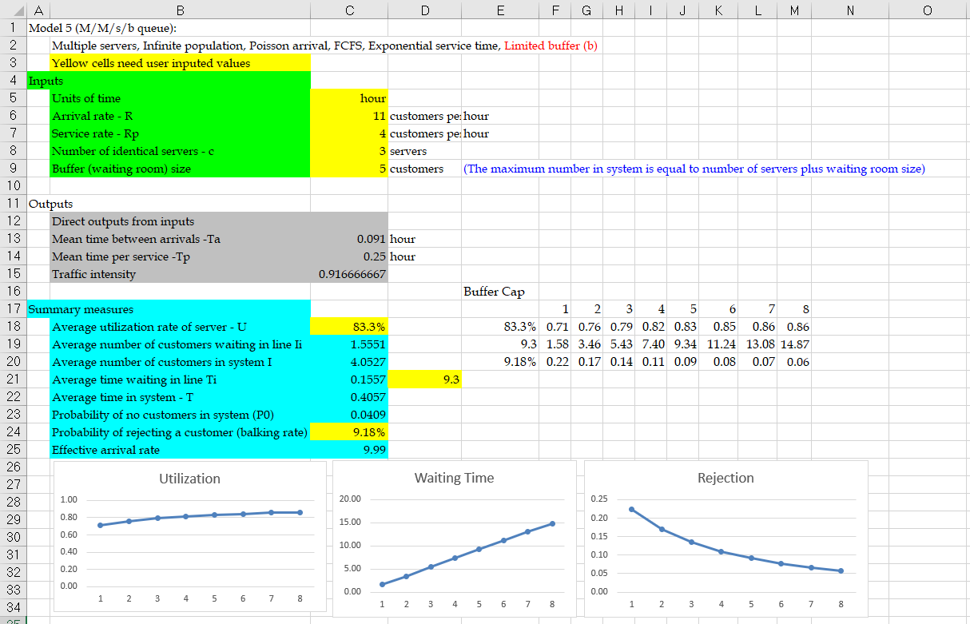
Single-Stage Processes—Impact of Limited Buffer Size
Managers of Easysurrance call center are not sure if they can get permission to hire more than one agent. Thus, before deciding to hire an additional agent, they are trying to find other ways to achieve their new service goals.
One suggestion is to improve their performance by increasing the number of trunk lines.
Question: How does increasing the number of trunk lines affect average speed of answer (ASA) and fraction of blocked callers (FBC) as well as occupancy (OCC) in their call center?

Slide 17
Single-Stage Processes—Impact of Limited Buffer Size

Slide 18
Single-Stage Processes with Limited Buffer—Impact of Variability
Easysurrance decided to hire one agent and reduce the number of trunk lines to 6.
The arrival rate is still 11 calls per hour.
Managers are now considering a training program for all their agents that can reduce the variability in (coefficient of variation of) call handling times from 1 to 0.5.
Question: How will this change impact the call center measures in the coming year?
With change in CV_{eff} = 1 to CV_{eff} = 0.5, the queueing model of call center would be M/G/3/6, for which there is no simple queueing model, so we must use computer simulation.
Using computer simulation we get the following:
FBC is reduced from 13.5% to 7.8%
OCC is increased from 79.3% to 84.1%
ASA is decreased from 5.4 minutes to 4.9 minutes

Slide 19
Single-Stage Processes with Limited Buffer—Impact of Variability

Slide 20
Flow Time Analysis—Service Levels
Expresso is a manufacturer of espresso machines one-by-one in a produce-to-order fashion.
Time to finish an order in one of 3 assembly cells follows an exponential distribution with mean of 2 days.
The firm receives orders according to a Poisson process with a rate of 1.4 orders per day.
Current data shows the following:
It takes an average of around 10 days from the time a customer places an order until the order is shipped.
About 63 percent of the customers receive their orders within the 10 days.
However, one of every five customers receives their orders in 17 days or more.
Improving Performance:
Managers of Expresso want to increase the capacity of each cell by 10 percent. They believe this increase in capacity such that
(i) at least 90 percent of the customers receive their orders within a week of placing their orders, and
(ii) the percent of customers who receive their orders later than 10 days would be less than 3 percent.
Question: Can this capacity investment help Expresso to achieve its new service goals?

Slide 21
Flow Time Analysis—Service Levels

Slide 22
Flow Time Analysis—Service Levels
Fraction of Delayed Customers (FDC):
Utilization:
Throughput:
Where :
Average Flow Time:
Flow Time Service Level:
In-buffer Flow Time Service Level:
Average Inventory:

Slide 23
Flow Time Analysis—Service Levels
Expresso’s process after increasing capacity would be an M/M/3 queueing system with capacity of μ = 1.10 (0.5) = 0.55 orders per day and λ = 1.4 orders per day.

Slide 24
Flow Time Analysis—Service Levels
Computing flow time service level for t = 7 days:
Repeating the above calculation for t = 10 days we get
Conclusion:
After investing in increasing the capacity by 10 percent,
Only 77.5 percent of customers will receive their orders within 1 week.
About 1 – 0.892 = 0.108 = 10.8% of customers will receive their orders later than 10 days after they place their orders.

Slide 25
The Little’s Law Applies Everywhere
R
Flow time T = Ti + Tp
Inventory I = Ii + Ip
I = R× T
Ii = R× Ti
Ip = R × Tp
R = I/T = Ii/Ti = Ip/Tp
We know that U= R/Rp
We have already learned Rp = c/Tp, R= Ip/Tp
We can show U= R/Rp = (Ip/Tp)/(c/Tp) = Ip/c
But it is intuitively clear that U = Ip/c
We know Tp and we can compute Ip at least in two ways.
Given our understanding of the Little’s Law, it is then enough to know either Ii or Ti.

Slide 26
Operational Performance Measures
Flow time T = Ti + Tp
Inventory I = Ii + Ip

Slide 27
Utilization and Safety Capacity
Waiting time in the line? RTi = Ii
Ti=Ii/R = 14.0625 /7.5 = 1.875 hr or 60(1.875)= 112.5 min.
Waiting time in the system?
T = Ti+Tp
Since Tp = 7.5 ➔ T = Ti+ Tp = 112.5+7.5 = 120 min.
Total number of passengers in the system?
I = RT = ( 7.5/60)(120) = 15
Alternatively, 14.0625 are in the buffer. How many are with the processor?
0.9375
I = 14.0625 + 0.9375 = 15
After few more computations, we will start using predesigned Excelsheets with Macros for these computations. But it is important to understand the quantitative relationships that we have discussed.

Slide 28
Utilization and Safety Capacity
Total number of passengers in the system?
I = RT = ( 7.5/60)(120) = 15
Alternatively, 14.0625 are in the buffer. How many are with the processor?
0.9375
I = 14.0625 + 0.9375 = 15
Now suppose there are 2 processors, c=2
R is still 1/8 per minute or 7.5 per hour
Rp= 2/7.5 per minutes or 60(2/7.5) = 16 /hr
U = R/Rp = 7.5/16 = 0.46875
= 0.294222
On average Ii = 0.29 passengers waiting in line.

Slide 29
Now suppose we have two servers
On average Ii = 0.29 passengers waiting in line.
Safety capacity is Rs = R_{P} - R = 16-7.5 = 8.5 flow units per hour.
Ti=Ii/R = (0.294222/7.5)60 = 2.3538 min.
Total time in the system: T = Ti+Tp
Since Tp = 7.5 ➔ T = Ti + Tp = 7.5+2.4= 9.9 min
Total number of passengers in the process:
I = 2(0.4688) = 0.9376 in the buffer and 0.2942 in the process.
I = 0.94 + 0.29 = 1.23

Slide 30
The arrival rate to a store is 6 customers per hour and follows Poisson distribution. The service time is 5 min per customer and follows exponential distribution.
a) Compute Processing time (How long does a customer stay with the cashier?)
Tp = 5 min.
b) On average how many customers are with cashier?
R= 6/ hr
Rp=1/Tp = 1/5 per min. or 60(1/5) = 12/hr
U= 6/12 = 0.5 ➔ Ip = 0.5
6(5/60) = 0.5
=(6/60)5 = 0.5
Alternatively;
RTp = Ip =
c) Compute Ii, Ti, Ip, Tp, I, and T.
d) What if arrival Rate changes to 11, 11.1, 11.2, ………11.9.

Slide 31
Problem 1: M/M/1 Performance Evaluation
 | 6 | 11 | 11.1 | 11.2 | 11.3 | 11.4 | 11.5 | 11.6 | 11.7 | 11.8 | 11.9
50.0% | 0.500 | 0.917 | 0.925 | 0.933 | 0.942 | 0.950 | 0.958 | 0.967 | 0.975 | 0.983 | 0.992
50.0% | 0.500 | 10.083 | 11.408 | 13.067 | 15.201 | 18.050 | 22.042 | 28.033 | 38.025 | 58.017 | 118.01
100.0% | 1.000 | 11.000 | 12.333 | 14.000 | 16.143 | 19.000 | 23.000 | 29.000 | 39.000 | 59.000 | 119.00
8.3% | 0.083 | 0.917 | 1.028 | 1.167 | 1.345 | 1.583 | 1.917 | 2.417 | 3.250 | 4.917 | 9.917
16.7% | 0.167 | 1.000 | 1.111 | 1.250 | 1.429 | 1.667 | 2.000 | 2.500 | 3.333 | 5.000 | 10.000
Average utilization rate of server - U | 50.0%
Average number of customers waiting in line Ii | 0.500
Average number of customers in system I | 1.000
Average time waiting in line Ti | 0.083
Average time in system - T | 0.167

Slide 32
Problem 1: M/M/1 Performance Evaluation
R= 6/hour with Poisson distribution. Tp = 5 min with exponential distribution.
Ii
V
U

