Slide 1




Polling: Lower Waiting Time, Longer Processing Time (Perhaps)
Waiting Lines

Slide 2
Now Let’s Look at the Rest of the System;
The Little’s Law Applies Everywhere
R
Flow time T = Ti + Tp
Inventory I = Ii + Ip
I = R× T
Ii = R× Ti
Ip = R × Tp
R = I/T = Ii/Ti = Ip/Tp
We know that U= R/Rp
We have already learned Rp = c/Tp, R= Ip/Tp
We can show U= R/Rp = (Ip/Tp)/(c/Tp) = Ip/c
But it is intuitively clear that U = Ip/c

Slide 3
Characteristics of Waiting Lines
Variability in arrival time and service time leads to
  Idleness of resources
  Waiting time of flow units
We are interested in two measures
  Average waiting time of flow units in the waiting line and in the system (Waiting line + Processor).
  Average number of flow units waiting in the waiting line (to be then processed).

Slide 4
Operational Performance Measures
Flow time T = Ti + Tp
Inventory I = Ii + Ip
Ti: waiting time in the inflow buffer = ?
Ii: number of customers waiting in the inflow buffer =?
Given our understanding of the Little’s Law, it is then enough to know either Ii or Ti.
We can compute Ii using an approximation formula.

Slide 5
Utilization – Variability - Delay Curve
T
Variability
Increases
Average
time in system
Tp
Utilization
100%
U

Slide 6
Utilization and Variability
Our two measures of effectiveness (average number of flow units waiting and their average waiting time) are driven by
  Utilization: The higher the utilization the longer the waiting line/time.
  Variability: The higher the variability, the longer the waiting line/time.
High utilization U= R/Rp or low safety capacity Rs =Rp – R, due to
  High inflow rate R
  Low processing rate Rp = c/Tp, which may be due to small-scale c and/or slow speed 1/Tp

Slide 7
Drivers of Process Performance
Variability in the interarrival time and processing time is measured using standard deviation (or Variance). Higher standard deviation (or Variance) means greater variability.
Standard deviation is not enough to understand the extend of variability. Does a standard deviation of 20 represents more variability or a standard deviation of 150
for an average
of 80
for an average of 1000?
Coefficient of Variation: the ratio of the standard deviation of interarrival time (or processing time) to the mean(average).
  Ca = coefficient of variation for interarrival time
  Cp = coefficient of variation for processing time

Slide 8
The Queue Length Approximation Formula
Utilization effect
U-part
Variability effect
V-part
U= R /Rp, where Rp = c/Tp
Ca and Cp are the Coefficients of Variation
Standard Deviation/Mean of the inter-arrival or processing times (assumed independent)

Slide 9
Factors affecting Queue Length
Utilization effect; the queue length increases rapidly as U approaches 1.
Variability effect; the queue length increases as the variability in interarrival and processing times increases.
While the capacity is not fully utilized, if there is variability in arrival or in processing times, queues will build up and customers will have to wait.

Slide 10
Coefficient of Variations for Alternative Distributions
Tp: average processing time ➔ Rp =c/Tp
Ta: average interarrival time ➔ Ra = 1/Ta
Sp: Standard deviation of the processing time
Sa: Standard deviation of the interarrival time

Slide 11
Coefficient of Variation
Example. A sample of 10 observations on Interarrival times in minutes → 10,10,2,10,1,3,7,9, 2, 6 min.
Ta=AVERAGE () ➔ Avg. interarrival time = 6 min.
Ra = 1/6 arrivals /min.
Sa=STDEV() ➔ Std. Deviation = 3.94
Ca = Sa/Ta = 3.94/6 = 0.66
Example. A sample of 10 observations on Processing times in minutes → 7,1,7, 2,8,7,4,8,5, 1 min.
Tp= 5 minutes; R_{p} = 1/5 processes/min.
Sp = 2.83
Cp = Sp/Tp = 2.83/5 = 0.57

Slide 12
Utilization and Safety Capacity
Example. Given the data of the previous examples.
Ta = 6 min ➔ Ra=1/6 per min (or 10 per hr).
Tp = 5 min ➔ Rp =1/5 per min (or 12 per hr).
Ra< Rp ➔ R=Ra . U= R/ R_{P} = (1/6)/(1/5) = 0.83
Ca = 0.66, Cp =0.57
On average 1.56 passengers waiting in line, even though U <1 and safety capacity Rs = R_{P} - Ra= 1/5 - 1/6 = 1/30 passenger per min, or 60(1/30) = 2/hr.

Slide 13
Example: Other Performance Measures
Waiting time in the line? RTi = Ii
Ti=Ii/R = 1.56/(1/6) = 9.4 min.
Waiting time in the system?
T = Ti+Tp
Since Tp = 5 ➔ T = Ti+ Tp = 14.4 min.
Total number of passengers in the system?
I = RT = (1/6) (14.4) = 2.4
Alternatively, 1.56 are in the buffer. How many are with the processor?
I = 1.56 + 0.83 = 2. 39

Slide 14
Now suppose we have two servers
Compute R, Rp and U: Ta= 6 min, Tp = 5 min, c=2
R = Ra= 1/6 per minute
Processing rate for one processor 1/5 for two processors
Rp = 2/5
U = R/Rp = (1/6)/(2/5) = 5/12 = 0.417
On average Ii = 0.076 passengers waiting in line.
Safety capacity is Rs = R_{P} - R = 2/5 - 1/6 = 7/30 passenger per min or 60(7/30) = 14 passengers per hr or 0.233 per min.

Slide 15
Other Performance Measures for Two Servers
Ti=Ii/R = (0.076)(6) = 0.46 min.
Total time in the system:
T = Ti+Tp
Since Tp = 5 ➔ T = Ti + Tp = 0.46+5 = 5.46 min
Total number of passengers in the process:
I = 0.076 in the buffer and 0.417 in the process.
I = 0.076 + 2(0.417) = 0.91
c | U | Rs | Ii | Ti | T | I
1 | 0.83 | 0.03 | 1.56 | 9.38 | 14.38 | 2.4
2 | 0.417 | 0.23 | 0.077 | 0.46 | 5.46 | 0.91

Slide 16
Terminology and Classification of Waiting Lines
Terminology: The characteristics of a waiting line is captured by five parameters; arrival pattern, service pattern, number of server, queue capacity, and queue discipline. a/b/c/d/e
M/M/1; Poisson arrival rate, Exponential service times, one server, no capacity limit.
M/G/12/23; Poisson arrival rate, General service times, 12 servers, queue capacity is 23.

Slide 17
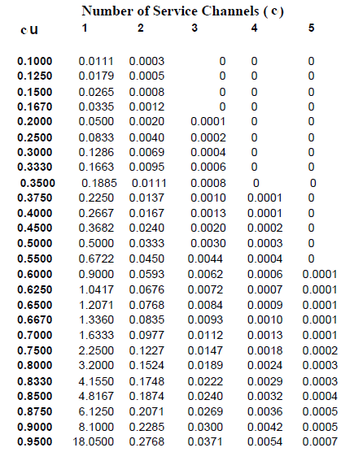
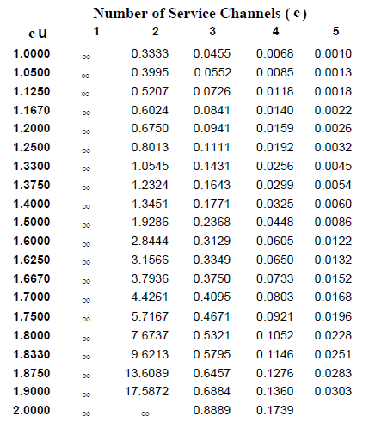
Exact Ii for M/M/c Waiting Line

Slide 18
The M/M/c Model EXACT Formulas

Slide 19
The M/M/c/b Model EXACT Formulas

