Slide 1
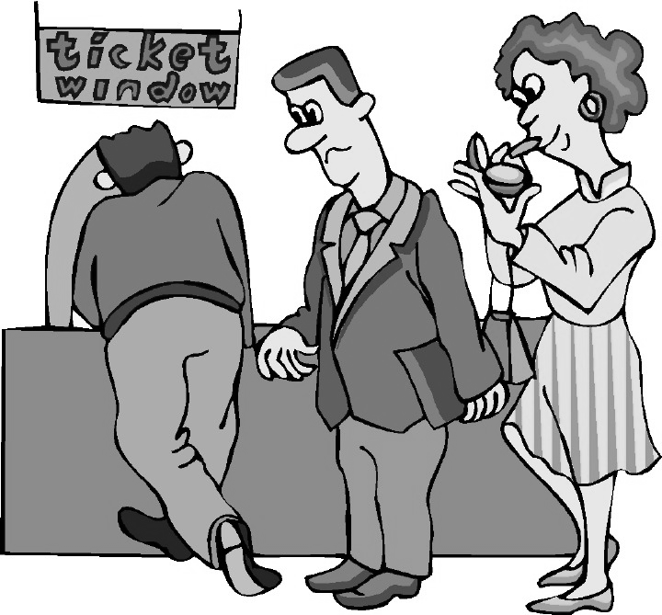

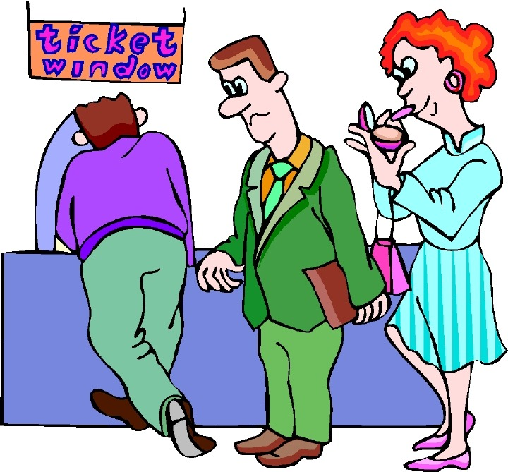

Polling: Lower Waiting Time, Longer Processing Time (Perhaps)
Waiting Lines

Slide 2
Article: The Psychology of Waiting Lines
Unoccupied time feels longer than occupied time.
Pre-process waits feels longer than in-process waits.
Anxiety makes waits seem longer.
Uncertain waits are longer than known, finite waits.
Unexplained waits are longer than explained waits.
Unfair waits are longer than equitable waits.
The more valuable the service, the longer I will wait.
Solo waiting feels longer than group waiting.

Slide 3
Make to Stock (MTS) vs. Make to Order (MTO)
Made-to-stock (MTS) operations. Product is manufactured and stocked in advance. Safety inventory protects against stockouts due to variability of arrival time and processing time. Inventory also permits economies of scale.
  Make-to-order (MTO) operations. Each order is specific, cannot be stored in advance. Ex. banks, restaurants, retail checkout counters, airline reservation, hospitals , repair shops, call centres. Production systems also try to follow Dell Computer model. We needs to maintain sufficient capacity to deal with uncertainty in both arrival and processing time. Safety Capacity vs. Safety Inventory.

Slide 4
Capacity More than Demand- Still Waiting Lines? Variability
The time of the arrival of an order is not known ahead of time. It is a random variable with estimated Ta (average) and Sa (standard deviation).
  The time of the next telephone call is not known.
  The time of arrival of the next car into a gas station is not known.
The service time is not known (precisely) ahead of time. It is a random variable with estimated Tp (average) and Sp (standard deviation).
  The time a customers spends on the web page of amazon.com is not precisely known.
  The time a customer spends speaking with the teller in the bank is unknown.

Slide 5
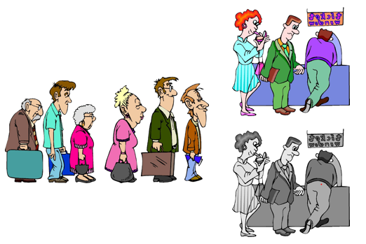
A Call Centre

Slide 6
A Call Centre
The Call Centre Process
Sales Reps
Processing
Calls
(Service Process)
Incoming Calls
(Customer Arrivals)
Answered Calls
(Customer Departures)
Calls
on Hold
(Service Inventory)
Blocked Calls
(Due to busy signal)
Abandoned Calls
(Due to long waits)
Calls In Process
(Due to long waits)

Slide 7
AVERAGE Processing Time Tp
AVERAGE Processing Rate Rp
Tp : Activity processing time or Resource unit load. It is stated in terms of units of time. Ex. on average it takes 5 minutes to serve a customer, Tp=5.
Rp : processing rate. This many flow units are handled per unit of time.
What is the relationship between Tp and Rp?

Slide 8
AVERAGE Processing Time Tp
AVERAGE Processing Rate Rp
Tp = 5 min, Rp =?
5 min1 1 unit
1 min Rp How many units per minute?
Rp=(1×1)/5 =1/5 flow units per minute.
For one resource unit, Rp =1/Tp
For c resource units c(1/Tp)= c/Tp
If Tp is 5 minutes, and there are three resource units, compute Rp.

Slide 9
Average Processing Rate of c Servers
Tp = 5 minutes. Processing time is 5 minute. Each customer on average is with the server for 5 minutes.
c = 3, we have three servers.
Processing rate of each server is 1/5 customers per minute, or 12 customer per hour.
Rp is the processing rate of all three servers.
Rp = c/Tp
Rp = 3/5 customers/minute, or 36 customers/hour.

Slide 10
Inter-arrival Time (Ta) and Arrival Rate (Ra)
Ta : customer inter-arrival time.
On average each 10 minutes one customer arrives.
Ra: customer arrival (inflow) rate.
What is the relationship between Ta and Ra
Ta = every ten minutes one customer arrives
How many customers in a minute? 1/10; Ra= 1/Ta= 1/10
Ra = 1/10 customers per min; 6 customers per hour
Ra= 1/Ta

Slide 11
Throughput = Min (Ri,Rp)
Ra MUST ALWAYS <= Rp.
We will show later that even Ra=Rp is not possible.
Incoming rate must be less than processing rate.
Throughput = Flow Rate R = Min (Ra, Rp) .
Stable Process = Ra< Rp ➔ R = Ra
Safety Capacity Rs = Rp – Ra

Slide 12
Buffer (waiting line) and Processors (Servers)
Flow time T = Ti + Tp
Inventory I = Ii + Ip
Ti: waiting time in the inflow buffer
Ii: number of customers in the inflow buffer
What is the waiting time in the servers (processors)?
Throughput?

Slide 13
Utilization is Always Less than 1
U = Utilization
U =inflow rate / processing rate
U = throughout / process capacity
U = R/ Rp < 1
Safety Capacity = Rp – R
For example , R = 6 per hour, processing time for a single server is 5 min ➔ Rp= 12 per hour,
U = R/ Rp = 6/12 = 0.5
Safety Capacity = Rp – R = 12-6 = 6

Slide 14
Given the Utilization, How Many Flow Units are in the Processor(s)
Given a single server, and a utilization of U= 0.5
How many flow units are in the server ?
U = 0.5 means
50% of time there is 1 flow unit in the server
50% of time there is 0 flow unit in the server
0.5 × 1 + 0.5 × 0 = 0.5
Average Inventory in the server is equal to utilization
Ip= 1U = U

Slide 15
Given the Utilization, How Many Flow Units are in the Processor(s)
Given 2 servers, and a utilization of U = 0.3
How many flow units are in the servers ?
U = 0.3 means
30% of time there is 1 flow unit in each server
70% of time there is 0 flow unit in each server
0.3 × 1 + 0.7 × 0 = 0.3 flow unit in each server
Average Inventory in the server is equal to utilization times the number of servers Ip= 2U = cU

Slide 16
What We Have Learned Without Looking for any Formula
Processing time: Tp, Ex. Tp = 5 minutes
Number of servers: c, Ex. c=3
Tp is also waiting time in the server, no mater one server or c servers. Tp in this example is always 5 min.
Processing rate Rp= c/Tp. Ex. Rp =3/5 per min; 36/hr
Utilization: U. Ex. U = 0.8 in our example
Number of the flow units in all servers, Ip = cU
In our example, Ip = 3 × 0.8 = 2.4
Can we compute R? ➔ TR = I
Tp × R = cU ➔ R = cU/Tp
5 × R = 2.4 ➔ R = 0.48 flow units per minute or 28.8 / hr
We learned it without looking at any formula

Slide 17
What We Have Learned Without Looking for any Formula
Processing time of a set of servers is 5 minutes. Tp = 5 minutes. There are 3 servers. Utilization of these servers is 0.8.
1. Compute the processing rate of this system. Rp=?
2. On average how many flow units are in these servers?
3. Compute the arrival rate (throughput) of this system.
4. What is the average interarival time between two consecutive customers ?

Slide 18
Characteristics of Queuing Systems
Variability in arrival time and service time leads to
  Idleness of resources
  Waiting time of customers (orders) to be processed
We are interested in evaluating two measures:
  Average waiting time of flow units. Average waiting time in the waiting line and in the system (Waiting line + Processor).
  Average number of flow units. The average number of orders (customers) waiting in the waiting line (to be then processed).
Let us first look at the Servers or Processors

