Slide 1

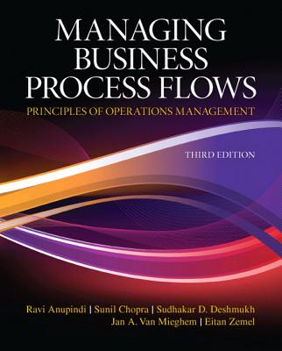
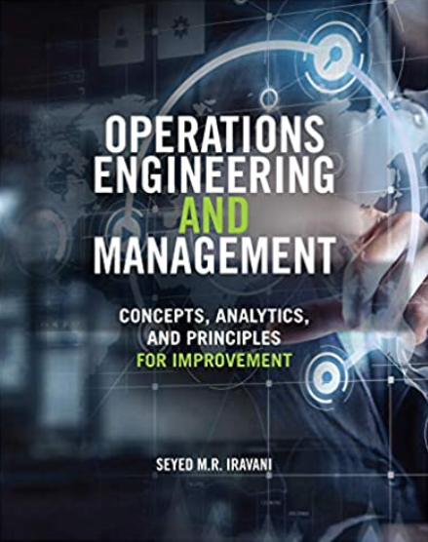
Waiting Line Analysis
These slides have been developed on the foundations provided by the following books.
Ardavan Asef-Vaziri

Slide 2
Make to Stock (MTS) vs. Make to Order (MTO)
Made-to-stock (MTS) operations. Product is manufactured and stocked in advance. Safety inventory protects against stockouts due to variability of arrival time and processing time. Inventory also permits economies of scale.
  Make-to-order (MTO) operations. Each order is specific, cannot be stored in advance. Ex. banks, restaurants, retail checkout counters, airline reservation, hospitals , repair shops, call centres. Production systems also try to follow Dell Computer model. We needs to maintain sufficient capacity to deal with uncertainty in both arrival and processing time. Safety Capacity vs. Safety Inventory.
  The Psychology of Waiting Lines
  Pre-process waits feels longer than in-process waits.
  Uncertain waits are longer than known, finite waits.
  Unexplained waits are longer than explained waits.
  Long waits feel shorter for more valuable services.
  Unfair waits are longer than equitable waits.
  Solo waiting feels longer than group waiting.

Slide 3
Content
Why Do Waiting Lines Exist?
Stability and Safety Capacity
Queueing Theory and Flow Time Measures
Elements of Queueing Systems
Single-Stage Processes with Infinite Buffer
– Impact of utilization
– Impact of variability
Single-Stage Processes with Limited Buffer
– Impact of buffer size
– Impact of variability
Flow Time Service Levels

Slide 4
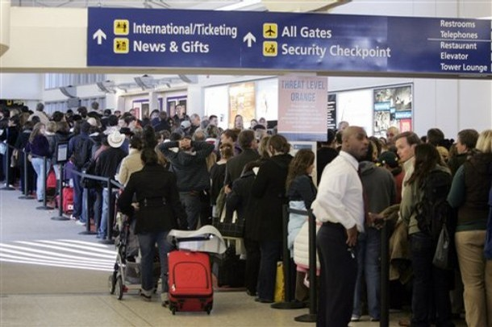
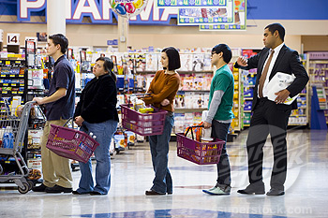
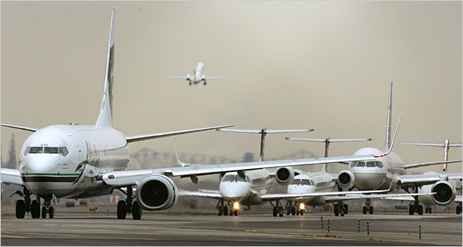
Queues Exist in all Business Processes
Waiting lines are everywhere in business processes
– Jobs waiting in workstation to be processed
– Broken machines in factories wait for repair crew
– Parcels are waiting in warehouses to be shipped
– Customers wait in emergency departments to see a doctor
– Airplanes wait in line for takeoff
– Files in computer systems wait for processing
– … waiting lines are every where in business processes
Both customers and managers do not like long waiting line
and long waiting times (i.e., flow times)
Question: Why do waiting lines exist?

Slide 5
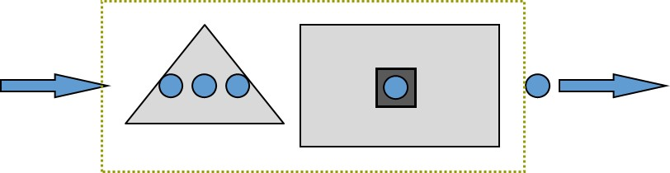
AVERAGE Processing Time Tp & AVERAGE Processing Rate Rp
Tp : Activity processing time or Resource unit load. It is stated in terms of units of time. Ex. on average it takes 5 minutes to serve a customer, Tp=5.
Rp : Capacity or processing rate. This many flow units are handled per unit of time.
Processing time is Tp=5 mins. What is capacity Rp?
For one processor Rp =1/Tp
Rp=1/Tp= 1/5 per minute.
Why per minute? Because Tp was in minute.
Rp=60(1/5) = 12 per hour

Slide 6
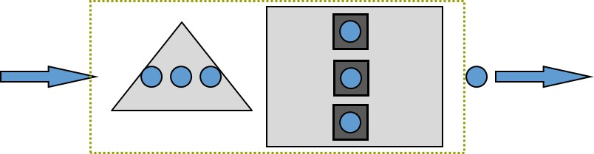
AVERAGE Processing Time Tp & AVERAGE Processing Rate Rp
For one resource unit, Rp =1/Tp
For c resource units c(1/Tp)= c/Tp
If Tp is 5 minutes, and there are three resource units, compute Rp for the resource pool.
Tp = 5 minutes. Capacity of each processor is 1/5 per minutes.
Since we have c = 3 servers, capacity is 3(1/5)=3/5 per minute or 36 per hour. .
Rp = c/Tp
Ta : customer inter-arrival time.
Example. On average each 10 minutes one customer arrives.
Ra: customer arrival (inflow) rate. That is customer demand.
What is the relationship between Ta and Ra?
How many customers in a minute? Ra= 1/Ta= 1/10 customer per minute.

Slide 7
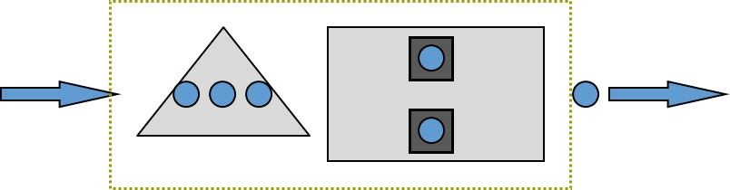
Inter-arrival Time (Ta) and Arrival Rate (Ra)
Ra = 1/10 customers per min; 6 customers per hour ➔ Ta= 1/Ra=1/6 hour.
Ra <= Rp.
We will show later that even Ra = Rp is not possible.
Incoming rate must be less than processing rate.
Throughput = Flow Rate R = Min (Ra, Rp) .
Stable Process = Ra< Rp ➔ R = Ra
Utilization = inflow-rate/processing-rate = throughout/capacity
Utilization = U = R/ Rp < 1
Safety Capacity = Rs = Rp – Ra
Given a single server, R = 6 per hour, processing time for a single server is 5 min ➔ Rp= 12 per hour,
U = R/ Rp = 6/12 = 0.5
Rs = Rp – R = 12-6 = 6

Slide 8
The Relationship Between U and Ip
How many flow units are in the server ?
U = 0.5 means 50% of time there is 1 flow unit in the server, 50% of time there is 0 flow unit in the server
0.5 × 1 + 0.5 × 0 = 0.5
For one server, average Inventory in the server is equal to utilization
Ip= U = 1U
Given 2 servers, and a utilization of U = 0.3, How many flow units are in the servers ?
U = 0.3 means 30% of time there is 1 flow unit in each server, and 70% of time there is 0 flow unit in each server.
0.3 × 1 + 0.7 × 0 = 0.3 flow unit in each server
Average Inventory in the server is equal to utilization times the number of servers
Ip = cU =2(0.3) = 0.6 flow units with the servers.

Slide 9
What We Have Learned Without Looking for any Formula
Processing time of a set of servers is Tp = 5 minutes. There are c=3 servers. Utilization of these servers is U=0.8.
Tp is also waiting time in the server, no mater one server or c servers. Tp in this example is always 5 min.
a) Compute the processing rate of this system. Rp=?
Processing rate Rp= c/Tp. Ex. Rp =3/5 per min; 36/hr
b) Compute the throughput.
U = R/Rp ➔ 0.8 =R/36 ➔ R=28.8 in our example.
It worth to have the following insight too.
Ip= Tp × R (due to the Little's Law), and also Ip= cU, therefore R = cU/Tp
c) On average how many flow units are in these servers?
Ip = cU = 3(0.8) = 2.4, alternatively,under the Little’s Law, Ip= Tp × R =28.8(5/60) = 2.4.
d) What is the average interarrival time?
Ta = 60/28.8 =2.08 minute

Slide 10
A Single Station Waiting Line- A Call Centre
A Call Centre Process
Sales Reps
Processing
Calls
(Service Process)
Incoming Calls
(Customer Arrivals)
Answered Calls
(Customer Departures)
Calls
on Hold
(Service Inventory)
Blocked Calls
(Due to busy signal)
Abandoned Calls
(Due to long waits)
Calls In Process
(Due to long waits)
Flow time T = Ti + Tp
Inventory I = Ii + Ip
Ti: waiting time in the inflow buffer.
Ii: number of customers in the inflow buffer.

Slide 11
Characteristics of Waiting Lines
Variability in arrival time and service time leads to
  Idleness of resources
  Waiting time of flow units
We are interested in two measures
  Average waiting time of flow units in the waiting line and in the system (Waiting line + Processor).
  Average number of flow units waiting in the waiting line (to be then processed).
Let us first look at the Servers or Processors

Slide 12
The Little’s Law Applies Everywhere
R
Flow time T = Ti + Tp
Inventory I = Ii + Ip
I = R× T
Ii = R× Ti
Ip = R × Tp
R = I/T = Ii/Ti = Ip/Tp
We know that U= R/Rp
We have already learned Rp = c/Tp, R= Ip/Tp
We can show U= R/Rp = (Ip/Tp)/(c/Tp) = Ip/c
But it is intuitively clear that U = Ip/c
We know Tp and we can compute Ip at least in two ways.
Given our understanding of the Little’s Law, it is then enough to know either Ii or Ti.

Slide 13
Operational Performance Measures
Flow time T = Ti + Tp
Inventory I = Ii + Ip

Slide 14

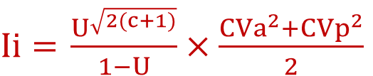
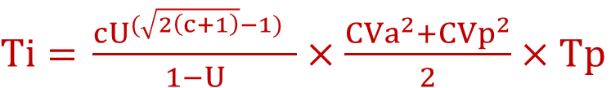
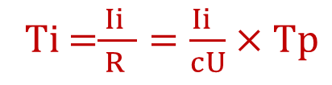
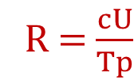
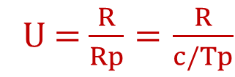

Utilization – Variability - Delay Curve
$Ii=$ $\frac{U^{\sqrt{2(c+1)}}}{1−U}×\frac{{CVa}^{2}+{CVp}^{2}}{2}$
I
U = $\frac{R}{Rp}=\frac{R}{c/Tp}$
R = $\frac{cU}{Tp}$
Variability
Increases
Ti =$\frac{ Ii }{R }=\frac{Ii }{cU}×Tp$
Average # of units in the system
$Ti=$ $\frac{{cU}^{(\sqrt{2\left(c+1\right)}−1)} }{1−U}×\frac{{CVa}^{2}+{CVp}^{2}}{2}×Tp$
$Ii=$ $\frac{U^{2}}{1−U}$
$Ti=$ $\frac{U }{1−U}×Tp$
Ip= SUM(cU)
Ip= R/ThFT
Utilization
100%
U

Slide 15
Utilization and Variability
Our two measures of effectiveness (average number of flow units waiting and their average waiting time) are driven by
  Utilization (U-Part): The higher the utilization the longer the waiting line/time.
  Variability (V-Part): The higher the variability, the longer the waiting line/time.
High utilization U= R/Rp or low safety capacity Rs =Rp – R, due to
  High inflow rate R
  Low processing rate Rp = c/Tp, which may be due to small-scale c and/or slow speed 1/Tp
Variability in the interarrival time and processing time is measured using standard deviation. Higher standard deviation means greater variability.
Standard deviation is not enough to understand the extend of variability. Does a standard deviation of 20 represents more variability or a standard deviation of 150
for an average of 80
for an average of 1000?

Slide 16
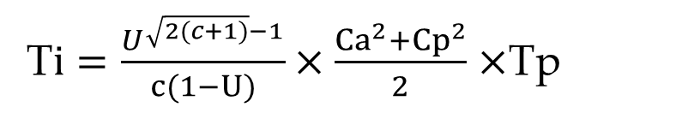
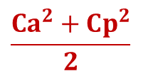
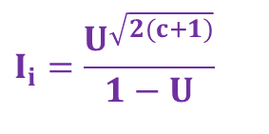
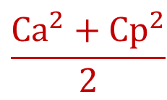
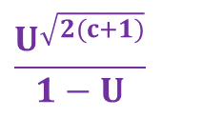
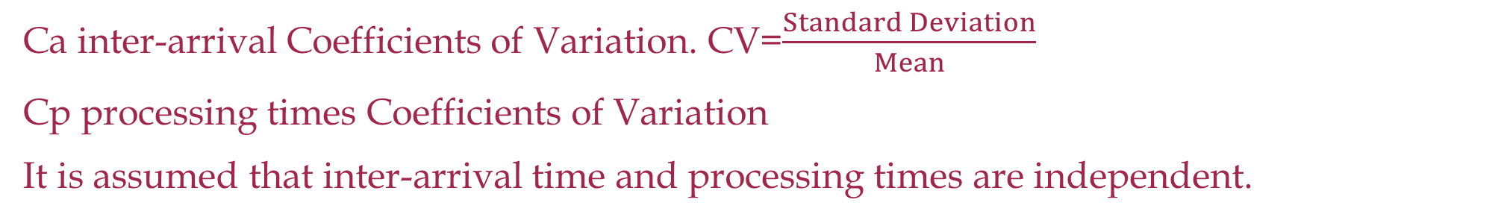
The Queue Length Approximation Formula
Utilization effect
U-part
$$\frac{U^{\sqrt{2(c+1)}}}{1−U}$$
$$\frac{Ca^{2}+Cp^{2}}{2}$$
Variability effect
V-part
Ca inter-arrival Coefficients of Variation. CV=$\frac{Standard Deviation}{Mean}$
Cp processing times Coefficients of Variation
It is assumed that inter-arrival time and processing times are independent.
$$I_{i}=\frac{U^{\sqrt{2(c+1)}}}{1−U}$$
Utilization effect; the queue length increases rapidly as U approaches 1.
$$\frac{Ca^{2}+Cp^{2}}{2}$$
Variability effect; the queue length increases as the variability in interarrival and processing times increases.
T$i=\frac{U^{\sqrt{2(c+1)}−1}}{c(1−U)}×\frac{Ca^{2}+Cp^{2}}{2}$ $×$Tp
Waiting Time in the Line = U-part×V-part×T-part

Slide 17


Elements of Queueing Theory—An Example
Example: Michigan Yacht Club Example
No place to park, I am going to another club!
Michigan Yacht Club
(2 launch ramps)
Limited space for 4 trailers
Demand = 12/hour
Leaves if no space available
Customers: Cars with boat trailers
Servers: Two launch ramps

Slide 18
Modeling Arrivals—General Arrival Models
General Arrival Models only require mean, standard deviation and coefficient of variation of interarrival times.

Slide 19
Modeling Arrivals—Markovian Models
Markovian Arrival Models: If the interarrival times follow exponential distribution, then the arrivals are called Markovian arrivals.
Markovian Arrival Models:
Probability of next arrival arrives in the next x time units:
Probability of having D = x arrivals in the next time unit (e.g., next hour)
Arrivals at the yacht club is Markovian

Slide 20
Queueing Theory—Modeling Process Times
Markovian Model:
If process times follow exponential distribution, then processing times are called Markovian.
The process times at the Yacht club is Markovian (Check the histogram)

Slide 21
Elements of Queueing Theory
Service Process
  Number of servers (Michigan Yacht Club has two servers, i.e., two launching ramps)
  Batch or single customer service (Each ramp can serve a single boat each time)
System Size
  Maximum queue size (Michigan Yacht club has maximum queue size of 4
  Maximum system size (With two ramps, the maximum system size is 6)
Service Discipline
  First Come First Served (FCFS), or Last Come First serve (LCFS), or Service in Random Order (SIRO), or Priority (Michigan yacht club follows FCFS)
Customer Population
– Finite or infinite (Michigan yacht club has infinite customer population)

Slide 22
Queueing Theory—Kendall’s Notation
Michigan Club : M/M/2/6
: Correspond to the distribution of inter-arrival times
  Use M if the inter-arrival times are Markovian (i.e., exponential distribution)
  Use D if the inter-arrival times are Deterministic (i.e., no variability)
  Use G if the inter-arrival times has completely General Distribution.
  : Corresponds to the distribution of service times
  Use M if the processing times are Markovian (i.e., exponential distribution)
  Use D if the processing times are Deterministic (i.e., no variability)
  Use G if the processing times has completely General Distribution.
: Corresponds to the number of servers (can be any number between 1 to infinity)
: Corresponds to the system size (can be any number between 1 to infinity. Omit it if no limit.
: Corresponds to the size of customer population (can be any number between 1 to infinity)
: Corresponds to service discipline (can be any of the following: FCFS, LCFS, SIRO, PRIO)

Slide 23


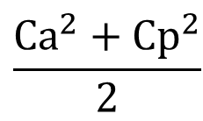
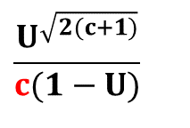
Coefficient of Variations for Alternative Distributions
While the capacity is not fully utilized, since U must be less than 1, if there is variability in arrival or in processing times, queues will build up and customers will have to wait.
Tp: average processing time ➔ Rp =c/Tp
Ta: average interarrival time ➔ Ra = 1/Ta
Sp: Standard deviation of the processing time
Sa: Standard deviation of the interarrival time
$$\frac{U^{\sqrt{2(c+1)}}}{c(1−U)}$$
$$\frac{Ca^{2}+Cp^{2}}{2}$$
$$×$$
Ti=
$$×$$
Tp

Slide 24


Utilization and Safety Capacity
Interarrival time is 8 minutes. Processing time is 7.5 minutes. There is only one server.
Both interarrival time and processing time follow Exponential distribution.
How long a flow unit stays with the server?
Tp = 7.5 min
How many flow units are with the server?
Ra= 1/8 per minute or 60(1/8) = 7.5 per hr,
Rp = 1/7.5 per minute or 60(1/7.5) = 8 per hr
Ra< Rp ➔ R=Ra ➔ U= R/Rp
U = 7.5/8 = 0.9375
Ip-cU. Since there is only one server, Ip = 0.9375
How many flow units are in the waiting line?
$$\frac{U^{\sqrt{2(c+1)}}}{1−U}$$
$$I_{i}=$$
= 14.0625
While U = 0.9375 <1 and safety capacity Rs = R_{P} - Ra = 8 -7.5 = 0.5/hr, still On average 14.1 passengers waiting in line.

Slide 25
Utilization and Safety Capacity
Waiting time in the line? RTi = Ii
Ti=Ii/R = 14.0625 /7.5 = 1.875 hr or 60(1.875)= 112.5 min.
Waiting time in the system?
T = Ti+Tp
Since Tp = 7.5 ➔ T = Ti+ Tp = 112.5+7.5 = 120 min.
Total number of passengers in the system?
I = RT = ( 7.5/60)(120) = 15
Alternatively, 14.0625 are in the buffer. How many are with the processor?
0.9375
I = 14.0625 + 0.9375 = 15
After few more computations, we will start using predesigned Excelsheets with Macros for these computations. But it is important to understand the quantitative relationships that we have discussed.

Slide 26
Utilization and Safety Capacity
Total number of passengers in the system?
I = RT = ( 7.5/60)(120) = 15
Alternatively, 14.0625 are in the buffer. How many are with the processor?
0.9375
I = 14.0625 + 0.9375 = 15
Now suppose there are 2 processors, c=2
R is still 1/8 per minute or 7.5 per hour
Rp= 2/7.5 per minutes or 60(2/7.5) = 16 /hr
U = R/Rp = 7.5/16 = 0.46875
= 0.294222
On average Ii = 0.29 passengers waiting in line.

Slide 27
Now suppose we have two servers
On average Ii = 0.29 passengers waiting in line.
Safety capacity is Rs = R_{P} - R = 16-7.5 = 8.5 flow units per hour.
Ti=Ii/R = (0.294222/7.5)60 = 2.3538 min.
Total time in the system: T = Ti+Tp
Since Tp = 7.5 ➔ T = Ti + Tp = 7.5+2.4= 9.9 min
Total number of passengers in the process:
I = 2(0.4688) = 0.9376 in the buffer and 0.2942 in the process.
I = 0.94 + 0.29 = 1.23

Slide 28
Ta = 8 mins. Tp = 7.5 mins. C=1 ➔ M/M/1

Slide 29
Ta = 8 mins. Tp = 7.5 mins. C=2 ➔ M/M/2

Slide 30
G/G/c
Consider a call center that employs 8 agents. Past data collected on the customer inter-arrival times has shown that the mean time between customer arrivals is 1 minute and has a standard deviation of 1/2 minute. The amount of time in minutes the past 10 callers have spent talking to an agent is as follows:
    4.1, 6.2, 5.5, 3.5, 3.2, 7.3, 8.4, 6.3, 2.6, 4.9.
  a) What is the coefficient of variation for the inter-arrival times?
  (standard deviation) / mean = 0.5/1 = 0.5
  b) What is the mean time a caller spends talking to an agent?
  = 5.2 minutes
  c) What is the standard deviation of the time a caller spends talking to an agent?
  = 1.88 minutes
d) What is the coefficient of variation for the times a caller spends talking to an agent?
  (standard deviation) / mean = 5.2/1.88 = 2.77
  (standard deviation) / mean = 1.88/5.2 = 0.192

Slide 31
G/G/c
e) What is the expected number of callers on hold, waiting to talk to an agent?
R= 1 per minute, c = 8, processing rate for one agent is = 1/5.2. For c=8 agents, Rp = 8/5.2 = 1.54 /min
U = R/Rp= 1/(1.54) = 0.65
f) What is the expected number of callers either on hold or talking to an agent?
I = Ii + Ip= 0.09 + 0.65(8) =5.29
g) What is the expected amount of time a caller must wait to talk to an agent?
RTi = Ii ➔ Ti = 0.09/1 = 0.09 minutes.
h) What is the expected amount of time between when a caller first arrives to the system, and when that caller finishes talking to an agent?
T = I/R = 5.29/1 = 5.29 minutes or alternatively Alternatively; T= Ti+Tp = 0.09+5.2 = 5.29

Slide 32
Terminology and Classification of Waiting Lines
Terminology: The characteristics of a waiting line is captured by five parameters; arrival pattern, service pattern, number of server, queue capacity, and queue discipline. a/b/c/d/e
M/M/1; Poisson arrival rate, Exponential service times, one server, no capacity limit.
M/G/12/23; Poisson arrival rate, General service times, 12 servers, queue capacity is 23.
Approximation formula gives exact answers for M/M/1 system.
Approximation formula provide good approximations for M/M/2 system.
From Now on, for all computations Regarding M/M/c (including M/M/1), M/G/1 (including M/D/1) and M/M/c/b we use predesigned Excelsheets with Macros.
For other situations, we use the approximation formula.

Slide 33
The arrival rate to a store is 6 customers per hour and follows Poisson distribution. The service time is 5 min per customer and follows exponential distribution.
a) Compute Processing time (How long does a customer stay with the cashier?)
Tp = 5 min.
b) On average how many customers are with cashier?
R= 6/ hr
Rp=1/Tp = 1/5 per min. or 60(1/5) = 12/hr
U= 6/12 = 0.5 ➔ Ip = 0.5
6(5/60) = 0.5
=(6/60)5 = 0.5
Alternatively;
RTp = Ip =
c) Compute Ii, Ti, Ip, Tp, I, and T.
d) What if arrival Rate changes to 11, 11.1, 11.2, ………11.9.

Slide 34
Problem 1: M/M/1 Performance Evaluation
 | 6 | 11 | 11.1 | 11.2 | 11.3 | 11.4 | 11.5 | 11.6 | 11.7 | 11.8 | 11.9
50.0% | 0.500 | 0.917 | 0.925 | 0.933 | 0.942 | 0.950 | 0.958 | 0.967 | 0.975 | 0.983 | 0.992
50.0% | 0.500 | 10.083 | 11.408 | 13.067 | 15.201 | 18.050 | 22.042 | 28.033 | 38.025 | 58.017 | 118.01
100.0% | 1.000 | 11.000 | 12.333 | 14.000 | 16.143 | 19.000 | 23.000 | 29.000 | 39.000 | 59.000 | 119.00
8.3% | 0.083 | 0.917 | 1.028 | 1.167 | 1.345 | 1.583 | 1.917 | 2.417 | 3.250 | 4.917 | 9.917
16.7% | 0.167 | 1.000 | 1.111 | 1.250 | 1.429 | 1.667 | 2.000 | 2.500 | 3.333 | 5.000 | 10.000
Average utilization rate of server - U | 50.0%
Average number of customers waiting in line Ii | 0.500
Average number of customers in system I | 1.000
Average time waiting in line Ti | 0.083
Average time in system - T | 0.167

Slide 35
Problem 1: M/M/1 Performance Evaluation
R= 6/hour with Poisson distribution. Tp = 5 min with exponential distribution.
Ii
V
U

Slide 36
Problem 2: M/M/1 Performance Evaluation
Case 1. An airport runway for arrivals only. Arriving aircraft join a single line for the runway. Exponentially distributed service time with a rate 25 arrivals /hour. Poisson arrivals with a rate 18 / hour. Compute Tp, Ip, Ii, Ti, I, and T. Case 2. Now suppose we are in holidays and the arrival rate increases to 21 arrivals/hour. Case 3. Now suppose we have a bad weather, and the service rate decreases 22 landing /hour. Case 4. Now suppose we open a second runway. R=21, Rp=2*25/hr ➔ U= 21/50 = 0.42

Slide 37
Problem 7
Bank of San Pedro has only 1 teller. On average, 1 customer comes every 6 minutes, and it takes the teller an average of 3 minutes to serve a customer. To improve customer satisfaction, the bank is going to implement a unique policy called, “We Pay While You Wait.” Once implemented, the bank will pay each customer $3 per minute while a customer waits in line. (So the clock starts when a customer joins the line and stops when the customer begins to talk to the teller.) Bank of San Pedro hired you as a consultant and you are responsible for estimating how much the “We Pay While You Wait” program will cost. Assume linear cost. If a customer waits for ten seconds in line, Bank of San Pedro will pay $0.5. Assume that arrival follows Poisson and service time follows exponential distribution.
Compute the capacity of the Teller Station.
It takes the teller an average of 3 mins to serve a customer, 60/3 = 20 customers per hr.
b) Compute the proportion of the time the teller is busy.
R=10, Rp= 20 ➔ U= R/Rp= 10/20 = 0.5 ➔ Busy 50%, Idle 50%.
c) Compute key waiting line Metrics.

Slide 38
Problem 7
Average utilization rate of server - U
Average number of customers waiting in line Ii
Average number of customers in system I
Average time waiting in line Ti
Average time in system - T
Ii= 0.5
There is 0.5 customers around the clock in the waiting line.
We pay $3 per minute for one customer in the line. That is $3(60) =$180 per hour for one customer in the line.
We have 0.5 customers, that is 0.5($180) = $90 per hour.
It seems you do not believe me.
Lets compute it in an alternative way.

Slide 39
Problem 7
Average utilization rate of server - U
Average number of customers waiting in line Ii
Average number of customers in system I
Average time waiting in line Ti
Average time in system - T
Each customer spends 0.05 hours.
Why hour?
Because R and Rp were in hours. 0.5(60)= 3 minutes in the line.
He or she receives, on average, 3(3) =$9.
There are 10 customers arriving per hour.
The overall hourly cost of this program is 9*10=$90.

Slide 40
Problem 7
e) Suppose each additional clerk costs X dollars per hour (including all other clerk related costs such as benefits, space and equipment hourly costs). Compute the maximum value of X if it is at our benefit to hire one additional clerk?
If we have two clerks, Rp increases from 20 to 40, and utilization drops from 0.5 to 10/40 = 0.25.
Ii= 0.0333 for two clerks.
Ii reduced from 0.5 customers to 0.033 customers = 0.467 reduction in the number of customers in the line.
That is 0.467(3(60))= $84 cost reduction.
We are ready to pay up to $84 for the second clerk.
f) Suppose each additional clerk costs $30 per hour. How many new clerk should we hire, one or two?
Obviously, it is at our benefit to hire one clerk. But lets also think about two.

Slide 41
Problem 7
If we hire two clerks (to have 3 clerks), Rp increases to 60, and utilization drops 10/60 = 0.167. With three clerks, Ii os reduced to 0.003.
That is from 0.033 with two clerks to 0.003. That is 0.03 reduction.
By adding the third clerk, there are 0.03 less customers waiting in line (each hour and always)
180(0.03) = about $5-$6.
It is not at our benefit to hire the second additional clerk, pay $30 per hour capacity cost to reduce waiting cost by $5-$6 per hour.
We did not need to do this much computations for the third clerk. With two clerks the total number of customers waiting in line was 0.033.
Even if we reduce the number of customers in the waiting line to 0, we have reduced the line by 0.033(180) =$6. It is not worth the cost $30 to benefit $6
And we will pay not even one dollar (0.003(180)) for the fourth clerk.

Slide 42
Problem 8. Effect of Pooling- M/M/2 vs. 2M/M/1
R
Tp
Server 1
Queue1
2M/M/1
Server 2
Queue2
R
Tp
Server 1
M/M/2
20/hr
Queue
Server 2

Slide 43
Problem 8. Effect of Pooling- M/M/2 vs. 2M/M/1
10/hr
5 min
Server 1
Queue1
2M/M/1
Server 2
Queue2
10/hr
5 min
Server 1
M/M/2
20/hr
Queue
Server 2

Slide 44
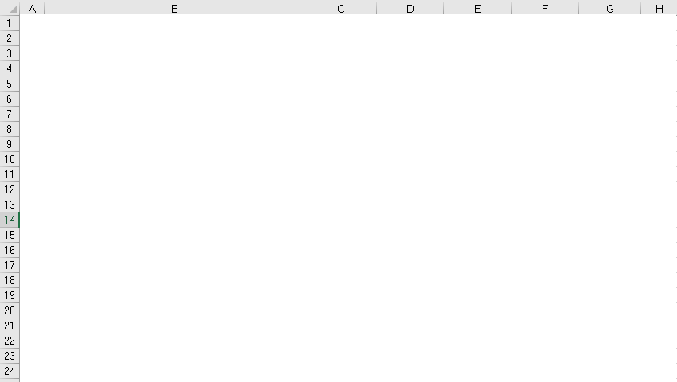
Problem 8. Effect of Pooling- M/M/2 vs. 2M/M/1

Slide 45
Problem 8. Effect of Pooling- M/M/2 vs. 2M/M/1
U = R/Rp =10/12 = 5/6 ➔
Ip = cU = U = 0.833 or
RTp =Ip ➔ 10(5/60) = 0.833
10/hr
Ti = 25 min.
Tp= 5 min
Tp= 5 min
Server 1
Queue1
Ii = 4.167
Ip= 0.833
Ip=
0.833
+0.833
---------
1.667
Ii = 2*4.167 = 8. 334
Ti = 25 min.
Tp= 5 min
Ti = 25 min.
Server 2
Queue2
10/hr
Ii = 4.167
Ip= 0.833
T= Tp+Ti = 5+ 25 = 30 mins

Slide 46
Problem 8. Effect of Pooling- M/M/2 vs. 2M/M/1
U = R/Rp =20/24 = 5/6 ➔
Ip = cU = 2(0.833) = 1.667 or
RTp =Ip ➔ 20(5/60) = 1.667
Tp= 5 min
Server 1
20/hr
Queue
Ii = 3.79
Server 2
Ti = 11.36 min.
T= Tp+Ti = 5+11.365 = 16.36 mins
Why is Design B better than A?
  Design A the waiting time of customer is dependent on the processing time of those ahead in the queue
  Design B, the waiting time of customer is only partially dependent on each preceding customer’s processing time
  Combining queues reduces variability and leads to reduce waiting times

Slide 47
Problem 11
American Vending Inc. (AVI) supplies vending food to a large university. Because students often kick the machines out of anger and frustration, management has a constant repair problem. The machines break down on an average of 3/hr, and the breakdowns are distributed in a Poisson manner. Downtime costs the company $25/hr/machine, and each maintenance worker gets $4 per hr.
One worker can service machines at an average rate of 5/hr, distributed exponentially;
2 workers working together can service 7/hr, distributed exponentially;
and a team of 3 workers can do 8/hr, distributed exponentially. What is the optimal maintenance crew size for servicing the machines?

Slide 48
Problem 11
c=????
c = 1
U=??
Down time cost = 25Ii
Capacity Cost= 4(# of team members)
Total Cost
Have I made any mistakes?
Downtime costs the company $25 /hr/machine.
When the machine is down?
Until it is up.
In the waiting line it is down. In the processor until the end of the process it is down.
There fore, besides Ii, I also need Ip
Ip is simply U+Ii

Slide 49
Problem 11

Slide 50
Problem 11
Lets check by using Ti and Tp instead of Ii and Ip

Slide 51
Performance Improvement Levers
These slides have been developed on the foundations provided by the following book.

Slide 52
Lessons Learned
If inter-arrival and processing times are constant, queues will build up if and only if the arrival rate is greater than the processing rate.
If there is (unsynchronized) variability in inter-arrival and/or processing times, queues will build up even if the average arrival rate is less than the average processing rate.
If variability in interarrival and processing times can be synchronized (correlated), queues and waiting times will be reduced.

Slide 53
Performance Measures
Financial Performance Measures
  Sales: Throughput Rate
  Cost: Capacity utilization, Flow units in queue / in system
  Customer service: Waiting Time in queue /in system
Performance Improvement Levers
  Decrease variability in inter-arrival and processing times.
  Decrease capacity utilization.
  Synchronize available capacity with demand.

Slide 54
1. Arrival Variability Reduction Levers
Customers arrival are hard to control
  Better scheduling, Reservations, Appointments, Price differentials (matinee shows, early-bird , off-season rates for hotels) , alternative services (ATM, Online). Batch size reduction, JIT. etc…Demand management strategies. The objective is to reduce the arrival rate during peak periods of congestion as well as to reduce variability in inflows. If queues are visible to arrivals, demand management may be self-enforcing. Restaurant being so crowded that nobody goes there anymore!
Limit product variety, increase commonality of parts.

Slide 55
2. Capacity Utilization and Variability Reduction Levers
U↓ (or increase Rs) → delays ↓ and queues ↓. To decrease U = Ra/Rp or Rs=Rp-Ra), we can decrease capacity utilization (or increase safety capacity).
Increase scale of the process (c).
Increase speed of the process (Tp). Tp reduction: Methods, Training, Standardization, Technology, Lower employee turnover rate, More experienced work force, Parallel Processing, Pre-processing, Alternative Services. State of the art order processing at McDonald’s drive-through. Starbuck’s baristas often make multiple coffee drinks in parallel . Preregistration at hospitals or printing boarding passes online), Customer participation in a self-service salad bar.
Pool capacity across homogeneous arrivals and separate heterogeneous arrivals

Slide 56
3. Synchronizing Capacity with Demand
Capacity Adjustment Strategies
  Personnel shifts, cross training, flexible resources.
  Workforce planning & season variability.
  Synchronize the available processing capacity with demand, Better scheduling.

Slide 57
Variability Reduction Levers - Arrivals
The average queue length (and hence waiting time in queue) is directly proportional to the sum of the squares of the two coefficients of variation of interarrival and processing times.
In manufacturing, reliable suppliers, (lover variability in lead time leads to reduced safety inventory), batch size reduction (leads to reduction of average inventories and flow times).
In service operations where there is only limited control over customer arrivals, it is possible to make arrivals more predictable through scheduling, reservations, and appointments. Medical offices and restaurants try to match capacity with uncertain demand through appointments and reservations. – there are still late arrivals and no show-ups.

Slide 58
Variability Reduction Levers - Processing Times
To reduce variability in processing times, we must understand its source. A common resource may be used for producing a variety of products, each requiring very different processing times. We can reduce the processing time variability by limiting product variety or specializing resources to perform only a narrow range of processing. Standard express meal packs in fast food restaurants, specialized teller windows at banks, and separate extensions for different types of telephone calls. Processing times may be variable because of a lack of standardization or training . Toyota defines an exact sequence of activities for each workstation, resulting in a reduction in the variability in processing times as well as in the average processing time. Experienced workers tend not only to process faster but also do so with higher consistency in terms of the processing time (as well as output quality).

Slide 59
Variability Reduction Levers - Processing Times
Therefore, any managerial actions and incentives aimed at maintaining a stable workforce and low turnover rate will lead to shorter and more consistent processing times and better process performance in terms of shorter queues and delays.
It is impossible to eliminate all sources of variability. Banks cannot force customers to come in at regular intervals; each customer decides when to go to the bank independently . Banks cannot eliminate processing time variability completely because different customers have different transaction needs, and all these cannot be standardized. In fact, the primary virtue of make-to-order processes is their ability to provide customization. Given the presence of unavoidable variability in inflow and processing times, managers must deal with it by investing in some safety capacity albeit at a higher cost.

Slide 60
Capacity Synchronization Levers – Short Term
Synchronization of supply and demand requires managing either the supply (capacity) or the demand (arrival rates).
Adjusting capacity in response to demand may not be economical or even feasible . Examples are the number of rooms in a hotel or tables in a restaurant . We must manage demand; using off‑season hotel rates and differential pricing.
In the short term, adjusting human resources is easier than capital resources. Checkout counters are opened/closed depending on the number of waiting customers. This strategy also illustrates the advantages of pooling the available total capacity, but it requires that all personnel are trained to perform different tasks. Importance of resource flexibility in reducing the permanent capacity requirements.
Servers often tend to work faster as the queues get longer.

Slide 61
Capacity Synchronization Levers – Long Term
In a somewhat longer time frame, synchronization is easier. In call centers and fast food restaurants—demand varies by the time of the day and the day of the week. This seasonality can be anticipated with a high degree of accuracy. The managers can then plan the required capacity (personnel) to match the forecasted demand. McDonald’s plans the required number of personnel in 15‑minute intervals by scheduling their shifts and breaks and by using part-time workers.
In manufacturing operations, managers can synchronize the arrival and processing rates by limiting the size of the buffer that is allowed to build up between the two workstations. The feeder workstation is then forced to stop once its output buffer is full. The synchronization decreases the in-process inventory and waiting time but also results in some loss of throughput.

Slide 62
Pooling and Segregation Levers
8.8.5 Pooling and Segregation Levers
As we saw in Section 8.7, merging of queues of similar customers leads to improved utilization of the available capacity. Pooling is often implemented in banks, post offices, departments of motor vehicles, where a single line feeds into the server pool, instead of a separate line for each server. Similarly, in call centers, all customers call one number and are then routed to the next available agent. Note that if arrivals can see and switch between queues, then having separate queues for different servers is equivalent to a single queue that is served by the entire pool. Thus, for example, in restaurants such as McDonald’s, each cash register has a separate queue of customers waiting to place orders. However, if a server becomes idle, he/she takes orders from customers in adjacent lines (although perhaps not necessarily in the FCFS fashion).

Slide 63
Pooling and Segregation Levers
Note, however, that pooling different types of customers increases variability in processing times and requires that the servers have sufficient flexibility to be able to process a variety of jobs. The cost of cross-training required must be weighed against the benefits of pooling. Similarly, we have seen above that specialization reduces the average processing time as well as its variability and may improve the service quality. Therefore, segregating customers according to their processing requirements will result in reduced waiting times and queues within each class. Supermarkets keep special checkout counters for customers with fewer items, which reduces the mean as well as variability in their processing times, thus reducing the average overall wait.
The key to allocating the available capacity is to collect information about processing requirements of customer arrivals, so that customers can be classified into homogeneous classes and each class can assigned to a separate pools of servers. The result will be reduced average and variability in processing times within each class due to server specialization.

Slide 64
Managing Customer Perceptions and Expectations
Waiting has significant economic and behavioral implications.
Provide Comfort. Comfortable seating, well decorated surroundings, friendly staff.
Provide Distraction. TV monitors, video games, mirrors, etc.
Provide Information. Customers tolerate waits better if they are informed of the expected waiting times.
Provide Explanation. It creates the empathy if customers sense that the management is aware of the customers waiting and is doing something about it.
Manage Expectations. Customers are often willing to wait longer if the service itself is time consuming. Customers with full carts are willing to wait longer. Sometimes, pessimistic estimates are provided so customers are pleasantly surprised when the actual wait turns is less than the announced period.

Slide 65
Managing Customer Perceptions and Expectations
Ensure Fairness Customers complain if later arrivals have been served first. Pooling arrivals in a single waiting line creates a sense of fairness; with separate waiting lines, the other line always seems to move faster than ours! Although providing priority service to customers paying a premium price may be economically rational, it may appear unfair to the rest who perceive that the rich get preferential treatment.
Sometimes quick service and short waits may be perceived to imply lower quality experience! Fine dining experience would involve a long, leisurely meal, prepared and served in a relaxed atmosphere.
Managing customer expectations and perceptions of the wait could be just as important a lever as reducing the actual waiting time itself.

Slide 66
Problem 12
Bank of San Pedro has only 1 teller. On average, 1 customer comes every 6 minutes, and it takes the teller an average of 3 minutes to serve a customer. To improve customer satisfaction, the bank is going to implement a unique policy called, “We Pay While You Wait.” Once implemented, the bank will pay each customer $3 per minute while a customer waits in line. (So the clock starts when a customer joins the line, and stops when the customer begins to talk to the teller.) Bank of San Pedro hired you as a consultant and you are responsible for estimating how much the “We Pay While You Wait” program will cost. Your preliminary study indicates there are, on average, 0.5 customers waiting in line. Assume linear cost. If a customer waits for ten seconds in line, Bank of San Pedro will pay $0.5. Assume that arrival follows Poisson and service time follows exponential distribution.

Slide 67
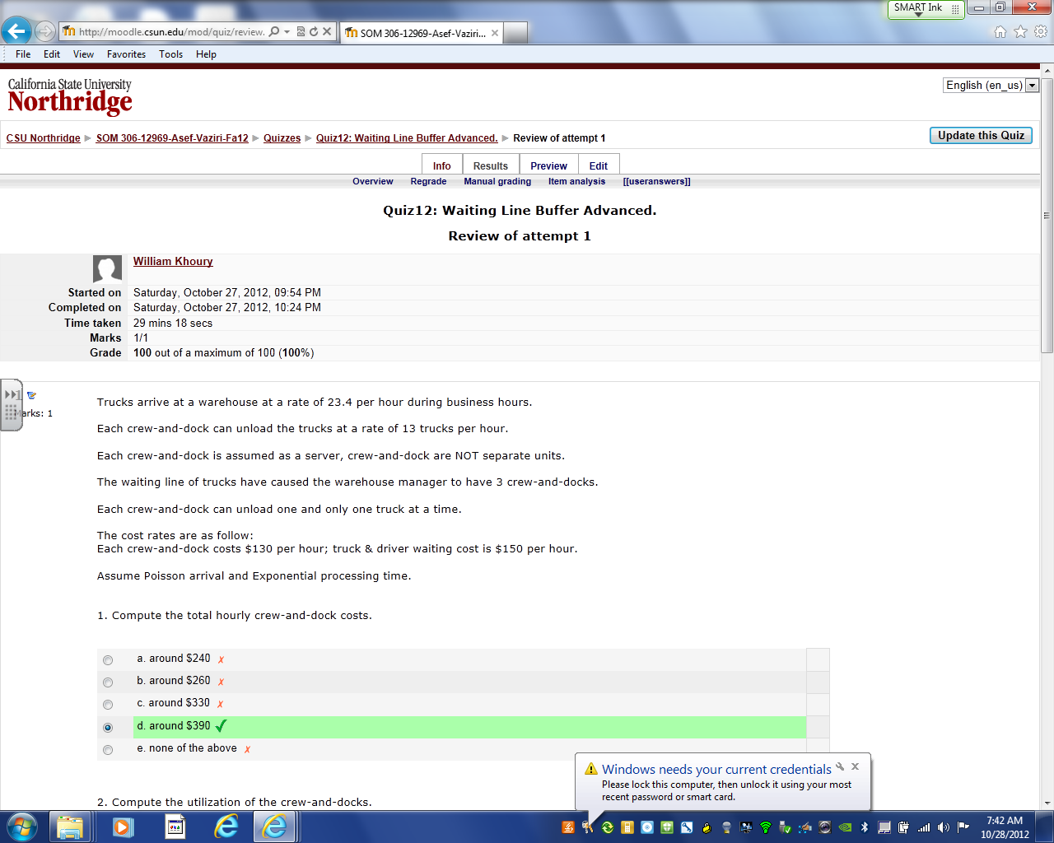

Slide 68
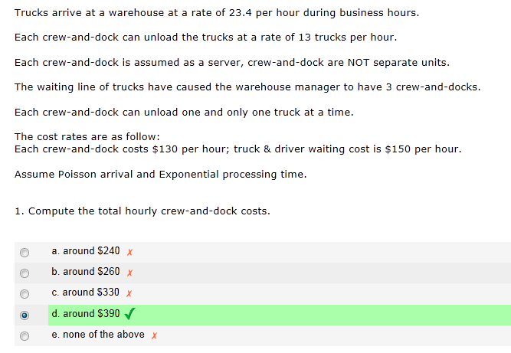
$130 (3) = 390

Slide 69
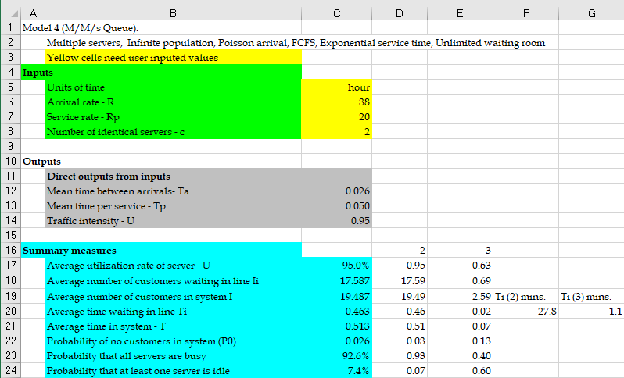
Queueing Models of Single-Stage Processes—An Example
A bank has two tellers who serve customers waiting in a single line. Customers arrive according to a Poisson process with a rate of 38 customers per hour. The time it takes for a teller to serve a customer follows Exponential distribution with an average of 3. Bank managers are considering to hire another teller to reduce customer waiting time.

Slide 70
Single-Stage Processes—Impact of Utilization on Flow Times
In Diorucci Furniture, the time to complete a customer’s has an average of 3 days and standard deviation of 6 days.
The demand, which follows Poisson process, is expected to increase from 8 orders per month to 9 orders per month.
The company’s policy has been to keep the average time the customers wait until they get their order—the average order lead time—less than 50 days. Managers are worried that the expected increase
Marketing department’s claim:
Two years ago when demand increased by one unit from 7 to 8 days, the average order lead time increased by 13 days. Thus, increasing the demand by one unit from 8 to 9 would increase the average order lead time from its current 31 days to 31 + 13 = 44 days, which is still lower than the company’s goal of 50 days. Thus, they concludes that no action is needed to handle the new demand.
Question: Do you agree with?
http://www.csun.edu/~aa2035/CourseBase/WaitingLine/Slides/M-G-1-Rags-Seyed-Furniture.xlsx

Slide 71
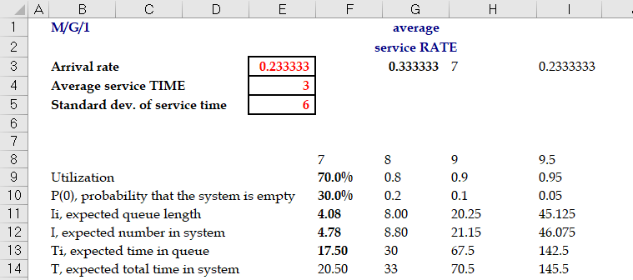
Single-Stage Processes—Impact of Utilization on Flow Times
Conclusion:
Increase in demand by one unit increases the average lead time to about 70 days.

Slide 72
Single-Stage Processes—Impact of Utilization on Flow Times

Slide 73
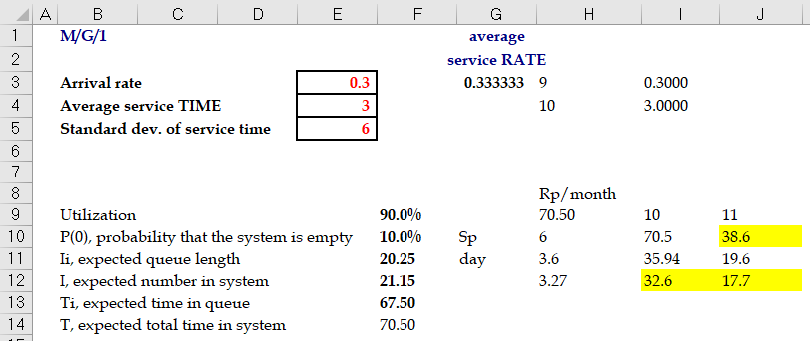
Single-Stage Processes—Impact of Variability on Flow Times
To decrease lead time, Diorucci Furniture is considering the following two actions
Increasing Capacity: Increasing capacity of the factory by 10 percent from 10 orders to 11 orders per month. Increasing capacity is not expected to affect the variability.
Reducing Variability: Implementing lean manufacturing principles to reduce the variability in the order processing time by 40 percent from 2 to 1.2 or less.
Question: Do you think if any of these actions can keep the target lead time below 50 days when the demand increases to 9 orders per month?

Slide 74
Single-Stage Processes—Impact of Variability on Flow Times

Slide 75
Single-Stage Processes—Impact of Variability on Flow Times

Slide 76
Single-Stage Processes with Limited Buffer Size
Easysurrance call center has two agents who answer the calls.
The time that takes an agent to answer a caller’s inquiry follows an exponential distribution with mean of 15 minutes.
The call center has 7 different phone lines, called Trunk Lines. If a customer calls and all 7 lines are busy, the customer will hear a busy signal and will hang up.
Calls that do not get busy signals (i.e., not blocked) and are connected to the call center, and wait on hold (if no agent is available). These calls are answered in the order they are received.
Data shows that call arrivals according to a Poisson process with a mean of 11 calls per hour
Performance Measure: Call center performance is measured based on three metrics:
Average Speed of Answer (ASA): the average time a caller waits on hold before speaking to an agent.
Fraction of Blocked Callers (FBC the percent of callers who get busy signal and thus are blocked from getting connected to the call center.
Occupancy (OCC), is the percentage of time call center agents are busy answering calls.

Slide 77
Single-Stage Processes with Limited Buffer Size
M/M/3/7
New service Goals: The new service goals are to keep ASA below 4 minutes and FBC below 15 percent and occupancy above 75 percent.
Question: To achieve these goals, they are authorized to hire one additional agent if needed. Managers are wondering if hiring an additional agent can help them achieve the new service goals.
After hiring an agent, Easysurrance call center is an M/M/3/7 queueing systems.

Slide 78
Single-Stage Processes with Limited Buffer Size
Utilization:
Offered Load:
Throughput:
Probability of all agents being idle: :
Average Flow Time:
Probability of a customers is blocked (FBC):
Utilization (OCC) and throughput:
Average Inventory:

Slide 79
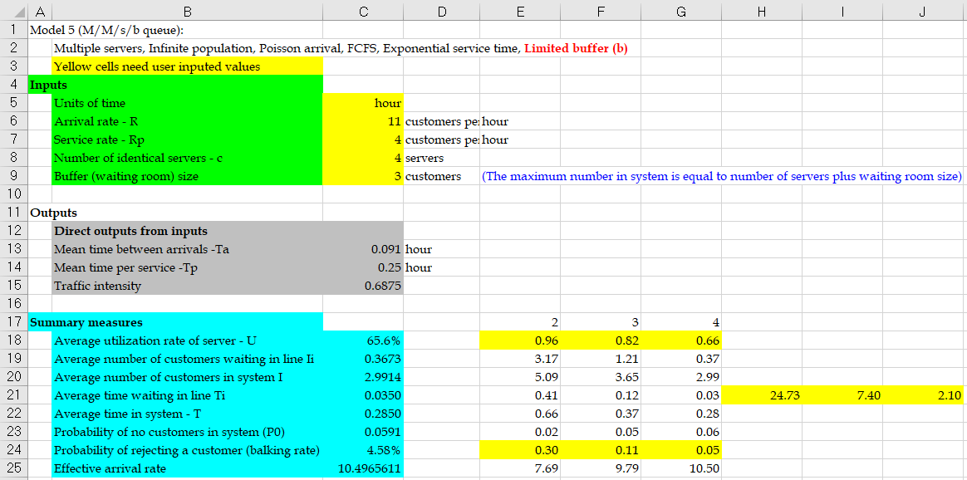
Single-Stage Processes with Limited Buffer Size

Slide 80
Single-Stage Processes with Limited Buffer Size
Question: After hiring one agent, the target level FBC < 15% will be satisfied. But what about ASA being less than 4 minutes?
ASA violates the target level of ASA < 4 minutes.
However, with one additional agent, the center will have the occupancy of 81.6%, satisfying target level OCC > 75%.
With Two Additional Agents: The system becomes M/M/4/7, and:
FBC = 4.6% < 15% , ASA = 2.1 < 4 minutes , OCC = 65.6% (violating the target level)

Slide 81
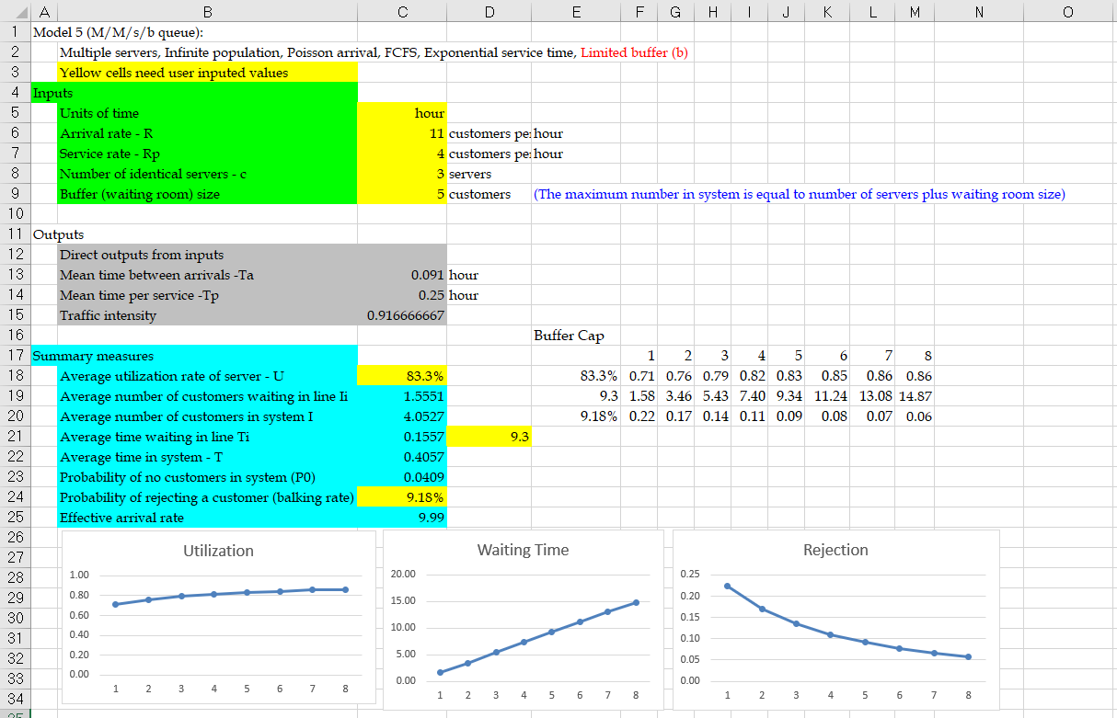
Single-Stage Processes—Impact of Limited Buffer Size
Managers of Easysurrance call center are not sure if they can get permission to hire more than one agent. Thus, before deciding to hire an additional agent, they are trying to find other ways to achieve their new service goals.
One suggestion is to improve their performance by increasing the number of trunk lines.
Question: How does increasing the number of trunk lines affect average speed of answer (ASA) and fraction of blocked callers (FBC) as well as occupancy (OCC) in their call center?

Slide 82
Single-Stage Processes—Impact of Limited Buffer Size

Slide 83
Single-Stage Processes with Limited Buffer—Impact of Variability
Easysurrance decided to hire one agent and reduce the number of trunk lines to 6.
The arrival rate is still 11 calls per hour.
Managers are now considering a training program for all their agents that can reduce the variability in (coefficient of variation of) call handling times from 1 to 0.5.
Question: How will this change impact the call center measures in the coming year?
With change in CV_{eff} = 1 to CV_{eff} = 0.5, the queueing model of call center would be M/G/3/6, for which there is no simple queueing model, so we must use computer simulation.
Using computer simulation we get the following:
FBC is reduced from 13.5% to 7.8%
OCC is increased from 79.3% to 84.1%
ASA is decreased from 5.4 minutes to 4.9 minutes

Slide 84
Single-Stage Processes with Limited Buffer—Impact of Variability

Slide 85
Flow Time Analysis—Service Levels
Expresso is a manufacturer of espresso machines one-by-one in a produce-to-order fashion.
Time to finish an order in one of 3 assembly cells follows an exponential distribution with mean of 2 days.
The firm receives orders according to a Poisson process with a rate of 1.4 orders per day.
Current data shows the following:
It takes an average of around 10 days from the time a customer places an order until the order is shipped.
About 63 percent of the customers receive their orders within the 10 days.
However, one of every five customers receives their orders in 17 days or more.
Improving Performance:
Managers of Expresso want to increase the capacity of each cell by 10 percent. They believe this increase in capacity such that
(i) at least 90 percent of the customers receive their orders within a week of placing their orders, and
(ii) the percent of customers who receive their orders later than 10 days would be less than 3 percent.
Question: Can this capacity investment help Expresso to achieve its new service goals?

Slide 86
Flow Time Analysis—Service Levels

Slide 87
Flow Time Analysis—Service Levels
Fraction of Delayed Customers (FDC):
Utilization:
Throughput:
Where :
Average Flow Time:
Flow Time Service Level:
In-buffer Flow Time Service Level:
Average Inventory:

Slide 88
Flow Time Analysis—Service Levels
Expresso’s process after increasing capacity would be an M/M/3 queueing system with capacity of μ = 1.10 (0.5) = 0.55 orders per day and λ = 1.4 orders per day.

Slide 89
Flow Time Analysis—Service Levels
Computing flow time service level for t = 7 days:
Repeating the above calculation for t = 10 days we get
Conclusion:
After investing in increasing the capacity by 10 percent,
Only 77.5 percent of customers will receive their orders within 1 week.
About 1 – 0.892 = 0.108 = 10.8% of customers will receive their orders later than 10 days after they place their orders.

