Slide 1
Problem 12
Bank of San Pedro has only 1 teller. On average, 1 customer comes every 6 minutes, and it takes the teller an average of 3 minutes to serve a customer. To improve customer satisfaction, the bank is going to implement a unique policy called, “We Pay While You Wait.” Once implemented, the bank will pay each customer $3 per minute while a customer waits in line. (So the clock starts when a customer joins the line, and stops when the customer begins to talk to the teller.) Bank of San Pedro hired you as a consultant and you are responsible for estimating how much the “We Pay While You Wait” program will cost. Your preliminary study indicates there are, on average, 0.5 customers waiting in line. Assume linear cost. If a customer waits for ten seconds in line, Bank of San Pedro will pay $0.5. Assume that arrival follows Poisson and service time follows exponential distribution.

Slide 2
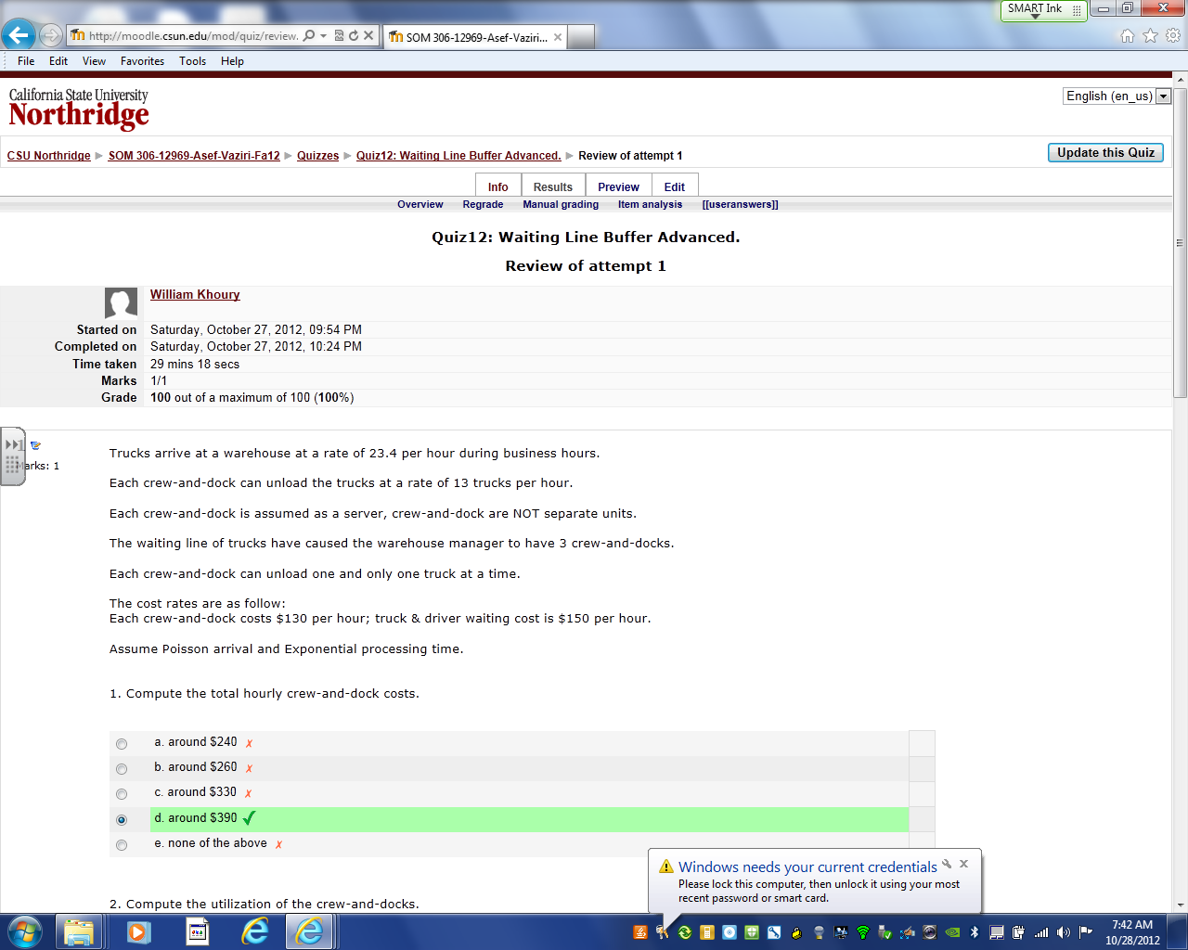

Slide 3
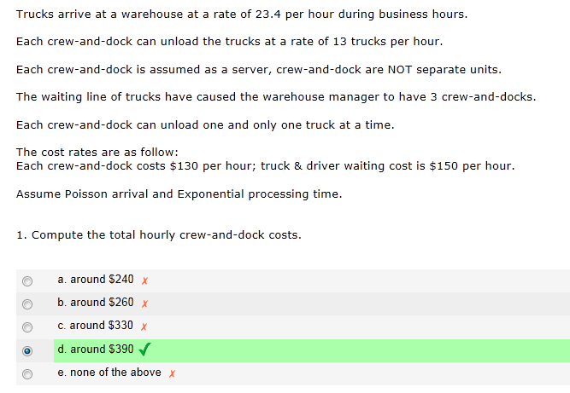
$130 (3) = 390

Slide 4
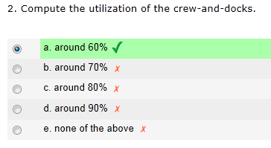
R=23.4/hr
Rp=3(13) =39/hr
Tp=1/13 hour
Rp =3/[1/13] =39/hr
Tp=60/13 min
Rp =3/[60/13] =39/60/min
U=R/Rp=23.4/39 = 0.6

Slide 5
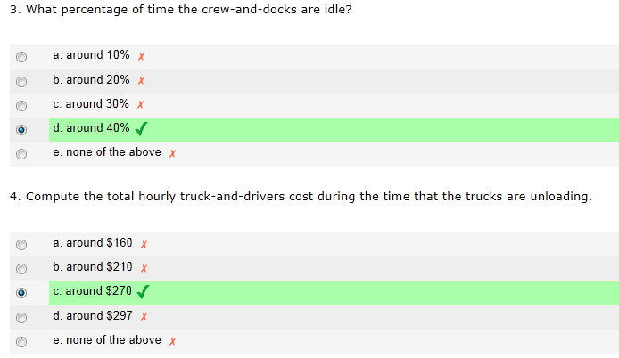
1-0.6 = 0.4 = 40%
On average how many trucks are unloading?
c = 3
U = 0.6
Ip= cU
Ip= 3(0.6) = 1.8
$150 cost of 1 truck and driver /hr
150(1.8) = $270

Slide 6
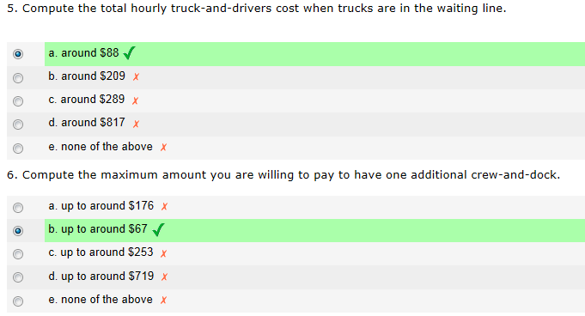
150(0.589464) = $88.42
R=23.4/hr
Rp=4(13) =52/hr
U=R/Rp=23.4/52 = 0.45
150(0.145546) = $21.83
88.42-$21.83 = 66.59
150(0.589464-0.145546) = $66.59

Slide 7
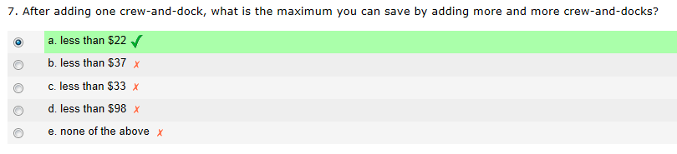
150(0.145546) = $21.83

