Slide 1
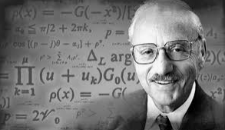
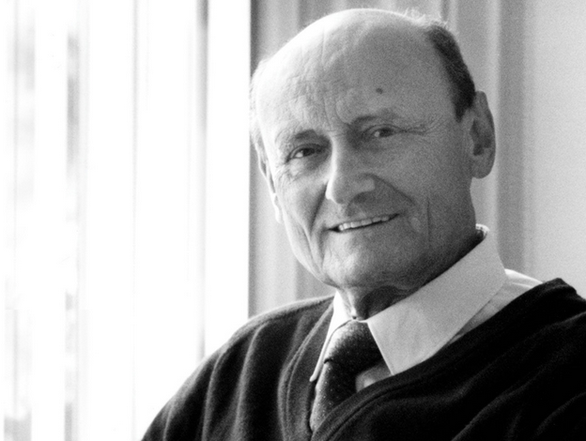
A Second Talk on LP & IP
A Basic Transportation & Supply Chain Model
How can it be that mathematics, being after all a product of human thought which is independent of experience, is so admirably appropriate to the objects of reality?
Albert Einstein, 1879-1955

Slide 2
The Problem
Four manufacturing plants, with capacities of P1(80), P2(100), P3(120), and P4(140).
Three warehouses of capacities W1(90), W2(110) and W3(130).
Four distribution centers with capacities of D1(80), D2(100), D3(120), D4(140)
The warehousing capacity is 110 units short of the plants and distribution centers.
Three candidate locations, C1, C2, C3, to built a single warehouse with the capacity of 120.
Per unit P-W and W-D transportation costs are given below.

Slide 3
From Plants to Existing and Future Warehouses

Slide 4
From Warehouses to Distribution Centers

Slide 5
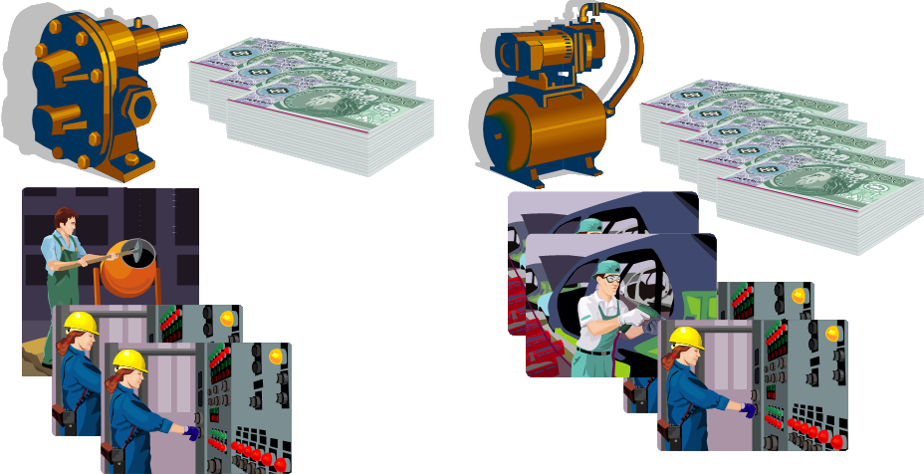
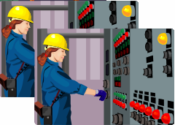
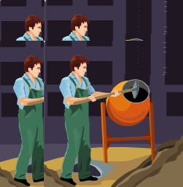
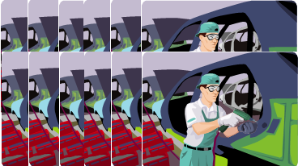
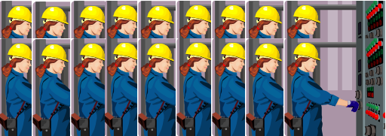
A Prototype Linear Programming Example
Objective Function
Z = 3 x₁ +5 x₂
Constraints
Resource 1
x₁ ≤ 4
Resource 2
2x₂ ≤ 12
Resource 3
3 x₁ + 2 x₂ ≤ 18
Nonnegativity
x₁ ≥ 0, x₂ ≥ 0

Slide 6
Problem Formulation
Objective Function
Z = 3 x₁ +5 x₂
Constraints
Resource 1
x₁ ≤ 4
Resource 2
2x₂ ≤ 12
Resource 3
3 x₁ + 2 x₂ ≤ 18
Nonnegativity
x₁ ≥ 0, x₂ ≥ 0

Slide 7
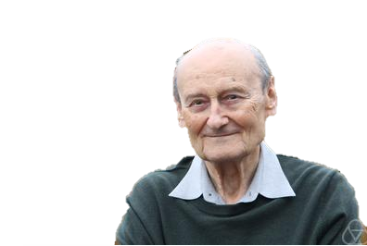
A Second Talk on LP & IP
A Basic Transportation & Supply Chain Model
How can it be that mathematics, being after all a product of human thought which is independent of experience, is so admirably appropriate to the objects of reality?
Albert Einstein, 1879-1955

