Slide 1
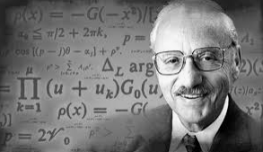
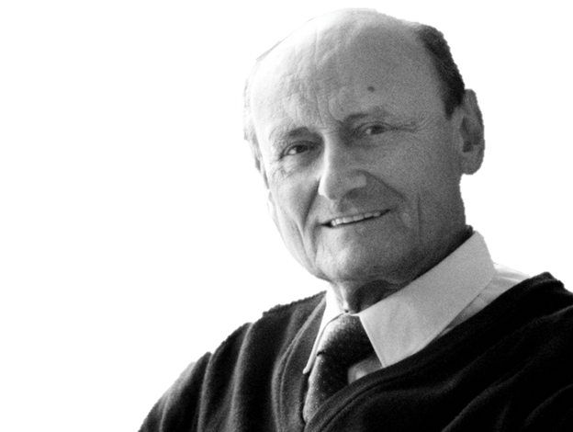
A Second Talk on LP & IP
A Basic Transportation & Supply Chain Model
How can it be that mathematics, being after all a product of human thought which is independent of experience, is so admirably appropriate to the objects of reality?
Albert Einstein, 1879-1955

Slide 2

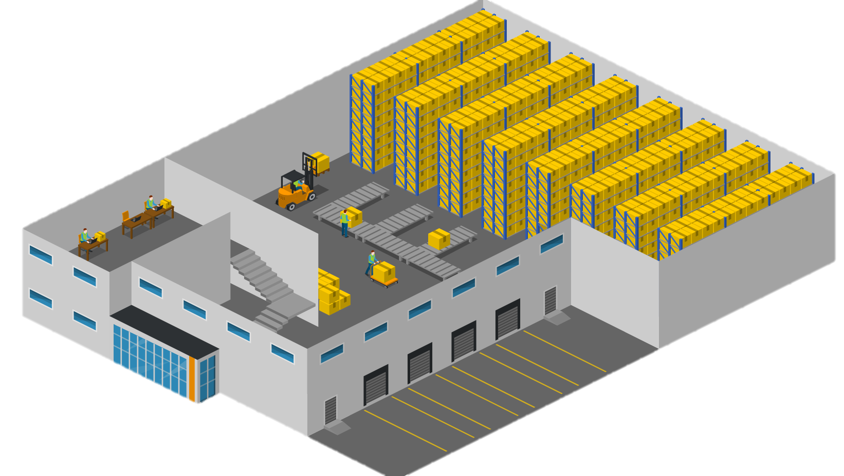
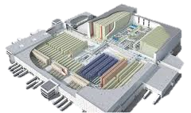
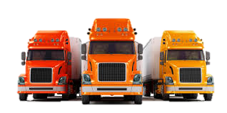
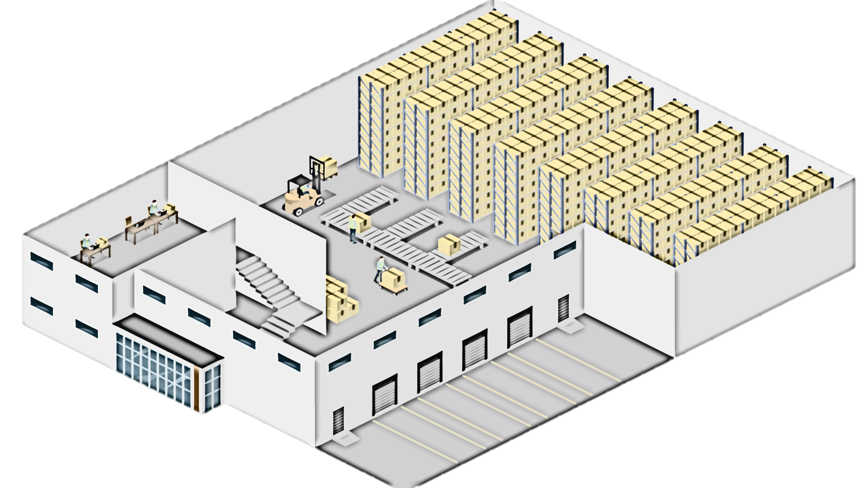
A Basic LP&IP - Transportation & Supply Chain Model

Slide 3
Supply, Demand, Unit Transportation Costs, Operational Costs

Slide 4
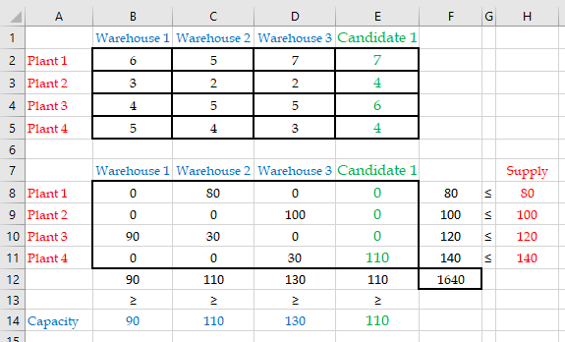
Plant to Warehouse

Slide 5
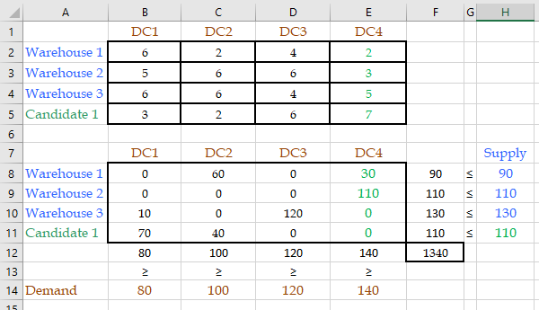
Warehouse to DC

Slide 6
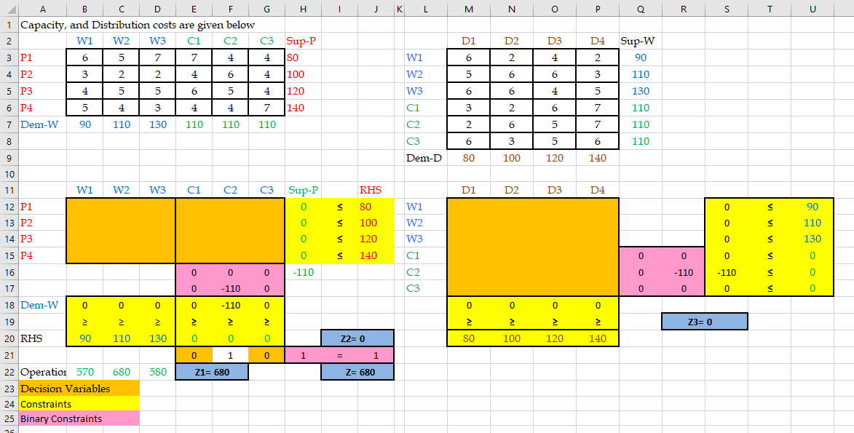
MIP-Setup

Slide 7
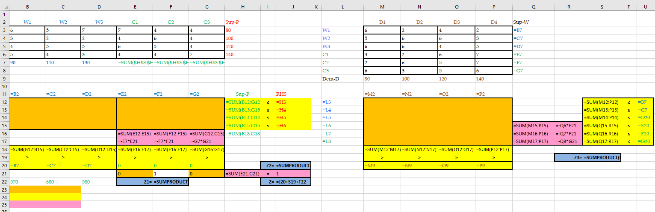
MIP Formulas
=SUM($H$3:$H$6)-SUM($B$7:$D$7)

Slide 8
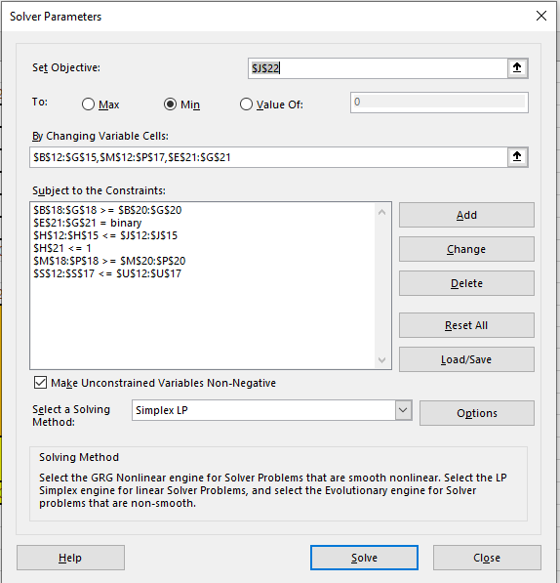
MIP-Model to SOLVER

Slide 9
Optimal Solution

Slide 10
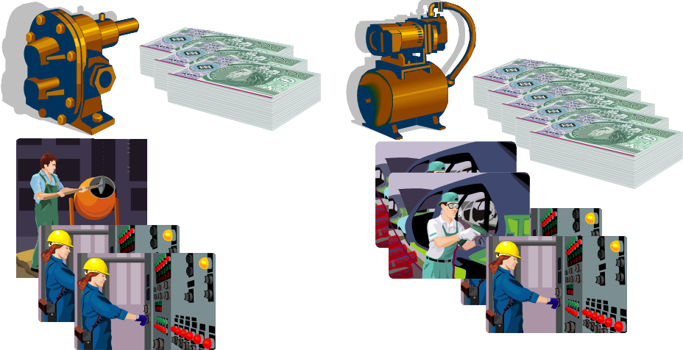

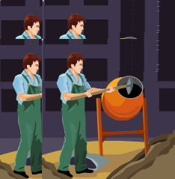
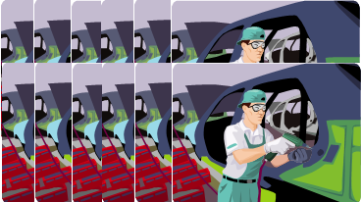
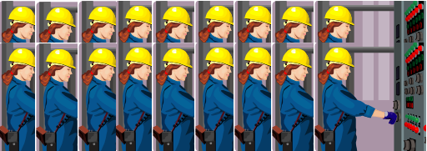
A Prototype Linear Programming Example
Objective Function
Z = 3P1 +5P2
Constraints
Resource 1
P1 ≤ 4
Resource 2
2P2 ≤ 12
Resource 3
3P1 + 2P2 ≤ 18
Nonnegativity
P1≥ 0, P2≥ 0

Slide 11
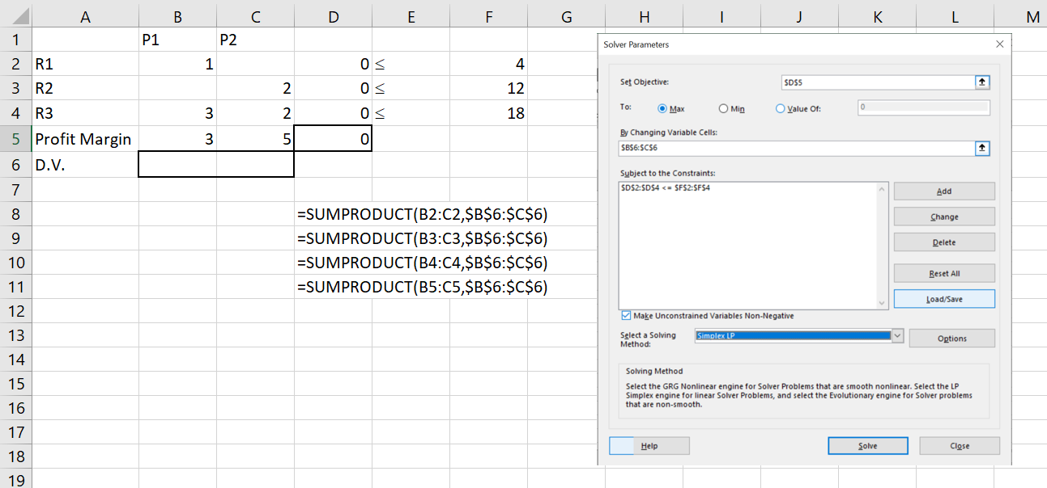

Slide 12
Math Quiz 1
C(Q) =48 +3Q
P=11
Fixed cost is 48 since it has no relation with Q
Variable cost is 3 because for one unit increase in Q the cost will go up by 3
Total cost of making 18 pies
C(18) = 48+3(18) = 102
Total cost of making 19 pies instead of 18
102+3=105
Total Revenue = Total Cost
PQ=48+3Q ➔ 11Q=48+3Q ➔ 8Q=48 ➔ Q=6
Profit = Total Cost ➔ Total Revenue = Total Cost + Total Cost
11Q=2(48+3Q) ➔ 11Q=96+6Q
5Q=96 ➔ Q=19.2

