Slide 1
Transportation Problem and Related Topics

Slide 2
Transportation problem : Narrative representation
There are 3 plants, 3 warehouses.
Production of Plants 1, 2, and 3 are 100, 150, 200 respectively.
Demand of warehouses 1, 2 and 3 are 170, 180, and 100 units respectively.
Transportation costs for each unit of product is given below
Warehouse
1 2 3
1 12 11 13
Plant 2 14 12 16
3 15 11 12
Formulate this problem as an LP to satisfy demand at minimum
transportation costs.

Slide 3
Data for the Transportation Model
Plant 1
Plant 2
Plant 3
Warehouse 1
Warehouse 2
Warehouse 3
Quantity demanded at each destination
Quantity supplied from each origin
Cost between origin and destination

Slide 4
Data for the Transportation Model
Supply Locations
100
150
200
Plant 1
Plant 2
Plant 3
$13
$15
$12
$11
$11
$12
$14
$16
$12
Warehouse 1
Warehouse 2
Warehouse 1
170
180
100
Demand Locations

Slide 5
Transportation problem I : decision variables
x₁₁
100
1
x₁₂
1
170
x₁₃
x₂₁
150
2
x₂₂
2
180
x₂₃
x₃₁
x₃₂
3
200
x₃₃
3
100

Slide 6
Transportation problem I : decision variables
x₁₁ = Volume of product sent from P1 to W1
x₁₂ = Volume of product sent from P1 to W2
x₁₃ = Volume of product sent from P1 to W3
x₂₁ = Volume of product sent from P2 to W1
x₂₂ = Volume of product sent from P2 to W2
x₂₃ = Volume of product sent from P2 to W3
x₃₁ = Volume of product sent from P3 to W1
x₃₂ = Volume of product sent from P3 to W2
x₃₃ = Volume of product sent from P3 to W3
Minimize Z = 12 x₁₁ + 11 x₁₂ +13 x₁₃ + 14 x₂₁ + 12 x₂₂ +16 x₂₃
+15 x₃₁ + 11 x₃₂ +12 x₃₃

Slide 7
Transportation problem I : supply and demand constraints: equal only of Total S = Total D
x₁₁ + x₁₂ + x₁₃ = 100
x₂₁ + x₂₂ + x₂₃ =150
x₃₁ + x₃₂ + x₃₃ = 200
x₁₁ + x₂₁ + x₃₁ = 170
x₁₂ + x₂₂ + x₃₂ = 180
x₁₃ + x₂₃ + x₃₃ = 100
x₁₁, x₁₂, x₁₃, x₂₁, x₂₂, x₂₃, x₃₁, x₃₂, x₃₃ ≥ 0

Slide 8
Transportation problem I : supply and demand constraints: ≤ for S, ≥ for D always correct
x₁₁ + x₁₂ + x₁₃ ≤ 100
x₂₁ + x₂₂ + x₂₃ ≤ 150
x₃₁ + x₃₂ + x₃₃ ≤ 200
x₁₁ + x₂₁ + x₃₁ ≥ 170
x₁₂ + x₂₂ + x₃₂ ≥ 180
x₁₃ + x₂₃ + x₃₃ ≥ 100
x₁₁, x₁₂, x₁₃, x₂₁, x₂₂, x₂₃, x₃₁, x₃₂, x₃₃ ≥ 0

Slide 9
Origins
s₁
s₂
s_{i}
s_{m}
1
We have a set of ORIGINs
Origin Definition: A source of material
- A set of Manufacturing Plants
- A set of Suppliers
- A set of Warehouses
- A set of Distribution Centers (DC)
In general we refer to them as Origins
2
i
There are m origins i=1,2, ………., m
Each origin i has a supply of s_{i}
m

Slide 10
Destinations
d₁
d₂
d_{i}
d_{n}
We have a set of DESTINATIONs
Destination Definition: A location with a demand for material
- A set of Markets
- A set of Retailers
- A set of Warehouses
- A set of Manufacturing plants
In general we refer to them as Destinations
1
2
j
There are n destinations j=1,2, ………., n
Each origin j has a supply of d_{j}
n

Slide 11
Transportation Model Assumptions
There is only one route between each pair of origin and destination
Items to be shipped are all the same
for each and all units sent from origin i to destination j there is a shipping cost of C_{ij} per unit

Slide 12
C_{ij} : cost of sending one unit of product from origin i to destination j
C₁₁
1
1
C₂₁
C₁₂
C₂₂
2
2
C_{2n}
i
C_{1n}
j
Use Big M (a large number) to eliminate unacceptable routes and allocations.
n
m

Slide 13
X_{ij} : Units of product sent from origin i to destination j
x₁₁
1
1
x₂₁
x₁₂
2
2
x₂₂
x_{2n}
x_{1n}
i
j
n
m

Slide 14
The Problem
The problem is to determine how
much material is sent from each
origin to each destination, such
that all demand is satisfied at the
minimum transportation cost
1
1
2
2
i
j
n
m

Slide 15
The Objective Function
1
1
If we send X_{ij} units
from origin i to destination j,
its cost is C_{ij} X_{ij}
We want to minimize
2
2
i
j
n
m

Slide 16
Transportation problem I : decision variables
x₁₁
100
1
x₁₂
1
170
x₁₃
x₂₁
150
2
x₂₂
2
180
x₂₃
x₃₁
x₃₂
3
200
x₃₃
3
100

Slide 17
Transportation problem I : supply and demand constraints
x₁₁ + x₁₂ + x₁₃ =100
+x₂₁ + x₂₂ + x₂₃ =150
+x₃₁ + x₃₂ + x₃₃ =200
x₁₁ + x₂₁ + x₃₁ =170
x₁₂ + x₂₂ + x₃₂ =180
x₁₃ + x₂₃ + x₃₃ = 100
In transportation problem. each variable Xij appears only in two constraints, constraints i and constraint m+j, where m is the number of supply nodes. The coefficients of all the variables in the constraints are 1.

Slide 18
Our Task
Our main task is to formulate the problem.
By problem formulation we mean to prepare a tabular
representation for this problem.
Then we can simply pass our formulation ( tabular
representation) to EXCEL.
EXCEL will return the optimal solution.
What do we mean by formulation?

Slide 19
Cost Table

Slide 20
Right Hand Side (RHS)

Slide 21
Left Hand Side (RHS), and Objective Function

Slide 22
≤ for Supply, ≥ for Demand unless Some Equality Requirement is Enforced

Slide 23
Optimal Solution
Extra Credit. How the colors were generated and what they mea?
Using Conditional formatting.
Green if the decision variable is >0
Red if the constraint is binding LHS = RHS

Slide 24
Example: Narrative Representation
We have 3 factories and 4 warehouses.
Production of factories are 100, 200, 150 respectively.
Demand of warehouses are 80, 90, 120, 160 respectively.
Transportation cost for each unit of material from each origin to each destination is given below.
Destination
1 2 3 4
1 4 7 7 1
Origin 2 12 3 8 8
3 8 10 16 5
Formulate this problem as a transportation problem

Slide 25
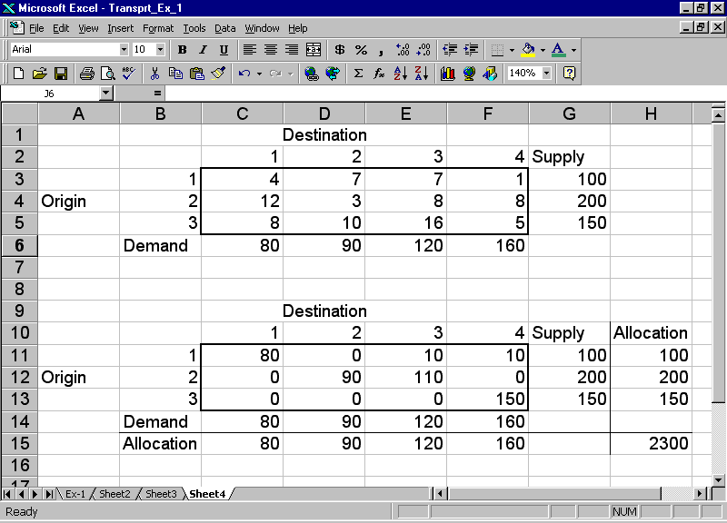
Excel : Data

Slide 26
The Assignment Problem : Example
11 repairmen and 10 tasks. The time (in minutes) to complete each job by each repairman is given below.
Assign each task to one repairman in order to minimize to total repair time by all the repairmen.
In the assignment problem, all RHSs are 1. That is the only difference with the transportation problem,.

Slide 27
The Assignment Problem : Example

