Slide 1
Throughput Analysis
Ardavan Asef-Vaziri

Slide 2
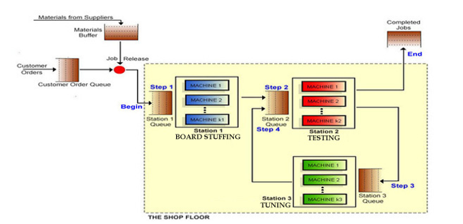
The Situation
Tp=3 hrs
Rp1=0.667/hr
Rp1=8/day
c=2
Tp=4 hrs
Rp1=0.75/hr
Rp1=6/day
c=3
Tp=2.4
Rp1=0.833/hr
Rp1=10/day
c=2

Slide 3
Utilization, Inventory, Flow Time, Little’s Law
  Suppose throughput is 12 contracts per day. Compute the average number of jobs on all machines.
  Station Rp R U c Ip
  Station1 16 12 0.75 2 2* 0.75 = 1.5
  Station2 18 12 0.667 3 3* 0.667 = 2
  Station3 20 12 .6 2 2*0.6 = 1.2
  Ip = 1.5+2+1.2 = 4.7
  Using the Little’s Law
  Theoretical Flow Time = 3+4+2.4= 9.4 hrs ex: 3 = 24hrs (1/8) [8 is capacity of station 1]
  RT=I
  12(9.4/24) = I
  I = 4.7

Slide 4
Utilization, Inventory, Flow Time, Little’s Law
  b) Suppose Max-WIP in the game is set to 20, and average WIP is 18. That means on average there are 18 either in the waiting lines or on the machines. Compute the Flow Time ?
  RT=I
  12T= 18
  T = 1.5 days
  How long a job spends in the waiting lines
  T=1.5(24) = 36 hrs
  T=Tp+Ti
  36=9.4+Ti
  Ti= 26.6 hrs
  Compute the ratio of the time in waiting lines to the time on the machines
  Ti/Tp= 26.6/9.4= 2.83

Slide 5
Implied Utilization
  c) Can this system handle 19 contracts per day?
  The system cannot even handle 16 orders per day because when utilization get close to 100%, flow time increases exponentially.
  At 16 contracts per day, U1=1, U2=0.89, U3=0.8.
  Utilization of Station-2 also is a sign of warning.
  To handle 19 contracts per day, since capacity of the system is 16 contracts per day.
  Implied Utilization =19/16 = 1.1875
  d) If the firm wishes to process all the contracts, how many machines of each type are needed?
  # of Station-1 machines required = 19/8 = 2.375
  # of Station-2 machines required = 19/6 = 3.167
  # of Station-3 machines required = 19/10 = 1.9

Slide 6
Resources
  We need 2.375, 3.167, and 1.9 resource units.
Indeed 3, 4, and 2. We have 2, 3, and 2.
We may buy one machine for each of the three stations. In that case, utilization of the three stations are as follows.
The utilization of station 3 is scary. High utilization, in presence of variability, leads to long waiting lines.

Slide 7
Resources
  We need 2.375, 3.167, and 1.9 resource units.
Indeed 3, 4, and 2. We have 2, 3, and 2.
We may buy one machine for each of the three stations. In that case, utilization of the three stations are as follows.
For example:
A paralegal who works 8hrs/ day will need to work overtime of 0.25hrs.
0.25(8) = 2 hours total over time.
There will be 6 paralegals; over time of each = 2hrs/6 = 1/3 hour
Or 20 minute per paralegal. PLUS some safety Capacity.
Or we may use tax lawyers as flexible resources and they may help the paralegals
(Flexible resources can increase capacity).

Slide 8
Cross-Training (Flexibility) Increases Capacity
Suppose we have two resources, and they work sequentially. They are both expert in their own tasks.
  Suppose the first resource completes its task in 5 mins (Tp=5 mins). Rp=60/5 =12 per hour.
  Suppose the second resource completes its task in 10 mins (Tp=10 mins). Rp=60/10 =6 per hour.
  Both resources are highly specialized in their task. The capacity of the system is 6 per hours.
  Now suppose the first resource is cross-trained (we increase flexibility of this resource) to do the second job too. But under the new situation, due to moving back and forth, it takes 6 mins to do the first task and 12 mins to do the second task.
  Under the new situation, he can complete 7 units in the first task (7*6=42 min) and still has 18 minutes for the second task where they can complete 18/12= 1.5 task.
  By increasing the flexibility, the capacity increases from 6 to 7+.

Slide 9
Multiple Choice
Which of the following 2 statements is true?
I. A process can have more than 1 bottleneck resource.
II. Having flexible resources can increase capacity.
  Only I
  Only II
  Both I and II
  Neither I nor II
  Cannot be determined
Which of the following statement is false?
  Throughput is always smaller than or equal to the capacity.
  Customers may wait even if the utilization of a resource is 80%.
  Bottleneck resources always have 100% utilization.
  Increasing inventory may increase utilization.
  Increasing flexibility of the resources may increase the capacity

Slide 10
Multiple Choice
To improve the utilization, we can
I. cross-train the workers
II. adopt flexibility equipment
III. Combine resources in a resource pool.
Choose the most appropriate.
  I
  II
  III
  I, II, and III
  I and II

