Slide 1
Throughput Analysis-2
Ardavan Asef-Vaziri

Slide 2
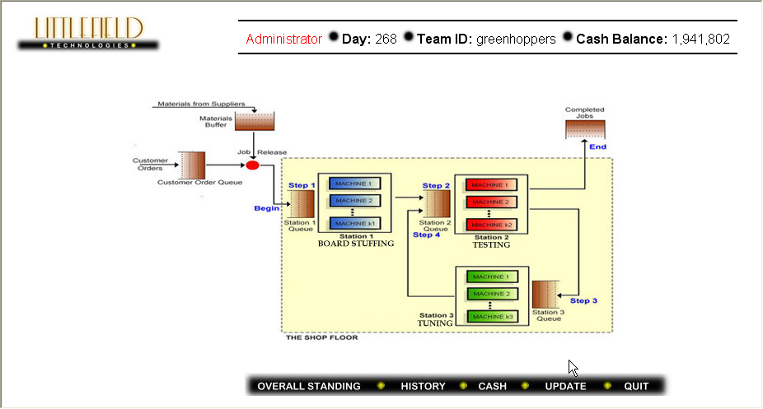
One Machine in Each Station

Slide 3
Capacity Planning
The average utilization of the three stations in the past 50 days were 0.6875, 0.916667, and 0.55, respectively.
Given, R=5.5 per day, and U=R/Rp, we estimate the capacity of the machines as
A machine in Station-1: 5.5/ 0.6875 = 8 contracts per day.
A machine in Station-2: 5.5/ 0.916667 = 6 contract per day.
A machine in Station-2: 5.5/ 0.55 = 10 contract per day.
The current Binding constraint (bottleneck) is our capacity.
During the past 50 days, the average demand per day was 16 contracts. Due to our Max-WIP=25, we have accepted and processed 5.5 jobs per day, and have rejected 11.5 contract per day.

Slide 4
Capacity Planning
Compute the total loss due to las of capacity.
Currently our daily profit is 5.5($750-$600) = $825.
If we buy enough capacity and move to contract 3, then our potential daily profit could reach 16($1250-$600) = $10,400
Therefore we are missing the opportunity of ($10400-$825) = $9575 profit per day.
Assuming 7(24)+50= 218 days.
A clever aggressive team whose members have watched all the lectures may make about 2 million dollars more compared to a DoNothing team.
Suppose the purchase price of each machine is 100,000. With $2,000,000, we can purchase 20 machines.
Therefore the payback-period for each machine that we purchase for capacity expansion (in harmony with all three stations) is 100,000/9575 ≈ 11 days.

Slide 5
Capacity Planning

Slide 6
Investment, Capacity, and Implied Utilization

Slide 7
Capacity & Cycle Time
  Compute the cycle time?
  Capacity is 16 per day.
  Cycle Time = 1/Capacity
  Cycle Time = 1/16 days.
  Cycle Time 24(1/16) = 1.5 hrs.
  Capacity is 0.666666667 per hr.
  Cycle Time = 1/Capacity
  Cycle Time = 1/ 0.666666667 hrs.
  Cycle Time = 1.5 hrs.

