Slide 1
Throughput Analysis
Ardavan Asef-Vaziri

Slide 2
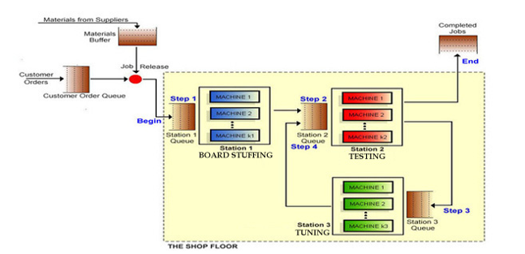
The Situation
Rp1=8/day
Rp1=6/day
Rp1=10/day

Slide 3
Throughput-Problem-1
In Game 2, there are 2 machines in Station-1, 3 machines in Station-2, and 2 machines in Station-3. Capacity of a single machine at each station is 8, 6, 10 jobs per day. A day is 24 hours, and a month is 30 days. Compute the Theoretical Flow Time.
The theoretical flow time is a time a flow unit spends on a resource or with a resource.
Flow Time = Theoretical Flow Time + Waiting times.
Since the average capacities are 8, 6, 10 jobs per day.
Each job takes 1/8 days at Station-1, 1/6 day at Station-2, and 1/10 days at Station-3.
Since a day is 24 hours, therefore the average time for each job on each machine is
Station Capacity/Day Time in Day Time in hours
Station-1 8 1/8 24(1/8)= 3
Station-2 6 1/6 24(1/6)= 4
Station-3 10 1/10 24(1/10) =2.4
Theoretical Flow Time = 3+4+2.4= 9.4 hours.

Slide 4
Capacity, Theoretical Flow Time, and Pipeline Inventory
  Suppose you produce at capacity. Compute the pipeline inventory (the absolute minimal inventory in this system).
  Theoretical Flow Time = ThFT= 9.4 hours or 9.4/24 = 0.392 day
  Capacity = Throughout = Rp=R= 18 per day
  RT = I ➔ I = 18(9.4/24) = 7.05
  This is the absolute minimal inventory that we can have to allow 16 output a day. They are all with the processors. We refer to this minimal inventory as the Pipeline Inventory.

Slide 5
Utilization, Pipeline Inventory, and Little’s Law
  Compute utilization of each station assuming throughput = capacity.
  Station Capacity Throughput Utilization
  Station-1 24 18 18/24 = 0.75
  Station-2 18 18 18/18 = 1
  Station-3 20 18 18/20 = 0.9
  On average 0.75 job is on each machine (resource unit) in Station-1 (resource pool 1), 1 job on each machine in station-2, and 0.9 job on each machine in station-3.
  Inventory with the processors (Ip) is 0.75+1+0.9 = 2.65
  The pipeline inventory or Inventory in the processors (Ip) is equal to 2.65 flow units.
  It seems we have already computed Ii=(18/24)(9.4) = 7.05.
  Where we made a mistake? 2.65 vs 7.05?
  There are more than one machine in each station. 0.75(3)+ 1(3)+0.9(2) = 2.25+3+1.8= 7.05

Slide 6
Theoretical Flow Time, Capacity & Pipeline Inventory
  Given the requirements of contract-3, on average how many flow-units can be allowed in the system? On average, how many are in the waiting lines?
  R=18, T=0.5. RT=I ➔ 18(0.5)➔ I= 9
  The inventory of jobs (WIP) is always <= Max-WIP. Because some days we may reject the demand since the number of jobs inside the system WIP is equal to Max-WIP, and in other days while WIP<Max-WIP there may be no demand.
  Given the volume of variability in interarrival time and service time, after setting Max-WIP to 9, you may keep an eye on it. You may increase or decrease it by one or two units.

Slide 7
Ip, Ii, Tp, and Ti
  Given the requirements of contract-3, on average how many flow-units are in the waiting lines?
  I = 9 = Ii+Ip
  9 = Ii +7.05 ➔ Ii = 1.95
  How long a job spends in the waiting lines
  Procedure-1.
  T=0.5 day, ThFT= 9.4/24=0.39167 Day
  Tp= 0.5-0.39167 =0.108
  Procedure-2.
  R=18, Ip=1.95
  Tp= Ip/R = 1.95/18 = 0.108

Slide 8
Ip, Ii, Tp, and Ti
  Given the requirements of contract-2, on average how many flow-units can be inside the system? On average how many are in the waiting lines?
  R=18, T=1, RT=I ➔ 18(1)➔ I= 18
  I =Ii+Ip ➔ 18 = Ii +7.05 ➔ Ip = 10.95
  How long a job spends in the waiting lines
  Procedure-1.
  T=1 day, ThFT= 9.4/24=0.39167 Day
  Tp= 1-0.39167 =0.60833
  Procedure-2.
  R=18, Ip=10.95
  Tp= Ip/R = 10.95/18 = 0.60833

Slide 9
100% Utilization is a High Risk
Currently, under any contract with R=18, utilizations are 0.95, 1. 0.9. Too high.
Imagine a freeway where all cars driving exactly 65 and the distance between pairs of cars in 1”. As long as everyone has a speed of exactly 65 – no variability- that is fine.
What happens if one hits the break? How long does it take to clean the freeway. Do cars pass freeway easier when utilization is 1 and they are moving bumper to bumper, or when 50% of the freeway is empty, U = 0.5, or when U = 0.25. How long it takes to clean up accidents in these situations?
Never make U of all the sub-processes or activities, and not even a single sub-process = 1. If possible, consider cross taring and pooling.
Utilization of the Resource Pool= Throughput/Effective capacity of a resource pool = R/Rp. Utilization of the Process = U = Throughput/Effective capacity of the bottleneck resource pool.
  Compute Cycle time and Takt Time: CT=1/18 days = 24(1/18) = 1.333 hours. TT= 1/16 days = 24(1/16)= 1.5 hours
9

Slide 10
Unit Load for a Product Mix
Billing: Contract Type A, 70%, Contract Type B, 40%.
10

