Slide 1
Throughput Analysis-Game 2
Ardavan Asef-Vaziri

Slide 2
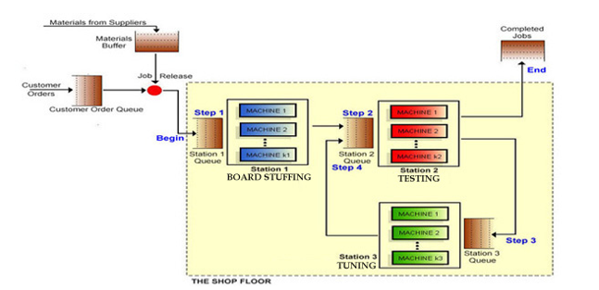
The Situation
60 Kits per Contract
60(10)=$600
R=5.5
U= 0.6875
c=1
U= 0.916667 c=1
Max-WIP= 25
Contract 1: $750
Contract 2: $1000
Contract 3: $1250
U= 0.55
c=1

Slide 3
Capacity, Demand, and Binding Constraint (Bottleneck)
The average utilization of the three stations in the past 50 days were 0.6875, 0.916667, and 0.55, respectively.
Given, R=5.5 per day, and U=R/Rp, we estimate the capacity of the machines as
A machine in Station-1: Rp = 5.5/ 0.6875 = 8 contracts per day.
A machine in Station-2: Rp = 5.5/ 0.916667 = 6 contract per day.
A machine in Station-2: Rp = 5.5/ 0.55 = 10 contract per day.
Process Capacity is min(8, 6, 10) = 6 contracts per day.
Currently we are processing 5.5 contracts per day.
The ceiling for our daily profit is 5.5($750-$600) = $825.
During the past 50 days, the average demand per day was 16 contracts.
The current Binding Constraint (Bottleneck) is Internal and is our Capacity.
Compute the total loss due to lack of capacity.

Slide 4
Loss of Profit Due to Lack of Capacity, and Payback Period
Due to our Capacity and also Max-WIP=25, we have accepted and processed 5.5 jobs per day, and have rejected 11.5 contract per day.
Suppose we buy enough capacity to match the demand and also move to contract 3.
Then our potential daily profit could reach 16($1250-$600) = $10,400
We are missing the opportunity of ($10400-$825) = $9575 profit per day.
Assuming 7(24)+50= 218 days.
A clever aggressive team whose members have watched all the lectures may make about 2 million dollars more compared to a DoNothing team.
Suppose the purchase price of each machine is 100,000. With $2,000,000, we can purchase 20 machines.
The payback-period for each machine that we purchase for capacity expansion (in harmony with all three stations) is 100,000/9575 ≈ 11 days.

Slide 5
Capacity Expansion, Investment, and Utilization

Slide 6
Investment, Capacity, and Implied Utilization

Slide 7
Very Conservative vs. Aggressive Capacity and Cycle Time
  Compute the cycle time?
  Capacity is 6 per day.
  Cycle Time = 1/Capacity
  Cycle Time = 1/6 days.
  Cycle Time 24(1/6) = 4 hrs.
  Compute the cycle time?
  Capacity is 18 per day.
  Cycle Time = 1/Capacity
  Cycle Time = 1/18 days.
  Cycle Time 24(1/18) = 1.33 hrs.

Slide 8
Capacity & Cycle Time- Very Conservative vs. Aggressive
  Capacity is 0.25 per hr.
  Cycle Time = 1/Capacity
  Cycle Time = 1/ 0.25 hrs.
  Cycle Time = 4 hrs.
  Capacity is 0.75 per hr.
  Cycle Time = 1/Capacity
  Cycle Time = 1/ 0.75 hrs.
  Cycle Time = 1.33 hrs.

