Slide 1
LittleField- Fowl Time vs Capacity
To complete each contract in the LFT game, we need to process 60 kits. Following the previous discussion regarding capacity in other sessions, suppose processing time is 3, 4, and 2.4 hours in the three stations, respectively. Furthermore, suppose the setup time in station-1 is 30 minutes per batch, while the other stations have no setup time. Given these assumptions, it is straightforward to compute processing time per kit in each station in minutes. That is Station-1: (3(60)-30)/60 = 2.5, Station-2: (4(60)-0)/60 = 4, and Station-3: (2.4(60)-0)/60 = 2.4 minutes.
Suppose we can process each contract in batches of 60, 30, 20, and 15 kits. That is to produce 60 kits in 1, 2, 3, or 4 batches. Consider the impact of batch size on flow time and capacity.
Since there is no setup in statins 2 and 3, splitting the batches into these stations has no impact on flow time but reduces the capacity.

Slide 2
LittleField- Fowl Time vs Capacity
Furthermore, in the number of machines in station 1, processing the contact kits in a few batches greater than c will only decrease the capacity without impacting flow time. Therefore, if there are 2 machines in station 1, only batches of sizes 60 and 30 are considered. For three machines, batches of sizes 60, 30, and 20, and for 4 machines in station 1, batches of sizes60, 30, 20, and 15 are considered. That is 1, 2, 3, and 4 batches of kits per contract.

Slide 3
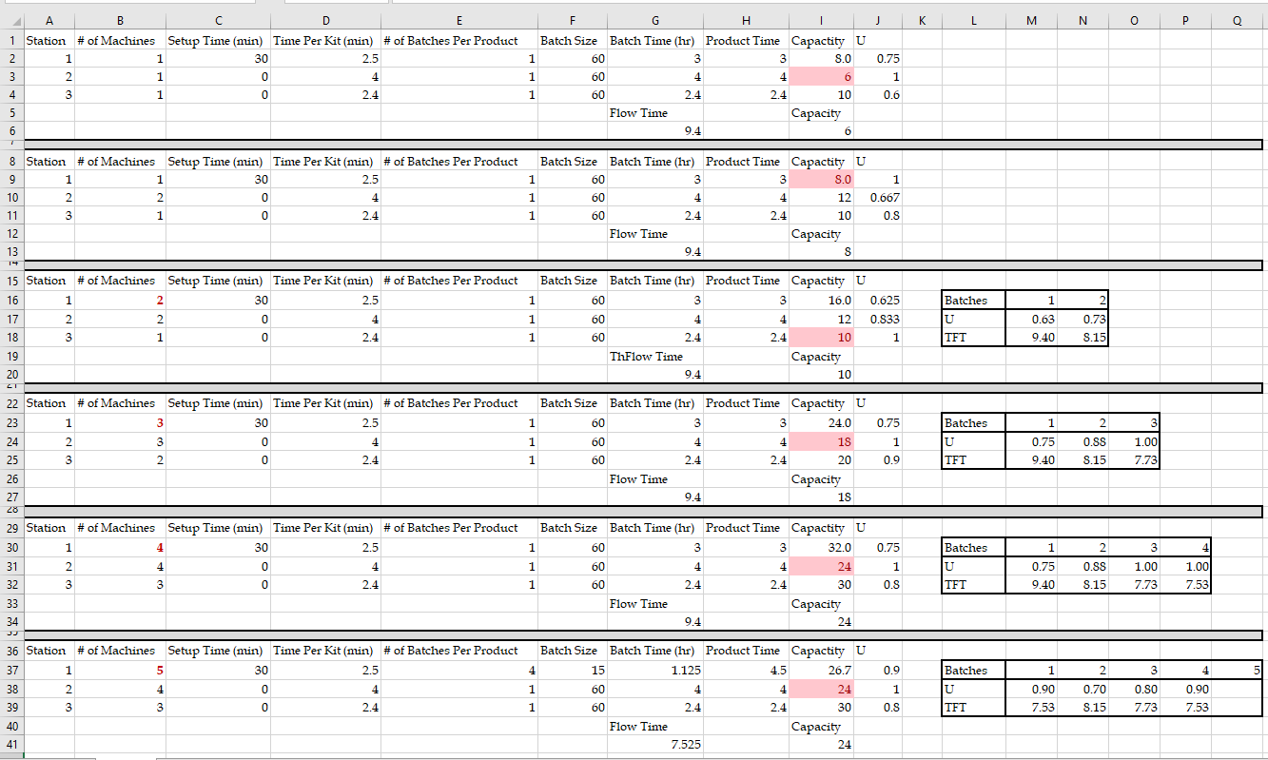
Capacity & Flow Time Trade-Off Through Batch Size

