Slide 1
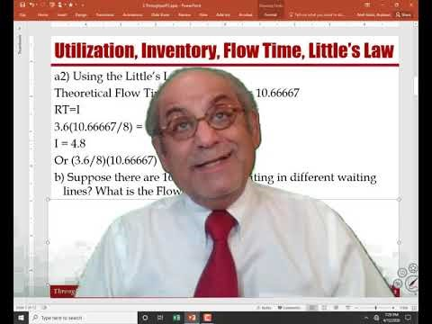
More on Throughput & Capacity
https://youtu.be/EkwteDoj6Rg
Based on the book: Managing Business Process Flows.

Slide 2
Recorded Lecture

Slide 3
Utilization, Inventory, Flow Time, Little’s Law
Operation 1
Operation 2
Operation 3
Paralegals
Tax Lawyers
Senior Partner
Tp=20/3 hr., c= 4
Rp = 0.6/hr, 4.8/dy
Tp=2 hr., c=3
Rp=1.5/hr, 12/dy
Tp=2 hr., c = 2
Rp=1/hr, 8/dy
  Suppose throughput is 3.6 contracts per day. Compute the average inventory in the processors.
  a1) Using utilizations
  Station Rp R U c Ip
  Station1 4.8 3.6 0.75 4 4* 0.75 = 3
  Station2 12 3.6 0.3 3 3* 0.3 = 0.9
  Station3 8 3.6 .45 2 2*0.45 = 0.9
  I = 3+0.9+0.9= 4.8

Slide 4
Utilization, Inventory, Flow Time, Little’s Law
  a2) Using the Little’s Law
  Theoretical Flow Time = 6.66667+2+2= 10.66667
  RT=I
  3.6(10.66667/8) = I
  I = 4.8
  Or (3.6/8)(10.66667) = 4.8
  b) Suppose there are 16.8 contracts waiting in different waiting lines? What is the Flow Time ?
  RT=I
  3.6T= 16.8+4.8 = 21.6
  3.6T = 21.6
  T=6 days

Slide 5
Implied Utilization
Operation 1
Operation 2
Operation 3
Paralegals
Tax Lawyers
Senior Partner
Tp=20/3 hr., c= 4
Rp = 0.6/hr, 4.8/dy
Tp=2 hr., c=3
Rp=1.5/hr, 12/dy
Tp=2 hr., c = 2
Rp=1/hr, 8/d
  c) Can the company handle 150 cases per month?
  R/day = 150/20 ➔ R= 7.5 per day, Rp (Capacity) =4.8
  Implied Utilization =7.5/4.8 = 1.5625
  d) If the firm wishes to process all the 150 cases, how many professionals of each type are needed?
  # of paralegals required = 7.5/1.2 = 6.25
  # of tax lawyers required = 7.5/4 = 1.875
  # of senior lawyers required = 7.5/4 = 1.875

Slide 6
Resources
  We need 6.25, 1.875, and 1.875 resources.
Or indeed 7, 2, and 2.
We have 4, 3, and 2.
We may hire 3 additional paralegals.
Alternatively, we may hire just 2 and have 6 paralegals.
They need to work overtime for 0.25 paralegal who works 8 hrs /day. 0.25(8) = 2 hours total over time.
There will be 6 paralegals; over time pf each = 2/6 = 1/3 hour
Or 20 minute per paralegal. PLUS some safety Capacity.
Or we may use tax lawyers as flexible recourses and they may help the paralegals( Flexible resources can increase capacity).
Suppose we have two resources. And they work sequentially.
They are both expert in their own task

Slide 7
Cross-Training (Flexibility) Increases Capacity.
  Suppose the first resource completes its task in 5 mins (Tp=5 mins). Rp=60/5 =12 per hour.
  Suppose the second resource completes its task in 10 mins (Tp=10 mins). Rp=60/10 =6 per hour.
  Both resources are highly specialized in their task. The capacity of the system is 6 per hours.
  Now suppose the first resource is cross-trained (we increase flexibility of this resource) to do the second job too. But under the new situation, due to moving back and forth, it takes 6 mins to do the first task and 12 mins to do the second task.
  Under the new situation, he can complete 7 units in the first task (7*6=42) and still has 18 minutes for the second task where s/he can complete 18/12= 1.5 task.
  By increasing the flexibility, the capacity increases from 6 to 7+.

Slide 8
Multiple Choice
Which of the following 2 statements is true?
I. A process can have more than 1 bottleneck resource.
II. Having flexible resources can increase capacity.
  Only I
  Only II
  Both I and II
  Neither I nor II
  Cannot be determined
Which of the following statement is false?
  Throughput is always smaller than or equal to the capacity.
  Customers may wait even if the utilization of a resource is 80%.
  Bottleneck resources always have 100% utilization.
  Increasing inventory may increase utilization.
  Increasing flexibility of the resources may increase the capacity

Slide 9
Multiple Choice
To improve the utilization, we can
I. cross-train the workers
II. adopt flexibility equipment
III. Combine resources in a resource pool.
Choose the most appropriate.
  I
  II
  III
  I, II, and III
  I and II

