Slide 1

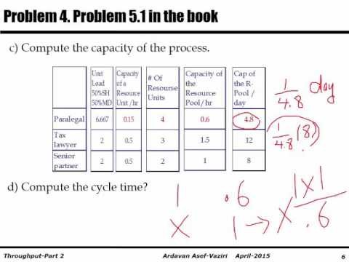
Throughput Key Problems: Effective Capacity & Utilization- Set 1
Based on the book: Managing Business Process Flows.

Slide 2
Problem 4. Problem 5.1 in the book
A law firm processes shopping centers and medical complexes contracts. There are four Paralegals, three Tax lawyers, and two Senior partners. The unit loads of the resources to handle one standard contract is given below. Assume 8 hours per day, and 20 days per month.
It takes a Paralegal 20 hours to complete 3 contract.
That is 20/3 = 6.666666666666666667 hours to complete a contract.
It takes a Tax lawyer 2 hours to complete a contract.
It takes a Senior partner 2 hours to complete a contract.
a) What is the Theoretical Flow Time of a contract?
6.667+2+2=10.667.
  Flow Time = Theoretical Flow Time + Waiting times
  Flow Time = 10.67 + Waiting times
b) Compute the Capacity of each of the three Resource Pools

Slide 3
Paralegals
Operation 1
Operation 2
Operation 3
Paralegals
Tax Lawyers
Senior Partners
Tp=20/3 hr., c= 4
Tp=2 hr., c=3
Tp=2 hr., c = 2
A Paralegal can complete 1 contract in 20/3 = 6.667 hour
How many contracts in one hour? 1/6.667 , or 1/(20/3) = 0.15
How many contracts all the Paralegals can complete in one hour.
There are 4 Paralegals: c = 4
Four Paralegals 4(0.15) = 0.6 contracts per hours
We could have also said Tp = 20/3 = 6.6667.
Capacity of one resource unit is 1/Tp.
Capacity of one resource unit is 1/6.667 = 0.15.
Capacity of the resource units: Rp=c/Tp ; c=4 and Tp = 20/3 =6.667
Rp = 4/(20/3) = 4/6.667 = 0.6 per hour
Capacity of the resource pool is 0.6 contracts per hour.
It is 8(0.6) = 4.8 contracts per day

Slide 4
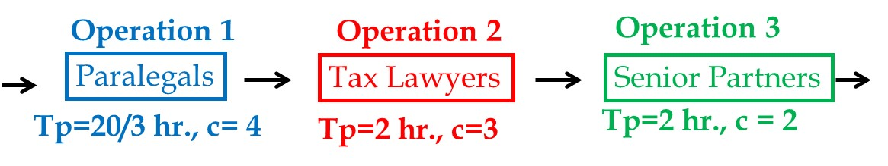
Tax Lawyers
A Tax Lawyer can complete 1 contract in 2 hour
How many contracts in one hour?
1/2 = 0.5
How many contracts all the Tax Lawyers can complete in one hour.
There are 3 Tax Lawyers: c = 3
There Tax Lawyers 3(0.5) = 1.5 contracts per hours
We could have also said Tp = 2.
Capacity of one resource unit is 1/Tp.
Capacity of one resource unit is 1/2 = 0.5.
Capacity of all resource units: Rp=c/Tp where c=3 and Tp = 2
Rp = 3/2 = 1.5 per hour
Capacity of the resource pool is 1.5 contracts per hour.
It is 8(1.5) = 12 contracts per day

Slide 5
Senior Partners
A Senior Partners can complete 1 contract in 2 hours.
How many contracts in one hour?
1/2 = 0.5
How many contracts all the Senior Partners can complete in one hour.
There are 2 Senior Partners: c = 2
There Senior Partners 2(0.5) = 1 contracts per hours
We could have also said Tp = 2.
Capacity of one resource unit is 1/Tp.
Capacity of one resource unit is 1/2 = 0.5.
Capacity of all resource units: Rp=c/Tp where c=2 and Tp = 2
Rp = 2/2 = 1 per hour
Capacity of the resource pool is 1 contracts per hour.
It is 8(1) = 8 contracts per day.

Slide 6
Problem 4. Problem 5.1 in the book
  c) Compute the capacity of the process.
  d) Compute the cycle time?
  Capacity is 4.8 per day.
  Cycle Time = 1/Capacity
  Cycle Time = 1/4.8 days.
  That is 8(1/4.8) = 8/4.8 = 1.67 hrs.
  Capacity is 0.6 per hr.
  Cycle Time = 1/Capacity
  Cycle Time = 1/0.6 hrs.
  Cycle Time = 1.67 hrs.

Slide 7
Problem 4. Problem 5.1 in the book
  e) Compute the average inventory (assume U=1).
  Lets look at the utilization of the 3 stations
  Station Capacity Throughput Utilization
  Station 1 4.8 4.8 4.8/4.8 = 1
  Station 2 12 4.8 4.8/12 = 0.4
  Station 3 8 4.8 4.8/8 = 0.6
  On average 1 person with a resource in Station 1, 0.4 person with a resource in Station 2, and 0.6 person with a resource in Station 3.
  Inventory with the processors is 1+ 0.4+0.6 = 2
  On average there are 2 flow units with the processors; Inventory in the processors (Ii)

Slide 8
Problem 4. Problem 5.1 in the book
  Now let’s look from Little’s Law point of view
  RT=I ➔ R= 4.8 per 8 hours or 0.6 per hour
  T =10.67 hours ➔ I = 0.6(10.67) = 6.4
  6.4 vs 2? Where is my mistake??
  1(4)+ 0.4(3)+0.6(2) = 6.4
  Suppose there are 36 contracts in process. Compute the flow time.
  RT=I ➔ I = 36, R= 4.8
  T= 36/4.8 = 7.5 ? ➔7.5 days.
  How many contracts in the waiting lines?
  36 is the total in the system.
  6.4 with the processors
  36-6.4 = 29.6 in the waiting lines.

