Slide 1


Process Flow Analysis
In the Context of
LittleField Technologies Game
Ardavan Asef-Vaziri

Slide 2


Slide 3
One Machine Per Station; Theoretical Flow Time (ThT)
I will review some of the Process Flow and Little’s Law concepts in the context of Littlefield Technologies (LFT) game.
Contract ➔ Flow unit. Machine ➔ Resource unit, Station ➔ Resource pool.
Minimal flow time, or theoretical flow time (ThT): The minimal time required to produce a flow unit.
Minimal inventory or pipeline inventory (Ip): The minimal inventory required to produce a flow unit. Min-WIP.
The Maximal inventory or Maximal Work in Progress (Max-WIP) to regulate WIP to achieve the expected flow time (T).
Ensure that I or WIP remains less than (but not much less than) Max-WIP.
The time in the waiting lines (Ti) vs in processes (Tp).
The number of flow units in the waiting lines (Ii) vs in processes (Ip).

Slide 4
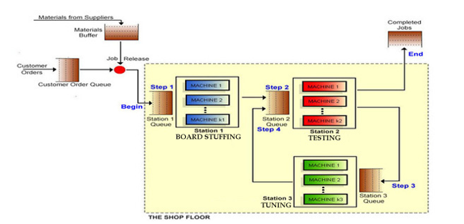
The Situation- Not the Same Numbers as in Your Game
Where is the bottleneck?
The station with the highest utilization.
Station 2.
c=1
Rp1=8/day
Tp=24/8=3
U= 0.6875
c=1
Rp1=6/day
Tp=24/6=4
U= 0.916667
R=5.5
Compute Rp
U=R/Rp
Rp=R/U
c=1
U= 0.6875
c=1
U= 0.916666
Compute unit load (Tp) at each station
Rp = c/Tp
Tp =c/Rp
c=1 in all stations ➔ Tp=1/Rp day
c=1
Rp1=10/day
Tp=24/10=2.4
U= 0.55
c=1
U= 0.55

Slide 5
Capacity & Theoretical Flow Time (ThT)
Compute Capacity of this System (Rp).
Capacity of the system = Min(8,6,10) = 6 per day.
Compute Theoretical Flow Time (ThT)
ThT is the minimal time that we need to produce a product.
ThT = 3+4+2.4 = 9.4 hours or 9.4/24 = 0.39 day.
ThT does not depend on the number of machines (c) or throughput(R).
ThT depends on each machine's capacity and the operations' routing. As long as there is no change in the capacity of machines and the routing of the operations, ThT is always 9.4.
ThT is the absolute minimal flow time. Flow time (T) is much greater than the ThT.

Slide 6
Pipeline Inventory (Ip or Min-WIP)
Pipeline inventory (Ip) is the Min-WIP the system needs to operate.
Compute pipeline inventory: Procedure 1- Little’s Law.
RT = I, R = 5.5/day, and T = 9.4/24 day. Or, R= 5.5/24 per hour, and T= 9.4 hours.
RT = I ➔ I = 5.5(9.4/24) = 2.15 flow units. Ip = 2.15.
Compute pipeline inventory: Procedure 2- Utilizations.
R=5.5/day, U1= 0.6875, U2= 0.55, and U3 = 0.916666.
When U=0.55, on average, 0.55 flow units are with the resource unit.
The pipeline inventory is I= U1+U2+U3.
Min-WIP ➔ I = 0.6875 + 0.55 + 0.9167 = 2.15. Ip = 2.15.

Slide 7
Flow Time, Max-WIP, WIP, R and Rp
Suppose the average number of units inside the system (I or WIP) is 19.2 contracts.
Compute the flow time. R = 5.5, I = 19.2.
T = 19.2/5.5 = 3.5.
Suppose we must deliver the product under 3 days. Otherwise, the revenue of $800 linearly goes down and reaches zero if we deliver after 5 days.
Therefore we lose 800[(3.5-3)/(5-3)] = $200 and collect $600 per contract.
Compute the Max-WIP to guarantee a Lead Time = 3 days for a Capacity = Rp = 6.
We use Rp and Max-WIP to regulate the relationship between R and WIP.
We use Rp(T) = Max-WIP to regulate RT= WIP.
To estimate Max-WIP, we set R = Rp and T as 3 days.

Slide 8
Max-WIP & WIP, A Balance between ⬇T and ⬆R
Rp(T)=Max-WIP
6(3)= 18 = Max-WIP.
We know R<Rp and WIP<Max-WIP.
The average inventory (WIP) computed inside the model is always less than the Max-WIP that we compute to set.
RpT=Max-WIP is always a reasonable estimate for RT=WIP.
We compute T = Max-WIP/Rp as a surrogate for T=WIP/R.
This is to prevent T > 3.
Suppose our current Max-WIP =100. Should we change it to 18?
Not Immediately.
We need to look at lead time and revenue. If they are fine, we then look at WIP.

Slide 9
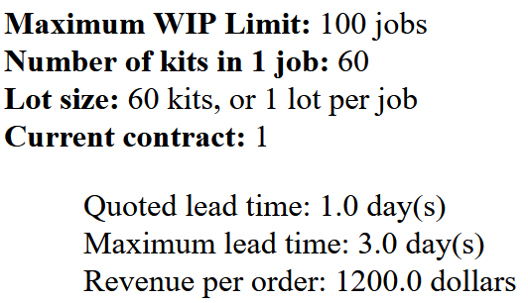
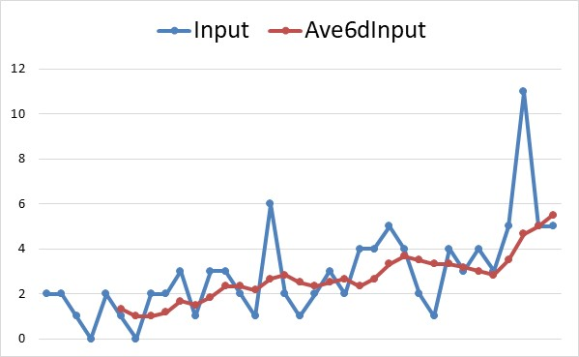
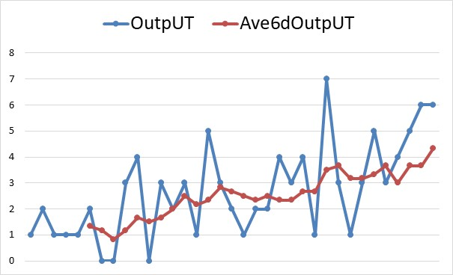
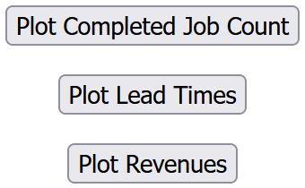
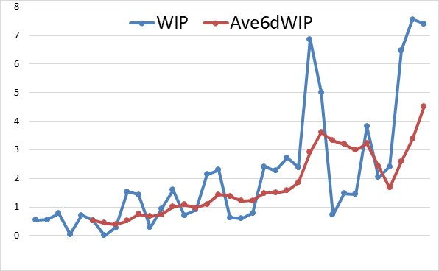
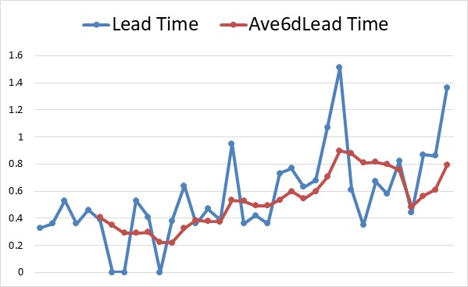
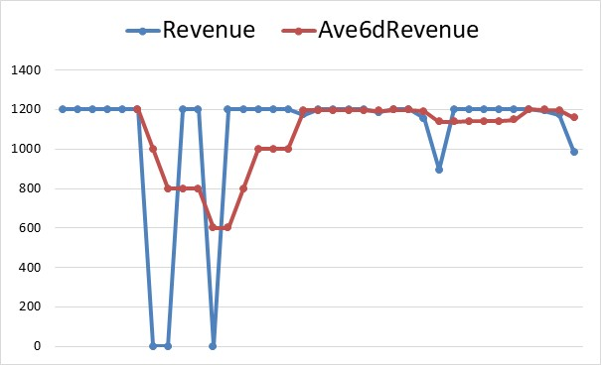
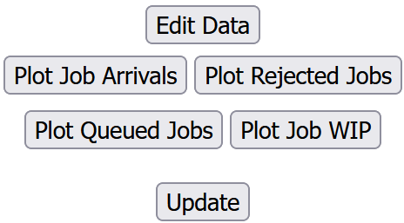
Max-WIP, Input, Output, Lead Time, Revenue, and WIP

Slide 10
Max-WIP & WIP, A Balance between ⬇T and ⬆R
Do not make any change if WIP is less than your Max-WIP= 6.
When WIP gets close to your Max-WIP=6, or even slightly exceeds it, then replace 100 by 6. In the previous graphs I have used 6 period moving average to decide.
Check both sides. Two edges of a slippery roof.
If WIP > 6, then T>3 ➔ you will not collect the entire Revenue of $1200.
If WIP << 6, then while T<3 and you collect full $1200 (or any other number that is related to this contract) your R could be <<Rp.
We need to look at WIP, Lead time, and Revenue. If they are fine, we will not touch the current Max-WIP =100.
When WIP gets close to 5, 6, 7. Then we replace Max-WIP =100 by Max-WIP =9.
Note that it is better to produce 6 units at $1150 and make 6(1150-600) = $3300 than 5 units at $1200 to make 5(1200-600)= $3000.

Slide 11
Input, Output, Lead Time, Revenue, and WIP
c=3
U=0.666667
c=3
U = 0.888889
R=16
Rp = 16/0.666667 = 24
Rp=16/ 0.888889 = 18
Rp1 = 24/3 = 8/day
Rp1=18/3=6/day
Tp= 24/8 =3 hrs
Tp=4 hrs
Where is the bottleneck?
U = 0.888889 ➔ Sta-2
Capacity of Stations?
c=2
U=0.8
Capacity of each machine?
Unit load (Tp) of each machine?
Rp=16/0.8 = 20
Rp1=20/2 =10
Tp=24/10 =2.4

Slide 12
Several Machines-Theoretical Flow Time, and Pipeline Inventory
  Compute Theoretical Flow Time.
  ThT= 9.4 hours or 9.4/24 = 0.39 day.
  Theoretical flow time does not depend on R and it does not depend on c.
  Theoretical flow time depends on Rp and routings. It is always 3+4+2.4 = 9.4.
  Computer Pipeline Inventory (Ip or Min-WIP).
  Pipeline inventory (Ip or Min-WIP) shows the flow units that are with the processors (not in the buffers).
  Little’s Law. RTp = Ip.
  Ip= 16(9.4/24) = 6.267
  Compute the pipeline inventory using utilizations.
  3(16/24)+3(16/18)+2(16/20) = 2+2.667+1.6 = 6.267.

Slide 13
R ≤ Rp & WIP ≤ Max-WIP Leads to Expected T
  Given the requirements of completing a contract in 0.5 days, on average how many flow-units can be allowed in the system?
  RpT=Max-WIP is a surrogate for RT=WIP.
  Rp=18, T=0.5. ➔ 18(0.5) = Max-WIP = 9.
  Max-WIP = 9 ➔ WIP<9.
  Rp = 18 ➔ R<Rp.
  Under these conditions we deliver in T ≤ 0.5 day.
  When you compute Max-WIP using Rp and T, we should also pay attention to the other side of the problem, we do not want average WIP to be much less than our Max-WIP = 9.
  If we set Max-WIP = 9 and WIP is 4, our T is smaller than 0.5 but our R is also less than what we can actually produce.
  Do not reduce your Max-WIP to 9 until WIP gets close to 8, 9, 10.
13

Slide 14
T, ThT, Ti, and Tp
  If the average inventory WIP = 7.8, and throughput R = 16. Compute the flow time.
  16T=8.8 ➔ T = 8.8/16 = 0.4875 days or 11.7 hours.
  How long a flow unit spends in the waiting lines?
  T = Ti+Tp ➔ Ti= T-Tp
  Ti = 11.7-9.4 = 2.3 hrs.
  Compute number of flow units in the waiting lines.
  I = Ii+Ip ➔ Ii = I-Ip.
  Ii= 7.8- 6.27 = 1.53.
  Suppose the are a total of 40 contracts inside this system. Compute the flow time
  RT=I ➔ 16T=40 ➔ 2.5 days.

Slide 15
T, Tp, Ti, I, Ip, Ii, Cycle Time, Takt Time, Flow Time
  How long each load spends in waiting lines?
  2.5(24)-9.4= 60-9.4 = 50.6 hours.
  How many flow units are in the waiting lines?
  40-6.27= 33.73.
  Compute Cycle Time and Takt Time for R= 16/day and Rp=18 per day.
  CT=1/18 days = 24(1/18) = 1.333 hours.
  TT= 1/16 days = 24(1/16)= 1.5 hours.

Slide 16
More Practice
These commutations are not associated to any specific LittleField Technologies game. They serve a prototype example. Please do your own computations for the game that you are playing.
Ardavan Asef-Vaziri

Slide 17
3, 3, and 2: Capacity, Theoretical Flow Time, and Pipeline Inventory
  Given the requirements of contract-2 to complete a job in one day, on average how many flow-units can be inside the system?
  R=17, T=1, RT=I ➔ 17(1)➔ I= 17
  On average how many flow units are with processors ➔ Ip=17(9.4/24)= 6.66
  How many flow units are in the waiting lines? I =Ii+Ip ➔ 17 = Ii + 6.66 ➔ Ii = 10.34
  How long a job spends in the waiting lines
  Procedure-1. T=1 day, ThT= 9.4/24=0.39167 Day ➔ Ti= 1-0.39 = 0.61 day or 14.6 hrs.
  Procedure-2. R=17, Ii=10.34 ➔ Ti= Ii/R = 10.34/17 = 0.61 day or 14.6 hrs.
Compute Cycle time. CT=1/Capacity = 1/Rp = 1/18 days = 24(1/18) hours = 1.33 hrs.
Compute takt time. TT= 1/Throughput = 1/R = 1/17 = day ➔ 24(1/17) hours = 1.41 hours. R is always <=Rp & TT is always >=CT

Slide 18
Theoretical Flow Time, Capacity & Pipeline Inventory
  Estimate the maximum WIP inventory (Max-WIP) if we are on contract-2.
  That is a flow time of less than 1 day to earn $1200 per job which goes to zero if the flow time exceeds 3 days. We refer to it as (1, 1200, 3).
  R (capacity)= 16 per day, T=1 day.
  RT=I➔ 16(1)=16, set Max-WIP to 16.
  On average how many flow-units are in the waiting lines?
  I =Ii+Ip ➔ 16 = Ii+6.267 ➔ Ii = 9.733
  How long a job spends in the waiting lines
  Procedure-1. T=1 day, ThT= 9.4/24 = 0.391667 Day
  Ti= 1-0.392 =0.608 days
  Procedure-2. R=16, Ii=9.733 ➔ Ti= Ii/R = 9.733/16 = 0.608 days = 14.6 hours

Slide 19
Utilization, Inventory, Flow Time, Little’s Law
  Suppose Max-WIP in the game is set to 22, and average WIP is 20. That means on average there are 20 contracts either in the waiting lines or on the machines. Compute the Flow Time ?
  RT=I
  16T= 20
  T = 1.25 days
  How long a job spends in the waiting lines
  T=1.25(24) = 30 hrs
  T=Tp+Ti
  30=9.4+Ti
  Ti= 20.6 hrs
  Compute the ratio of the flow time to the theoretical flow time.
  T/Tp= 30/9.4= 3.19

Slide 20
Implied Utilization
  Can this system handle 20 contracts per day?
  The system cannot even handle 18 orders per day because when utilization get close to 100%, flow time increases exponentially.
  At 18 contracts per day, U1=18/24= 0.75, U2=18/18=1, U3=18/20=0.9.
  Besides Station-2, utilization of Station-3 also is a sign of warning.
  To handle 20 contracts per day, since capacity of the system is 18 contracts per day.
  Implied Utilization =20/18 = 1.111
  d) If the firm wishes to process all the contracts, how many machines of each type are needed?
  # of Station-1 machines required = 20/8 = 2.5
  # of Station-2 machines required = 20/6 = 3.333
  # of Station-3 machines required = 20/10 = 2

Slide 21
Resources
  We need 2.5, 3.33, and 2 resource units.
  That is 3, 4, and 2.
  The utilization of station 3 is scary. High utilization, in presence of variability, leads to long waiting lines.
We need 3, 4, and 3.
We have 2, 3, and 2.
We may buy one machine for each of the three stations. In that case, utilization of the three stations are as follows.

Slide 22
100% Utilization is a High Risk
Imagine a freeway where all cars driving exactly 65 and the distance between pairs of cars in 1”. As long as everyone has a speed of exactly 65 – no variability- that is fine.
What happens if one hits the break? How long does it take to clean the freeway?
Do cars pass freeway easier when utilization is 1 and they are moving bumper to bumper, or when 50% of the freeway is empty, U = 0.5, or when U = 0.25.
Never make U of all the sub-processes or activities, and not even a single sub-process = 1
Consider cross taring and pooling to reduce the utilization of the bottleneck.
Up = Throughput/Effective capacity of a resource pool = R/Rp
Capacity utilization of the process
U = Throughput/Effective capacity of the bottleneck resource pool.
22

Slide 23
Input, Output, Lead Time, Revenue, and WIP

