Slide 1

Systems Thinking and the Theory of Constraints
Any intelligent fool can make things bigger, more complex, and more violent. It takes a touch of genius -- and a lot of courage -- to move in the opposite direction.
Albert Einstein
These sides and note were prepared using
1. The book Streamlined: 14 Principles for Building and Managing the Lean Supply Chain. 2004. Srinivasan. TOMPSON ISBN: 978-0-324-23277-6.
2. The slides originally prepared by Professor M. M. Srinivasan.

Slide 2
Practice; Follow the 5 Steps Process
$90 / unit
Q:
$135 / unit
P:
120 units / week
50 units / week
D
D
Purchased Part
20 min.
5 min.
$5 / unit
C
C
B
10 min.
5 min.
20 min.
B
A
A
15 min.
10 min.
10 min.
RM1
RM2
RM3
$20 per
$20 per
$20 per
unit
unit
unit

Slide 3
What Product to Produce?
Sales View: Suppose you are the sales manager and you will be paid a 10% commission on the sales Price. What product do you recommend to produce?
P: Sales Price = $90 ➔ commission /unit = $9
Q: Sales Price = $100 ➔ commission /unit = $10
P
Finance View: Suppose you are the financial manager and are in favor of the product with more profit per unit.
P: Profit Margin = $90 - 45 ➔ Profit Margin= $45
Q: Profit Margin = $100-40 ➔ Profit Margin= $60
P
Production View: Profit per minute of production time
P

Slide 4
What Product to Produce?
Sales View: Suppose you are the sales manager and you will be paid a 10% commission on the sales Price. What product do you recommend to produce?
P: Sales Price = $90 ➔ commission /unit = $9
Q: Sales Price = $100 ➔ commission /unit = $10
P
Finance View: Suppose you are the financial manager and are in favor of the product with more profit per unit.
P: Profit Margin = $90 - 45 ➔ Profit Margin= $45
Q: Profit Margin = $100-40 ➔ Profit Margin= $60
P
Production View: Profit per minute of production time
P

Slide 5
Cost World Solution
For 50 units of Q, need 50 ( ) = min. on B, leaving min. on B, for product P.
Each unit of P requires minutes on B. So, we can produce units of P.
If we sell units of Q and units of P, we get 50($60) +60($45) = per week.
After factoring in operating expense ($6,000), we
30
1500
900
15
900/15 = 60
50
60
$5700
LOSE $300!
Go and Exploit the Constraint– Find the best way to use the constraint

Slide 6

Theory of Constraints (TOC)
Think Globally not Locally. Link Performance of each subsystem (Marketing, Finance, Operations, etc) to the performance of the total system (the Business Enterprise)
The Goal of a Business Enterprise is to make more money, … in the present and in the future ➔ Max NPV.
There is one or at most few constraint(s) determine its output.
Just like the links of a chain, the processes within the enterprise work together to generate profit for the stakeholders. The chain is only as strong as its weakest link.
Time lost at a bottleneck resource results in a loss of throughput for the whole enterprise. Time saved a non-bottleneck resources is a mirage.
Human Resources and Capital Resources are not variable cost.

Slide 7
1. Identify The Constraint(s. Can We Meet the Demand of 100 Ps and 50Qs?
Can we satisfy the demand?
Resource requirements for 100 P’s and 50 Q’s:
Resource A: 100 × + 50 × = minutes
Resource B: 100 × + 50 × = minutes
Resource C: 100 × + 50 × = minutes
Resource D: 100 × + 50 × = minutes
15
10
2000
15
30
3000
15
5
1750
15
5
1750

Slide 8
2. Exploit the Constraint : Find the Throughput World Best Solution
Resource B is Constraint - Bottleneck
Product P Q
Profit $ 45 60
Resource B needed (Min) 15 30
Profit per min of Bottleneck 45/15 =3 60/30 =2
Per unit of bottleneck Product P creates more profit than Product Q
Produce as much as P, then Q

Slide 9
2. Exploit the Constraint : Find the
Throughput World Best Solution
For 100 units of P, need 100 ( ) = min. on B, leaving min. on B, for product Q.
Each unit of Q requires minutes on B. So, we can produce units of Q.
If we sell units of P and units of Q, we get 100( ) +30( ) = per week.
After factoring in operating expense ($6,000),
15
1500
900
30
900/30 = 30
100
30
$45
$60
$6300
Profit $300!

Slide 10
2. Exploit the Constraint : Find the
Throughput World Best Solution
How much additional profit can we make if market for P increases from 100 to 102; by 2 units.
We need 2(15) = 30 more minutes of resource B.
Therefore we need to reduce 30 minutes of the time allocated to Q and allocate it to P.
For each unit of Q we need 30 minutes of resource B.
Therefore we produce one unit less Q
For each additional P we make $45, but $60 is lost for each unit less of Q. Therefore if market for P is 102 our profit will increase by 45(2)-60 = 30

Slide 11
2. Exploit the Constraint : LP Formulation
Decision Variables
x₁ : Volume of Product P
x₂ : Volume of Product Q
Resource A
15 x₁ + 10 x₂ ≤ 2400
Resource B
15 x₁ + 30 x₂ ≤ 2400
Resource C
15 x₁ + 5 x₂ ≤ 2400
Resource D
15 x₁ + 5 x₂ ≤ 2400
Market for P
x₁ ≤ 100
Market for Q
x₂ ≤ 50
Objective Function
Maximize Z = 45 x₁ +60 x₂ -6000
Nonnegativity
x₁ ≥ 0, x₂ ≥ 0

Slide 12
2. Exploit the Constraint : LP Formulation and Solution

Slide 13
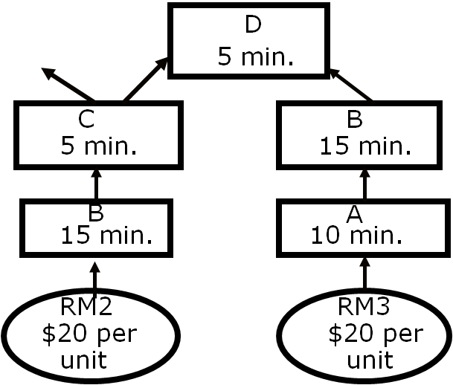
Step 3: Subordinate Everything
Else to This Decision
Keep Resource B running at all times.
Resource B can first work on RM2 for products P and Q, during which Resource A would be processing RM3 to feed Resource B to process RM3 for Q.
Never allow starvation of B by purchasing RM2 or by output of Process A. Never allow blockage of B by Process D- Assembly.
Minimize the number of switches (Setups) of Process B from RM2 to RM3-Through-A and vice versa.
Minimize variability at Process A.
Minimize variability in arrival of RM2
Do not miss even a single order of Product P

Slide 14
A Practice on Sensitivity Analysis
What is the value of the objective function? Z= 45(100) + 60(?)-6000!
Shadow prices?
2400(Shadow Price A)+ 2400(Shadow Price C)+2400(Shadow Price C) + 2400(Shadow Price D)+100(Shadow Price P) + 50(Shadow Price Q).
2400(0)+ 2400(2)+2400(0) +2400(0)+100(15)+ 50(0).
4800+1500 = 6300
Is the objective function Z = 6300?
6300-6000 = 300

Slide 15
A Practice on Sensitivity Analysis
How many units of product Q?
What is the value of the objective function?
Z= 45(100) + 60(?)-6000 = 300.
4500+60X2-6000=300
60X2 = 1800
X2 = 30

Slide 16
Step 4 : Elevate the Constraint(s)
The bottleneck has now been exploited
Besides Resource B, we have found a market bottleneck.
  Generate more demand for Product P
  Buy another Resource B
The Marketing Director: A Great Market in Japan !
  Have to discount prices by 20%.

Slide 17
Step 4 : Elevate the Constraint(s). Do We Try To Sell In Japan?
$/Constraint
Minute
3
2
1.8
1.33

Slide 18
Step 4 : Elevate the Constraint(s). Do We Try To Sell In Japan?
2
Right now, we can get at least $ per constraint minute in the domestic market.
So, should we go to Japan at all?
Okay, suppose we do not go to Japan. Is there something else we can do?
      Let’s buy another machine! Which one?
      Cost of the machine = $100,000.
      Cost of operator: $400 per week.
      What is weekly operating expense now?
      How soon do we recover investment?
Perhaps not.
B
$6,400

Slide 19
Step 5: If a Constraint Was Broken in previous Steps, Go to Step 1

Slide 20
Step 5: If a Constraint Was Broken in previous Steps, Go to Step 1
80P, 50Q,0PJ, 70QJ
Total Profit = 3000
What is the payback period?
100000/3000 = 33.33 weeks
What is the payback period?
100000/(3000-300) = 37.03 weeks
The domestic P had the max profit per minute on B. Why we have not satisfied all the domestic demand.

Slide 21
Practice: A Production System Manufacturing Two Products, P and Q
$90 / unit
Q:
$100 / unit
P:
110 units / week
60 units / week
Purchased Part
D
D
10 min.
5 min.
$5 / unit
C
C
B
10 min.
5 min.
25 min.
B
A
A
15 min.
10 min.
10 min.
RM1
RM2
RM3
$20 per
$20 per
$25 per
unit
unit
unit
Time available at each work center: 2,400 minutes per week.
Operating expenses per week: $6,000. All the resources cost the same.

