Slide 1

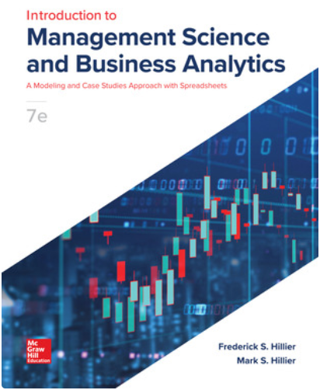


Sensitivity Analysis
Ardavan Asef-Vaziri

Slide 2
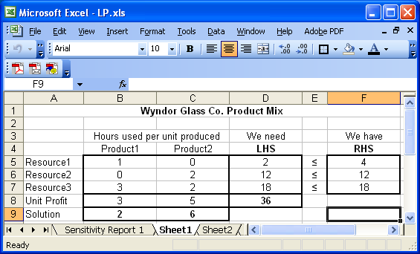
Practice
What is the optimal Objective function value for this problem?
What is the allowable range for changes in the objective coefficient for Product 2
What is the allowable range for changes in the RHS for Resource 3.
If the coefficient of Product 2 in the objective function is changed to 7, what will happen to the value of the objective function?
If the coefficient of Product 1 in the objective function is changed to 8, what will happen to the value of the objective function?
If the RHS of Resource 2 is increased by 2 , what will happen to the objective function.
If the RHS of Resource 1 is increased by 2, what will happen to the objective function.
If the RHS of Resource 2 is decreased by 10, what will happen to the objective function.

Slide 3
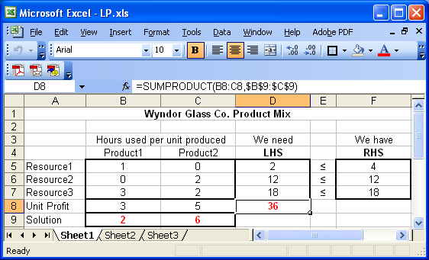
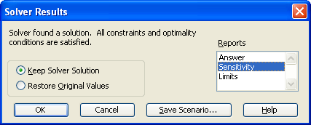
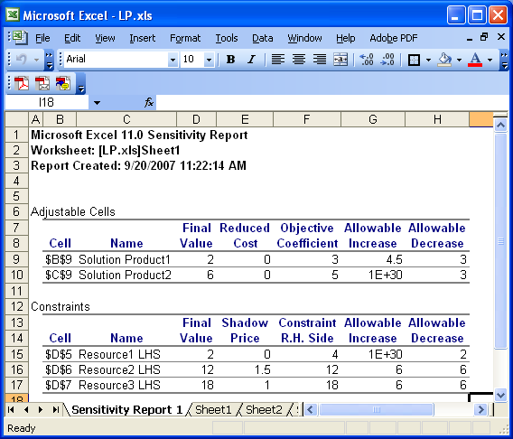
Sensitivity

Slide 4
Sensitivity Analysis- Changing Cells-The Decision Variables
Final Value: The value of the Decision variables in the optimal solution
Reduced Cost: Increase in the objective function value per unit increase in the value of a zero-valued variable (a product that the model has decided not to produce).
Allowable: Defines the range of increase or decrease in the objective function coefficients for which the current optimal solution will not change

Slide 5
Sensitivity Analysis- Constraints- Shadow Prices
Shadow price: The change in the value of the objective function per unit increase in the right hand side of the constraint: Z↑ = (Shadow Price)(RHS↑).
Constraint: The current value of the right hand side of the R.H. Side constraint (the amount of the resource that is available).
Allowable: The range of changes in the RHS for which the shadow prices remain the same. The objective function value can also be calculated by using the shadow prices and RHSs.

Slide 6
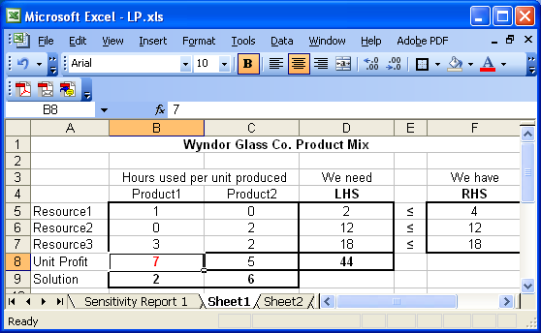
Sensitivity Analysis - Change the profit to 7

Slide 7


Sensitivity Analysis - Change the profit to 8

Slide 8
Practice
Given the following problem
  Maximize Z = 3x1 + 5x2
  Subject to: the following constraints
      x1 + 3x2 ≤ 14
      3x1 + 2x2 ≤ 15
x1, x2 ≥ 0
For the production combination of 3 units of product 1 and 3 units of product 2, shadow price of which resource is equal to 0 ?
    A) Resource 1 (only)
    B) Resource 2 (only)
    C) both Resource 1 and Resource 2
    D) neither Resource 1 nor resource 2.
    E) can only be discovered by the sensitivity report

Slide 9
Practice: Given the following Sensitivity Analysis Report

Slide 10
Practice: Questions
What is the optimal objective function value for this problem?
a. It cannot be determined from the given information.
b. $900.
c. $987.5.
d. $875.
e. $19375.
What is the allowable range for the objective function coefficient for Product 3?
a. 0.71 ≤ P3 ≤ 5.
b. 20 ≤ P3 ≤ 25.71.
c. 0 .71≤ P3 ≤ 25.71.
d. 25 ≤ P3 ≤ 25.71.
e. non of the above.
What is the allowable range of the right-hand-side for Resource1?
a. 500 ≤ RHS1 ≤ ∞.
b. 0 ≤ RHS1 ≤ 500.
c. 100 ≤ RHS1 ≤ ∞.
d. 400 ≤ RHS1 ≤ ∞.
e. -∞ ≤ RHS1 ≤ 400.
0(15)
500(20)
375(25)
= 19375
(e)
25+0.71 = 25.71
25-5 = 20
20 to 25.71
(b)
500+ ∞ = ∞
500-100=400
400 to ∞
(d)

Slide 11
If the coefficient for Product2 in the objective function changes to $24, then the objective function value:
a. will increase by $24.
b. will increase by $120,000.
c. will increase by $2000.
d. will remain the same.
e. can only be discovered by resolving the problem.
If the coefficient for Product1 in the objective function changes to $5, then the objective function value:
a. will increase by $5.
b. is $0.
c. will increase by $10.
d. will remain the same.
e. can only be discovered by resolving the problem.
If the coefficient of Product2 in the objective function changes to $15, then:
a. the original solution remains optimal.
b. the problem must be resolved to find the optimal solution.
c. the optimal solution will decrease by 2500.
d. the shadow price will decrease by 5.
e. the optimal solution will increase by 2500.
Product 2: 20→ 24
↑4 is within the range
Final values remain the same
Instead of 500(20) we will have 500(24)
500(4) = 2000 increase
(c)
Product 1: 15→ 5; ↓10,
allowable decrease ∞
10 is within the range; Final values remain the same
Still we produce 0 units of product 1
The objective function will remain the same
(d)
Product 2: 20→ 15
↓5 is out of range
(b)

Slide 12
If the right-hand side of Resource1 increases, then the objective function value:
a. will increase.
b. will decrease.
c. will decrease then increase.
d. will remain the same.
e. will increase then decrease.
If the right-hand side of Resource2 changes to 370, then the objective function value:
a. will increase by $370.
b. will increase by $350.
c. will increase by $250.
d. will remain the same.
e. can only be discovered by resolving the problem.
If the right-hand side of Resource3 changes to 130, then:
a. the original solution remains optimal.
b. the problem must be resolved to find the optimal solution.
c. the objective function will decrease by 130.
d. the objective function will decrease by 3000.
e. the objective function will increase by 3000
R1 ↑
R1 ↑ ∞
Any change then is within the range
Shadow prices will remain the same; still 0
Therefore, no change in the objective function
(d)
R2 from 350 to 370
20 ↑ allowable increase 50
Within the range
Shadow prices will remain the same; still 12.5
20(12.5) = 250
(c)
R2 from 100 to 130
30↑ out of range
(b)

Slide 13
More Than One Parameter – But in One Table
If the sum of the ratio of (Change)/(Change in the Corresponding Direction) <=1
Things remain the same.
If we are talking about profit, the production plan remains the same.
If we are talking about RHS, the shadow prices remain the same.

Slide 14
More Than One Parameter – But in One Table
If the objective coefficients of Product1 is increased by 1 and the objective coefficient of product3 is decreased by 2, then:
a. the objective function will decrease.
b. the objective function will increase.
c. the optimal solution will remain the same.
d. the shadow prices will remain the same.
e. can only be discovered by resolving the problem.
If the right-hand side of all three resources, each increases by 10 units:
a. the optimal solution remains the same. The objective function value will increase.
b. the optimal solution will change. The objective function value will increase.
c. the optimal solution and the shadow prices will remain the same.
d. the optimal solution and the shadow prices both will change.
e. can only be discovered by resolving the problem.
If the right-hand side of resouses1 and 2 each decreases by 20 and the right hand side of resource 3 increases by 5:
a. the objective function value will increase by 250.
b. the objective function value will decrease by 250.
c. the objective function value will remain the same.
d. the optimal solution will remain the same.
e. can only be discovered by resolving the problem.
P1: ↑1, P3 ↓2
P1 ↑ 1.25, P2 ↓5
(1/1.25)+(2/5) >1
(e)
R1, R2, R3: ↑10
R1 ↑∞, R2 ↑50, R3 ↑25
10/ ∞ + 10/50+10/25 ≤1
Shadow prices will remain the same
0(10)+12.5(10)+100(10) = 1125
(b)
R1 ↓ 20, R2↓20, R3 ↑5
R1 ↓ 100, R2↓50, R3 ↑25
0.4+0.4+0.2 ≤ 1
Shadow prices will remain the same
0(-20)+12.5(-20)+100(5) = 250
(a)

Slide 15
Assignment
The following 12Questions refer to the following sensitivity report.

Slide 16
Assignment
What is the optimal objective function value for this problem?
a. it cannot be determined from the given information.
b. $1,200.
c. $975.
d. $8,250.
e. $500.
What is the allowable range for the objective function coefficient for Activity 3?
a. 150 ≤ A3 ≤ ∞.
b. 0 ≤ A3 ≤ 650.
c. 0 ≤ A3 ≤ 250.
d. 400 ≤ A3 ≤ ∞.
e. 300 ≤ A3 ≤ 500.
What is the allowable range of the right-hand-side for Resource A?
a. 0 ≤ RHSA ≤ 60.
b. 0 ≤ RHSA ≤ 110.
c. 60 ≤ RHSA ≤ 110.
d. 110 ≤ RHSA ≤ 160.
e. 0 ≤ RHSA ≤ 160.

Slide 17
Assignment
If the coefficient for Activity 2 in the objective function changes to $400, then the objective function value:
a. will increase by $7,500.
b. will increase by $2,750.
c. will increase by $100.
d. will remain the same.
e. can only be discovered by resolving the problem.
If the coefficient for Activity 1 in the objective function changes to $50, then the objective function value:
a. will decrease by $450.
b. is $0.
c. will decrease by $2750.
d. will remain the same.
e. can only be discovered by resolving the problem.
If the coefficient of Activity 2 in the objective function changes to $100, then:
a. the original solution remains optimal. The objective function value decreases.
b. the problem must be resolved to find the optimal solution.
c. the shadow prices will remain the same.
d. the original solution and the objective function value remain the same.
e. none of the above.

Slide 18
Assignment
If the objective coefficients of Activity 2 and Activity 3 are both decreased by $100, then:
a. the objective function will decrease by 2750.
b. the objective function will decrease by less than 2750.
c. the objective function will decrease by more than 2750.
d. The objective function will remain the same.
e. can only be discovered by resolving the problem.
If the right-hand side of Resource C is increased by 40, and the right-hand side of Resource B is decreased by 20, then:
a. the optimal solution remains the same.
b. the objective function value increases by 1500.
c. the shadow prices remain the same.
d. can only be discovered by resolving the problem.
e. the objective function value decreases by 1500.
If the right-hand side of Resource A is increased by 25, and the right-hand side of Resource B is decreased by 20, then:
a. the optimal solution remains the same.
b. the objective function value increases by 1500.
c. the objective function value remains the same.
d. can only be discovered by resolving the problem.
e. the objective function value decreases by 1500.

