Slide 1
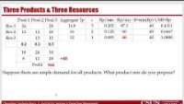
Capacity- Product Mix
Multi-Product Flow
Ardavan Asef-Vaziri

Slide 2
The Lego Production Problem
You have a set of Legos
8 small bricks
6 large bricks
These are your “raw materials”.
You have to produce tables and chairs out of these Legos. These are your “products”.
How many chairs and how many tables do you produce?
Les assume X1 as the number of chairs and X2 as the number of tables we produce
Weekly supply of raw materials
8 Small Bricks
6 Large Bricks
Products
Chair
Profit = 15 cents per Chair
Table
Profit = 20 cents per Table

Slide 3
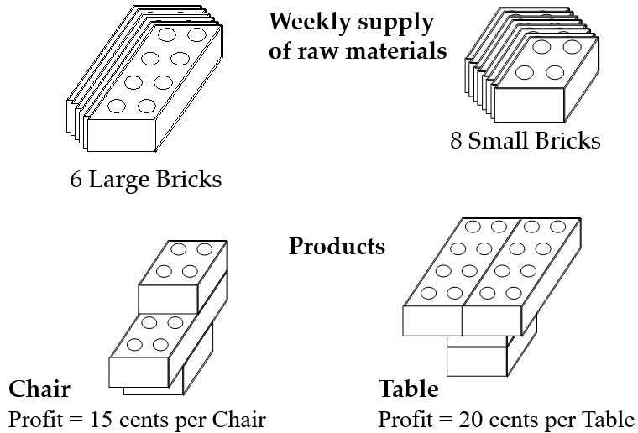
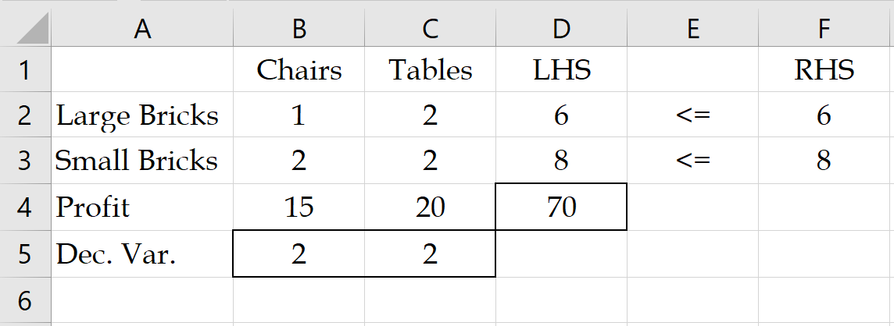
Mathematical Formulation
X1 is the number of Chairs
X2 is the number of Tables
Large brick constraint
X1+2X2 ≤ 6
Small brick constraint
2X1+2X2 ≤ 8
Objective function is
Maximize 15X1+20 X2
X1 ≥ 0
X2 ≥ 0

Slide 4


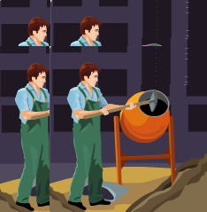

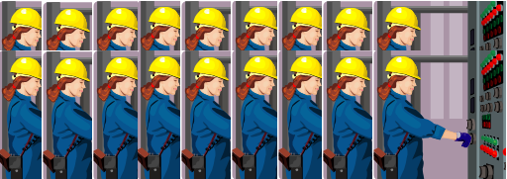
Door and Window
Two products (Product1 and Product2) and three resources (Resource1, Resource2, Resource3).
Contribution Margin of product 1 and Product2 are $300 and $500, respectively.
Product1 needs 1 hour of Resource1, nothing of Resource2, and 3 hours of resource3. Product2 needs nothing from Resource1, 2 hours of Resource2, and 2 hours of resource3.
Available hours of resources 1, 2, 3 are 4, 12, 18, respectively.
Formulate the Problem
Solve the problem using solver in excel

Slide 5
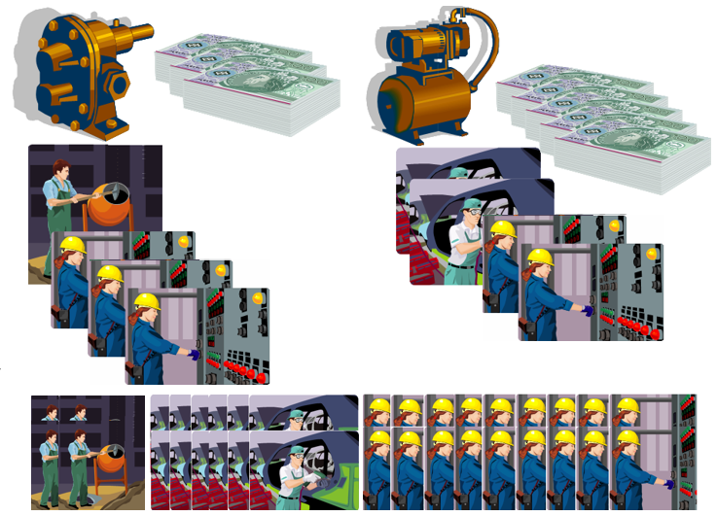
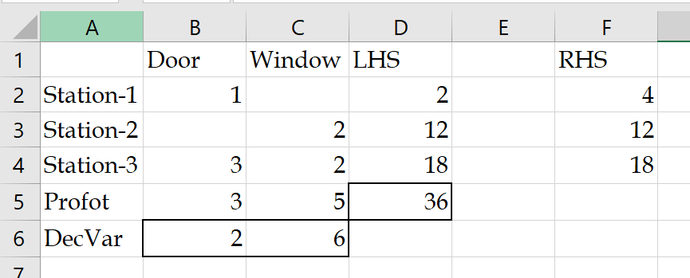
Formulation
Objective Function
Z = 300X1 +500X2
Constraints
Resource 1
X1 ≤ 4
Resource 2
2X2 ≤ 12
Resource 3
3X1+ 2X2 ≤ 18
Nonnegativity
X1≥ 0, X2≥ 0

Slide 6
Solver Optimal Solution
We can increase capacity of Sta-1 from 4 to 5 hours at a cost of $55. What is your decision?
We can increase either the capacity of Sta-2 from 12 to 13 hours, or the capacity of Sta-3 form 18 to 19 hours at a cost of $110. What is your decision?

Slide 7
Infeasible, Feasible, Optimal
Given the following problem
  Maximize Z = 3x1 + 5x2
  Subject to: the following constraints
      x1 ≤ 4
      2x2 ≤ 12
      3x1 + 2x2 ≤ 18
x1, x2 ≥ 0
What combination of x1 and x2 could be the optimal solution?
    A) x1 = 4, x2 = 4
    B) x1 = -3, x2 = 6
    C) x1 = 3, x2 = 4
    D) x1 = 0, x2 = 7
    E) x1 = 2, x2 = 6
Infeasible; Violates Constraint 3
Infeasible; Violates nonnegativity
Feasible; z = 3×3+ 5×4 = 29
Infeasible; Violates Constraint 2
Feasible; z = 3×2+ 5×6 = 36 and Optimal

Slide 8
Product Mix: Three Products & Three Resources
  Three Products (Prod-1, Prod-2, and Prod-3) go through three resource pools (Res-1, Res-2, Res-3).
  Currently the product mix is Prod-1: 20%, Prod-2: 30%, and Prod-3: 50%.
  The profit margins are Prod-1=$10, Prod-2=$24, and Prod-3=$30.
  There are 3 resource units in the first resource pool, 2 resource units in the second resource pool, and 1 resource in the third resource pool. Each resource unit has 480 minutes per day.
  Where is the bottleneck?
  Compute the capacity in term of the aggregate product.
  Compute the optimal product mix.
  Compute the total net profit.
  The time required by each product at each resource pool in minute is given below.

Slide 9
Three Products & Three Resources
https://youtu.be/Dtsh2yVP7rw
  =40
  Suppose there are ample demand for all products. What product mix do you propose?

Slide 10
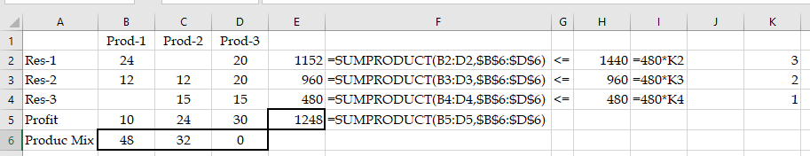
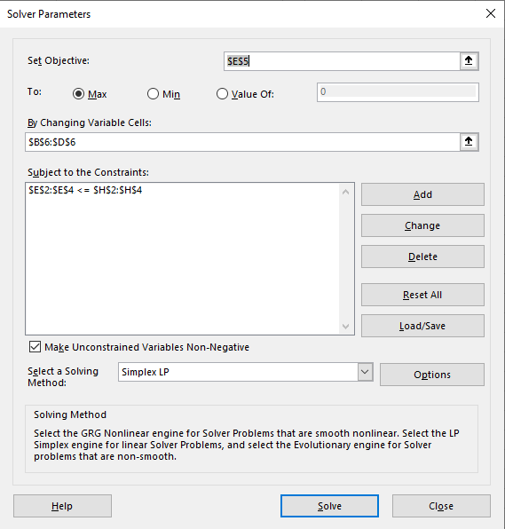
Three Products & Three Resources
  Product mix is 48, 32, and 0.
  Prod-1= 48/(48+32)= 60%
  Prod-2=40%
  Prod-3=0%
  Total Profit = $1248
  Increase in Profit $1248-$968= $280/day

Slide 11
Three Products & Three Resources
  Sh-Price-Res-1 = 0/ hour, Sh-Price-Res-2 = 50/ hour, Sh-Price-Res-3 = 56/ hour
  This analysis, however, is valid only for limited ranges.

Slide 12
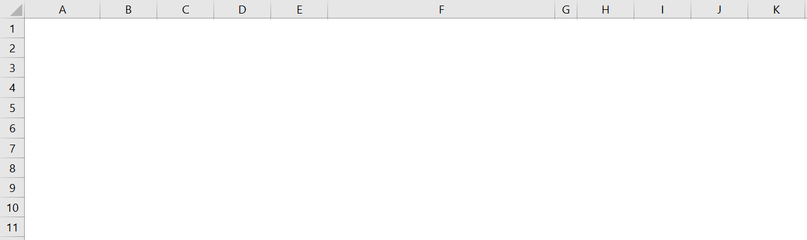
Three Products & Three Resources
  If we could have sold 32 units, profit was 1248. The market is limited to 30 units, and the new profit is $1.33 less. Therefore, it worth to spend up to $1.33/2 = $0.66 to increase the sales of product-1 by one unit.

Slide 13

Practice- Original Problem with Cross Training
  Sh-Price-Res-1 = 0/ hour, Sh-Price-Res-2 = 50/ hour, Sh-Price-Res-3 = 56/ hour.
  Take the current RHS to the left and have all RHS=0
  Define Y1, Y2, and Y3 as the fraction of capacity of Res-1 assigned to Res-1, Res-2, and Res-3, respectively

Slide 14
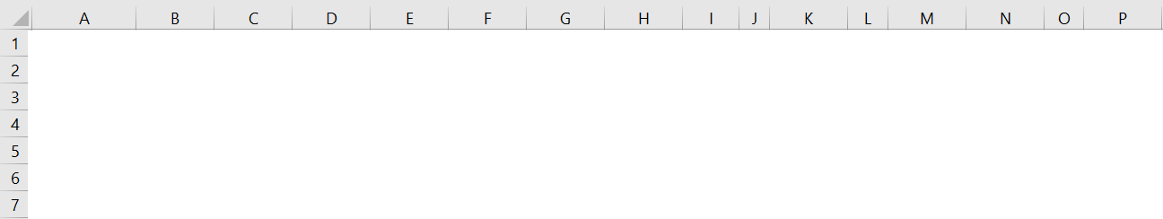
Practice- Original Problem with Cross Training NOT NOW

