Slide 1
Introduction to the Theory of Constraints
These slides were prepared based on
Building Lean Supply Chains with the Theory of Constraints. 2012. M. M. Srinivasan
Ardavan Asef-Vaziri

Slide 2
A Production Planning Problem
Hitchcock-Kubrick-Lean Incorporation has 5 line employees. Wage per employee is $2,000 including benefits. Hours budgeted per employee per month = 200 hours.
Monthly Administrative Overhead (Salaries) = $18,000. Monthly Non-Administrative Overhead (Rent, Truck Fleet Maintenance, Marketing, Depreciation) = $9,000.
Total Direct Labor cost per month is $10,000. Direct labor rate = $10,000/1,000 = $10 per hour.
Other information is given below. Plumbing (Product-1), Window Cleaning (Product-2), Gutter Guard Installation (Product-3), and Landscaping (Product-4).

Slide 3
A Production Planning Problem
HKL is currently completing an average of 90 units of Product-1, 70 units of Product-2, 80 units of Product-3, and 60 units of Product-4 per month.
For this level of output, HKL uses up (90×2 + 70×4 + 80×3 + 60×5) = 1,000 hours of labor, and that effectively accounts for all the available capacity.
HKL assigns labor costs to the four products as follows: Product-1 takes 2 hours per unit and so the labor cost is $10 x 2 = $20 per unit of Product-1. The labor costs for the other three products are, $40, $30, and $50, respectively.
HKL has hired two team of consultant for product mix planning. One is using standard cost accounting (the other team uses activity based accounting) to allocate the administrative and non-administrative overhead costs.
You are a member of one of these teams. They are expected to propose a production plan (product mix) to maximize profit.

Slide 4
Standard Cost Accounting
Standard cost accounting allocates indirect costs to products based on the volume of the cost driver they have consumed. There may be more than one single cost driver such as labor cost, number of jobs, etc.
The cost driver chosen by this team is the monthly production volume. Currently HKL is completing (90 + 70 + 80 + 60) = 300 jobs a month.
Each job is allocated an administrative overhead cost of $18,000/300 = $60.
Each job is allocated a non-administrative overhead cost of $9,000/300 = $30.

Slide 5
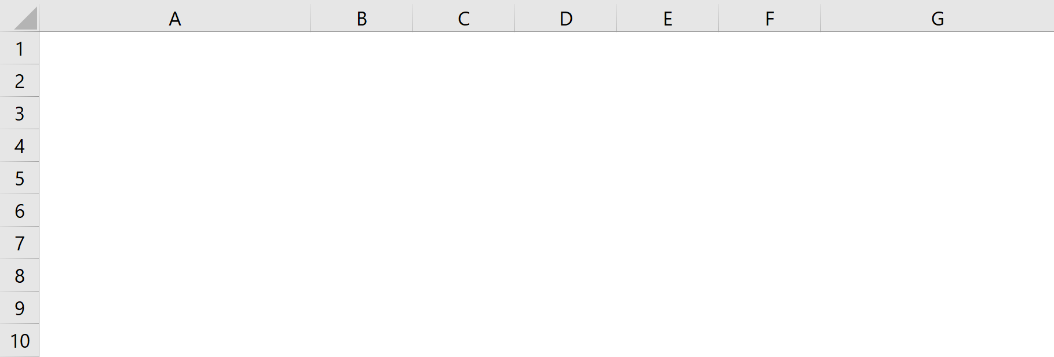
Standard Costing Computations
HKL is using all its labor capacity, and is absorbing all overheads. So there is no labor variance or overhead absorption variance to worry about.
Total Profit = 90(-$10) + 70($30) + 80($10) + 60($35) = $4,100.

Slide 6
Standard Cost Accounting- Quest for Maximum Profit
Prod-4 generates the highest profit of $35 per unit, lets produce as much as we can.
Resource per unit =5. Total resource available =1000.
Capacity = 1000/5 = 200. Demand = 120.
Production = Min{200,120} = 120. External Constraint.
Product 4 generates 35(120) = $4200 profit.
Capacity used = 5(120) = 600.
Remaining capacity = 1000- 600 = 400.
Prod-2 generates the next highest profit of $30 per unit. Lets produce as much as we can.
Resource per unit =4, Total resource available =400.
Capacity = 400/4 = 100. Demand = 160.
Produce Min{160,100} =100 ➔ Internal Constraint.

Slide 7
Standard Cost Accounting- Quest for Maximum Profit
Product 4 generates 30(100) = $3000 profit.
Total profit 4200+3000 = $7200.
Do you really make this much profit?
Lets check.

Slide 8
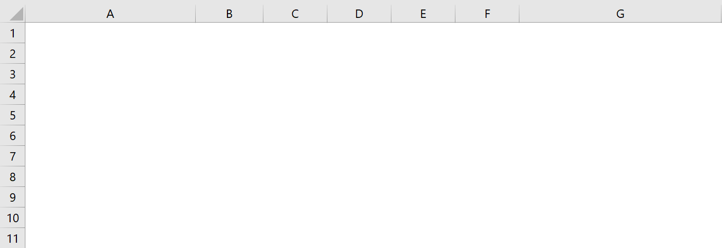
Standard Cost Accounting Recommendation ➔ Make ZERO Profit
Instead of 7200 Profit, We have 0 Profit. With original plan we had 4100 Profit.

Slide 9
Standard Costing is Not a Good Production Planning Tool
It is easy to see this.
Revenue = 120(250)+100 (170)= 47000
Material Cost = 120(75)+100(10) = 10000
We could have also said
Financial throughput = 120(250-75)+100 (170-10)= 37000
Fixed Costs = 10000+18000+9000 = 37000
The activity based costing (ABC) team (the second accounting team) gathers data on the actual time the three administrators spend on the various products. The data shows that the administrators allocate their time as follows: Product-1 30%; Product-2: 35%; Product-3: 20%; and Product-4: 15%.
The ABC group uses labor hours as the cost driver to allocate the non-administrative overhead cost. That is $9,000/1,000 = $9 per labor hour.

Slide 10
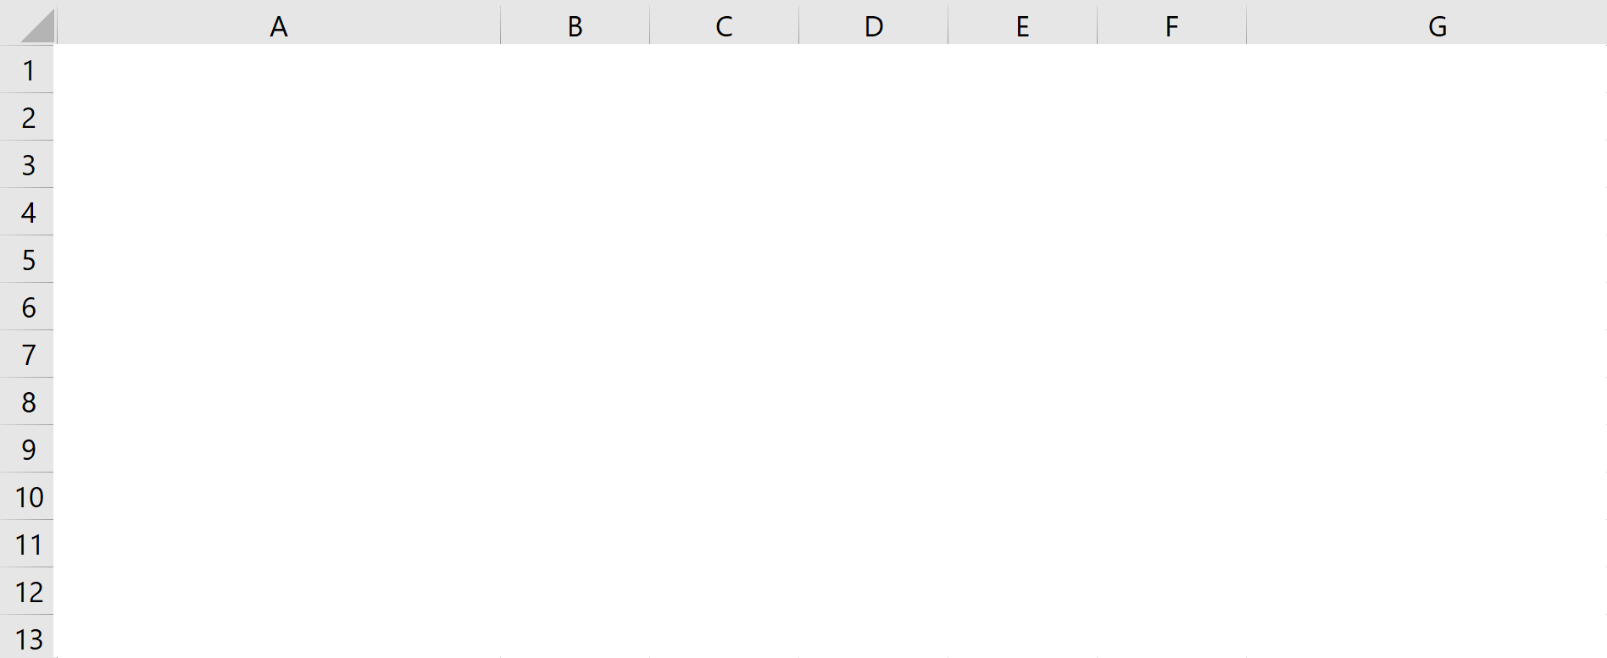
Activity Based Costing vs Standard Costing

Slide 11
Can HKL Do Better?
Let’s use ABC figures to find the most profitable product mix.
Product-4 generates the highest profit of $35 per unit, lets produce as much as we can.
Resource per unit =5, Total resource available =1000.
Capacity = 1000/5 = 200.
Demand = 120.
Produce Min(200,120) =120. External Constraint.
Product 4 generates 35(120) = $4200 profit.
Capacity used = 5(120) = 600.
Remaining capacity = 1000- 600 = 400.
Product-3 generates the next highest profit of $28 per unit, lets produce as much as we can.
Resource per unit =3, Total resource available =400.

Slide 12
Can HKL Do Better?
Capacity = 400/3 = 133.33.
Demand = 145.
Produce Min{133.33,145} =133.33 =133. Internal Constraint.
Product 3 generates 28(133) = $3724 profit.
Total profit 4200+ 3724 = $7924.
Do you really make this much profit?
No. Why?
Total Revenue = 120(250-75)+133(200-70) = 38290
Total Cost = 10000+18000-9000 = 37000
Profit = 38290 – 37000 = 1290
Why?

Slide 13
Activity Based Costing is Not a Good Production Planning Tool.
There are Unabsorbed overheads.
120 Prod-1 and 133 Prod-2 will each recover $45 of Administrative Overhead, that is:
$45 x 120 + $45 x 133 = $11,385.
Admin. Overhead Variance =
$18,000 - $11,385 = $6,615.
The 1 hour of unused labor gives a Labor Usage Variance of $10 and Non-Admin. Overhead Variance of $9.
So, the total of all the Variances is:
$6,634.
Actual profit with ABC is thus:
$7924 - $6,634 = $1,290.
120(200-70)+ So, “optimal” profit is less than earlier profit! Why?

Slide 14
Planning By Using the Theory of Constraints
Product-1 generates the highest profit of $50 per unit of consumption of the bottleneck resource, lets produce as much as we can.
Resource per unit =2, Total resource available =1000.
Capacity = 1000/2 = 500.
Demand = 250.
Produce Min(250,500 =250. External Constraint.
Product 4 generates 250(100) = $25000 financial throughput.

Slide 15
Can HKL Do Better?
Capacity used = 2(250) = 500.
Remaining capacity = 1000- 500 = 500.
Product-3 generates the next highest contribution margin of 43.33 per unit of consumption of the bottleneck resource, lets produce as much as we can.
Resource per unit = 3, Total resource available =500.
Capacity = 500/3 = 166.67.
Demand = 145.
Produce Min{145, 166.67} =145. External Constraint.
Capacity used = 3(145) = 435.
Remaining capacity = 500- 435 = 65.
Product-2 generates the next highest contribution margin of 40 per unit of consumption of the bottleneck resource, lets produce as much as we can.

Slide 16
Can HKL Do Better?
Resource per unit =4, Total resource available = 45.
Capacity = 65/4 = 26.25, let d0 16
Demand = 160.
Produce Min{160,16} =16. Internal Constraint.
Product 4 generates 250(100) = $25000 financial throughput.
Product 3 generates 130(145) = $18850 financial throughput.
Product 2 generates 160(16) = $2560 financial throughput.
25000++18850+ 2560 = 46410
46410 - 37000 = 9410
We may produce one less product 3 and make $130 less but save 3 hours of bottleneck. We also had one hour of bottleneck left, that is a total of 4 hours. We can produce one extra unit of product 2 and make $160.
Final profit = 9410-130+160= 9440

Slide 17
Final Analysis
Summary:
Profit with arbitrary product mix: $4,100
Optimal profit under Standard Costing recommendation: $0
Optimal profit under ABC recomendation: $1,290
Optimal profit with Throughput Accounting: $9,440

Slide 18

The 5 Step TOC Focusing Process
Step 1: Identify the System’s Constraint(s)
Step 2: Determine how to Exploit the System’s Constraints
Step 3: Subordinate Everything Else to that Decision
Step 4: Elevate the System’s Constraints
Step 5: If a Constraint Was Broken in previous Steps, Go to Step 1
Performance of subsystems to be linked to the performance of the total system.

Slide 19
Solution
For more information or practice, and at your own will, you may watch another example at
https://www.youtube.com/watch?v=sVyltL7O2KM

Slide 20
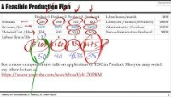

Slide 21
A Feasible Production Plan
For a more comprehensive talk on application of TOC in Product Mix you may watch my other lecture at
https://www.youtube.com/watch?v=sVyltL7O2KM

Slide 22
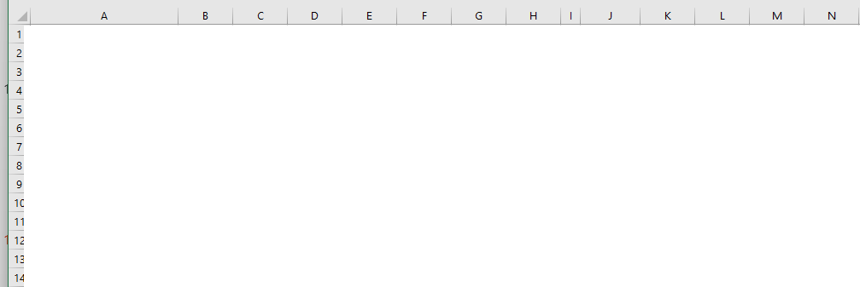
Linear Programming and Solver

