Slide 1


Break-Even Analysis Simulation
Ardavan Asef-Vaziri

Slide 2
Seven Principles of Supply Chain Management
Operation costs are divided into 2 main groups:
  Fixed costs – Costs of Human and Capital Resources
  wages, benefits, depreciation, rent, property tax and insurance.
  the total fixed cost is fixed throughout the year. No matter if we produce one unit or one million units. It does not depend on the production level.
  fixed cost per unit of production is variable.
Variable costs – Costs of Inputs
  raw material, packaging material, supplies, production water and power.
  The total variable costs depend on the volume of production. The higher the production level, the higher the total variable costs.
  variable cost per unit of production is fixed.

Slide 3
Five Elements of the Process View
Process
Management
Information
structure
Network of
Activities and Buffers
Inputs
(natural or processed resources, parts and components, energy, data, customers, cash, etc.)
Outputs
Goods
Services
Flow Unit
Human & Capital
Fixed
Variable
Resources

Slide 4
Total Fixed Cost and Fixed Cost per Unit of Product
Total fixed cost
(F)
Fixed cost per unit of product
(F/Q)
Production volume (Q)
Production volume (Q)

Slide 5
Variable Cost per Unit and Total Variable Costs
Variable costs
Per unit of product
Total Variable costs
(VQ)
(V)
Production volume (Q)
Production volume (Q)

Slide 6
Diminishing Marginal Return
Variable costs
Output
Per unit of product
(V)
Input
Production volume
(Q)

Slide 7

Economy of Scall & Diseconomy of Scale
Economies of scale
  Labor specialization
  Managerial specialization
  Efficient capital
  -------------
Diseconomies of scale
  Control and coordination problems
  Communication problems
  Worker alienation
  Shirking
  Dinosaur Effect
ATC-5
ATC-1
ATC-2
ATC-4
Average Total Costs Per Output
ATC-3
Long-Run ATC
Output
Control
Size

Slide 8
Total Costs TC = F+VQ
Total cost = F+VQ
Total Costs in $ (TC)
Total variable cost (VQ)
Total Fixed cost (F)
0
Volume of Production and Sales in units (Q)

Slide 9
Total Revenue
It is assumed that the price of the product is fixed, and we sell whatever we produce.
Total sales revenue depends on the production level.
The higher the production, the higher the total sales revenue.

Slide 10
Break-Even Computations
Profit
Total cost = F+VQ
Total Costs or Revenue in $ (TC)
Loss
Total Revenue (PQ)
Break-Even Point
Volume of Production and Sales in units (Q)

Slide 11
BEP-Example
$1000,000 total yearly fixed costs.
$200 per unit variable costs
$400 per unit sale price
TR = TC
400Q= 1000,000+200Q
(400-200)Q= 1000,000
Q= 5000
Q_{BEP}=5000
If our market research indicates that the present demand is > 5,000, then this manufacturing system is economically feasible.
Simulation
$1000,000 average total yearly fixed costs U($800,000-$1,200,000).
$200 average per unit variable costs U($180-$220).
$400 average per unit sale price U($350-$450)
Sales 4000-6000
.

Slide 13
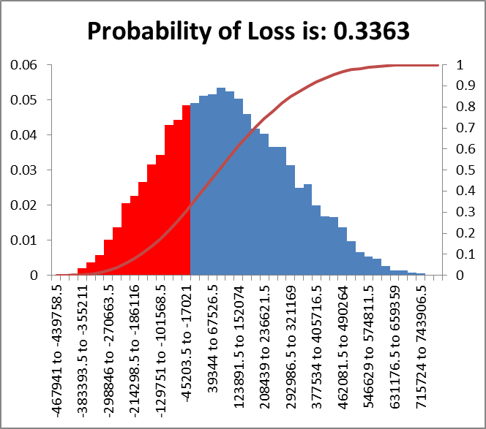

Slide 14
Simulation of Project Management Network
https://youtu.be/wqjGsLsadOo
URV Generation
x= a+(b-a)Rand()
x= 20+(60-40)Rand()

Slide 15
Central Limit Theorem
The distribution of each of the activity was uniform. Summation of them moves towards normal distribution.
Given certain conditions, the arithmetic mean of a sufficiently large number of independent random variables, each with a
well-defined expected value and well-defined
variance, will be approximately normally distributed, regardless of the underlying distribution

Slide 16
Simulation of Project Management Network

Slide 17
Simulation of Project Management Network

Slide 18
Simulation of Project Management Network

Slide 19
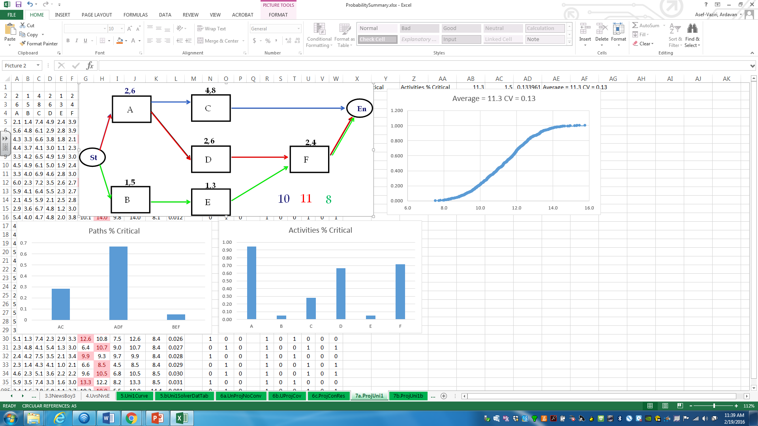
Simulation of Project Management Network

