Slide 1
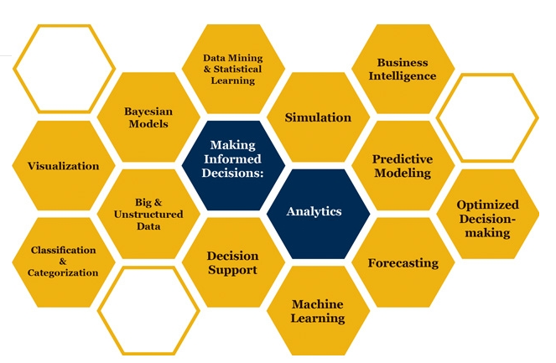

Slide 2

Project Planning Simulation
How can it be that mathematics, being after all a product of human thought independent of experience, is so admirably adapted to the objects of reality
Albert Einstein

Slide 3
Watch the First Lecture
Click Here to Access The First Part of the YouTube Lecture
Click Here to Access the Excel Sheet
Click Here to Access The Second Part of the YouTube Lecture

Slide 4
Simulation of Project Management Network
https://youtu.be/wqjGsLsadOo
URV Generation
x= a+(b-a)Rand()
x= 20+(60-40)Rand()

Slide 5
Central Limit Theorem
The distribution of each of the activity was uniform. Summation of them moves towards normal distribution.
Given certain conditions, the arithmetic mean of a sufficiently large number of independent random variables, each with a
well-defined expected value and well-defined
variance, will be approximately normally distributed, regardless of the underlying distribution

Slide 6
Simulation of Project Management Network

Slide 7
Simulation of Project Management Network

Slide 8
Simulation of Project Management Network

Slide 9
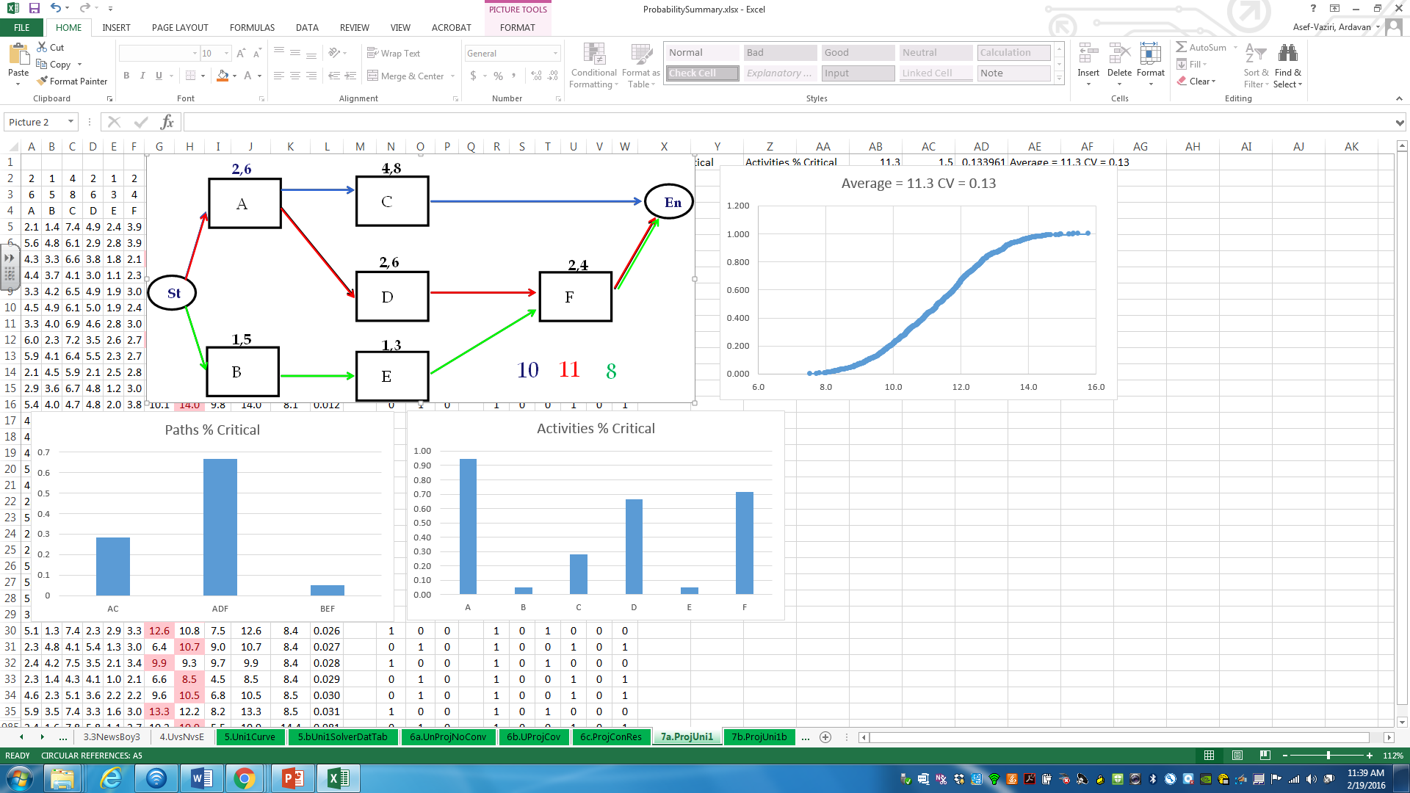
Simulation of Project Management Network

