Slide 1
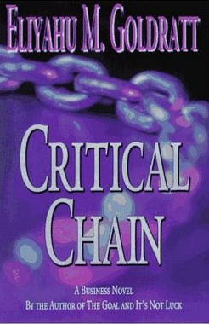
The Critical Chain
Group 2 Chapters 19-21

Slide 2

Lose-Lose to Win-Win
Student (Ted) looks at the relationship between contractors and owners
Lose-Lose:
  Contractor bids low to obtain contract
  Contractor makes more money off of changes and delays
  Owner pays high price for changes
  No incentives for contractor to complete the project on time

Slide 3

Lose-Lose to Win-Win
The Win-Win relationship:
  Owner benefits from a project which is completed early
  Owner shares this benefit with contractor in incentive bonus for finishing early
  Owner punishes contractor for finishing late with heavy penalties
  Contractors no longer bid on price but ability to complete project faster

