Slide 1

Critical Chain:
Chapters 16 thru 18
Group 3
Katelyn Fang ∙ Sherry Liu ∙ Kevin Nagatori ∙ Adam Terry
IOM 580
Dr. Ardavan Asef-Vazir
Spring 2009

Slide 2
Chapter 16
Pitfalls of Managing a Program:
  Pad each step’s completion dates.
  Pad each step with a lot of safety time
  Waste safety time:
    Student Syndrome
    Multi-Tasking
    Delays accumulate and advances do not

Slide 3
Chapter 16 (cont)
Bottleneck: a resource with capacity that is not sufficient to produce the quantities that the market demands.
Critical Path: the constraint of the project.
Feeding Buffer: a buffer used by the non-critical path so that it does not affect the critical path.

Slide 4
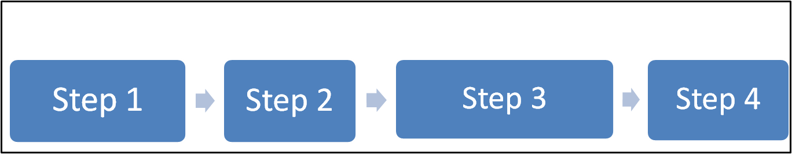
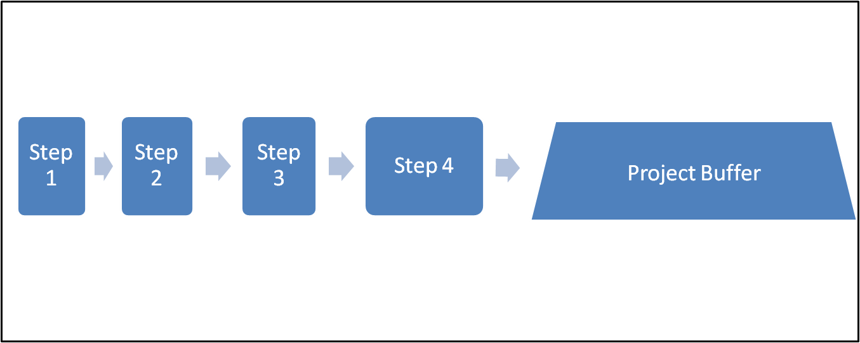
Chapter 16 (cont)
Before / Most Common
Project Plan with buffer at each step
After / Best Way
#A1
FB
Project Plan with buffer at Critical Path and Feeder Buffers for Non-Critical Path
#B1
FB
#B2

Slide 5
Chapter 17
Monitoring Progress
  Before => Monitor critical path by % complete
  After => Adding feeding buffer monitoring
    Days consumed on feeding buffer
    Days consumed compared with original buffer days
    Days left on feeding buffer
  Conclusion => Focus on continuous monitoring

Slide 6
Chapter 18
2 Types of Projects
  Projects done solely by the company
    Reduce lead time estimates
    Eliminate milestones
    Frequent reporting
  Projects done by vendors and subcontractors
    Talk their language
    Pay for vendor responsiveness
Penalty for not finishing a project on time
  Cash Flow
  Sales
  Market Share
  Stock Value

