Slide 1
Simulation
Simulation helps us to overcome our shortcomings in analysis of complex systems using statistics, and also to see the dynamics of the system.
Statistics vs. Simulation: To compute probability of completion time or cost of a network of activities.
  Both must enumerate all the paths to compute the probability
  Statistics assume path interdependence while simulation does not
For Simplicity, Triangular distribution is used to estimate Beta distribution.
3/21/2012
Ardavan Asef-Vaziri
5-3-1

Slide 2
Continuous Probability Distributions
Uniform Distribution
Normal Distribution
σ
a
b
Exponential Distribution
μ
Triangular Distribution
μ
a
m
b

Slide 3
Triangular Probability Distributions
a
m
b
a = smallest value the variable can assume
b = largest value the variable can assume
m = most likely value the variable can assume
Expected Value of x ➔ µ = (a +m+ b)/3
Variance of x ➔ σ ² = (a² + m² +b² – ab- am-bm)/18
3/21/2012
Ardavan Asef-Vaziri
5-3-3

Slide 4
Generate a Triangular Random Variable
Compute the height of this triangle
H/2= 1/(b-a)
a
m
b
Similarly, the area to the right is
Generate a random number if rand() ≤ (m-a)/(b-a) we are on the left, otherwise on the right
3/21/2012
Ardavan Asef-Vaziri
5-3-4

Slide 5
Triangular Probability Distributions
Suppose we are on the left
Then the triangular random variable is something like X
H
h
a
X
m
b
What is the height associated with X?
➔
➔
The area to the left of X is then
3/21/2012
Ardavan Asef-Vaziri
5-3-5

Slide 6
Triangular Probability Distributions
H
h
a
X
m
b
The area to the left of X was our rand() which happened to drop on the left
3/21/2012
Ardavan Asef-Vaziri
5-3-6

Slide 7
Triangular Probability Distributions
H
h
a
X
m
b
Generate a random number if ≤ (m-a)/(b-a) we are on the left, and implement the above equation to generate the random variable, otherwise we are on the right
3/21/2012
Ardavan Asef-Vaziri
5-3-7

Slide 8
Triangular Probability Distributions
We showed that for X on the left
H
h
a
m
X
b
Similarly, we can show that if X is on the right of m, the area to the right of h is
This is the area to the right of X, but the area to the left of X was equal to Rand() ➔ The area to the right of X is equal to 1- Rand()
3/21/2012
Ardavan Asef-Vaziri
5-3-8

Slide 9
Triangular Probability Distributions
H
h
a
m
X
b
3/21/2012
Ardavan Asef-Vaziri
5-3-9

Slide 10
Triangular Probability Distributions
Generate a random number if ≤ (m-a)/(b-a) we are on the left, otherwise on the right.
If on the left ➔
If on the Right ➔
3/21/2012
Ardavan Asef-Vaziri
5-3-10

Slide 11
Triangular Probability Distributions
Suppose a=5, b= 20, m=10
Generate a random number
If Rand()≤0.333333
Otherwise
3/21/2012
Ardavan Asef-Vaziri
5-3-11

Slide 12
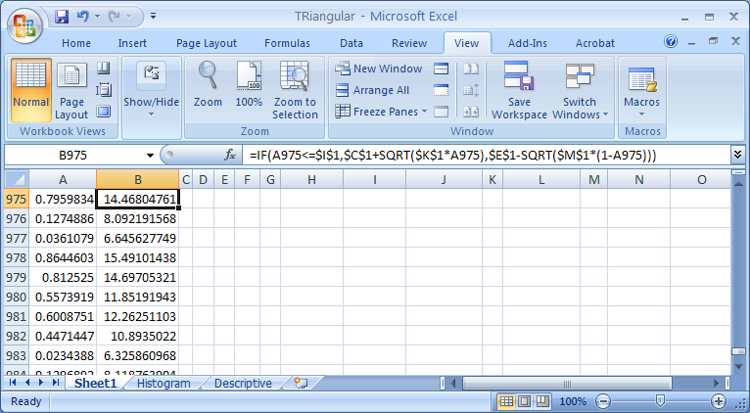
Generate
3/21/2012
Ardavan Asef-Vaziri
5-3-12

Slide 13
Histogram
3/21/2012
Ardavan Asef-Vaziri
5-3-13

Slide 14
Descriptive Statistics
3/21/2012
Ardavan Asef-Vaziri
5-3-14

Slide 15
Practice: Simulate in excel: All Activities Follow Triangular Distribution
3,4,6
6,4,7
A1
A3
E
3,4,5
2,3,5
S
A4
A6
1,3,5
1,2,4
10
11
8
A2
A5
What is the probability of completing the project in 12 days?
3/21/2012
Ardavan Asef-Vaziri
5-3-15

Slide 16
Distribution | Mean | Var | Generation
Uniform | (a+b)/2 | (b-a)/12 | x=a+(b-a)Rand()
Normal | μ | σ×σ | x=μ+σNORMSINV(Rand())
Exponential | μ | μ×μ | x=-μLN(Rand())
Triangle | (a +m+ b)/3 | (a² + m² +b² – ab- am-bm)/18 | If Rand()≤(m-a)/(b-a)
 |  |  | Otherwise

Slide 17
Practice
Problems: Solve these problems using your excel knowledge, not using Cristal Ball.
Ch1 Problem 25
Ch4 Problem 17.
Ch5 Problem 29(it refers to Problem 27 not 26).
3/21/2012
Ardavan Asef-Vaziri
5-3-17

