Slide 1
Activity Times in PERT
Optimistic (a)
  Activity duration to be ≤ a has 5% probability. ➔ ≥ a has 95% probability
Pessimistic (b)
  Activity duration to be ≥ b has 5% probability ➔ ≤ b has 95% probability
Most likely (m)
  The mode of the distribution
All possible task durations (or task costs) can be represented by statistical distributions
10/11/2015
Ardavan Asef-Vaziri
5-2-1

Slide 2
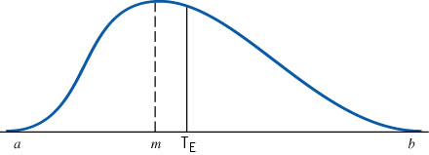
Beta Distribution: The Probability Distribution of Activity Time
Mean (expected time) = T_{E} = (a + 4m + b)/6
Standard deviation = σ = (b-a)/3.3
Variance = σ² = [(b-a)/3.3]²
10/11/2015
Ardavan Asef-Vaziri
5-2-2

Slide 3
Probability of Completing the Critical Path on Time
We assume the various activities are statistically independent of each other
Individual variances (and mean) of the activities on a path can then be summed to find the variance (mean) of the path
Determine the mean and standard deviation of the critical path
Compute the probability of critical path being ≤ a specific value
D_{CP} = the desired completion date of the critical path
μ_{CP}= the sum of the T_{E} for the activities on the critical path
σ²_{CP} = the sum of the variances of the activities on the critical path
10/11/2015
Ardavan Asef-Vaziri
5-2-3

Slide 4
Critical Path Method: Paths
Suppose all activities have beta distribution. The first number is the mean; the second is standard deviation.
4,1
6,2
A1
A3
E
4,1
3,1
S
A4
A6
5,1
4,0.5
A2
A5
10/11/2015
Ardavan Asef-Vaziri
5-2-4

Slide 5
Probability of Completing CP in 12 days
What is the probability of competing the critical path in a maximum of 12 days?
D_{CP} = the desired completion date of the critical path
μ_{CP}= 4+4+3 = 11
σ²_{CP} = 1²+1²+1² = 3
σ_{CP} = 1.73
=NORM.S.DIST(0.58,1)
=0.719043
=NORM.DIST(12,11,1.73,1)
=0.71838
10/11/2015
Ardavan Asef-Vaziri
5-2-5

Slide 6
Selecting Risk and Finding CP Time
With a probability of 90%, in how many days will the CP be completed?
=NORM.INV(0.9,11,1.73)
13.21708
10/11/2015
Ardavan Asef-Vaziri
5-2-6

Slide 7
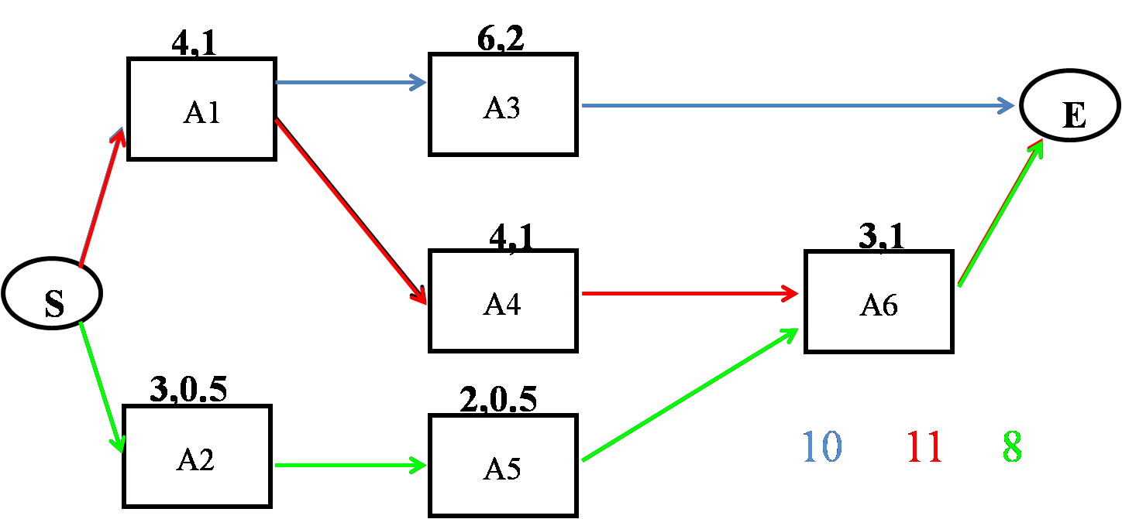
Probability of Completing The Project in 12 days
The probability of completing the critical path in not more than 12 days was 0.72. We need to compute this probability for blue path and green path too, and then multiply these probabilities
10/11/2015
Ardavan Asef-Vaziri
5-2-7

Slide 8
Probability of Completing The Project in 12 days
μ_{CP}= 4+4+3 = 11
σ²_{CP} = 1²+1²+1² = 3
σ_{CP} = 1.73
=NORM.DIST(12,11,1.73,1)
= 0.7184
μ_{CP}= 6+4 = 10
σ²_{CP} = 1²+2² = 5
σ_{CP} = 2.24
=NORM.DIST(12,10,2.24,1)
= 0.814
=NORM.DIST(12,8,1.22,1)
= 0.9995
μ_{CP}= 3+2+3 = 8
σ²_{CP} = 0.5²+0.5²+1²
σ²_{CP} = 1.5
σ_{CP} = 1.22
The probability of competing the Project in not more than 12 days is 0.72×0.81×1 = 0.58
10/11/2015
Ardavan Asef-Vaziri
5-2-8

Slide 9
The Probability of Completing the Critical Path and the Project on Time
Critical Path
D_{CP} = the desired completion date of the critical path
μ_{CP}= the sum of the T_{E} for the activities on the critical path
σ²_{CP} = the sum of the variances of the activities on the critical path
Using μ_{CP} and σ_{CP} and NORM.DIST(D_{CP}, μ_{CP}, σ_{CP},1) we can find probability of completing the critical path in ≤ D_{CP} .
Project
Find all paths in the network. Compute µ and σ of each path
Compute the probability of completing each path in ≤ the given time
Calculate the probability that the entire project is completed within the specified time by multiplying these probabilities together
10/11/2015
Ardavan Asef-Vaziri
5-2-9

Slide 10
Practice
T_{E} = (a + 4m + b)/6
σ = (b-a)/3.3
10/11/2015
Ardavan Asef-Vaziri
5-2-10

Slide 11
Practice
T_{E} = (a + 4m + b)/6
σ = (b-a)/3.3
10/11/2015
Ardavan Asef-Vaziri
5-2-11

Slide 12
Practice
17.83,2.3
7,0
12.17,2.3
A
D
G
E
20.33,0.37
10.67,1.47
10,0.37
B
S
E
H
14,1.47
20.83,4.5
C
F
10/11/2015
Ardavan Asef-Vaziri
5-2-12

Slide 13
Practice
Find the Critical path:
Compute expected duration of CP μ _{cp}=
14.1+20.83+10= 44.93
17.83,2.3
7,0
12.17,2.3
A
D
G
E
20.33,0.37
10.67,1.47
10,0.37
B
S
E
H
14,1.47
20.83,4.5
C
F
10/11/2015
Ardavan Asef-Vaziri
5-2-13

Slide 14
Practice
μ_{CP} = 44.93
Compute Standard deviation of critical path
Variance of CP = 1.47+4.5+0.37 = 6.34
σ_{CP} = SQRT(6.34) = 2.52
Prob( T_{CP}≤ 48)?
=NORM.DIST(48,44.93,2.52,1)
= 0.888436
Prob(T_{CP} ≤ 43?
=NORM.DIST(43,44.93,2.52,1)
= 0.221876
Prob(43 ≤T_{CP}≤ 48)?
=0.888436-0.221876
= 0.66656
10/11/2015
Ardavan Asef-Vaziri
5-2-14

Slide 15
Practice
Review Questions: 1,2,4,6,8, 9, 10, 12
Discussion Questions: 13,14,15
Problems: 23,24,27
Cases: 1 St. Dismas -3
10/11/2015
Ardavan Asef-Vaziri
5-2-15

