Slide 1
Project Management
Chapter 3
Project Planning

Slide 2
In Chapter 3: Planning the Project
Project plan is a route map from project start to finish.
Project launch meeting sets the project scope, asks cooperation of others in the organization, demonstrates managerial commitment to the project, and initiates the project plan.
The Work Breakdown Structure, Linear Responsibility Chart, and Mind Mapping can be developed using the project plan.
Interface Coordination Map shows the ways in which different groups interact during the project life cycle.
Concurrent Engineering and Design Structure Matrix facilitate the task of integrating the work of various functional groups.
Participatory Management leads to empowered teams.

Slide 3
PM’s First Job
Two extreme views on planning
  Ready, fire, aim
  Paralysis by analysis
Review the project scope with the senior mgt
  What expectations the organization has
  Who among senior managers have interest in the project
  Is there anything in the project which is atypical
Develop Invitation List
  Senior mgt: At least the project champion
  Related functional managers
  Related highly technical experts

Slide 4
Project Charter
(or Project Master Plan)
Agreed-upon, legally binding project plan (the final plan)
Overview
Objectives
General approach
Contractual aspects
Schedules
Resources and budgets
Personnel
Evaluation methods
Potential problems
Small or routine projects may not need all 9 of these elements in the project charter.

Slide 5
Project Charter
Overview
  Brief description of project and deliverables
  Major milestones
  Profitability and competitive impacts
Objectives
  Purpose of project
  More detailed description of deliverables
General Approach
  Technical and managerial approaches
  Relationship with other projects

Slide 6
Project Charter
Contractual Aspects
  Description of all agreements (client, vendors, etc.)
  Reporting requirements, technical specs, delivery dates, penalties, process for changes.
Schedules
  Outline of all schedules and milestones
  Project action plan, WBS
Resource Requirements
  All capital and operating expenses
  Cost monitoring and control procedures

Slide 7
Project Charter
Personnel
  What types of personnel are needed and when
  Skill requirements, necessary training, security clearances, nondisclosure agreements
8. Evaluation Methods
  Descriptions of all procedures and standards for evaluating project—how information will be collected, stored, monitored
Potential Problems
  Potential risks to project progress
  Contingency planning to prevent or soften the impacts of some problems

Slide 8
Project Launch Meeting
Senior management introduces PM. The PM chairs the meeting
Important Results
  Scope is understood and is temporarily fixed
  May be limited to just brainstorming the project
  Required functional inputs are identified
  Functional managers committed to develop the initial plan
  May develop the initial plan
  No budget discussed.

Slide 9
Start with Project Scope
  Project Scope Checklist: Review with customer (agreement on expectations)
  Project objectives (purpose, due date, budget)
  Deliverables (at each major phase of project)
  Milestones (significant events in the project)
Hierarchical Planning
  Level 1 Activities: major activities needed to achieve objectives
  Level 2 activities: will be developed by functional areas
  Degree of detail should be same within a given level

Slide 10



Hierarchical Project Planning

Slide 11
The Project Action Plan
Activities arranged by level
Resources and their quantity for each activity
Duration of each activity, and its predecessors
Start date of each activity
Milestones
Individual or group assigned (responsible not necessarily performer) to each activity
May also show finish date, WBS index, cost, slack time, etc.
The data will be then entered into a DSS such as MSP

Slide 12
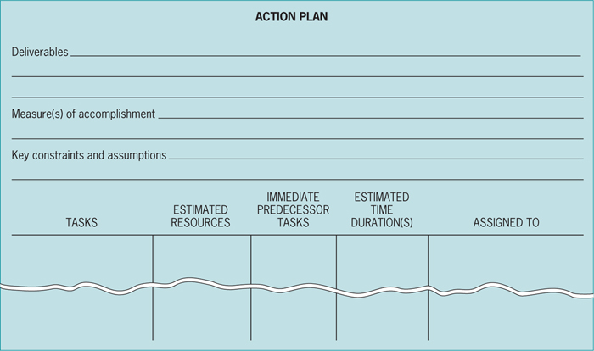

Slide 13
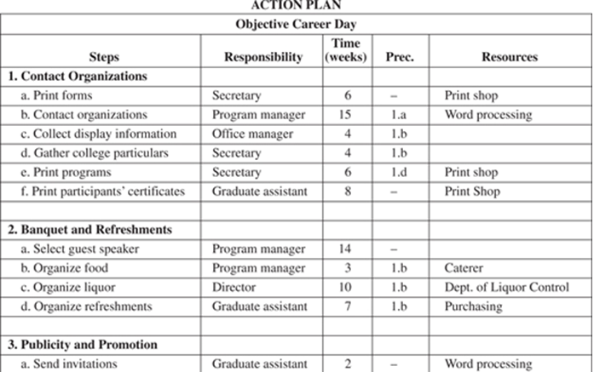

Slide 14
Work Breakdown Structure (WBS)
WBS: The set of all tasks in a project, arranged by task levels, indented by task level, or visualized like an org-chart.
Project deliverable is at the top of the tree, level 1 tasks are below it, then level 2, level 3,...
  Team Members write down all tasks they can think of
  Sticky-Notes placed and arranged on wall
  MPS will make a WBS list (but not a tree-chart).

Slide 15
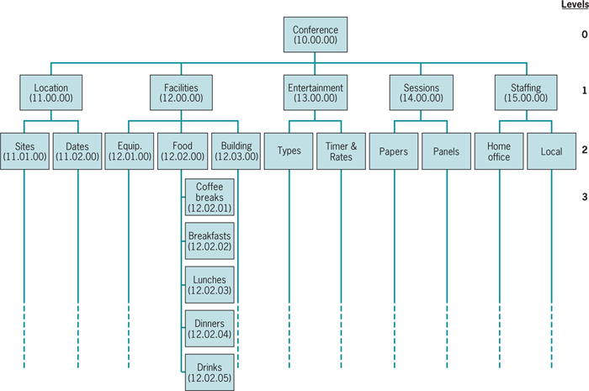
WBS
WBS Activity
0 Carnival
1 Volunteers
2 Promotion
2.1 Posters
2.2 Newspaper
2.3 Tickets
3 Games
4 Rides
5 Entertainment
5.1 Grandstand
5.1.1 Stage
5.1.2 Sound
5.1.3 Seating
5.2 Performers
6 Food

Slide 16
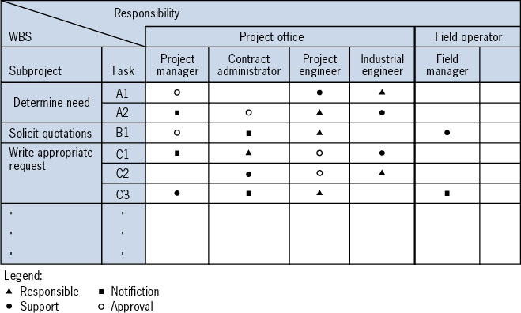
Linear Responsibility Chart (LRC)
The LRC is a matrix with project tasks listed in the rows and departments/individuals columns

Slide 17
Mind Mapping
A visual approach for identifying project tasks
Similar to the way the human brain records and stores information
Begin by defining the project goal
Identify major tasks to achieve the goal
Hierarchically break down each task into more detailed tasks

Slide 18






Mind Map
Registration
Transportation
Promotion
Route
10K run to
raise $50K
for homeless
shelter
Prizes/recognition
Clean-up
Refreshments
Safety
Facilities

Slide 19



Mind Map: Next Levels
Investigate
past events
Produce
ads
TV and
radio ads
Purchase
air time
Interview
running
club
members
Research
Promotion
Monitor
airings
Flyers
Print
Design
Mailings
Mail
promo
Distribute
Prepare
mailing
Acquire
address
lists
To schools
To sports
retailers

Slide 20
Concurrent Engineering
Carrying out tasks concurrently rather than sequentially

Slide 21
Integration Management – Design Structure Matrix
Integration Management: Coordinating the tasks and timing of their interaction
One question is which tasks have to be technically completed in order for other to start
Another important question is what information is needed from other tasks to complete one task
The Design Structure Matrix (DSM) shows which tasks should provide information for a specific task
Technically they my be executed before or after this specific task

Slide 22
Design Structured Matrix (DSM)
a
b
c
d
e
f
Put X: a task in row needs information from a task in column.
X above the diagonal: a task needs information from a subsequent task. It may result in re-work.
a
b
X
X
c
X
X
d
X
X
X
e
X
f
X
X
X
X -- information flow

Slide 23
DSM for Project with Six Activities and Concurrent Activities
a
b
c
d
e
f
Two potential solutions.
1. Try to see if you can rearrange the activities (if presence allows) to move all Xs below the diagonal.
2. Complete additional activities concurrently– difficult.
Draw a box surrounding tasks planed to be executed concurrently.
a
b
X
O
c
X
X
O
d
X
X
X
e
X
f
X
X
X
tasks to be completed concurrently
X: information flow
O: potential rework situation

Slide 24
Interface Map: interdependencies between members of the team
Review
Adapted from: Bailetti, Callahan, and Di-Pietro, Nov. 1994, IEEE Transactions on Engineering Management
Review
Program
manager
Review
Project
schedule
Technical
overview
Contribute use
Manufacturing
Process
technology
Project
manager
Create
Use
Use
Use
Create
Create
Use
Review
Test
vectors
Process
file
Chip
schedule
Create
Use
Review
contribute
Cell
library
Cell library
group
Chip
manager
Use
Create
Create
Use
Use
Use
Chip
specification
Use
Design
team
Layout
Layout
specialist
Review
Create
Create
Chip
design
Use
High level
design
Schematic
Netlist
Verification
plan
Verification
vectors
Simulation
prelayout
Simulation
postlayout

Slide 25
Team Empowerment
Project managers must delegate responsibilities, coordinate work, and supervise and motivate team members
A participative management style works best with project teams
Participative management give more empowerment to team members and allows them to be more self-directed
A participative style with team empowerment requires less supervision by the PM

Slide 26
Practice
Review Questions: 1,2,3,4,6,7,8
Discussion Questions: 9,10,11,12,16,17,23
Incidents for Discussion: 1
Problems: 24
Cases: 1

