Slide 1
Project Portfolio Process (PPP)
PPP links projects to the goals and strategies of the organization. In the initiation and planning phases, and throughout the Project life cycle of the projects.
The PPP is also a means for monitoring and controlling the organization's strategic projects. This may mean shutting down projects prior to their completion because of their risks regarding T/B/S, or because another project does a better job of supporting the organizational goals.

Slide 2
Steps In The Project Portfolio Process
Establish a project council.
Identify project categories and criteria.
Collect project data.
Assess resource availability.
Reduce the project and criteria set.
Prioritize the projects within categories.
Select the projects to be funded or held in reserve.
Implement the process.

Slide 3
Step 1: Establish a Project Council
Establishes strategic direction for projects. Allocates funds and control the allocation of human and capital resources to the projects.
  Senior management.
  The project managers of major projects.
  The head of the Project Management Office.
  Relevant functional managers.
  Anyone who can identify key opportunities and risks facing the organization.

Slide 4
Step 2: Identify Project Categories and Criteria
Project categories are identified so the mix of projects will contribute to the organization's goals.
Within each category various criteria are established to rank the projects. The criteria are also weighted.
List the goals of each project and relate them to the organization's goals and strategies.
Identify the categories that are important to achieving the organization's goals.

Slide 5
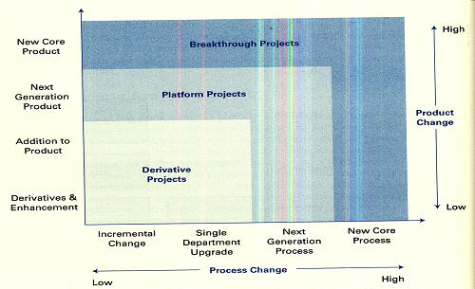
Wheelwright and Clark (1992) position - particularly product /service projects
Breakthrough
R&D
Platform
Breakthrough
Breakthrough
Platform
Platform

Slide 6
Wheelwright and Clark (1992) positioning
Derivative projects: Incrementally different in product or process from existing offerings. Often replace current offerings or add an extension to them (lower priced version, upscale version).
Platform projects: Major departures from existing offerings in terms of either the product or process. They become "platforms" for the next generation of organizational offerings, such as a new model of automobile or a new type of insurance plan.

Slide 7
Wheelwright and Clark (1992) positioning
Breakthrough projects: Involve a newer technology. A technology that is known to the industry or something proprietary that the organization has been developing over time. Use of fiber optic cables for data transmission, and hybrid gasoline-electric automobiles.
R&D projects: Blue sky, visionary endeavors, oriented toward using newly developed technologies, or existing technologies in a new manner. They may also be for acquiring new knowledge, or developing new technologies themselves.

Slide 8
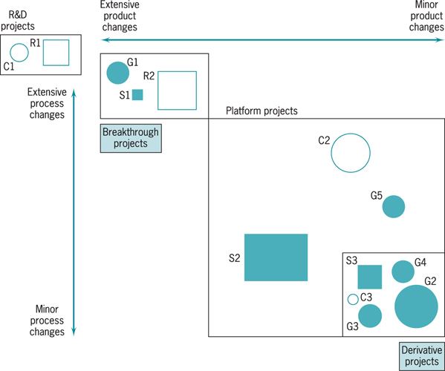
Project Portfolio
Size ➔ budget/resource needs.
Shape and shade ➔ internal/ external, long/medium/short term.
Numbers ➔ the order, or time frame, in which the projects are to be implemented, separated by category.

Slide 9
Benefits of the Aggregate Project Plan
Are the projects aligned with the strategy of the firms?
Is the mix of the projects appropriate – promise a growth?. Identify and adjust the gaps in the categories, sizes, and timing of the projects.
Do we have the required resource indicated by the size, timing, and number of projects.
Identify potential career paths for developing project managers, such as team members of a derivative project, then team members of a platform project, manager of a derivative project, members of a breakthrough project, and so on.

Slide 10
Step 3: Collect Project Data
Collect data on timing, expected benefit and costs using existing/past projects and expert opinion.
Use the scoring models to screen out high cost or lower benefit projects (because the organization's goals have changed).
Screen in any projects mandated by regulations or laws, competitive or operating necessities, projects required for environmental reasons.

Slide 11
Step 4: Assess Resource Availability
Assess the availability of internal/external resources by type/department/timing.
Balance aggregate project resource needs over future periods. Needing a normally plentiful resource at the same moment by several projects = catastrophe.
Scheduling resource usage as closely as possible to system capacity = catastrophe.

Slide 12
Step 5: Reduce the Project and Criteria Set
Organization’s goals
Have competence
Market for offering
How risky
Potential partner
Right resources
Good fit
Use strengths
Synergistic
Dominated by another
Has slipped in desirability

Slide 13
Step 6: Prioritize the Projects within Categories
Apply the scores and criterion weights to rank the projects within each category.
Hold some hard-to-measure criteria out for subjective evaluation, such as riskiness, or development of new knowledge.
Subjective evaluations can be translated from verbal to numeric terms easily by the Delphi, Pair-wise Comparisons, or other methods.
Different projects are offering different packages of benefits that are not comparable. For example, R&D projects will not have the expected monetary return of derivative projects.

Slide 14
Step 7: Select the Projects to be Funded and Held in Reserve
Determine the mix of projects across the various categories and time periods.
Leave about 15% of the organization's resource capacity free for variability and new opportunities.
Include some speculative projects in each category to allow future options, knowledge improvement, additional experience in new areas.

Slide 15
Step 8: Implement the Process
Communicate results with all levels of management, Repeat the communication regularly, and Improve the process.

Slide 16
Practice
Review Questions: 2,3,4,5,6,8
Discussion Questions: 10,11,13,16
Incidents for Discussion: None
Problems: 23,24
Cases: 1,2

