Slide 1
Continuous Probability Distributions
Uniform Distribution
Exponential Distribution
a
b
μ
Triangular Distribution
Normal Distribution
σ
a
m
b
μ

Slide 2
Continuous Probability Distributions
The probability of the continuous random variable assuming a specific value is 0.
The probability of the random variable assuming a value within a given interval from x₁ to x₂ is defined to be the area under the graph of the probability density function between x₁ and x₂.

Slide 3
Uniform Probability Density Distribution
a
b
Uniform Probability Density Function
    f (x) = 1/(b - a) for a < x < b
    = 0 elsewhere
a = smallest value the variable can assume
b = largest value the variable can assume
µ = (a + b)/2
σ ² = (b - a)²/12

Slide 4
Continuous Probability Distributions
a
μ
b
a
x₁
μ
b
x₁
x₂
P(X₁ ≤ x≤ X₂)
P(x≤ X₁)
P(x≥ X₁)= 1- P(x<X₁)
a
x₁
μ
b
P(x =X₁)= 0
P(x≥ X₁)

Slide 5
Example
It is suggested by several experts that the time required to complete a specific activity is uniformly distributed between 5 days and 15 days.
Probability Density Function
f (x ) = 1/10 for 5≤ x ≤ 15
= 0 elsewhere
where x = duration of the activity

Slide 6
Example
What is the probability that the activity will take between 12 and 15 days?
F (x )
P(12 < x < 15) = (1/10)(3) = 0.3
1/10
x
5
10
12
15
Duration (day)

Slide 7
The Uniform Probability Distribution
P(8 ≤ x ≤ 12) = ?
f (x )
1/10
P(8 ≤ x ≤ 12) = (1/10)(12-8) = 0.4
5
8
12
15
x
P(0<x < 12) = ?
f (x )
1/10
P(0<x < 12) = P(5<x < 12)=
= (1/10)(12-5) = 0.7
5
12
15
x

Slide 8
Head or Tail ⬅ excel
Lets Gamble.
If tail you win $1, if head I win.
Use excel to see if H or T?
Rand() ➔ a uniform random number (0,1)
Round(rand()) ➔ 0 or 1
If (rand()<=0.5, “H”, “T”)

Slide 9
Generate a Random Instance of this Activity
Generate a Uniform Random Variable between 5 and 15 days
U = 5 + (15-5)Rand()
U = 5+15Rand()
5
15
Generate a Uniform Random Variable
U = a + (b-a)Rand()
a
b

Slide 10
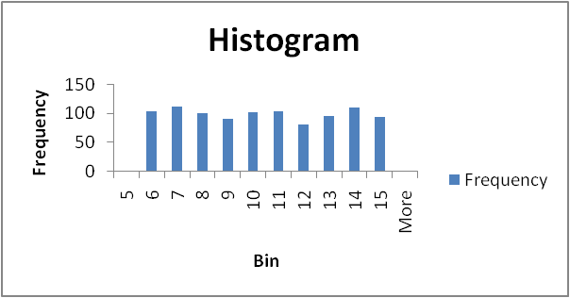
Paste Value, Histogram, Descriptive Statistics

Slide 11
Descriptive Statistics
Standard Error is the standard deviation of the Mean. That is the standard deviation of the sample divided by the square root of n.
Skewness measures the asymmetry of the data, when in an otherwise normal curve one of the tails is longer than the other. It is a roughly test for normality in the data (by dividing it by the SE). If it is positive there is more data on the left side of the curve (right skewed, the median and the mode are lower than the mean). An indicator of a normal curve shows a skew of +2 to –2. A normal distribution has a skew of 0.
Kurtosis measures the peak of the distribution. It is also an indicator of normality. Positive kurtosis indicates too few cases in the tails of a tall distribution (leptokurtic), negative kurtosis too many cases in the tails or a flat distribution (platykurtic). The range for normality should go, in general, from +2 or to –2. A normal distribution has a kurtosis of 0 (given a correction of –3, otherwise it will have a kurtosis of 3.

Slide 12
Normal Distribution
μ = mean
σ = standard deviation
π = 3.14159
e = 2.71828
x
μ

Slide 13
Standard Normal Distribution
where
μ = 0
σ = 1
π = 3.14159265358979
z
0

Slide 14
Normal and Standard Normal
A Normal Variable x is associated with a standard Normal Variable z
x is Normal (Average x , Standard Deviation x) ➔ z is Normal (0,1)
μ = Average x
σ = Standard Deviation of x
is z ➔ a Standard Normal variable.

Slide 15
Standard Normal Table
σ
μ
x
x-scale
0
z
z-scale
There is a table for z which tells us
Given any probability of not exceeding z, what the value of z is
Given any value for z, what the probability of not exceeding z is

Slide 16

Given z, Find the Probability
Table returns probability
0.05
z
Second digit
after decimal
Up to the first digit
after
decimal
Given z
Probability
1.6
z = 1.65

Slide 17
Given Probability, Find z
Given a 95% Probability
0.05
z
Second digit
after decimal
Up to the first digit
after
decimal
The table will give you z
Probability
Z = 1.65
1.6

Slide 18
The Standard Normal Distribution F(z)
F(z) = Prob( N(0,1) < z)
F(z)
0
z

Slide 19
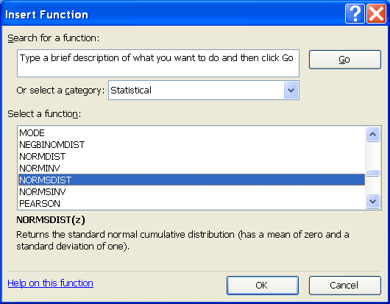
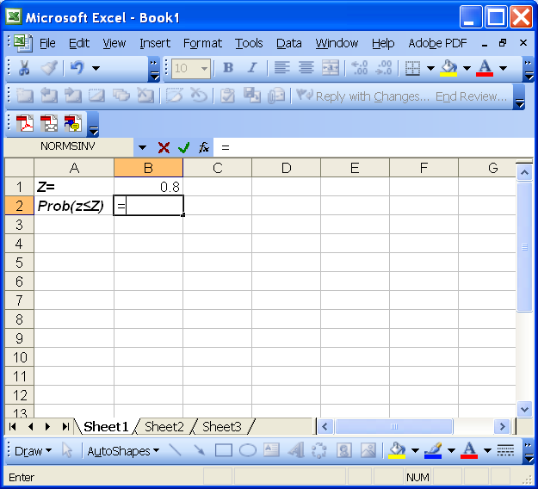
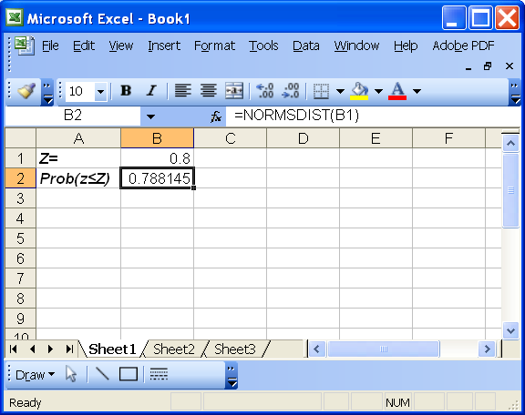
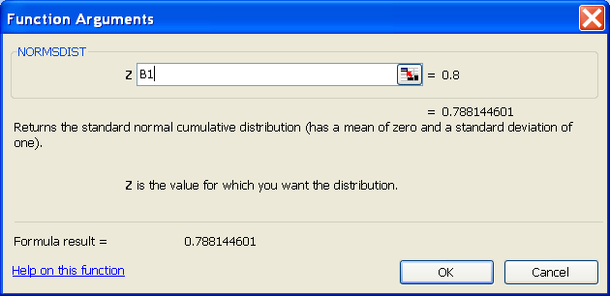
Excel: Given z, Compute Probability

Slide 20
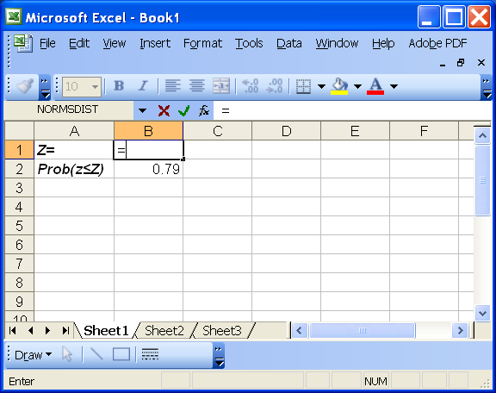
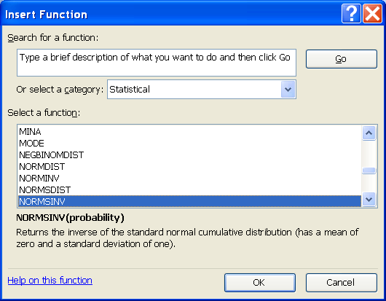
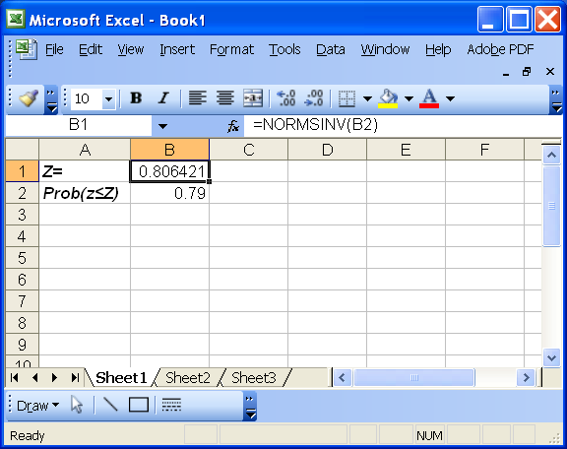
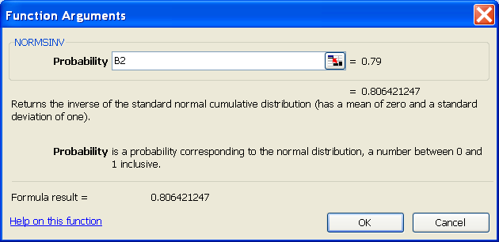
Excel: Given Probability, Compute z

Slide 21
Example
It is believed that the duration of an activity has a mean of 30 days and the standard deviation of 6 days. What is the probability (risk) of the activity to have a length of greater than 40 days. The project manager would like to know the probability of the activity duration to be greater than 40 days, P(x > 40).
P(x > 40). = P(x≥40) = 1- P(x≤40)
P(x≤40) = P(z ≤ (40-30)/6) = P(z ≤ 1.67) = 0.9525
P(x≤40) = 0.9525 ➔ P(x≥40) = 1- 0.9525 = .0475

Slide 22
Example
If the project manager wants to know a number such that with 10% probability the duration of the project is greater than that number.
Z (0.9) = 1.28
Z=(x-μ)/σ
Z= (X-30)/6
1.28 = (X-30)/6
X= 30+1.28(6) = 37.68
Area = 0.1
Area = 0.9
0
Z_{0.1}

Slide 23
Generate a Random Instance of this Activity
Generate a standard normal variable.
Generate a Rand() assume this is the P(z ≤ Z). Now you have a probability, find its z
Rand() = 0.83
P(z ≤ Z) = 0.83
Find z using the normal table 0.95
This is a random z, if you want a random x
x= Mean (x) + z(StdDev(x))
Z = normsinv(rand()) = normsinv(0.83) = 0.954165
X= 30+0.954165(6) = 35.72

Slide 24
Paste Value, Histogram, Descriptive Statistics

Slide 25
Exponential Probability Distribution
μ = mean
σ = μ
e = 2.71828182845904, the base of the natural logarithm.
μ
F (x )
0.4
0.3
P(x < X ) = area from 0 to X₁
0.2
0.1
x
1 2 3 4 5 6 7 8 10

Slide 26
Example
Duration of an activity has exponential distribution with average of 3 days (μ = σ = 3 days). What is the probability of competing the activity in 2 days or less.
F (x )
P(x < 2) = 1 - e^{-2/3} = 1 - .5134 = .4866
.4
.3
.2
.1
x
1 2 3 4 5 6 7 8 9 10

Slide 27
Generate an Exponential Random Variable
Duration of an activity has exponential distribution with average of 5 days (μ = σ = 5 days). Generate a random instance of this activity.
Probability of completing the activity in more than X days is
P(x < X) = 1 - e^{-X/μ}
P (x ≥X) = 1- (1 - e^{-X/μ}) = e^{-X/μ}
1 ≥ P (x ≥X) ≥ 0
1 ≥ Rand() ≥ 0
P (x ≥X) = Rand() = e^{-X/μ}
Rand() = e^{-X/μ}
ln (Rand()) = -X/μ
X= - μ ln(Rand())
Suppose Rand() = 0.1
X= - 5 ln(01) ➔ X = 11.51 days. The first activity takes 11.51 days
1/30/2012
Ardavan Asef-Vaziri
1-27

Slide 28
Paste Value, Histogram, Descriptive Statistics

Slide 29
Practice
A project has three sequential tasks. The first task follows Exponential distribution with parameter of 5 days. The second task follows Uniform distribution with parameters of 5 and 10 days, the last task follows Normal distribution with parameters of 9 and 2 days. The following numbers were generated using RAND() function in excel. Starting from the first row and column, moving through the first row first, and not using any given element twice, generate a random instance of duration of this project.
1/30/2012
Ardavan Asef-Vaziri
1-29

Slide 30
Problem
By not using any element twice we mean not using a specific element – in a specific row and column twice.
For example you can not use the number in row 1 and column 1 twice. Obviously you can use all the three 0.1s as soon as you reach their corresponding box in the table.
End of the book Table provide you with uniform [0,1] random numbers
1/30/2012
Ardavan Asef-Vaziri
1-30

Slide 31
Uniform Probability Density Distribution
Uniform PDF
f (x) = 1/(b - a) for a < x < b
= 0 elsewhere
a
b
The second task follows Uniform distribution with parameters of 5 and 10 days. The random number we have is the second number in the first row, and that is 0.1. For uniform distribution
The second activity takes 5.5 days

Slide 32
Exponential Probability Distribution
F (x )
0.4
0.3
P(x < X ) = area from 0 to x₁
0.2
0.1
x
1 2 3 4 5 6 7 8 10
I also know that P(x≤ X) is a number in the closed range of [0,1]. In addition I know that I have some tools – for example excel- to generate a uniform random number in the range of [0,1]. Therefore, I can generate a random probability and associate it with an exponential random variable. Then, I can claim that I have generated a random variable from exponential distribution.

Slide 33
Random Variable: Exponential Distribution
➔
Furthermore, I know that 1-rand() is between 0 and 1.
Therefore, for simplicity, I can replace 1-rand() with rand(). Thus
➔
Our Exponential distribution has a parameter of 5 days.
➔
X = 11.51 days. The first activity takes 11.51 days
1/30/2012
Ardavan Asef-Vaziri
1-33

Slide 34

Random Variable: Normal
x= μ_{x} + zσ_{x}
I know that P(z≤ Z) is a number in the range of [0,1].
Given a 40% Probability
Z =- 0.25
1/30/2012
Ardavan Asef-Vaziri
The table will give you z
1-34

Slide 35
Random Variable: Normal Distribution
We go to the end of the book. And find (after a little bit of manipulation) as shown on the next page z = -0.25
Then to generate our random variable we simple transform z into x
X= 9 -0.25*2 = 8.5
The first task duration: 11.5
The second task duration: 5.5
The third task duration: 8.5
1/30/2012
Ardavan Asef-Vaziri
1-35

Slide 36
Practice
2. Solve Problems 19 of Ch1 using
Simulation method by generation random normal variables, preparing histogram and descriptive statistics.
Go to the Excel work book Start from the first page and continue
1/30/2012
Ardavan Asef-Vaziri
1-36

