Slide 1
PMI Definition
Project: A project is a unique temporary endeavor, with a set beginning and end.
Project Management: The application of knowledge, skills, tools and techniques to a broad range of activities in order to meet the requirements of a particular project.

Slide 2
Characteristics of Projects
Main Characteristics of Projects
  Unique (a one-of-a-kind output or deliverable)
  Temporary (specific start and stop)
  A non-project (a process) refers to the routine, repetitive work of the organization
Other Characteristics of Projects
  Multidisciplinary
  Complex
  Conflict
  Part of programs

Slide 3
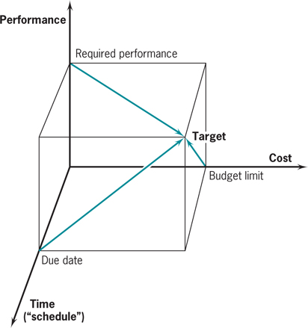
Goals and Trade-offs
The three goals of a project are:
  On time
  On budget
  To specification (including “quality” and “client satisfaction”)
The project manager meets the goals by making trade-offs. ➔ shorten the project duration by using more resources.
An over determined project: has a fixed budget, fixed delivery time, and fixed specifications.
  No place for trade-offs. Is it good?

Slide 4
Abilities Needed For Effective PM
Conflict Resolution
Creativity and Flexibility
Ability to Adjust to Change
Good Planning
Negotiation
  Win-lose negotiation is like a zero-sum game. Any time one side wins the other side loses. In a win-win negotiation, the outcome is such that both parties gain something from the interchange.
  Win-lose negotiating is dangerous for project managers who will have to deal with the same parties over and over again. The project manager who forces a functional manager to lose will have created a permanent enemy.

Slide 5
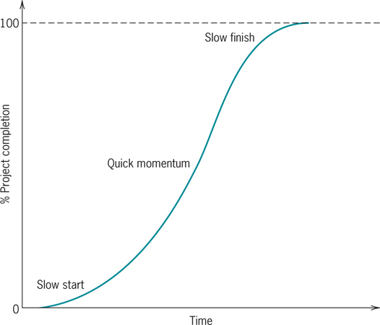
Project Life Cycle: S-Shaped

Slide 6
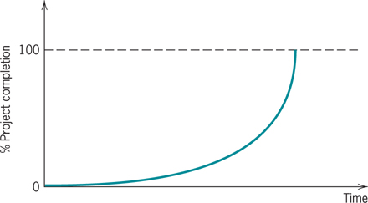
Life Cycle: J-Shaped
Resource allocation for S=shaped and J-shaped is quite different.

Slide 7
Project Selection: Qualitative Methods
The Sacred Cow
  A project proposed by the CEO, a big guy
The Operating/Competitive Necessity
  It is required to continue our operations
  We may lose our market share
Comparative Benefits
  Q-sort

Slide 8
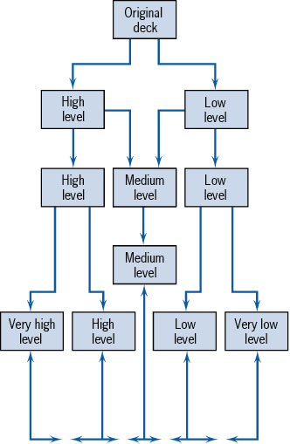
The Q-Sort Method

Slide 9
Project Selection: Quantitative Methods
Financial Assessment Methods
  Payback period
  Discounted cash flow
    NPV
    IRR
    B/C
Scoring Methods
  Unweighted 0-1 factor method
  Weighted factor scoring method

Slide 10
Payback Period

Slide 11

Payback Period
Number of years needed for the project to repay its initial fixed investment.
A project costs $100,000 and is expected to save the company $20,000 per year.
PP = $100,000 / $20,000 = 5 years
Shortcoming
  Ignores the time value of money, including interest rates and inflation.
  Ignores money earned after the payback period.

Slide 12
Future Value (FV)
$100, put it in a bank. How much after 1 year
100 +0.1(100) = 100(1+0.1)
How much after 2 years
100(1+0.1) + 0.1(100(1+0.1)) =
100(1+0.1) (1+0.1) = 100(1.1)²
How much after N years
100(1.1)^{N}

Slide 13
Future Value (FV)
P: The initial vale
MARR: Minimum Acceptable Rate of Return
F= P(1+MARR)^{N}
P= F(1+MARR)^{-N}
P = F/(1+MARR)^{-N}

Slide 14
Net Present Value (NPV)
I₀ = the initial investment
F_{t} = the net cash flow in period t
r = the required rate of return
Important note: NPV function in excel assumes that the first cash flow is at the end of year 1.
PV function computes the present value of an annuity

Slide 15
EXCEL NPV Function

Slide 16
Internal Rate of Return (IRR)
The discount rate (r) that causes the NPV to be equal to zero
The higher the IRR, the better
In Excel “=IRR(Series,Guess)”
Compare IRR with MARR
Here it is not important where the first payment is – end of year 1 or end of year 0. The NPV for IRR is 0 everywhere.

Slide 17
Profitability Index or B/C Ratio

Slide 18
Present Value Index Table

Slide 19
Profitability Models
Advantages
  Easy to use and understand
  Based on accounting data and forecasts
  Familiar and well understood
  Give a go/no-go indication
  Can be modified to include risk
Disadvantages
  Ignore non-monetary factors
  Discounting models (NPV, IRR) are biased to the short-term

Slide 20
The Weighted Scoring Model
where
S_{i} = the total score of the i^{th} project
s_{ij} = the score of the i^{th} project on the j^{th} criterion
w_{j} = the weight or importance of the j^{th} criterion

Slide 21
Uncertainties Encountered in Project Management
Time required to complete a project
Availability of key resources
Cost of resources
Timing of solutions to technological problems
Actions taken by Competitors and Complementors
Actions taken by Government and Comunities
Uncertainty cannot be eliminated, but if managed properly, it can be minimized.
This is why we need trade-offs.

Slide 22
Risk Analysis
Estimate probabilities or distributions associated with key parameters
Develop analytical or simulation model
Analyze distribution of outcomes generated by the model

