Slide 1
Project Management
306

Slide 2
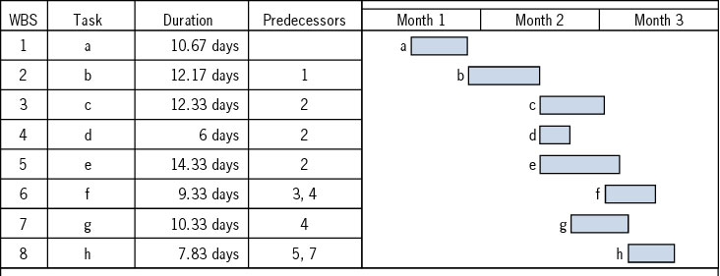
Scheduling the Project
From Action Plan and WBS to Gantt chart and project network.
Project Network
  Critical Path Method (CPM)
  Program Evaluation and Review Technique (PERT)
Risk analysis: likelihood of completing the project on time, on budget, to specifications
  Statistics
  Simulation
CPM; Deterministic activity durations
PERT; Probabilistic activity durations
7/10/2022
5-1-2

Slide 3
Draw Activity on Node Network
a:-
b:a
c:a
d:a
e: b
f:c
g:c
h:e,f
i: d,g
j: h,i
b
e
h
a
c
f
j
g
d
i
5-1-3

Slide 4
An Activity-On-Node (AON) Network
Activity | Imm. Pred
A | --
B | A
C | B
D | B
E | D
F | D
G | D
H | C, E, F, G
I | H
J | H
K | I
L | J
M | K, L
Final Plumbing
Rough Plumbing
Install Cabinets
C
I
K
Sheet Rock
Excavate
A
B
Lay Foundation
Finish Exterior
H
M
E
Install
Flooring
J
L
Frame
D
HVAC
Paint
Final Electric
F
Rough Electric
G

Slide 5
Critical Path Method
Activity | Immediate Precedence | Duration
A1 | - | 4
A2 | - | 3
A3 | A1 | 6
A4 | A1 | 4
A5 | A2 | 2
A6 | A4, A5 | 3
4
6
A1
A3
E
4
3
S
A4
A6
3
2
A2
A5
7/10/2022
5-1-5

Slide 6
Critical Path Method: Paths
4
6
How many path?
A1
A3
E
4
3
S
A4
A6
3
2
10
11
8
A2
A5
Critical Path is the longest path
It is the shortest time to complete the project
7/10/2022

Slide 7
Forward Path; Earliest Starts
4
6
A1
4
A3
E
10
11
0
0
4
4
10
11
4
3
0
S
4
A4
8
A6
0
5
3
4
2
8
8
11
0
A2
A5
3
0
3
3
5

Slide 8
Forward Path
Max = 30
35
10
35
35
30
20
5
7/10/2022

Slide 9
Backward Path; Latest Starts
0
4
4
5
6
11
5
11
A3
11
A1
4
4
10
E
11
0
0
4
4
10
11
0
4
4
8
8
3
11
11
0
8
S
4
A4
8
A6
0
3
4
8
5
11
3
3
6
2
8
6
8
0
6
8
A2
A5
3
0
3
3
5
7/10/2022

Slide 10
Backward Path
30
Min = 35
30
35
30
30
45
5
7/10/2022

Slide 11
Computing Slack Times
LST
LFT
Task = duration
slack = xxxx
EST
EFT
7/10/2022

Slide 12
Critical Path, Slacks
0
4
4
5
6
11
11
A1
A3
E
11
0
4
4
10
4
4
8
8
3
11
S
A4
A6
3
3
6
4
8
8
11
6
2
8
A2
A5
0
3
3
5
7/10/2022

Slide 13
Project vs Process- Flow Time, Theoretical Flow Time
The time of the critical path differs from the time of the theoretical critical path. Why?
4
6
A1
W3
A3
W8
E
W1
W4
W9
4
3
S
A4
W6
A6
W2
3
2
W7
A2
W5
A5
The critical path itself also may differ from the theoretical critical path. Why?

Slide 14
Slack Times Example
c=3
slack=
LST
LFT
Task=dur
slack=xxx
g=1
slack=
EST
EFT
a=4
slack=
j=6
slack=
d=2
slack=
Start
Finish
e=6
slack=
h=4
slack=
b=3
slack=
k=1
slack=
f=4
slack=
i=5
slack=
7/10/2022

Slide 15
Slack Times Example
c=3
slack=
LST
LFT
Task=dur
slack=xxx
4
7
g=1
slack=
EST
EFT
a=4
slack=
0
4
7
8
j=6
slack=
d=2
slack=
4
6
9
15
Start
Finish
15
e=6
slack=
3
9
h=4
slack=
b=3
slack=
9
13
k=1
slack=
0
3
13
14
f=4
slack=
i=5
slack=
3
7
7
12
7/10/2022
5-1-15

Slide 16
Slack Times Example
5
8
c=3
slack=
LST
LFT
Task=dur
slack=xxx
1
5
4
7
8
9
g=1
slack=
EST
EFT
a=4
slack=
15
9
15
9
0
4
6
8
7
8
j=6
slack=
d=2
slack=
9
15
15
4
6
9
15
Start
Finish
9
3
9
3
15
e=6
slack=
10
14
3
3
9
h=4
slack=
0
3
3
9
0
14
15
b=3
slack=
9
13
k=1
slack=
3
0
3
5
9
0
9
14
13
14
f=4
slack=
i=5
slack=
3
7
7
12
7/10/2022

Slide 17
Graphical Format
A
C
H
D
F
S
F
B
E
G
I

Slide 18
A Key Problem: The Impact Converging Activities
Which process has a longer flow time?.
Activity 1
Activity 2
15
15
In a deterministic world they both have a flow time of 30 mins.
The situation differs in real world where nothing is deterministic.
Suppose instead of an exact number of 15, the activity time is uniformly distributed in the range of 10 to 20. The average is still 15.
Activity 1
15
Activity
15
Activity 2
15

Slide 19
A Key Problem: The Impact Converging Activities
Activity time = 10+10rand()
rand() is a random number between 0 and 1.
If it is ranch = 0, the duration of the activity is 10, if rand() = 1, 1, the duration of the activity is 20.
For all possible rand() 10 ≤ Activity Time ≤ 20
For the fist project, the project duration is computed as the duration of Activity 1 + duration of Activity 2. That is
10+10rand()+10+10rand()
We can generate 1000 instance of each activity in excel and compute project duration.

Slide 20
A Key Problem: The Impact Converging Activities
For project 2, still duration of all the activities are computed as 10 ≤ 10+10rand() ≤ 20
However, the the project duration is computed as the MAX duration of (Activity 1, Activity 2) + duration of Activity 3.
Max duration of (Activity 1, Activity 2) > 10+10rand().
That is the significance of convergence points.
Not even in a single instance the duration of Project 1 was greater that that of Prject 2.

Slide 21
Key Problem Flow time: 10,000 Instances

Slide 22
Converging Activities + Common Resources
All activities are [10,20] minutes. 10+10RAND(). Average 15.
One Recourse Red, One Resource Blue, One Resource Green.
Project Duration >> 45
Activity B1
Activity R2
Activity G
Activity R1
Activity B2

