Slide 1

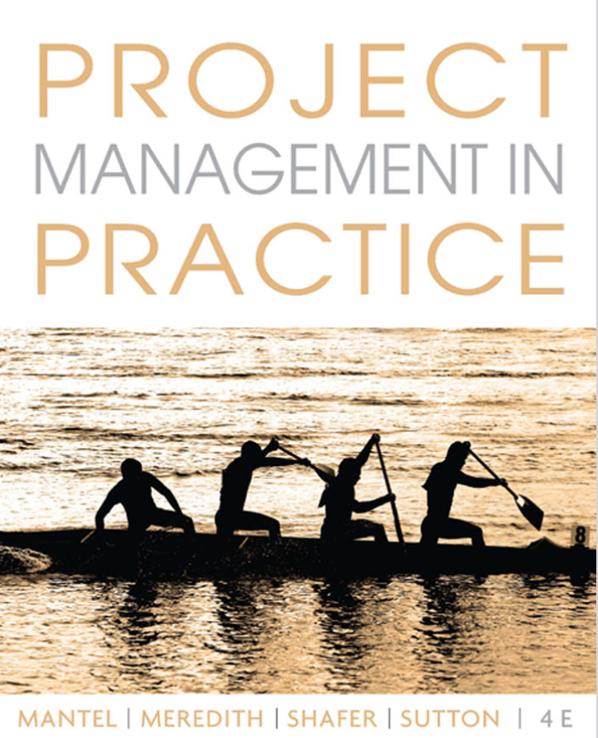

Project Management
Ardavan Asef-Vaziri

Slide 2
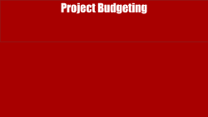
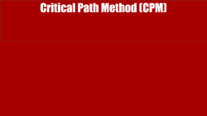

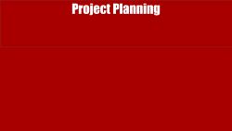
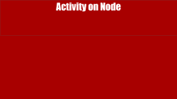

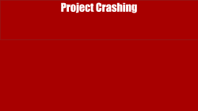
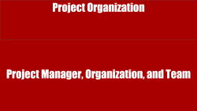
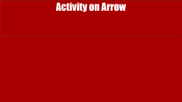
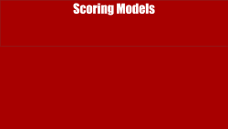
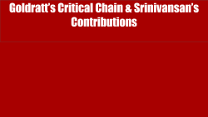

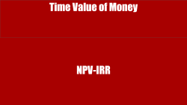



Slide 3

Project vs Process
Ardavan Asef-Vaziri

Slide 4
PMI Definition
Project: A project is a unique temporary endeavor, with a set beginning and end.
Project Management: The application of knowledge, skills, tools and techniques to a broad range of activities in order to meet the requirements of a particular project.
Main Characteristics of Projects
  Unique (a one-of-a-kind output or deliverable)
  Temporary (specific start and finish)
Other Characteristics of Projects
  Multidisciplinary
  Complex
  Conflict
  Part of programs

Slide 5
Goals and Trade-offs
The three goals of a project are:
  On time
  On budget
  To specification (including “quality” and “client satisfaction”)
The project manager meets the goals by making trade-offs. ➔ shorten the project duration by using more resources.
An over determined project: has a fixed budget, fixed delivery time, and fixed specifications.
  No place for trade-offs. Is it good?

Slide 6
Abilities Needed For Effective PM
Abilities Needed For Effective PM
  Conflict Resolution
  Creativity and Flexibility
  Ability to Adjust to Change
  Good Planning
  On time
  Negotiation
  In budget- replace Win-Lose by Win-Win

Slide 7
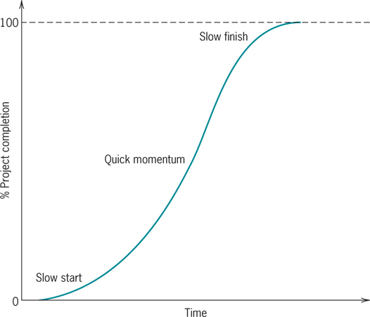
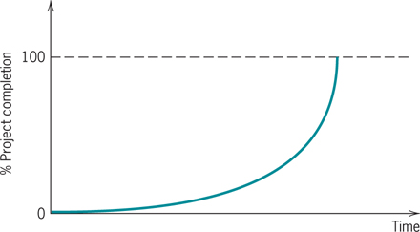
Project Life Cycle: L-Shape and J-Shape
Resource allocation for S=shaped and J-shaped is quite different.

Slide 8
Project Selection: Quantitative Methods
Financial Assessment Methods
  Payback period
  Discounted cash flow
    NPV
    IRR
    B/C
Scoring Methods
  Unweighted 0-1 factor method
  Weighted factor scoring method

Slide 9
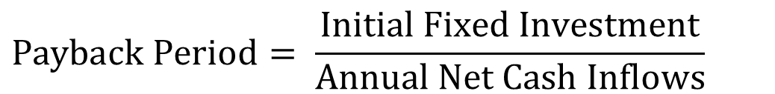
Payback Period
$$Payback Period= \frac{\text{Initial} \text{Fixed} \text{Investment}}{\text{Annual} \text{Net} \text{Cash} \text{Inflows}}$$
Number of years needed for the project to repay its initial fixed investment.
A project costs $100,000 and is expected to save the company $20,000 per year.
PP = $100,000 / $20,000 = 5 years
Shortcoming
  Ignores the time value of money, including interest rates and inflation.
  Ignores money earned after the payback period.

Slide 10
Time Value of Money
NPV-IRR

Slide 11
Future Value (FV)
$100, put it in a bank. Interest rate = 10%. How much after 1 year. P = 100. F?
F1 = 100 +0.1(100) = 100(1+0.1)
How much after 2 years?
F2= 100(1+0.1) + 0.1(100(1+0.1)) =
F2= 100(1+0.1) (1+0.1) = 100(1.1)²
How much after 3 years?
F3 = 100(1.1)² + 0.1[100(1.1)²] =
F3 = 100(1.1)² [1+0.1] = 100(1.1)² [1.1] = 100(1.1)³
How much after N years
F = 100(1.1)^{N}

Slide 12
Future Value (FV); Present Value (PV)
P: The initial vale
MARR: Minimum Acceptable Rate of Return
F= P(1+MARR)^{N}
P = F/(1+MARR)^{N}
P = F/(1+r)^{N}
P = F(1+r)^{-N}
r = the minimum acceptable rate of return
=FV(r, N,PMT,PV,0→ EOY) =
=PV(r, N,PMT,FV,0 →EOY) =

Slide 13
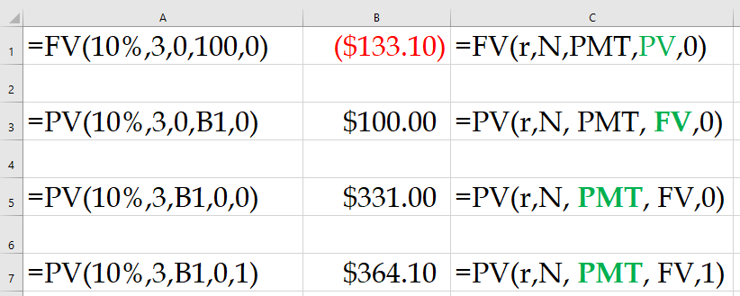
Present Value Index Table

Slide 14
Back to the PBP Example
The initial investment of a project at the end of year 0 is 10 million dollars. Depreciation is computed using straight-line method with accounting life of five years and zero salvage value. Net income before tax and depreciation is 3 million dollars per year. The tax rate is 40%. Compute net income after tax in Year 1. Compute net cash inflow in Year 1. At the end of year 7 we sell everything for 5 million dollars. Compute NPV and IRR.
Net Income Before Tax and Depreciation 3
Depreciation 2
Income Before Tax 1
Tax 0.4
Net Income After Tax 0.6
Cash Flow of Depreciation 2
Net cash flow per year 2.6
This is true for the first 5 yeas.

Slide 15
Future Value (FV); Present Value (PV)
But after year 5 we do not have depreciation.
Therefore, the two million dollars depreciation is not a cost anymore.
Our revenue will increases by
2- 0.4(2) = 1.2 million dollars.
Net income after tax = 0.6+1.2 =1.8
Net Income Before Tax and Depreciation 3
Depreciation 0
Income Before Tax 3
Tax 0.4(3) =1.2
Net Income After Tax in Year 6 1.8
Net Income After Tax in Year 7 1.8+5-0.4(5) = 4.8

Slide 16
Net Present Value (NPV)
I₀ = the initial investment
F_{t} = the net cash flow in period t
r = the required rate of return
Important note: NPV function in excel assumes that the first cash flow is at the end of year 1.

Slide 17
Internal Rate of Return (IRR)
The discount rate (r) that causes the NPV to be equal to zero.
The higher the IRR, the better.
In Excel “=IRR(Series,Guess)”
Compare IRR with MARR
Here it is not important where the first payment is – end of year 1 or end of year 0. The NPV for IRR is 0 everywhere.

Slide 18
Your Mortgage; PMT and PPMT
100,000 loan
4% interest rate
30 years fixed
Your monthly payment
=PMT(monthly rate,#of months,pv,[fv], [type])
=PMT(0.04/12, 30*12, 100000)

Slide 19
Practice
The initial investment of a project at the end of year 0 is 10 million dollars. Depreciation is computed using straight-line method with accounting life of 4 years and accounting salvage value of 0. Total revenue is 6 million dollars per year. All expenses, excluding depreciation and tax are 2 million dollars per year. Useful life of the project (which differs from accounting life) is 7 years. At the end of the useful life the project is sold for 2 million dollars. Tax rate of operating income as well as capital gain is 30%. Compute profit per year during the accounting life of the project.
Revenue 6
Operating Expenses 2
Net Income Before Tax and Depreciation 4
Depreciation 2.5
Income Before Tax 1.5
Tax 0.3(1.5) = 0.45
Net Income After Tax (years 1-4) 1.05

Slide 20
Practice: Net Income vs. Net Cash Inflow
Compute net cash inflow during the accounting life of the project.
Net Income After Tax 1.05
Depreciation 2.5
Net Cash Inflow (years 1-4) 3.55
Compute net cash inflow per year after accounting life is over and before the last year of the useful life of the project.
Net Income After Tax 1.05
Depreciation added to the profit 2.5
Tax on the additional profit due to end of depreciation (0.3)(2.5) = 0.75
Net income added 2.5-0.75 = 1.75
Total Net Income 1.05+1.75= 2.8
Net Cash Inflow (years 5-6) 2.8

Slide 21
I Am Sure It Was Easy to Grasp
If it was not easy to grasp, you may look at it from a different perspective
Revenue 6
Operating Expenses 2
Net Income Before Tax and Depreciation 4
Tax 0.3(4) = 1.2
Net Income After Tax (years 1-4) 2.8
Compute net cash inflow in the last year of the useful life of the project.
Net Income After Tax 2.8
Project Sold 2
Capital Gain Tax 0.3(2) = 0.6
Net Capital Gain 1.4
Net Cash inflow 2.8+1.4= 4.2

Slide 22
Practice: Net Income vs. Net Cash Inflow
What is the net cash flow of the project during its useful life. Compute NPV under 10% MARR and IRR.

Slide 23
Practice: Net Income vs. Net Cash Inflow
An investment at the end of year 0 has a depreciation life of 4 years and salvage value of 0. Depreciation is computed using straight line method and is 2.5 million dollars per year. Useful life of the project (which differs from accounting life) is 7 years. Other revenues and costs of the investment remain the same over the useful life of the investment. At the end of year 7, all the assets are sold for 2 million dollars. Tax rate of operating income as well as capital gain is 30%. The net income after depreciation and tax at the end of year 1 is 1.05 million dollars.
Compute the net cash flow in year 1.
1.05 + 2.5 = 3.55. It will remain the same in years 1-4
Compute the net cash flow in year 5.
1.05 + 2.5 – 0.3(2.5) = 2.8
1.05 + 0.7 (2.5) = 2.8
Compute the net cash flow in year 7
2.8 + 2 -0.3(2) = 2.8 + 0.7(2) = 2.8+1.4 = 4.2

Slide 24
Internal Rate of Return (IRR)
The discount rate (r) that causes the NPV to be equal to zero
The higher the IRR, the better
In Excel “=IRR(Series,Guess)”
Compare IRR with MARR
Here it is not important where the first payment is – end of year 1 or end of year 0. The NPV for IRR is 0 everywhere.

Slide 25
Profitability Index or B/C Ratio

Slide 26
Present Value Index Table

Slide 27
Profitability Models
Advantages
  Easy to use and understand
  Based on accounting data and forecasts
  Familiar and well understood
  Give a go/no-go indication
  Can be modified to include risk
Disadvantages
  Ignore non-monetary factors
  Discounting models (NPV, IRR) are biased to the short-term

Slide 28
Scoring Models

Slide 29
Weighted Scoring Model
S_{i} = the total score of the i^{th} project
s_{ij} = the score of the i^{th} project on the j^{th} criterion
w_{j} = the weight or importance of the j^{th} criterion

Slide 30
Uncertainties Encountered in Project Management
Uncertainty in Project Management
  Time required to complete a project
  Availability of key resources
  Cost of resources
  Timing of solutions to technological problems
  Actions taken by Competitors and Complementors
  Actions taken by Government and Communities
Uncertainty cannot be eliminated, but if managed properly, it can be minimized.
This is why we need trade-offs.
Risk Analysis
  Estimate probabilities or distributions associated with key parameters
  Develop analytical or simulation model
  Analyze distribution of outcomes generated by the model

Slide 31
Project Organization
Project Manager, Organization, and Team

Slide 32
Factors Increasing the Importance of Projects
Factors increasing the importance of projects
  Emphasis on time-to-market
  Need for specialized knowledge from a variety of areas
  Explosive rate of technological change
  Accountability and control
Who should be appointed as the PM?
  A technical expert?
  Someone with good organizational skills?

Slide 33
Functional vs. Project Managers
Project Manager
May not be expert in any area
May have limited authority over employees
Competes for resources with other projects
May not have known subordinates very long
Project environment is temporary & people expect changes
Functional Manager
Expert in functional area
Full authority over employees
Competes for resources with other functional dept
Knows subordinates very well
Functional environment is fairly stable & people are comfortable in their jobs

Slide 34
Roles a Project Manager
Manager: planning, organizing, staffing, budgeting, directing, and controlling.
Facilitator : facilitator vs. supervisor.
System Thinker: 2>1+1.
Communicator: with senior management, client, project team, vendors, functional managers.
Negotiator: with senior mgmt. for more human and capital resources, with functional manager to get a particular skills, with vendor for shorter lead time, with client about project changes (scope creep).
Politician: knows how to “get things done”, how to “work the system.”

Slide 35
Facilitator vs. Supervisor
  Ensures that all resources and work are available when needed, problems are resolved, each task is properly concluded.
Resolves conflict with functional managers, the client and others. Manages conflicts by negotiation.
Assigns the responsibility for the planning and organization of tasks to team members.
Avoids Micromanagement which is one of the deadly managerial sins where s/he closely supervises and second-guesses (and instructs on) every decision a project member makes. The same is true for the relationship between the program manager and PM.

Slide 36
Systems Engineering
The elephant was in a dark house; some Hindus had brought it for exhibition.
In order to see it, many people were going, every one, into that darkness.
As seeing it with the eye was impossible, each one was feeling it in the dark with the palm of his hand.
The first approached the elephant, and happening to fall
Against his broad and sturdy side, at once began to bawl
"God bless me! but the elephant is very like a wall!"
The second, feeling of the tusk, cried, "Ho! what have we here
So very round and smooth and sharp? To me 'tis mighty clear
This wonder of an elephant is very like a spear!"
The third approached the animal, and happening to take
The squirming trunk within his hands, thus boldly up and spake
"I see," quoth he, "the elephant Is very like a snake!"

Slide 37
Systems Engineering
The elephant was in a dark house; some Hindus had brought it for exhibition.
In order to see it, many people were going, every one, into that darkness.
As seeing it with the eye was impossible, each one was feeling it in the dark with the palm of his hand.
The first approached the elephant, and happening to fall
Against his broad and sturdy side, at once began to bawl
"God bless me! but the elephant is very like a wall!"
The second, feeling of the tusk, cried, "Ho! what have we here
So very round and smooth and sharp? To me 'tis mighty clear
This wonder of an elephant is very like a spear!"
The third approached the animal, and happening to take
The squirming trunk within his hands, thus boldly up and spake
"I see," quoth he, "the elephant Is very like a snake!"

Slide 38
Systems Engineering
The fourth reached out an eager hand, and felt about the knee.
"What most this wondrous beast is like, is mighty plain," quoth he;
" 'Tis clear enough the elephant is very like a tree!"
The fifth, who chanced to touch the ear, said: "E'en the blindest man
Can tell what this resembles most; Deny the fact who can
This marvel of an elephant , is very like a fan!"
The sixth no sooner had begun , about the beast to grope,
Than, seizing on the swinging tail , that fell within his scope,
"I see," quoth he, "the elephant Is very like a rope!“
Similarly, whenever anyone heard [a description of the elephant], he understood [it only in respect of] the part that he had touched.
On account of the [diverse] place [object] of view, their statements differed:
If there had been a candle in each one's hand, the difference would have gone out of their words.

Slide 39
How To Develop Good PM Skills
Gain experience on the job
  work on project teams, manage small projects, work in different job areas to get breadth of experience
Seek out feedback from others; look for a mentor
Conduct a self-evaluation; learn from mistakes
Interview senior or star project managers
Participate in training programs
Join PMI, Toastmasters, other organizations
Read journals, magazines, books on Project Mgmt.
Volunteer with charities to gain some skills

Slide 40
Project Manager Challenges
Dealing with many conflicts of opinions & interests
Handling job stress
Making goal tradeoffs when things go poorly
Staying within the budget
Meeting the project deadline
Achieving all desired project outcomes
Keeping all stakeholders happy
Time management
Balancing work time and family time (hrs/week)

Slide 41
The Pure Project Organization
President
Project Manager
VP Marketing
VP
Manufacturing
VP
R&D
Manager
Project A
Manager
Project B
Marketing
Manufacturing
R&D
Human Resources
Marketing
Manufacturing
R&D
Human Resources

Slide 42
Functional Project Organization
President
Manufacturing
Marketing
R & D
Human Resources
Finance
Project

Slide 43
Matrix Project Organization
President
Program Manager
Manufacturing
Marketing
Finance
R&D
Human Resources
PM1
3
1 ½
½
4
½
PM2
1
4
¼
1 ½
¼
PM3
0
1/2
3
1/2
1
  Hard and soft matrix organization?

Slide 44
Assignment of the Team to the Tasks – Can SOLVER in Excel Handle?

Slide 45
Project Planning

Slide 46
Matrix Project Organization
Project plan is a route map from project start to finish.
Project launch meeting sets the project scope, asks cooperation of others in the organization, demonstrates managerial commitment to the project, and initiates the project plan.
The Work Breakdown Structure, Linear Responsibility Chart, and Mind Mapping can be developed using the project plan.
Interface Coordination Map shows the ways in which different groups interact during the project life cycle.
Concurrent Engineering and Design Structure Matrix facilitate the task of integrating the work of various functional groups.
Participatory Management leads to empowered teams.

Slide 47
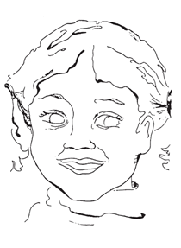
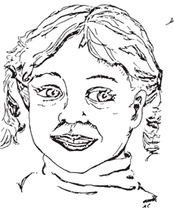

Hierarchical Project Planning

Slide 48
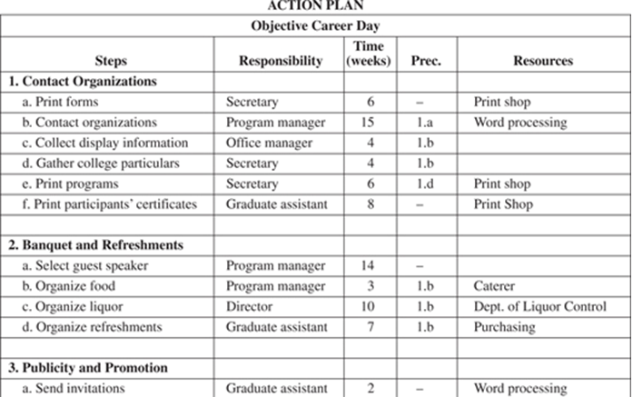
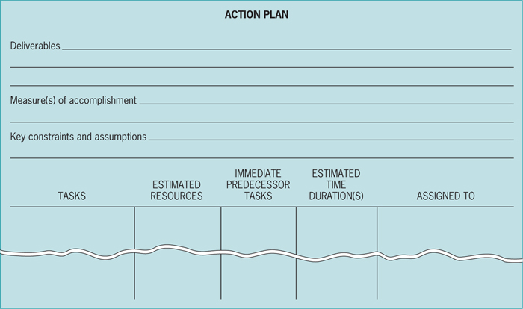
Project Action Plan

Slide 49
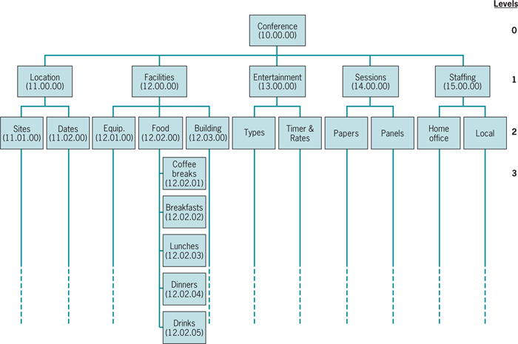
Work Breakdown Structure (WBS)

Slide 50
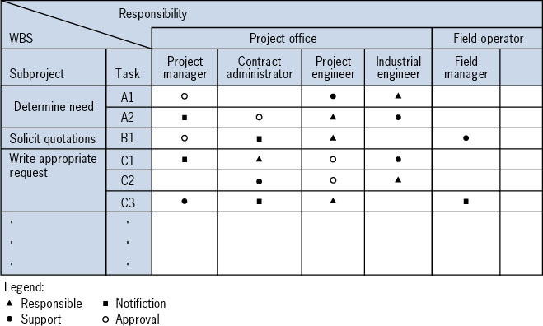
Linear Responsibility Chart (LRC)
The LRC is a matrix with project tasks listed in the rows and departments/individuals columns

Slide 51






Mind Map
Registration
Transportation
Promotion
Route
10K run to
raise $50K
for homeless
shelter
Prizes/recognition
Clean-up
Refreshments
Safety
Facilities

Slide 52



Mind Map – Second Level
Investigate
past events
Produce
ads
TV and
radio ads
Purchase
air time
Interview
running
club
members
Research
Promotion
Monitor
airings
Flyers
52
Print
Design
Mailings
Mail
promo
Distribute
Prepare
mailing
Acquire
address
lists
To schools
To sports
retailers

Slide 53
Design Structure Matrix (DSM)
a
b
c
d
e
f
a
b
c
d
e
f
a
a
b
X
X
b
X
O
c
X
X
c
X
O
d
X
X
X
d
X
X
X
e
X
e
X
f
X
X
X
f
X
X
X
tasks to be completed concurrently
X -- information flow
X -- information flow
O -- potential rework situation

Slide 54
Interface Map: Interdependencies Between Team Members
Review
Review
Program
manager
Review
Project
schedule
Technical
overview
Manufacturing
Process
technology
Project
manager
Create
Use
Use
Use
Create
Create
Use
Review
Test
vectors
Process
file
Chip
schedule
Create
Use
Review
contribute
Cell
library
Cell library
group
Chip
manager
Use
Create
Use
Use
Use
Use
Chip
specification
Use
Design
team
Layout
Layout
specialist
Review
Create
Create
Chip
design
Use
High level
design
Schematic
Netlist
Verification
plan
Verification
vectors
Simulation
prelayout
Simulation
postlayout

Slide 55
Project Budgeting

Slide 56
Budgeting
Budgeting: the process of forecasting what resources the project will require.
Cost estimating process: evaluating each work element for its resource requirement and then determining its costs. Forecasting required resources, quantities, timing, and costs
Formalization of the process: using forms and other simple procedures to improve the process of cost estimating.
Learning Curves and Tracking Signals: quantitative tools for improving cost estimations.
Projects are unique: risk pervades all elements of the project, and particularly performance, schedule, and budget.
Two methods of budgeting
Top-down Budgeting. Senior management decides how much the project should cost (the total project budget). The budget is divided among the activities.
bottom-up Budgeting. Cost are estimates by those responsible for each task. Estimates are rolled up for all activities to get the total project budget.

Slide 57
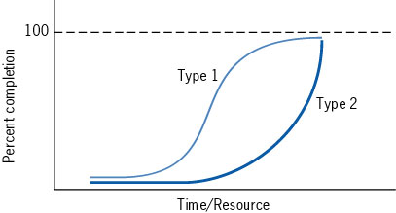

S-shaped and J-shaped Project Life Cycles
S-shaped: with a somewhat reduced level of resources, a smaller than proportional cut will be made in the project’s objectives or performance. The top-down budgeting process is more acceptable
J-shaped: a larger than proportional budget cut will be made in the project’s performance. It is dangerous for upper management not to accept the bottom-up budget estimates

Slide 58
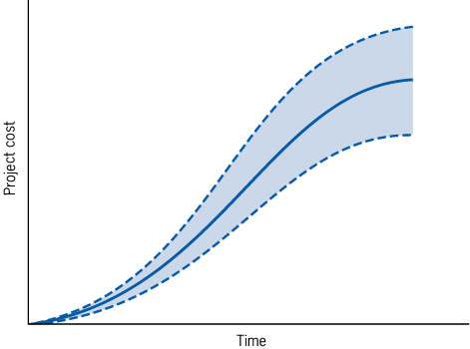
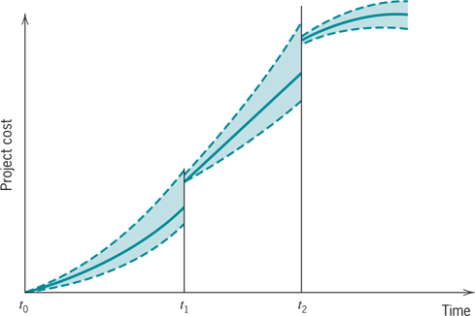
Estimate of Project Cost- Made at Project Start & at Intermediate Points

Slide 59
Risk Management Planning
Risk Identification
Risk Analysis: Evaluating the seriousness (magnitude) of risk and likelihood (probability)
  Qualitative
  Quantitative
Risk Response Planning
Risk Monitoring and Control
A structured approach to help identify, prioritize, and manage risk
  List ways project might fail
  Evaluate severity (S) of each failure
  Estimate likelihood (L) of each failure occurring
  Estimate ability to detect each failure (D)
  Calculate Risk Priority Number (RPN)
  Sort potential failures by their RPNs

Slide 60
Quantitative Approaches to Risk Management
Game Theory
  The decision maker takes a pessimistic mind-set and selects a course of action that minimizes the maximum harm (the minimax solution) any outcome can render regardless of the probabilities
Expected Value
  The value of an outcome multiplied by the probability of that outcome occurring
Simulation
  Use standard deviation to quantify the amount of risk associated with a given project
  Use frequency charts to calculate the probability for any number of scenarios

Slide 61
Learning Curves

Slide 62
Learning Curves
T_{n} = the time required to complete the n^{th} unit
T₁ = the time required to complete the first unit
Time to produce n^{th} unit with 85% learning (LR=0.85) when T1= 43
So, the 8th unit with 85% learning & T₁=43:
r = (ln 8)/(ln 2) =
T₈ = T₁(LR)^{(ln 8)/(ln 2)} = 43(.85)³ =

Slide 63
Learning Curves
A firm has a project to produce 21 units of a new part for a customer.
The firm’s typical learning rate is 85%.
The first unit of the part that was produced (the prototype) required 43 hours to make.
Labor cost is $27 per hour.
Pricing policy is 3 times the total labor cost.
How much should customer be charged?

Slide 64
Project Networks

Slide 65
Project Scheduling
From Action Plan and WBS to Gantt chart and project network.
Project Network
  Critical Path Method (CPM)- Late 1950s
  Dupont De Nemours Inc. developed the method
  Deterministic activity durations
Program Evaluation and Review Technique (PERT)
  U.S. Navy, Booz-Allen Hamilton, and Lockeheed Aircraft
  Probabilistic activity durations
Risk analysis: likelihood of completing the project on time, on budget, to specifications
  Statistics
  Simulation

Slide 66
Activity on Arrow

Slide 67
Activity on Arrow Network
An Activity is an arc with two nodes at its beginning and its end
Task | Predecessor
a b c | -- a b
Task | Predecessor
a b c d | --- -- b a
a
d
b
c
a
b
c
Task | Predecessor
a b c d | --- a a a
b
a
c
d

Slide 68
Activity on Arrow Network
Task | Predecessor
a b c d | --- -- -- a,b,c
a
b
d
c
Task | Predecessor
a b c d | --- a a b,c
d
b
a
c

Slide 69
AoA: A Power Plant Construction Project
b
e
a
c
f
h
j
g
d
i

Slide 70
Draw AOA
d = 4
2
6
a = 6
e = 3
k = 6
i = 4
b = 2
g = 9
1
4
7
f = 8
c = 5
j = 7
3
5
h = 9
12/23/2023
Ardavan Asef-Vaziri
5-70

Slide 71
Activity on Node

Slide 72
Draw Activity on Node Network
a:-
b:a
c:a
d:a
e: b
f:c
g:c
h:e,f
i: d,g
j: h,i
b
e
h
a
c
f
j
g
d
i

Slide 73
Draw Activity on Node Network
Activity | Imm. Pred
A | --
B | A
C | B
D | B
E | D
F | D
G | D
H | C, E, F, G
I | H
J | H
K | I
L | J
M | K, L
Final Plumbing
Rough Plumbing
Install Cabinets
C
I
K
Sheet Rock
Excavate
A
B
Lay Foundation
Finish Exterior
H
M
E
Install
Flooring
J
L
Frame
D
HVAC
Paint
Final Electric
F
Rough Electric
G

Slide 74
Critical Path Method (CPM)

Slide 75
Critical Path Method
Activity | Immediate Precedence | Duration
A1 | - | 4
A2 | - | 3
A3 | A1 | 6
A4 | A1 | 4
A5 | A2 | 2
A6 | A4, A5 | 3
4
6
A1
A3
E
4
3
S
A4
A6
3
2
A2
A5
12/23/2023
5-1-75

Slide 76
Critical Path Method: Paths
4
6
How many path?
A1
A3
E
4
3
S
A4
A6
3
2
10
11
8
A2
A5
Critical Path is the longest path
It is the shortest time to complete the project
12/23/2023

Slide 77
Forward Path; Earliest Starts
4
6
A1
4
A3
E
10
11
0
0
4
4
10
11
4
3
0
S
4
A4
8
A6
0
5
3
4
2
8
8
11
0
A2
A5
3
0
3
3
5

Slide 78
Forward Path
Max = 30
35
10
35
35
30
20
5
12/23/2023

Slide 79
Backward Path; Latest Starts
0
4
4
5
6
11
5
11
A3
11
A1
4
4
10
E
11
0
0
4
4
10
11
0
4
4
8
8
3
11
11
0
8
S
4
A4
8
A6
0
3
4
8
5
11
3
3
6
2
8
6
8
0
6
8
A2
A5
3
0
3
3
5
12/23/2023

Slide 80
Backward Path
30
Min = 35
30
35
30
30
45
5
12/23/2023

Slide 81
Computing Slack Times
LST
LFT
Task = duration
slack = xxxx
EST
EFT
12/23/2023

Slide 82
Critical Path, Slacks
0
4
4
5
6
11
11
A1
A3
E
11
0
4
4
10
4
4
8
8
3
11
S
A4
A6
3
3
6
4
8
8
11
6
2
8
A2
A5
0
3
3
5
12/23/2023

Slide 83
Slack Times Example
c=3
slack=
LST
LFT
Task=dur
slack=xxx
g=1
slack=
EST
EFT
a=4
slack=
j=6
slack=
d=2
slack=
Start
Finish
e=6
slack=
h=4
slack=
b=3
slack=
k=1
slack=
f=4
slack=
i=5
slack=
12/23/2023

Slide 84
Slack Times Example
c=3
slack=
LST
LFT
Task=dur
slack=xxx
4
7
g=1
slack=
EST
EFT
a=4
slack=
0
4
7
8
j=6
slack=
d=2
slack=
4
6
9
15
Start
Finish
15
e=6
slack=
3
9
h=4
slack=
b=3
slack=
9
13
k=1
slack=
0
3
13
14
f=4
slack=
i=5
slack=
3
7
7
12
12/23/2023
5-1-84

Slide 85
Slack Times Example
5
8
c=3
slack=
LST
LFT
Task=dur
slack=xxx
1
5
4
7
8
9
g=1
slack=
EST
EFT
a=4
slack=
15
9
15
9
0
4
6
8
7
8
j=6
slack=
d=2
slack=
9
15
15
4
6
9
15
Start
Finish
9
3
9
3
15
e=6
slack=
10
14
3
3
9
h=4
slack=
0
3
3
9
0
14
15
b=3
slack=
9
13
k=1
slack=
3
0
3
5
9
0
9
14
13
14
f=4
slack=
i=5
slack=
3
7
7
12
12/23/2023

Slide 86
Graphical Format
A
C
H
D
F
S
F
B
E
G
I

Slide 87
Random Activities

Slide 89
Program Evaluation and Review Technique
(PERT)

Slide 90
Activity Times in PERT
Optimistic (a)
  Activity duration to be ≤ a has 1% probability. ➔ ≥ a has 99% probability
Pessimistic (b)
  Activity duration to be ≥ b has 1% probability ➔ ≤ b has 99% probability
Most likely (m)
  The mode of the distribution
All possible task durations (or task costs) can be represented by statistical distributions

Slide 91
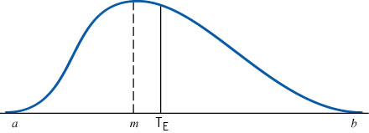
Beta Distribution: The Probability Distribution of Activity Times
Mean = : T_{E} = (a + 4m + b)/6
Standard deviation = σ = (b-a)/6
Variance = σ² = [(b-a)/6]²

Slide 92
95% & 90% Levels
If we replace 99% with 95% level
  Activity duration to be ≤ a has 5% probability
  Activity duration to be ≥ b has 5% probability
  If we replace 99% with 90% level
  Activity duration to be ≤ a has 10% probability
  Activity duration to be ≥ b has 10% probability

Slide 93
Probability of Completing the Critical Path on Time
We assume the various activities are statistically independent of each other
Individual variances (and mean) of the activities on a path can then be summed to find the variance (mean) of the path
Determine the mean and standard deviation of the critical path
Compute the probability of critical path being ≤ a
D_{CP} = the desired completion date of the critical path
m_{CP}= the sum of the T_{E} for the activities on the critical path
σ²_{CP} = the sum of the variances of the activities on the critical path
Given Z, the probability of having the standard normal variable being ≤ Z is the probability of completing the project in a time ≤ D

Slide 94
Selecting Risk and Finding D
Find all paths in the network
Compute mean and standard deviation of each path
Compute the probability of completing each path in ≤ the given time
Calculate the probability that the entire project is completed within the specified time by multiplying these probabilities together

Slide 95
Critical Path Method: Paths
Suppose all activities have beta distribution
4,1
6,2
A1
A3
E
4,1
3,1
S
A4
A6
3,0.5
2,0.5
10
11
8
A2
A5
The first number is the mean; the second is standard deviation.

Slide 96
Probability of Completing CP in 12 days
What is the probability of competing the critical path in a maximum of 12 days?
D_{CP} = the desired completion date of the critical path
m_{CP}= 4+4+3 = 11
σ²_{CP} = 1²+1²+1² = 3
σ_{CP} = 1.73
Z= 0.58 ➔ P(z≤0.58) = 0.72

Slide 97
Selecting Risk and Finding CP Time
With a probability of 90%, in how many days will the CP be completed?
From Standard Normal Table ➔ Z _{90%} = 1.28

Slide 98
Probability of Completing The Project in 12 days
The probability of completing the critical path in not more than 12 days was 0.72. We need to compute this probability for blue path and green path too, and then multiply these probabilities
m_{CP}= 6+4 = 10
σ²_{CP} = 1²+2² = 5
σ_{CP} = 2.24
Z= (12-10)/2.24 = 0.89 ➔ P(z≤0.89) = 0.81
m_{CP}= 3+2+3 = 8
σ²_{CP} = 0.5²+0.5²+1² = 1.22
σ_{CP} = 1.1
Z= (12-8)/1.1 = 3.63 ➔ P(z≤3.63) ≈ 1
The probability of competing the Project in not more than 12 days is 0.72×0.81×1 = 0.58

Slide 99
Problem- PERT
Activity | Immediate Predecessor | Optimistic Duration | Most Likely | Pessimistic Duration | Expected Duration t_{e} | V_{t} Variance
a | -- | 15 | 18 | 20
b | -- | 20 | 20 | 22
c | -- | 12 | 14 | 16
d | a | 7 | 7 | 7
e | b | 8 | 11 | 12
f | c | 17 | 21 | 24
g | b,d | 10 | 12 | 15
h | e,f | 9 | 10 | 11
d
g
a
b
e
c
h
f
Find the Critical path:
Compute expected duration of CP m _{cp}=
Compute Standard deviation of critical path σ_{cp} =
Prob( T_{CP}≤ 48)?, Prob(T_{CP} ≤ 43)? , Prob(43 ≤T_{CP}≤ 48)?
Find a completion date that you’re 80% sure you can meet.
Prob( T_{Project}≤ 43)?

Slide 100
Goldratt’s Critical Chain & Srinivansan’s Contributions

Slide 101
Srinivasan’s Notes on Goldratt’s Critical Chain ritical Path Method
In 1997, Goldratt introduced the Critical Chain methodology to apply Theory of Constraints concepts to manage projects.
The Critical Chain methodology expands on the notion of a critical path and helps determine where buffers should be placed to prevent unplanned disruptions from delaying project completion.
To schedule work is also to schedule resource usage. Resource availability constrains all solutions to the scheduling problem.
Project management is fundamentally concerned with effectively trading off performance, cost, and time. Yet, to what extent is the need to make these trade-offs caused by human decisions and practices?
A project has four sets of activities that must be completed before a synchronization operation, represented by C4 can be completed.
Use historical data to obtain an estimate of the average time for each activity.
Sum these estimates to obtain the average time it takes each series of activities that must be completed before C4 can begin.

Slide 102
The Critical Chain Concept
Start Date
A1
A2
Feeding Buffer
Completion Date
B1
B2
Feeding Buffer
C1
C2
C3
C4
Project Buffer
Critical Chain
D1
D2
Feeding Buffer
Time
An analysis reveals that the series of activities with the longest average time is C1-C2-C3.
This is the Critical Chain and the activities along the critical chain are termed critical activities.

Slide 103
Estimating Task Times: 3 Project Scenario
The primary difference is the degree of interdependence across the paths.
  Scenario 1: there is only a single path
  Scenario 2: the path B-C-D-E is preceded by three activities A1, A2, & A3. The completion of path B-C-D-E depends on which of its three preceding tasks takes the longest
  Scenario 3: there are two completely independent paths each consisting of five tasks
All three tasks require 10 days to complete.
What completion time would you calculate for each project?
Project times are not known with certainty
Activities that take less than the expected time tend to cancel out the variability of activities that take more than the expected completion time for the project.

Slide 104
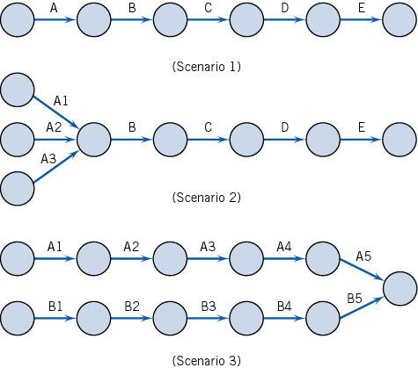
The Critical Chain Concept

Slide 105
Path Simulation

Slide 106
Common Chain of Events
According to Goldratt, activities dealing with resource allocation lead to the following chain of events.
  Assuming that the activity times are known and that the paths are independent leads to underestimating the actual amount of time needed to complete the project.
  Because the time needed to complete the project is underestimated, project team members tend to inflate their time estimates.
  Inflated time estimates lead to work filling available time, workers not reporting that a task has been completed early, and the ever-present student syndrome.
  An important caveat than becomes that safety time is usually visible to project workers and is often misused.
  Misused safety time further complicates the task of prioritizing project activities.
  Hidden safety time further complicates the task of prioritizing project activities.
  The lack of clear priorities likely results in poor multitasking.
  Task durations increase as a result of poor multitasking.
  Uneven demand on resources- some overloaded and others underloaded- may also occur as a result of poor multitasking.
  In an effort to utilize all resources fully, more projects will be undertaken to make sure that no resources are underutilized.
  Adding more projects further increases poor multitasking.
12/23/2023
Ardavan Asef-Vaziri
106

Slide 107
Critical Chain Project Management
Identify the critical chain: set of tasks that determine the overall duration of the project
Use deterministic CPM model with buffers to deal with uncertainty
Remove padding from activity estimates (otherwise, slack will be wasted). Estimate task durations at median.
Place project buffer after last task to protect customer’s completion schedule
Exploit constraining resource(s)
Avoid wasting slack times by encouraging early task completions
Have project team focus 100% effort on critical tasks
Work to your plan and avoid tampering
Carefully monitor and communicate buffer status
12/23/2023
Ardavan Asef-Vaziri
107

Slide 108
Critical Chain Project Management
12/23/2023
Ardavan Asef-Vaziri
108

Slide 109
Project Crashing

Slide 110
Crashing
Crashing: shortening duration of activities. Because
  Some activities were delayed.
  Client is willing to pay more for earlier completion.
Crashing changes the schedule for remaining activities.
It has impact on schedules for all the subcontractors.
Often introduces unanticipated problems.
The faster an activity is completed, the more it costs.
There is always a lower bound on task duration.

Slide 111
Linear Time / Cost Tradeoff
Slope (b_{j}) = increase in cost from reducing task duration by one time unit
Cost
Crash point
Crash cost
Normal point
Normal cost
Time
Crash time
Normal time

Slide 112
Crashing Algorithm
Assume each task can be crashed one day at a time (simplifying assumption, but not necessary)
Crash only critical activities. Crashing other activities can only increase cost without changing project duration
To decrease project duration by one day, the critical path or paths must decrease by one day.
  Find the critical path or paths
  If there is no other critical activity which could still be reduced, and shorten the critical path. Stop.
  Crash the cheapest critical activity (or combination of activities) to shorten the critical path (or paths) by one day.
  Go to 1

Slide 113

Crashing 21 Days to 20 Days Network
Activities A,C, and F are on Critical Path. A and C are the least-cost choice. We crash A because it affects two paths. Lower A’s normal time by one day.
It now equals the crash time and cannot be shortened further.
The critical path is unchanged.
The critical time will be lowered to 20 days.
The cost of the project will be $400+30(A)= $430.

Slide 114
Crashing 20 Days to 19 Days Network
Activities A,C, & F are still on the critical path.
A cannot be crashed any more. C is the least-cost choice.
Lower C’s normal time by one day. The critical path is unchanged
The critical time will be lowered to 19 days
The cost of the project will be $400+ 30(A) + 30(C) = $460

Slide 115
Crashing 19 Days to 18 Days Network
All activities are now critical. 3 paths; ACF,EDG, and BEG. A cannot be crashed any more. The only way to crash ACF is to crash C or F. C is cheaper.
On ADG path, A and D cannot be crashed. The only way to crash ADG is to crash G. Crashing G crashes BEG path too.
The critical time will be lowered to 18 days
The cost of the project will be $400+ 30(A) + 30(C2) + 60(G) = $550

Slide 116
Crashing 18 Days to 17 Days Network
All activities are critical. There are three paces ACF, ADG, and BEG.
Crash F and G by 1 at cost of 60 +40 = 100
The critical time has been lowered to 17 days
The cost of the project is $400+ 30(A) + 30(C2) + 60(G2)+40(F) = $650

Slide 117
Crashing 17 Days to 16 Days Network
We can shorten the project to 16 days by crashing F and G by another day.
The cost of the project is $400+ 30(A) + 30(C2) + 60(G3)+40(F2) = $750
Activities A,C,F, and g have been crashed to their limits.
No further crashing will help so B,D, and E remain at their normal times and costs.

Slide 118
Time-Cost Tradeoff

Slide 119
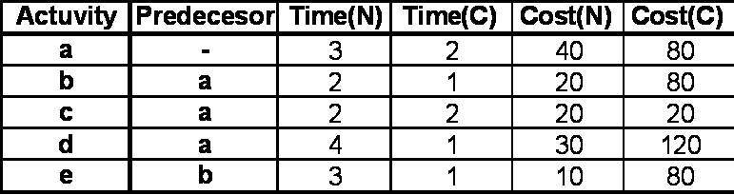
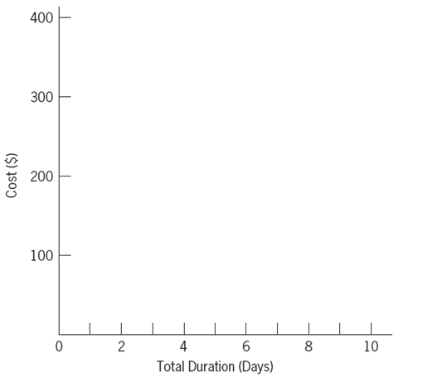
Crash the Following Network. Prepare Cost-time Curve

Slide 120
Crash the Following Network. Prepare Cost-time Curve

Slide 121
Crash the Following Network. Prepare Cost-time Curve

Slide 122
Crash the Following Network. Prepare Cost-time Curve

Slide 123
Crash the Following Network. Prepare Cost-time Curve

Slide 124
Crash the Following Network. Prepare Cost-time Curve

Slide 125
Time-Cost Curve
$400
300
200
100
All crash
e(2)+a+d(2)+b
e(2)+a+d
e+a
e
All normal
0 2 4 6 8 10
Total Duration (Days)
Ardavan Asef-Vaziri

Slide 126
Practice
The same example as we solved. Activity c either 0 or 2 but not 1. Solve it in the easiest way. Prepare Time-Cost Trade-off Curve

