Slide 1

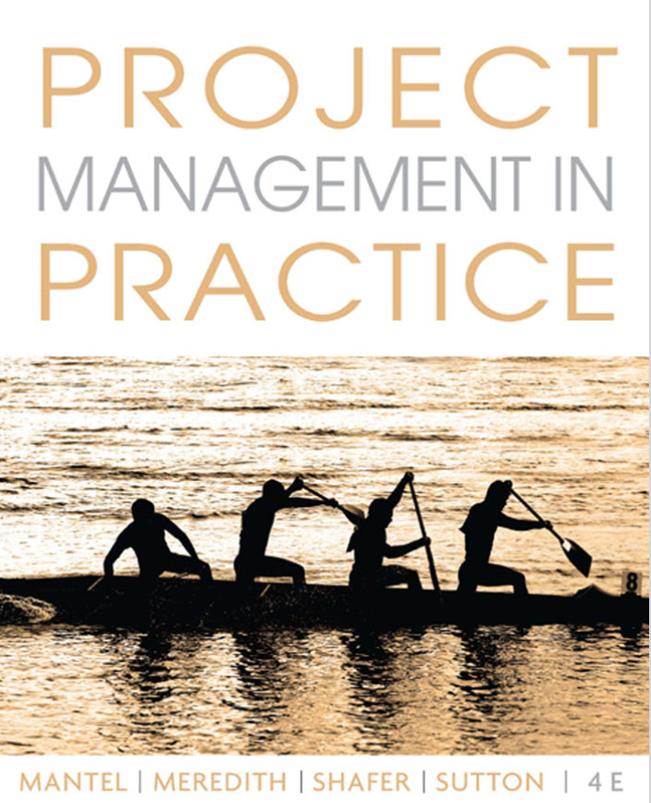

Project Management
Ardavan Asef-Vaziri

Slide 2
Project Networks

Slide 3
Project Scheduling
From Action Plan and WBS to Gantt chart and project network.
Project Network
  Critical Path Method (CPM)- Late 1950s
  Dupont De Nemours Inc. developed the method
  Deterministic activity durations
Program Evaluation and Review Technique (PERT)
  U.S. Navy, Booz-Allen Hamilton, and Lockeheed Aircraft
  Probabilistic activity durations
Risk analysis: likelihood of completing the project on time, on budget, to specifications
  Statistics
  Simulation

Slide 4
Draw Activity on Node Network
a:-
b:a
c:a
d:a
e: b
f:c
g:c
h:e,f
i: d,g
j: h,i
b
e
h
a
c
f
j
g
d
i

Slide 5
Draw Activity on Node Network
Activity | Imm. Pred
A | --
B | A
C | B
D | B
E | D
F | D
G | D
H | C, E, F, G
I | H
J | H
K | I
L | J
M | K, L
Final Plumbing
Rough Plumbing
Install Cabinets
C
I
K
Sheet Rock
Excavate
A
B
Lay Foundation
Finish Exterior
H
M
E
Install
Flooring
J
L
Frame
D
HVAC
Paint
Final Electric
F
Rough Electric
G

Slide 6
Critical Path Method (CPM)

Slide 7
Critical Path Method
Activity | Immediate Precedence | Duration
A1 | - | 4
A2 | - | 3
A3 | A1 | 6
A4 | A1 | 4
A5 | A2 | 2
A6 | A4, A5 | 3
4
6
A1
A3
E
4
3
S
A4
A6
3
2
A2
A5
3/12/2024
5-1-7

Slide 8
Critical Path Method: Paths
4
6
How many path?
A1
A3
E
4
3
S
A4
A6
3
2
10
11
8
A2
A5
Critical Path is the longest path
It is the shortest time to complete the project
3/12/2024

Slide 9
Forward Path; Earliest Starts
4
6
A1
4
A3
E
10
11
0
0
4
4
10
11
4
3
0
S
4
A4
8
A6
0
5
3
4
2
8
8
11
0
A2
A5
3
0
3
3
5

Slide 10
Forward Path
Max = 30
35
10
35
30
35
20
5
3/12/2024

Slide 11
Backward Path; Latest Starts
0
4
4
5
6
11
5
11
A3
11
A1
4
4
10
E
11
0
0
4
4
10
11
0
4
4
8
8
3
11
11
0
8
S
4
A4
8
A6
0
3
4
8
5
11
3
3
6
2
8
6
8
0
6
8
A2
A5
3
0
3
3
5
3/12/2024

Slide 12
Backward Path
30
Min = 35
30
35
30
30
45
5
3/12/2024

Slide 13
Computing Slack Times
LST
LFT
Task = duration
slack = xxxx
EST
EFT
3/12/2024

Slide 14
Critical Path, Slacks
0
4
4
5
6
11
11
A1
A3
E
11
0
4
4
10
4
4
8
8
3
11
S
A4
A6
3
3
6
4
8
8
11
6
2
8
A2
A5
0
3
3
5
3/12/2024

Slide 15
Slack Times Example
c=3
slack=
LST
LFT
Task=dur
slack=xxx
4
7
g=1
slack=
EST
EFT
a=4
slack=
0
4
7
8
j=6
slack=
d=2
slack=
4
6
9
15
Start
Finish
15
e=6
slack=
3
9
h=4
slack=
b=3
slack=
9
13
k=1
slack=
0
3
13
14
f=4
slack=
i=5
slack=
3
7
7
12
3/12/2024
5-1-15

Slide 16
Slack Times Example
c=3
slack=
LST
LFT
Task=dur
slack=xxx
4
7
g=1
slack=
EST
EFT
a=4
slack=
0
4
7
8
j=6
slack=
d=2
slack=
4
6
9
15
Start
Finish
15
e=6
slack=
3
9
h=4
slack=
b=3
slack=
9
13
k=1
slack=
0
3
13
14
f=4
slack=
i=5
slack=
3
7
7
12
3/12/2024
5-1-16

Slide 17
Network Design- Technical Precedence
C
A
G
D
J
STA
FIN
E
B
H
F
K
I
3/12/2024

Slide 18
Durations
C
6
A
G
7
9
D
7
J
STA
5
FIN
E
4
B
H
2
8
F
K
7
6
I
2
3/12/2024

Slide 19
Forward Path- Convergence Points
7
C
13
6
0
A
7
14
G
23
Max(C,D)
7
9
7
D
14
7
Max(E,G)
23
J
28
S
5
A
0
Max(J,K)
28
2
E
6
4
0
B
2
Max(E,F)
9
H
17
2
8
2
F
9
17
K
23
Max(H,I)
7
6
9
I
11
2
3/12/2024

Slide 20
Forward Path- Convergence Points
Max = 30
35
10
35
30
35
20
35
5
3/12/2024

Slide 21
Forward Path- Divergence Points
7
C
13
8
6
14
0
A
7
14
G
23
Min(C,D)
0
7
7
14
9
23
7
D
14
7
7
14
23
J
28
S
23
5
28
A
0
28
2
E
6
10
4
14
Min(H,J)
0
B
2
9
H
17
Min(E,F)
5
2
7
14
8
22
2
F
9
Min(H,I)
17
K
23
7
7
14
22
6
28
9
I
11
20
2
22
3/12/2024

Slide 22
Forward Path- Divergence Points
30
Min = 35
30
35
30
30
45
5
3/12/2024

Slide 23
Critical Path and Slacks

Slide 24
ProjMGT-RAND()

Slide 25
Slack Times Example
c=3
slack=
LST
LFT
Task=dur
slack=xxx
4
7
g=1
slack=
EST
EFT
a=4
slack=
0
4
7
8
j=6
slack=
d=2
slack=
4
6
9
15
Start
Finish
15
e=6
slack=
3
9
h=4
slack=
b=3
slack=
9
13
k=1
slack=
0
3
13
14
f=4
slack=
i=5
slack=
3
7
7
12
3/12/2024
5-1-25

Slide 26
Slack Times Example
5
8
c=3
slack=
LST
LFT
Task=dur
slack=xxx
1
5
4
7
8
9
g=1
slack=
EST
EFT
a=4
slack=
15
9
15
9
0
4
6
8
7
8
j=6
slack=
d=2
slack=
9
15
9
15
4
6
15
Start
Finish
9
3
9
3
15
e=6
slack=
10
14
3
h=4
slack=
0
3
3
9
0
3
9
14
15
b=3
slack=
9
13
k=1
slack=
3
0
3
5
9
0
9
14
13
14
f=4
slack=
i=5
slack=
3
7
7
12
3/12/2024

Slide 27
Graphical Format
31
A
46
46
C
67
67
H
69
0
15
15
15
21
36
55
12
67
18
D
35
47
F
67
S
15
35
20
55
F
17
32
0
B
16
16
E
35
35
G
51
51
I
69
0
16
16
16
19
35
35
16
51
51
18
69

Slide 28
Graphical Format
31
A
46
46
C
67
67
H
69
0
15
15
15
21
36
55
12
67
18
D
35
47
F
67
S
15
35
20
55
F
17
32
0
B
16
16
E
35
35
G
51
51
I
69
0
16
16
16
19
35
35
16
51
51
18
69

Slide 29
Network & Critical Path Simulation

Slide 31
Analysis of Projects
Financial & Scoring

Slide 32
Project Selection: Quantitative Methods
Financial Assessment Methods
  Payback period
  Discounted cash flow
    NPV
    IRR
    B/C
Scoring Methods
  Unweighted 0-1 factor method
  Weighted factor scoring method

Slide 33
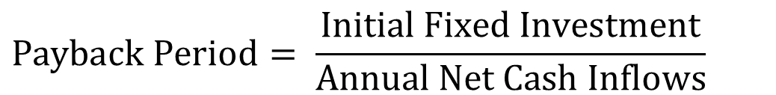
Payback Period
$$Payback Period= \frac{\text{Initial} \text{Fixed} \text{Investment}}{\text{Annual} \text{Net} \text{Cash} \text{Inflows}}$$
Number of years needed for the project to repay its initial fixed investment.
A project costs $100,000 and is expected to save the company $20,000 per year.
PP = $100,000 / $20,000 = 5 years
Shortcoming
  Ignores the time value of money, including interest rates and inflation.
  Ignores money earned after the payback period.

Slide 34
Future Value (FV)
$100, put it in a bank. Interest rate = 10%. How much after 1 year. P = 100. F?
F1 = 100 +0.1(100) = 100(1+0.1)
How much after 2 years?
F2= 100(1+0.1) + 0.1(100(1+0.1)) =
F2= 100(1+0.1) (1+0.1) = 100(1.1)²
How much after 3 years?
F3 = 100(1.1)² + 0.1[100(1.1)²] =
F3 = 100(1.1)² [1+0.1] = 100(1.1)² [1.1] = 100(1.1)³
How much after N years
F = 100(1.1)^{N}

Slide 35
Future Value (FV); Present Value (PV)
P: The initial vale
MARR: Minimum Acceptable Rate of Return
F= P(1+MARR)^{N}
P = F/(1+MARR)^{N}
P = F/(1+r)^{N}
P = F(1+r)^{-N}
r = the minimum acceptable rate of return
=FV(r, N,PMT,PV,0→ EOY) =
=PV(r, N,PMT,FV,0 →EOY) =

Slide 36
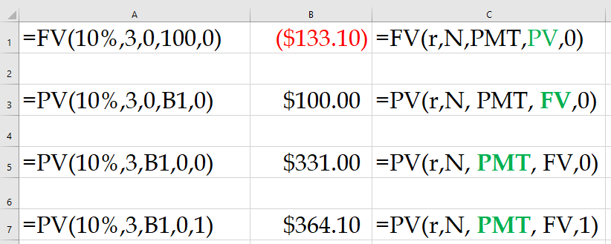
Present Value Index Table

Slide 37
Back to the PBP Example
The initial investment of a project at the end of year 0 is 10 million dollars. Depreciation is computed using straight-line method with accounting life of five years and zero salvage value. Net income before tax and depreciation is 3 million dollars per year. The tax rate is 40%. Compute net income after tax in Year 1. Compute net cash inflow in Year 1. At the end of year 7 we sell everything for 5 million dollars. Compute NPV and IRR.
Net Income Before Tax and Depreciation 3
Depreciation 2
Income Before Tax 1
Tax 0.4
Net Income After Tax 0.6
Cash Flow of Depreciation 2
Net cash flow per year 2.6
This is true for the first 5 yeas.

Slide 38
Future Value (FV); Present Value (PV)
But after year 5 we do not have depreciation.
Therefore, the two million dollars depreciation is not a cost anymore. Our revenue will increases by
2(1-0.4) = 1.2 million dollars.
Net income after tax = 0.6+1.2 =1.8
You do not believe me?
Net Income Before Tax and Depreciation 3
Depreciation 0
Income Before Tax 3
Tax 0.4(3) =1.2
Net Income After Tax in Year 6 1.8
Net Income After Tax in Year 7 1.8+5(1-0.4) = 4.8

Slide 39
Net Present Value (NPV)
I₀ = the initial investment
F_{t} = the net cash flow in period t
r = the required rate of return
Important note: NPV function in excel assumes that the first cash flow is at the end of year 1.

Slide 40
Internal Rate of Return (IRR)
The discount rate (r) that causes the NPV to be equal to zero.
The higher the IRR, the better.
In Excel “=IRR(Series,Guess)”
Compare IRR with MARR
MARR: Minimum Acceptable Rate of Return
Here it is not important where the first payment is – end of year 1 or end of year 0. The NPV for IRR is 0 everywhere.

Slide 41
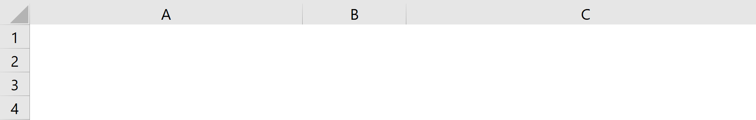
Your Mortgage; PMT and PPMT
$600,000 loan, 5% interest rate, 30 years fixed. What is your monthly payment? the money towards the principle in the first month? the money towards the principle in the last month, your cumulative principle at the end of the fifth year?
Your monthly payment
=PMT(monthly rate,#of months,pv,[fv], [type])
=PMT(0.05/12, 30*12, 600000)
Monthly Payment
($3,220.93)
=PMT(0.05/12,12*30,600000)
Pronciple Paid in month 1
($720.93)
=PPMT(0.05/12, 1, 30*12, 600000)
Principle paid in month 60
($921.37)
=PPMT(0.05/12, 60, 30*12, 600000)
Principle paid over the first 5 years
-49027.6075
=CUMPRINC(0.05/12,12*30,600000,1,60,0)

Slide 42
Practice
The initial investment of a project at the end of year 0 is 10 million dollars. Depreciation is computed using straight-line method with accounting life of 4 years and accounting salvage value of 0. Total revenue is 6 million dollars per year. All expenses, excluding depreciation and tax are 2 million dollars per year. Useful life of the project (which differs from accounting life) is 7 years. At the end of the useful life the project is sold for 2 million dollars. Tax rate of operating income as well as capital gain is 30%. Compute profit per year during the accounting life of the project.
Revenue 6
Operating Expenses 2
Net Income Before Tax and Depreciation 4
Depreciation 2.5
Income Before Tax 1.5
Tax 0.3(1.5) = 0.45
Net Income After Tax (years 1-4) 1.05

Slide 43
Practice: Net Income vs. Net Cash Inflow
Compute net cash inflow during the accounting life of the project.
Net Income After Tax 1.05
Depreciation 2.5
Net Cash Inflow (years 1-4) 3.55
Compute net cash inflow per year after accounting life is over and before the last year of the useful life of the project.
Net Income After Tax 1.05
Depreciation added to the profit 2.5
After Tax net income added 2.5(1-0.3) = 1.75
Total Net Income 1.05+1.75= 2.8
Net Cash Inflow (years 5-6) 2.8

Slide 44
I Am Sure It Was Easy to Grasp
If it was not easy to grasp, you may look at it from a different perspective
Revenue 6
Operating Expenses 2
Net Income Before Tax and Depreciation 4
Tax 0.3(4) = 1.2
Net Income After Tax (years 1-4) 2.8
Compute net cash inflow in the last year of the useful life of the project.
Net Income After Tax 2.8
Project Sold 2
Capital Gain Tax 0.3(2) = 0.6
Net Capital Gain 1.4
Net Cash inflow 2.8+1.4= 4.2

Slide 45
Practice: Net Income vs. Net Cash Inflow
What is the net cash flow of the project during its useful life. Compute NPV under 10% MARR and IRR.

Slide 46
Profitability Models
Advantages
  Easy to use and understand
  Based on accounting data and forecasts
  Familiar and well understood
  Give a go/no-go indication
  Can be modified to include risk
Disadvantages
  Ignore non-monetary factors
  Discounting models (NPV, IRR) are biased to the short-term

Slide 47
Weighted Scoring Model
S_{i} = the total score of the i^{th} project
s_{ij} = the score of the i^{th} project on the j^{th} criterion
w_{j} = the weight or importance of the j^{th} criterion

Slide 48
Factor Rating Method For Location & Site Evaluation
A company wants to build a major warehouse in Europe. Four locations are being considered. The following table shows the important factors to bring into account along with the importance level (weight) of each factor. The attractiveness of each location relative to each factor is indicated on a 0-100 point scale. Find the best location.
Germany: 0.3(70)+0.3(60)+0.3(70)+0.1(80) = 21+18+21+8 = 68
France: 0.3(90)+0.3(70)+0.3(30)+0.1(50) = 27+21+9+5 = 62
Belgium: 0.3(50)+0.3(60)+0.3(70)+0.1(60) = 15+18+21+6 =60
Netherland: 0.3(50)+0.3(70)+0.3(70)+0.1(50) = 15+21+21+5 = 62

Slide 49
Factor Rating Method For Location & Site Evaluation
In this example summation of the weight is NOT one (100%). We first need to normalize it to 100%. Scores were given in the range of 50 to 100.

Slide 50
Learning Curves

Slide 51
Learning Curves
T_{n} = the time required to complete the n^{th} unit
T₁ = the time required to complete the first unit
Time to produce n^{th} unit with 85% learning (LR=0.85) when T1= 43
So, the 8th unit with 85% learning & T₁=43:
r = (ln 8)/(ln 2) =
T₈ = T₁(LR)^{(ln 8)/(ln 2)} = 43(.85)³ =

Slide 52
Learning Curves
A firm has a project to produce 21 units of a new part for a customer.
The firm’s typical learning rate is 85%.
The first unit of the part that was produced (the prototype) required 43 hours to make.
Labor cost is $27 per hour.
Pricing policy is 3 times the total labor cost.
How much should customer be charged?

Slide 53
Assignment
Persons or Teams to Tasks

Slide 54
Assignment of the Team to the Tasks – Can SOLVER in Excel Handle?

Slide 55
Activity on Arrow

Slide 56
Activity on Arrow Network
An Activity is an arc with two nodes at its beginning and its end
Task | Predecessor
a b c | -- a b
Task | Predecessor
a b c d | --- -- b a
a
d
b
c
a
b
c
Task | Predecessor
a b c d | --- a a a
b
a
c
d

Slide 57
Activity on Arrow Network
Task | Predecessor
a b c d | --- -- -- a,b,c
a
b
d
c
Task | Predecessor
a b c d | --- a a b,c
d
b
a
c

Slide 58
AoA: A Power Plant Construction Project
b
e
a
c
f
h
j
g
d
i

Slide 59
Draw AOA
d = 4
2
6
a = 6
e = 3
k = 6
i = 4
b = 2
g = 9
1
4
7
f = 8
c = 5
j = 7
3
5
h = 9
3/12/2024
Ardavan Asef-Vaziri
5-59

Slide 60
Program Evaluation and Review Technique
(PERT)

Slide 61
Activity Times in PERT
Optimistic (a)
  Activity duration to be ≤ a has 1% probability. ➔ ≥ a has 99% probability
Pessimistic (b)
  Activity duration to be ≥ b has 1% probability ➔ ≤ b has 99% probability
Most likely (m)
  The mode of the distribution
All possible task durations (or task costs) can be represented by statistical distributions

Slide 62
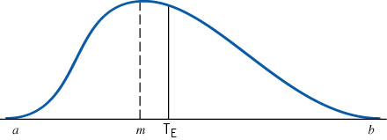
Beta Distribution: The Probability Distribution of Activity Times
Mean = : T_{E} = (a + 4m + b)/6
Standard deviation = σ = (b-a)/6
Variance = σ² = [(b-a)/6]²

Slide 63
95% & 90% Levels
If we replace 99% with 95% level
  Activity duration to be ≤ a has 5% probability
  Activity duration to be ≥ b has 5% probability
  If we replace 99% with 90% level
  Activity duration to be ≤ a has 10% probability
  Activity duration to be ≥ b has 10% probability

Slide 64
Probability of Completing the Critical Path on Time
We assume the various activities are statistically independent of each other
Individual variances (and mean) of the activities on a path can then be summed to find the variance (mean) of the path
Determine the mean and standard deviation of the critical path
Compute the probability of critical path being ≤ a
D_{CP} = the desired completion date of the critical path
m_{CP}= the sum of the T_{E} for the activities on the critical path
σ²_{CP} = the sum of the variances of the activities on the critical path
Given Z, the probability of having the standard normal variable being ≤ Z is the probability of completing the project in a time ≤ D

Slide 65
Selecting Risk and Finding D
Find all paths in the network
Compute mean and standard deviation of each path
Compute the probability of completing each path in ≤ the given time
Calculate the probability that the entire project is completed within the specified time by multiplying these probabilities together

Slide 66
Critical Path Method: Paths
Suppose all activities have beta distribution
4,1
6,2
A1
A3
E
4,1
3,1
S
A4
A6
3,0.5
2,0.5
10
11
8
A2
A5
The first number is the mean; the second is standard deviation.

Slide 67
Probability of Completing CP in 12 days
What is the probability of competing the critical path in a maximum of 12 days?
D_{CP} = the desired completion date of the critical path
m_{CP}= 4+4+3 = 11
σ²_{CP} = 1²+1²+1² = 3
σ_{CP} = 1.73
Z= 0.58 ➔ P(z≤0.58) = 0.72

Slide 68
Selecting Risk and Finding CP Time
With a probability of 90%, in how many days will the CP be completed?
From Standard Normal Table ➔ Z _{90%} = 1.28

Slide 69
Probability of Completing The Project in 12 days
The probability of completing the critical path in not more than 12 days was 0.72. We need to compute this probability for blue path and green path too, and then multiply these probabilities
m_{CP}= 6+4 = 10
σ²_{CP} = 1²+2² = 5
σ_{CP} = 2.24
Z= (12-10)/2.24 = 0.89 ➔ P(z≤0.89) = 0.81
m_{CP}= 3+2+3 = 8
σ²_{CP} = 0.5²+0.5²+1² = 1.22
σ_{CP} = 1.1
Z= (12-8)/1.1 = 3.63 ➔ P(z≤3.63) ≈ 1
The probability of competing the Project in not more than 12 days is 0.72×0.81×1 = 0.58

Slide 70
Problem- PERT
Activity | Immediate Predecessor | Optimistic Duration | Most Likely | Pessimistic Duration | Expected Duration t_{e} | V_{t} Variance
a | -- | 15 | 18 | 20
b | -- | 20 | 20 | 22
c | -- | 12 | 14 | 16
d | a | 7 | 7 | 7
e | b | 8 | 11 | 12
f | c | 17 | 21 | 24
g | b,d | 10 | 12 | 15
h | e,f | 9 | 10 | 11
d
g
a
b
e
c
h
f
Find the Critical path:
Compute expected duration of CP m _{cp}=
Compute Standard deviation of critical path σ_{cp} =
Prob( T_{CP}≤ 48)?, Prob(T_{CP} ≤ 43)? , Prob(43 ≤T_{CP}≤ 48)?
Find a completion date that you’re 80% sure you can meet.
Prob( T_{Project}≤ 43)?

Slide 71
Goldratt’s Critical Chain & Srinivansan’s Contributions

Slide 72
Srinivasan’s Notes on Goldratt’s Critical Chain ritical Path Method
In 1997, Goldratt introduced the Critical Chain methodology to apply Theory of Constraints concepts to manage projects.
The Critical Chain methodology expands on the notion of a critical path and helps determine where buffers should be placed to prevent unplanned disruptions from delaying project completion.
To schedule work is also to schedule resource usage. Resource availability constrains all solutions to the scheduling problem.
Project management is fundamentally concerned with effectively trading off performance, cost, and time. Yet, to what extent is the need to make these trade-offs caused by human decisions and practices?
A project has four sets of activities that must be completed before a synchronization operation, represented by C4 can be completed.
Use historical data to obtain an estimate of the average time for each activity.
Sum these estimates to obtain the average time it takes each series of activities that must be completed before C4 can begin.

Slide 73
The Critical Chain Concept
Start Date
A1
A2
Feeding Buffer
Completion Date
B1
B2
Feeding Buffer
C1
C2
C3
C4
Project Buffer
Critical Chain
D1
D2
Feeding Buffer
Time
An analysis reveals that the series of activities with the longest average time is C1-C2-C3.
This is the Critical Chain and the activities along the critical chain are termed critical activities.

Slide 74
Estimating Task Times: 3 Project Scenario
The primary difference is the degree of interdependence across the paths.
  Scenario 1: there is only a single path
  Scenario 2: the path B-C-D-E is preceded by three activities A1, A2, & A3. The completion of path B-C-D-E depends on which of its three preceding tasks takes the longest
  Scenario 3: there are two completely independent paths each consisting of five tasks
All three tasks require 10 days to complete.
What completion time would you calculate for each project?
Project times are not known with certainty
Activities that take less than the expected time tend to cancel out the variability of activities that take more than the expected completion time for the project.

Slide 75
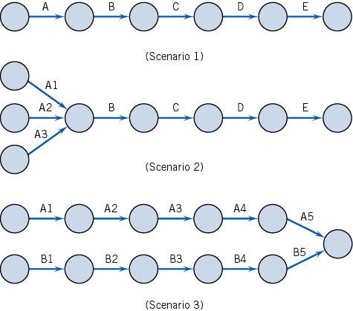
The Critical Chain Concept

Slide 76
Path Simulation

Slide 77
Common Chain of Events
According to Goldratt, activities dealing with resource allocation lead to the following chain of events.
  Assuming that the activity times are known and that the paths are independent leads to underestimating the actual amount of time needed to complete the project.
  Because the time needed to complete the project is underestimated, project team members tend to inflate their time estimates.
  Inflated time estimates lead to work filling available time, workers not reporting that a task has been completed early, and the ever-present student syndrome.
  An important caveat than becomes that safety time is usually visible to project workers and is often misused.
  Misused safety time further complicates the task of prioritizing project activities.
  Hidden safety time further complicates the task of prioritizing project activities.
  The lack of clear priorities likely results in poor multitasking.
  Task durations increase as a result of poor multitasking.
  Uneven demand on resources- some overloaded and others underloaded- may also occur as a result of poor multitasking.
  In an effort to utilize all resources fully, more projects will be undertaken to make sure that no resources are underutilized.
  Adding more projects further increases poor multitasking.
3/12/2024
Ardavan Asef-Vaziri
77

Slide 78
Critical Chain Project Management
Identify the critical chain: set of tasks that determine the overall duration of the project
Use deterministic CPM model with buffers to deal with uncertainty
Remove padding from activity estimates (otherwise, slack will be wasted). Estimate task durations at median.
Place project buffer after last task to protect customer’s completion schedule
Exploit constraining resource(s)
Avoid wasting slack times by encouraging early task completions
Have project team focus 100% effort on critical tasks
Work to your plan and avoid tampering
Carefully monitor and communicate buffer status
3/12/2024
Ardavan Asef-Vaziri
78

Slide 79
Critical Chain Project Management
3/12/2024
Ardavan Asef-Vaziri
79

Slide 80
Project Crashing

Slide 81
Crashing
Crashing: shortening duration of activities. Because
  Some activities were delayed.
  Client is willing to pay more for earlier completion.
Crashing changes the schedule for remaining activities.
It has impact on schedules for all the subcontractors.
Often introduces unanticipated problems.
The faster an activity is completed, the more it costs.
There is always a lower bound on task duration.

Slide 82
Linear Time / Cost Tradeoff
Slope (b_{j}) = increase in cost from reducing task duration by one time unit
Cost
Crash point
Crash cost
Normal point
Normal cost
Time
Crash time
Normal time

Slide 83
Crashing Algorithm
Assume each task can be crashed one day at a time (simplifying assumption, but not necessary)
Crash only critical activities. Crashing other activities can only increase cost without changing project duration
To decrease project duration by one day, the critical path or paths must decrease by one day.
  Find the critical path or paths
  If there is no other critical activity which could still be reduced, and shorten the critical path. Stop.
  Crash the cheapest critical activity (or combination of activities) to shorten the critical path (or paths) by one day.
  Go to 1

Slide 84

Crashing 21 Days to 20 Days Network
Activities A,C, and F are on Critical Path. A and C are the least-cost choice. We crash A because it affects two paths. Lower A’s normal time by one day.
It now equals the crash time and cannot be shortened further.
The critical path is unchanged.
The critical time will be lowered to 20 days.
The cost of the project will be $400+30(A)= $430.

Slide 85
Crashing 20 Days to 19 Days Network
Activities A,C, & F are still on the critical path.
A cannot be crashed any more. C is the least-cost choice.
Lower C’s normal time by one day. The critical path is unchanged
The critical time will be lowered to 19 days
The cost of the project will be $400+ 30(A) + 30(C) = $460

Slide 86
Crashing 19 Days to 18 Days Network
All activities are now critical. 3 paths; ACF,EDG, and BEG. A cannot be crashed any more. The only way to crash ACF is to crash C or F. C is cheaper.
On ADG path, A and D cannot be crashed. The only way to crash ADG is to crash G. Crashing G crashes BEG path too.
The critical time will be lowered to 18 days
The cost of the project will be $400+ 30(A) + 30(C2) + 60(G) = $550

Slide 87
Crashing 18 Days to 17 Days Network
All activities are critical. There are three paces ACF, ADG, and BEG.
Crash F and G by 1 at cost of 60 +40 = 100
The critical time has been lowered to 17 days
The cost of the project is $400+ 30(A) + 30(C2) + 60(G2)+40(F) = $650

Slide 88
Crashing 17 Days to 16 Days Network
We can shorten the project to 16 days by crashing F and G by another day.
The cost of the project is $400+ 30(A) + 30(C2) + 60(G3)+40(F2) = $750
Activities A,C,F, and g have been crashed to their limits.
No further crashing will help so B,D, and E remain at their normal times and costs.

Slide 89
Time-Cost Tradeoff

Slide 90
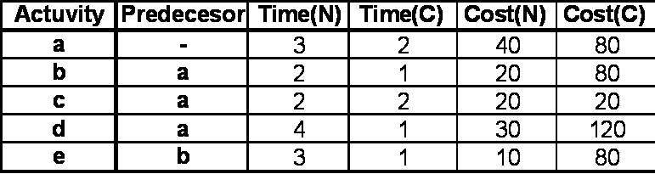
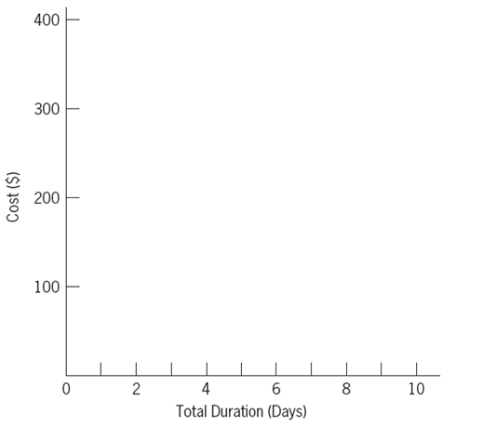
Crash the Following Network. Prepare Cost-time Curve

Slide 91
Crash the Following Network. Prepare Cost-time Curve

Slide 92
Crash the Following Network. Prepare Cost-time Curve

Slide 93
Crash the Following Network. Prepare Cost-time Curve

Slide 94
Crash the Following Network. Prepare Cost-time Curve

Slide 95
Crash the Following Network. Prepare Cost-time Curve

Slide 96
Time-Cost Curve
$400
300
200
100
All crash
e(2)+a+d(2)+b
e(2)+a+d
e+a
e
All normal
0 2 4 6 8 10
Total Duration (Days)
Ardavan Asef-Vaziri

Slide 97
Practice
The same example as we solved. Activity c either 0 or 2 but not 1. Solve it in the easiest way. Prepare Time-Cost Trade-off Curve

