Slide 1
Analysis of Projects
Financial & Scoring

Slide 2
Project Selection: Quantitative Methods
Financial Assessment Methods
  Payback period
  Discounted cash flow
    NPV
    IRR
    B/C
Scoring Methods
  Unweighted 0-1 factor method
  Weighted factor scoring method

Slide 3
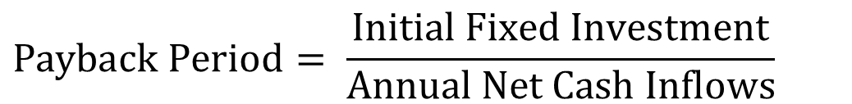
Payback Period
$$Payback Period= \frac{\text{Initial} \text{Fixed} \text{Investment}}{\text{Annual} \text{Net} \text{Cash} \text{Inflows}}$$
Number of years needed for the project to repay its initial fixed investment.
A project costs $100,000 and is expected to save the company $20,000 per year.
PP = $100,000 / $20,000 = 5 years
Shortcoming
  Ignores the time value of money, including interest rates and inflation.
  Ignores money earned after the payback period.

Slide 4
Future Value (FV)
$100, put it in a bank. Interest rate = 10%. How much after 1 year. P = 100. F?
F1 = 100 +0.1(100) = 100(1+0.1)
How much after 2 years?
F2= 100(1+0.1) + 0.1(100(1+0.1)) =
F2= 100(1+0.1) (1+0.1) = 100(1.1)²
How much after 3 years?
F3 = 100(1.1)² + 0.1[100(1.1)²] =
F3 = 100(1.1)² [1+0.1] = 100(1.1)² [1.1] = 100(1.1)³
How much after N years
F = 100(1.1)^{N}

Slide 5
Future Value (FV); Present Value (PV)
P: The initial vale
MARR: Minimum Acceptable Rate of Return
F= P(1+MARR)^{N}
P = F/(1+MARR)^{N}
P = F/(1+r)^{N}
P = F(1+r)^{-N}
r = the minimum acceptable rate of return
=FV(r, N,PMT,PV,0→ EOY) =
=PV(r, N,PMT,FV,0 →EOY) =

Slide 6
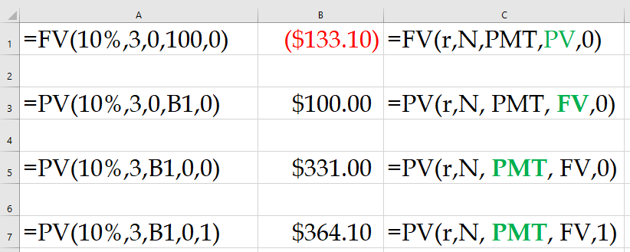
Present Value Index Table

Slide 7
Back to the PBP Example
The initial investment of a project at the end of year 0 is 10 million dollars. Depreciation is computed using straight-line method with accounting life of five years and zero salvage value. Net income before tax and depreciation is 3 million dollars per year. The tax rate is 40%. Compute net income after tax in Year 1. Compute net cash inflow in Year 1. At the end of year 7 we sell everything for 5 million dollars. Compute NPV and IRR.
Net Income Before Tax and Depreciation 3
Depreciation 2
Income Before Tax 1
Tax 0.4
Net Income After Tax 0.6
Cash Flow of Depreciation 2
Net cash flow per year 2.6
This is true for the first 5 yeas.

Slide 8
Future Value (FV); Present Value (PV)
But after year 5 we do not have depreciation.
Therefore, the two million dollars depreciation is not a cost anymore. Our revenue will increases by
2(1-0.4) = 1.2 million dollars.
Net income after tax = 0.6+1.2 =1.8
You do not believe me?
Net Income Before Tax and Depreciation 3
Depreciation 0
Income Before Tax 3
Tax 0.4(3) =1.2
Net Income After Tax in Year 6 1.8
Net Income After Tax in Year 7 1.8+5(1-0.4) = 4.8

Slide 9
Net Present Value (NPV)
I₀ = the initial investment
F_{t} = the net cash flow in period t
r = the required rate of return
Important note: NPV function in excel assumes that the first cash flow is at the end of year 1.

Slide 10
Internal Rate of Return (IRR)
The discount rate (r) that causes the NPV to be equal to zero.
The higher the IRR, the better.
In Excel “=IRR(Series,Guess)”
Compare IRR with MARR
MARR: Minimum Acceptable Rate of Return
Here it is not important where the first payment is – end of year 1 or end of year 0. The NPV for IRR is 0 everywhere.

Slide 11
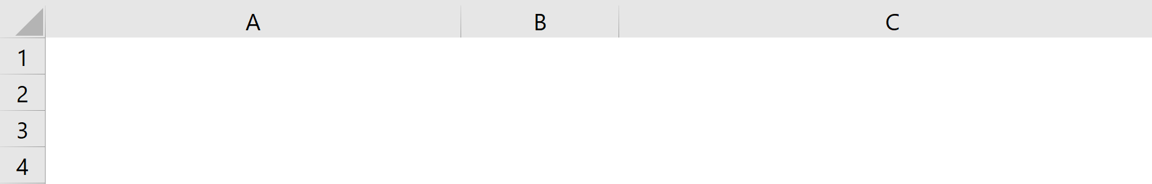
Your Mortgage; PMT and PPMT
$600,000 loan, 5% interest rate, 30 years fixed. What is your monthly payment? the money towards the principle in the first month? the money towards the principle in the last month, your cumulative principle at the end of the fifth year?
Your monthly payment
=PMT(monthly rate,#of months,pv,[fv], [type])
=PMT(0.05/12, 30*12, 600000)
Monthly Payment
($3,220.93)
=PMT(0.05/12,12*30,600000)
Pronciple Paid in month 1
($720.93)
=PPMT(0.05/12, 1, 30*12, 600000)
Principle paid in month 60
($921.37)
=PPMT(0.05/12, 60, 30*12, 600000)
Principle paid over the first 5 years
-49027.6075
=CUMPRINC(0.05/12,12*30,600000,1,60,0)

Slide 12
Practice
The initial investment of a project at the end of year 0 is 10 million dollars. Depreciation is computed using straight-line method with accounting life of 4 years and accounting salvage value of 0. Total revenue is 6 million dollars per year. All expenses, excluding depreciation and tax are 2 million dollars per year. Useful life of the project (which differs from accounting life) is 7 years. At the end of the useful life the project is sold for 2 million dollars. Tax rate of operating income as well as capital gain is 30%. Compute profit per year during the accounting life of the project.
Revenue 6
Operating Expenses 2
Net Income Before Tax and Depreciation 4
Depreciation 2.5
Income Before Tax 1.5
Tax 0.3(1.5) = 0.45
Net Income After Tax (years 1-4) 1.05

Slide 13
Practice: Net Income vs. Net Cash Inflow
Compute net cash inflow during the accounting life of the project.
Net Income After Tax 1.05
Depreciation 2.5
Net Cash Inflow (years 1-4) 3.55
Compute net cash inflow per year after accounting life is over and before the last year of the useful life of the project.
Net Income After Tax 1.05
Depreciation added to the profit 2.5
After Tax net income added 2.5(1-0.3) = 1.75
Total Net Income 1.05+1.75= 2.8
Net Cash Inflow (years 5-6) 2.8

Slide 14
I Am Sure It Was Easy to Grasp
If it was not easy to grasp, you may look at it from a different perspective
Revenue 6
Operating Expenses 2
Net Income Before Tax and Depreciation 4
Tax 0.3(4) = 1.2
Net Income After Tax (years 1-4) 2.8
Compute net cash inflow in the last year of the useful life of the project.
Net Income After Tax 2.8
Project Sold 2
Capital Gain Tax 0.3(2) = 0.6
Net Capital Gain 1.4
Net Cash inflow 2.8+1.4= 4.2

Slide 15
Practice: Net Income vs. Net Cash Inflow
What is the net cash flow of the project during its useful life. Compute NPV under 10% MARR and IRR.

