Slide 1
Project Crashing

Slide 2
Crashing
Crashing: shortening duration of activities. Because
  Some activities were delayed.
  Client is willing to pay more for earlier completion.
Crashing changes the schedule for remaining activities.
It has impact on schedules for all the subcontractors.
Often introduces unanticipated problems.
The faster an activity is completed, the more it costs.
There is always a lower bound on task duration.

Slide 3
Linear Time / Cost Tradeoff
Slope (b_{j}) = increase in cost from reducing task duration by one time unit
Cost
Crash point
Crash cost
Normal point
Normal cost
Time
Crash time
Normal time

Slide 4
Crashing Algorithm
Assume each task can be crashed one day at a time (simplifying assumption, but not necessary)
Crash only critical activities. Crashing other activities can only increase cost without changing project duration
To decrease project duration by one day, the critical path or paths must decrease by one day.
  Find the critical path or paths
  If there is no other critical activity which could still be reduced, and shorten the critical path. Stop.
  Crash the cheapest critical activity (or combination of activities) to shorten the critical path (or paths) by one day.
  Go to 1

Slide 5

Crashing 21 Days to 20 Days Network
Activities A,C, and F are on Critical Path. A and C are the least-cost choice. We crash A because it affects two paths. Lower A’s normal time by one day.
It now equals the crash time and cannot be shortened further.
The critical path is unchanged.
The critical time will be lowered to 20 days.
The cost of the project will be $400+30(A)= $430.

Slide 6
Crashing 20 Days to 19 Days Network
Activities A,C, & F are still on the critical path.
A cannot be crashed any more. C is the least-cost choice.
Lower C’s normal time by one day. The critical path is unchanged
The critical time will be lowered to 19 days
The cost of the project will be $400+ 30(A) + 30(C) = $460

Slide 7
Crashing 19 Days to 18 Days Network
All activities are now critical. 3 paths; ACF,EDG, and BEG. A cannot be crashed any more. The only way to crash ACF is to crash C or F. C is cheaper.
On ADG path, A and D cannot be crashed. The only way to crash ADG is to crash G. Crashing G crashes BEG path too.
The critical time will be lowered to 18 days
The cost of the project will be $400+ 30(A) + 30(C2) + 60(G) = $550

Slide 8
Crashing 18 Days to 17 Days Network
All activities are critical. There are three paces ACF, ADG, and BEG.
Crash F and G by 1 at cost of 60 +40 = 100
The critical time has been lowered to 17 days
The cost of the project is $400+ 30(A) + 30(C2) + 60(G2)+40(F) = $650

Slide 9
Crashing 17 Days to 16 Days Network
We can shorten the project to 16 days by crashing F and G by another day.
The cost of the project is $400+ 30(A) + 30(C2) + 60(G3)+40(F2) = $750
Activities A,C,F, and g have been crashed to their limits.
No further crashing will help so B,D, and E remain at their normal times and costs.

Slide 10
Time-Cost Tradeoff

Slide 11
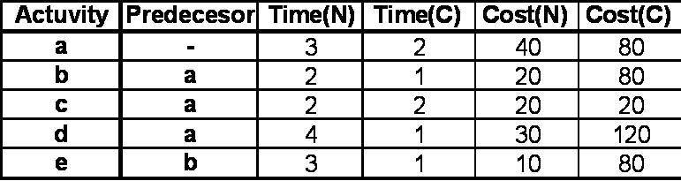
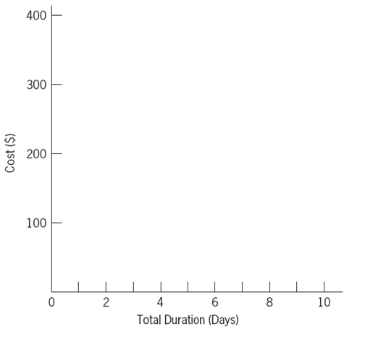
Crash the Following Network. Prepare Cost-time Curve

Slide 12
Crash the Following Network. Prepare Cost-time Curve

Slide 13
Crash the Following Network. Prepare Cost-time Curve

Slide 14
Crash the Following Network. Prepare Cost-time Curve

Slide 15
Crash the Following Network. Prepare Cost-time Curve

Slide 16
Crash the Following Network. Prepare Cost-time Curve

Slide 17
Time-Cost Curve
$400
300
200
100
All crash
e(2)+a+d(2)+b
e(2)+a+d
e+a
e
All normal
0 2 4 6 8 10
Total Duration (Days)
Ardavan Asef-Vaziri

Slide 18
Practice
The same example as we solved. Activity c either 0 or 2 but not 1. Solve it in the easiest way. Prepare Time-Cost Trade-off Curve

