Slide 1
Quiz-Process
Auto-Moto receives about 600 loan (R=600/mo or 20/day) applications per month (30 working days). All applications go through an Initial Review sub-process, where the applications are then classified as A (looks excellent), B (needs more detailed evaluation), and C (reject summarily). A and B applications would be forwarded to sub-processes A and B, respectively. On average, 25% of all applications go through Sub-process A➔ (RA=0.25*20 = 5/day), 30% go through sub-process B ➔ (RB=0.3*20 = 6/day), , and the rest are rejected (RJ= 20-5-6) = 9/day). On average, 70% of applications in sub-process A, and 10% of applications in sub-process B are accepted and the rest are rejected. (Recall that all Cs were rejected.) On average 100 applications are in the Initial Review sub-process, 20 are in sub-process A, and 30 applications are in sub-process B.
Notes:
Throughput R = 1,000 applications/month, Average Inventory I = 500 applications; T=15 days means that each application spent 15 days (on average) before receiving accept/reject decision.

Slide 2
K4. New Process: The Same R, But smaller I
Subprocess A
Review
70%
Accepted
I_{A} = 20
30%
25%
10%
600/month
Initial
Review
Subprocess B
Review
30%
I_{R} = 100
I_{B} = 30
90%
45%
Rejected
Notes:
New process for loan application review:
Each application is preprocessed and divided into three categories based on mechanical criteria. The company found the following data upon analyzing the new system:
On average, 200 applications are with the Initial ‘Review Team at any time.
Of those reviewed, 25% are categorized as “Excellent”, 25% as “Needs Further review”, and 50% are “Rejected”.
70% of the “Excellent” applications are eventually approved.
10% of the “Needs Further Review” applications are approved.

Slide 3
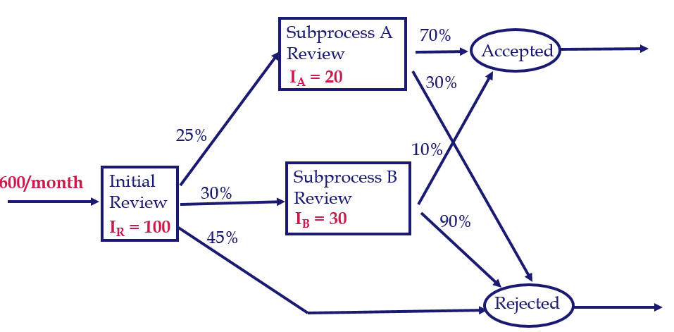
Quiz-Process
What is the average flow time of an application?
The potential answers are:
A: 10.8 days.
B: 11.25 days.
C: 7.5 days.
D: 3.95 days.
E: 12.8 days.
R= 20/day
I = 100+20+30 = 150
RT=I ➔ T=I/R ➔ T= 150/20 = 7.5 days
Notes:
Throughput R = 1,000 applications/month, Average Inventory I = 500 applications; T=15 days means that each application spent 15 days (on average) before receiving accept/reject decision.

Slide 4
Quiz-Process
2. How many applications are rejected per month? The potential answers are:
A: 477 applications.
B: 672 applications.
C: 870 applications.
D: 880 applications.
E: 1008 applications.
Notes:
Throughput R = 1,000 applications/month, Average Inventory I = 500 applications; T=15 days means that each application spent 15 days (on average) before receiving accept/reject decision.

Slide 5
K4. New Process: The Same R, But smaller I
Subprocess A
Review
70%
Accepted
30%
25%
10%
600/month
Initial
Review
Subprocess B
Review
30%
90%
45%
Rejected
Notes:
New process for loan application review:
Each application is preprocessed and divided into three categories based on mechanical criteria. The company found the following data upon analyzing the new system:
On average, 200 applications are with the Initial ‘Review Team at any time.
Of those reviewed, 25% are categorized as “Excellent”, 25% as “Needs Further review”, and 50% are “Rejected”.
70% of the “Excellent” applications are eventually approved.
10% of the “Needs Further Review” applications are approved.

Slide 6
K4. New Process: Intermediate Probabilities
Subprocess A
Review
17.5%
20.5%
Accepted
7.5%
25%
3%
100%
Initial
Review
Subprocess B
Review
30%
27%
45%
45%
79.5%
Rejected
R= 20/day
Rejected = 45%+7.5%+27%= 79.5%
Rejected = 0.795 (20) = 15.9/day
Rejected = 0.795 (600) = 477/ month
Notes:
New process for loan application review:
Each application is preprocessed and divided into three categories based on mechanical criteria. The company found the following data upon analyzing the new system:
On average, 200 applications are with the Initial ‘Review Team at any time.
Of those reviewed, 25% are categorized as “Excellent”, 25% as “Needs Further review”, and 50% are “Rejected”.
70% of the “Excellent” applications are eventually approved.
10% of the “Needs Further Review” applications are approved.

Slide 7
Quiz-Process
3. Compute the average flow time at Initial Review sub-process. The potential answers are:
A: 6 days.
B: 3 days.
C: 5 days.
D: 9 days.
E: 10 days.
4. Compute the average flow time at sub-process A. The potential answers are:
A: 4 days.
B: 3.33 days.
C: 4.55 days.
D: 14 days.
E: 12 days.
.
5. Compute the average flow time at sub-process B. The potential answers are:
A: 2.5 days.
B: 5 days.
C: 1 days.
D: 7 days.
E: 10 days.
Notes:
Throughput R = 1,000 applications/month, Average Inventory I = 500 applications; T=15 days means that each application spent 15 days (on average) before receiving accept/reject decision.

Slide 8
K4. New Process: Intermediate Probabilities
Subprocess A
Review
17.5%
20.5%
Accepted
I_{A} = 20
7.5%
25%(20)=5
3%
20/day
Initial
Review
Subprocess B
Review
30%(20)=6
I_{R} = 100
I_{B} = 30
27%
45%
45%
79.5%
Rejected
R= 20/day
I = 100
TI = 100/20 = 5 days.
R= 5/day
I = 20
TA = 20/5 = 4 ds.
R= 6/day
I = 30
TB = 30/6 = 5 ds.
Notes:
New process for loan application review:
Each application is preprocessed and divided into three categories based on mechanical criteria. The company found the following data upon analyzing the new system:
On average, 200 applications are with the Initial ‘Review Team at any time.
Of those reviewed, 25% are categorized as “Excellent”, 25% as “Needs Further review”, and 50% are “Rejected”.
70% of the “Excellent” applications are eventually approved.
10% of the “Needs Further Review” applications are approved.

Slide 9
Quiz-Process
6. Compute the average flow time of an accepted application. The potential answers are:
A: 16.17 days.
B: 12.5 days.
C: 9.15 days.
D: 20.81 days.
E: 10.8 days.
Accepted-A: IR, A
Accepted-B: IR, B
Rejected-IR: IR
Rejected-A: IR, A
Rejected-B: IR, B
T_{IR} = 5 days
T_{A} = 4 days
T_{B} = 5 days
Notes:
Throughput R = 1,000 applications/month, Average Inventory I = 500 applications; T=15 days means that each application spent 15 days (on average) before receiving accept/reject decision.

Slide 10
K4. New Process: Intermediate Probabilities
Subprocess A
Review
T=4
17.5%
20.5%
Accepted
7.5%
25%
3%
100%
Initial
Review
T= 5
Subprocess B
Review
T=5
30%
27%
45%
45%
79.5%
Rejected
Notes:
New process for loan application review:
Each application is preprocessed and divided into three categories based on mechanical criteria. The company found the following data upon analyzing the new system:
On average, 200 applications are with the Initial ‘Review Team at any time.
Of those reviewed, 25% are categorized as “Excellent”, 25% as “Needs Further review”, and 50% are “Rejected”.
70% of the “Excellent” applications are eventually approved.
10% of the “Needs Further Review” applications are approved.

Slide 11
K4. Flow Time of the Accepted Applications
On average 7.5 days to process an applicant.
On average, how long does it take to approve an applicant?
On average, how long does it take to reject an applicant?
Accepted-A: IR, A ➔ Accepted-A(T) = 5 + 4 = 9 ➔ Accepted-A = 17.5 %
Accepted-B: IR, B ➔ Accepted-B(T) = 5 + 5 = 10 ➔ Accepted-B = 3 %
Average Flow time of an accepted application =
[0.175(9)+0.03(10)]
/
(0.175+.03)
=9.146341≈9.15
Notes:
New process for loan application review:
Each application is preprocessed and divided into three categories based on mechanical criteria. The company found the following data upon analyzing the new system:
On average, 200 applications are with the Initial ‘Review Team at any time.
Of those reviewed, 25% are categorized as “Excellent”, 25% as “Needs Further review”, and 50% are “Rejected”.
70% of the “Excellent” applications are eventually approved.
10% of the “Needs Further Review” applications are approved.

Slide 12
Quiz-Process
7. Compute the average flow time of a rejected application. The potential answers are:
A: 9.31 days.
B: 8.75 days.
C: 7.08 days.
D: 9.43 days.
E: 4.57 days.
Rejected-IR: IR ➔ Rejected-IR(T) = 5 ➔ Rejected-IR(%) = 45%
Rejected-A: IR, A ➔ Rejected-A(T) = 5+4 = 9 ➔ Rejected-A(%) = 7.5%
Rejected-B: IR, B ➔ Rejected-B(T) = 5+5 = 10 ➔ Rejected-B(%) = 27%
Average Flow time of a rejected application =
[0.45(5)+0.075(9)+0.27(10)]/(0.45+.075+0.27) =7.075471698≈ 7.08
Notes:
Throughput R = 1,000 applications/month, Average Inventory I = 500 applications; T=15 days means that each application spent 15 days (on average) before receiving accept/reject decision.

Slide 13
Quiz-Process
8. Using which one of the following numbers can you prove that the flow times that you have found for accepted and rejected applications are correct? The potential answers are:
A: 10.8
B: 7.5
C: 4.8
D: 3.95
E: 12.8
Notes:
Throughput R = 1,000 applications/month, Average Inventory I = 500 applications; T=15 days means that each application spent 15 days (on average) before receiving accept/reject decision.

