Slide 1
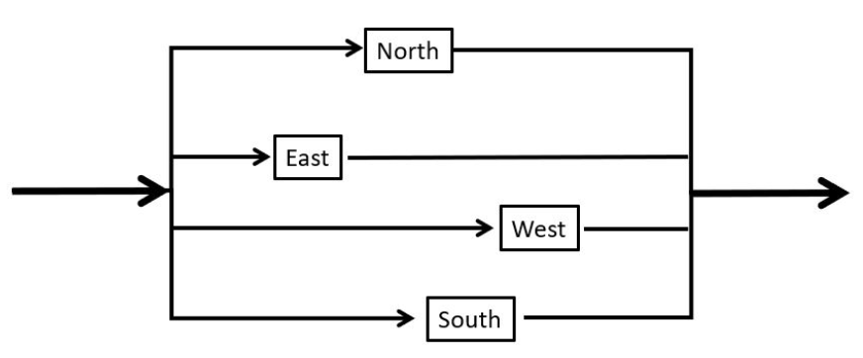
ExoticCar Quiz

Slide 2
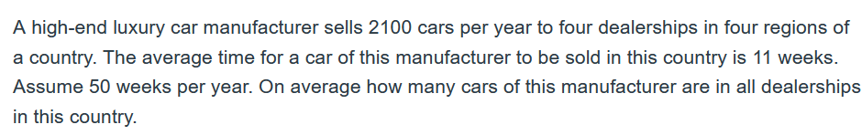
Exotic Cars- Problem-1-Inventory
RT=I
R = 2100 per year
T = 11 Weeks
RT=I
R = 2100/50 = 42 per week
T = 11 Weeks
I = 42(11) = 462
R = 2100 per year
T = 11/50 = 0.22 Year
I = 2100(0.22) = 462

Slide 3
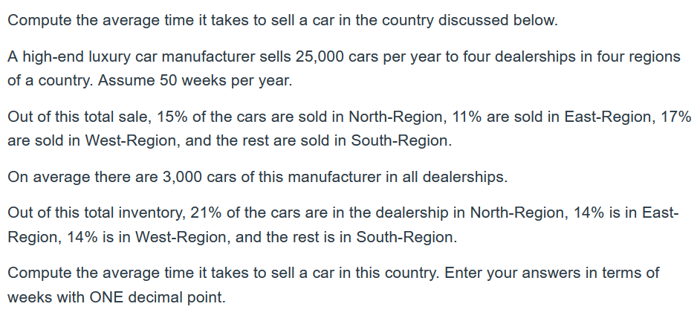
Exotic Cars- Problem-2-Overal Flow Time
RT = I
R = 25000 per year and I = 3000
R= 25000/50 = 500 per week
T = I/R = 3000/500 = 6 weeks
R = 25000 per year
I = 3000
T = I/R = 3000/25000 = 0.12 year

Slide 4
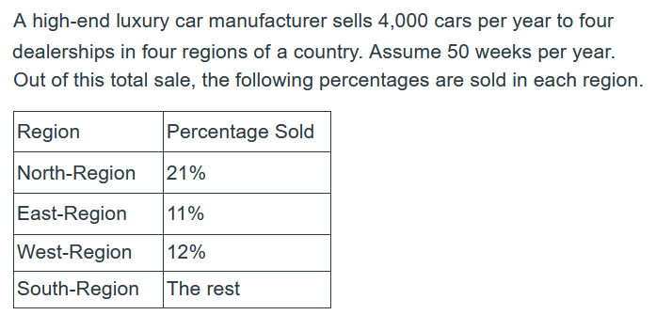
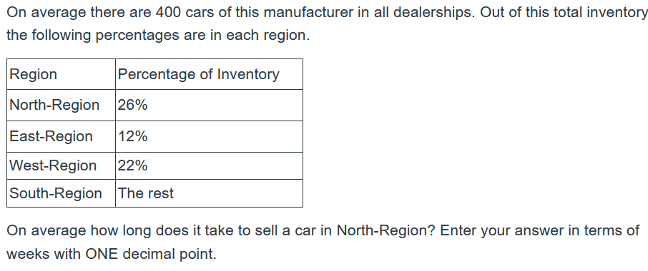
Exotic Cars- Problem-3-South Flow Time
R/week =4000/50 = 80
R-North %= 21%
R-North = 0.21(80)= 16.8 / week
I =400
I-North %= 26%
I-North = 0.26(400)= 104
T-North =I-North/R-North = 104/16.8 = 6.19 weeks

Slide 5
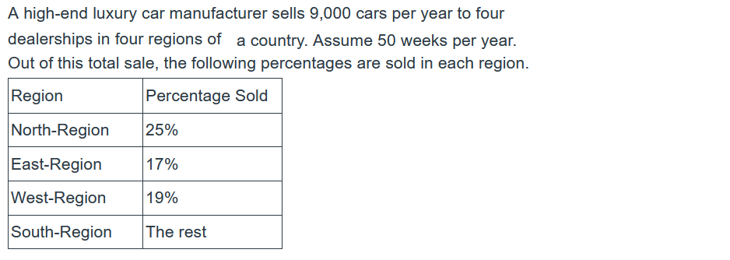
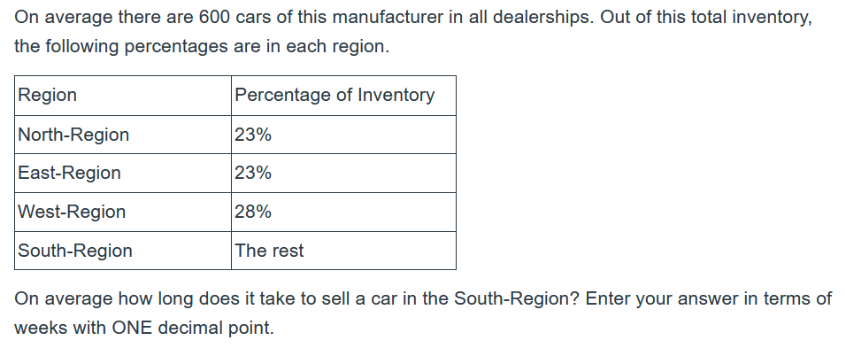
Exotic Cars- Problem-3-South Flow Time
R/week =9000/50 = 180
R-South %= 100-(25+17+19) = 100-61= 39%
R-South = 0.39(180)= 70.2 / week
I =600
I-South %= 100-(23+23+28) = 100-74= 26%
I-South = 0.26(600)= 156
T-South =I-South/R-South = 156/70.2 = 2.22 Weeks

